Slide 1
Online Generator and Corrector of Parametric Questions
in Hard Copy Useful for the Elaboration of Thousands of Individualized Exams
Francisco de Assis Zampirolli, Fernando Teubl, Valério Ramos Batista
Federal University of ABC, Brazil
International Conference on Computer Supported Education Crete, Greece, 2019
Notes:
25’ minutes slot for an oral presentation at the conference
(14:45 - 16:15, 6A, May/3) - poster 16:15 - 17:15, Poster Presentations 3, May/4
Slide 1.
Good afternoon!
This work is about an Online Generator and Corrector of Parametric Questions.
My name is Francisco, and coauthors are, Fernando and Valério.
I'm from Federal University of ABC, Brazil.

Slide 2
Contents
Motivation
Method to Generate Parametric Questions
Data-Flow Diagram
Class Diagram
Question
Create
Update
See-PDF
Examples
Exams
Generate PDF
Scan PDF (correct exams)
Conclusion and Future Works
Notes:
Slide 2.
This talks Contents.
Motivation.
Method to Generate Parametric Questions.
Data-Flow Diagram.
Class Diagram.
Question: Create, Update, See-PDF.
Examples.
Exams: Generate PDF, Scan PDF (correct exams).
Conclusion and Future Works.

Slide 3
Motivation
How to generate exams for many students?
For many purposes online exams aren't reliable.
Traditional paper exams are then required.
How to minimize fraud?
An exam in which the questions are unique to each student.
How to correct this exam automatically?
With computer vision applied to the scanned image of the answer sheets.
Notes:
Slide 3.
Motivation.
How to generate exams for many students?
For many purposes, online exams aren't possible.
Traditional paper exams are then required.
How to minimize fraud?
An exam in which the questions are unique, to each student.
How to correct this exam automatically?
With computer vision applied to the scanned image of the answer sheets.

Slide 4
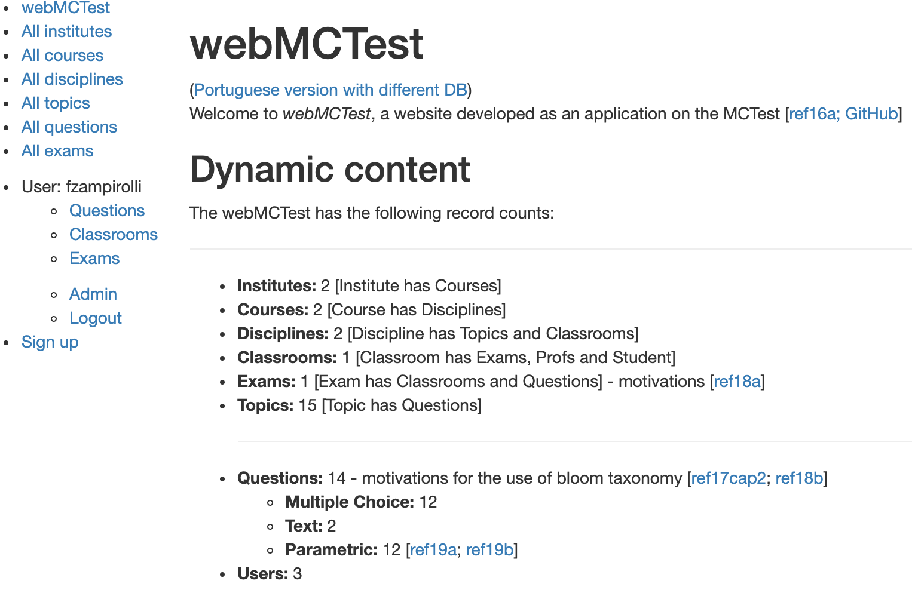
Method: website
This site is available in:
nubisys.ufabc.edu.br:8000 in English
In this paper
Notes:
Slide 4.
Method: website.
This site is available at this link. In English.
We can see Institutes, Courses, Disciplines, Topics, Questions, Classrooms and Exams.
For example, I'm logged with fzampirolli user.
This is the Dynamic Content in English. Still for publications.

Slide 5
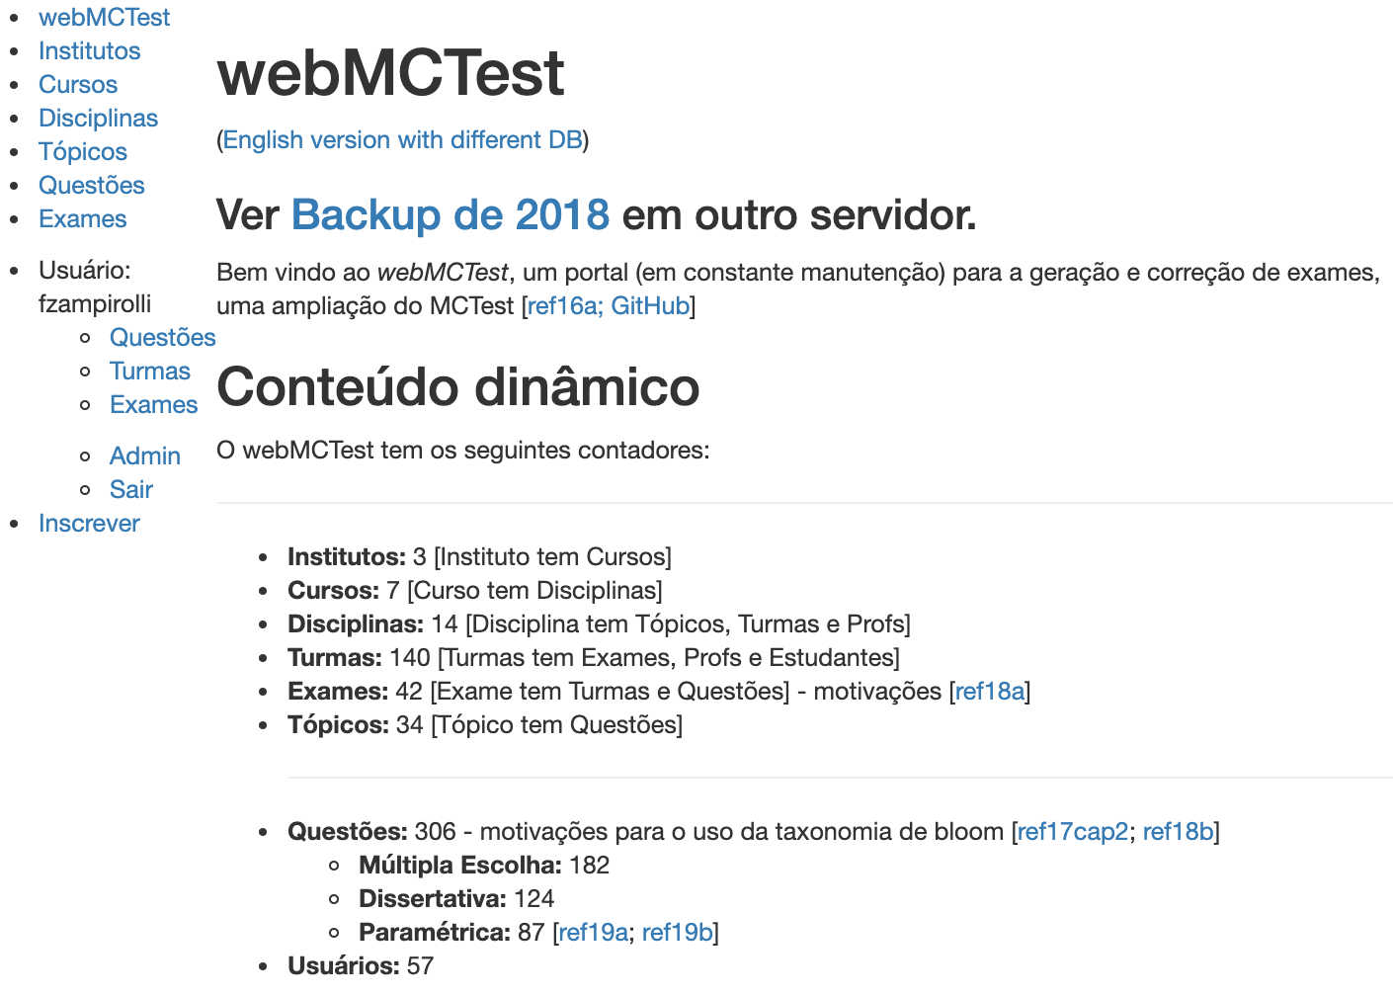
Method: website
This site is available in:
vision.ufabc.edu.br:8000 in Portuguese
Dynamic Contents, since February, 2019
In this paper
Notes:
Slide 5.
Method: website.
This site is available at this link. In Portuguese.
And this is the Dynamic Content, for production. Since February 2019.
3 institutes.
7 courses.
14 disciplines.
140 classrooms.
42 exams.
34 topics.
182 multiple-choice.
124 text questions.
Specifically, here are the 87 parametric questions.
Finally, 57 users.
Accessed April 25, 2019.

Slide 6
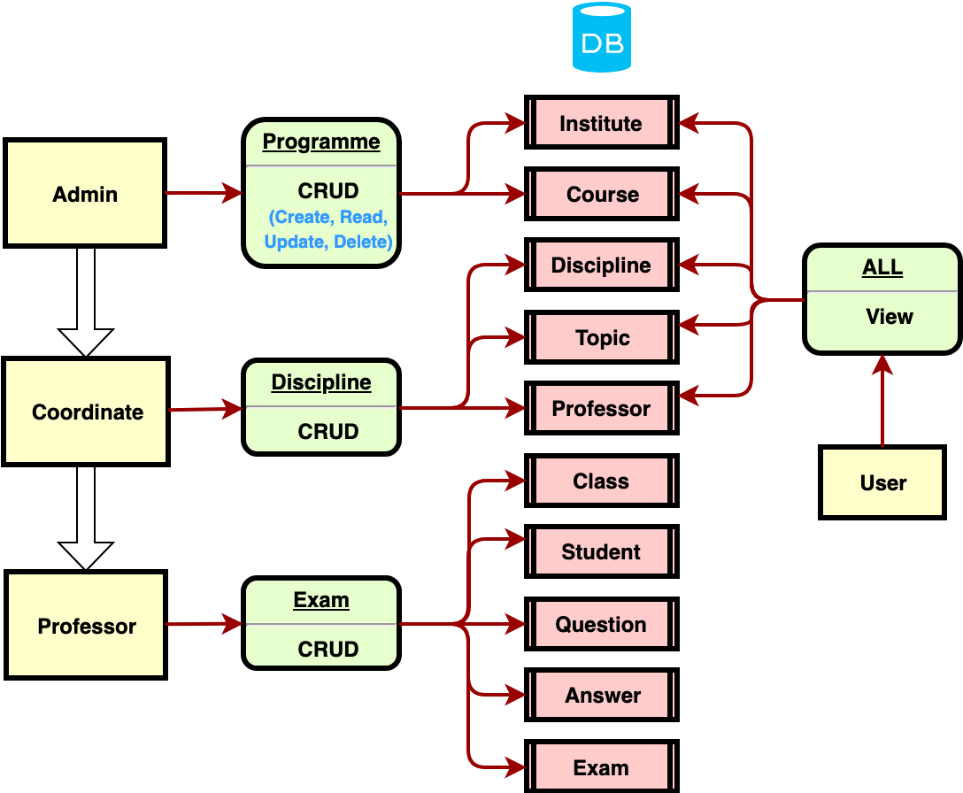
Method: Data-Flow Diagram
DB in MySQL
In this paper
Views in Django/Python
Notes:
Slide 6.
Method: Data-Flow Diagram.
In this diagram, we can see three different types of users: Admin, Coordinate, and Professor.
The Admin cans create, read, update, and delete. Or CRUD. The Institute and Course. Also, everything the Coordinate cans do.
Coordinate cans CRUD. Discipline, Topic, and Professor. Also, everything the Professor cans do.
The Professor cans CRUD Class, Student, Question, Answers, and Exam.
The focus of this article is only questions and answers.
Specifically on the parametric type.

Slide 7
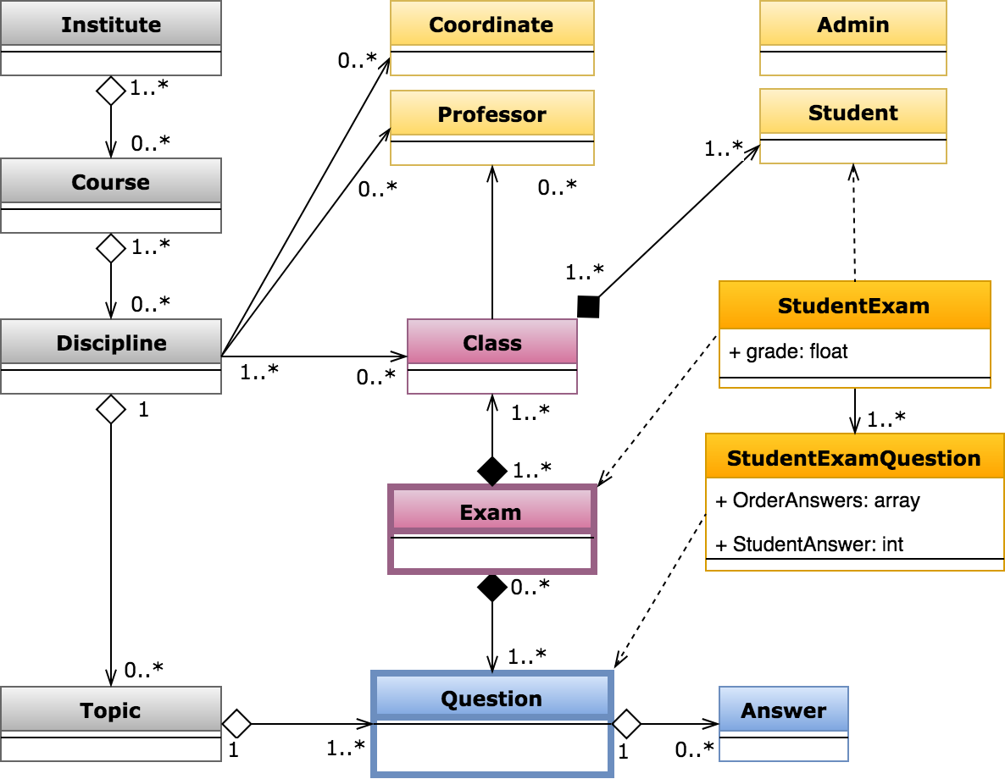
Method: Class Diagram (Model in MVC architecture)
In this paper
Notes:
Slide 7.
Method: Class Diagram, considering Model level, in MVC architecture.
In this diagram, we can see classes.
Institute has Course.
Course has Discipline.
Discipline has Topic, Coordinate, Professor, and Class.
Topic has Question.
Class has Student and Professor.
Exam has Class and Question. The Exam is the main class!
We can store exam history in StudentExam, and StudentExamQuestion.
Finally, in this paper, we can detail, Question has Answer.

Slide 8
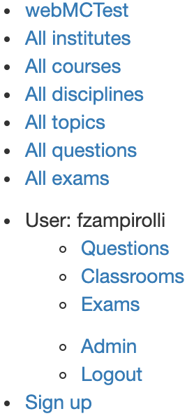
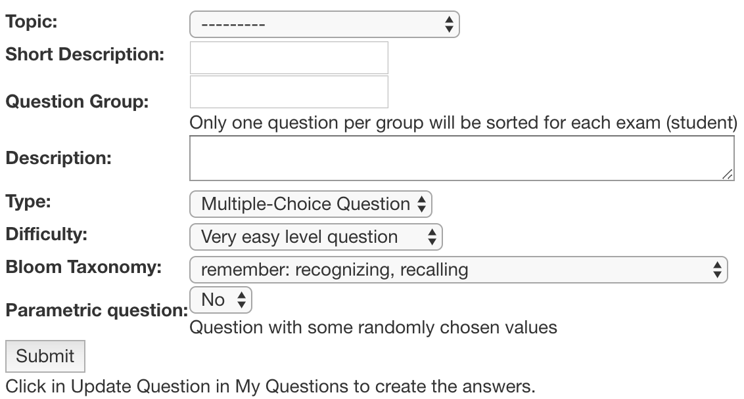
Method: Create Question
Notes:
Slide 8.
Method: create question.
In this slide, we can see where we created a question.
We define the Topic.
Short description.
Group.
Description.
Type. (Can be multiple choice or text question).
Difficulty. (Between 1-easy to 5-difficult).
Bloom Taxonomy.
Finally, parametric question.
After defining these values, let's update, including the answers, if it's a multiple-choice question.

Slide 9
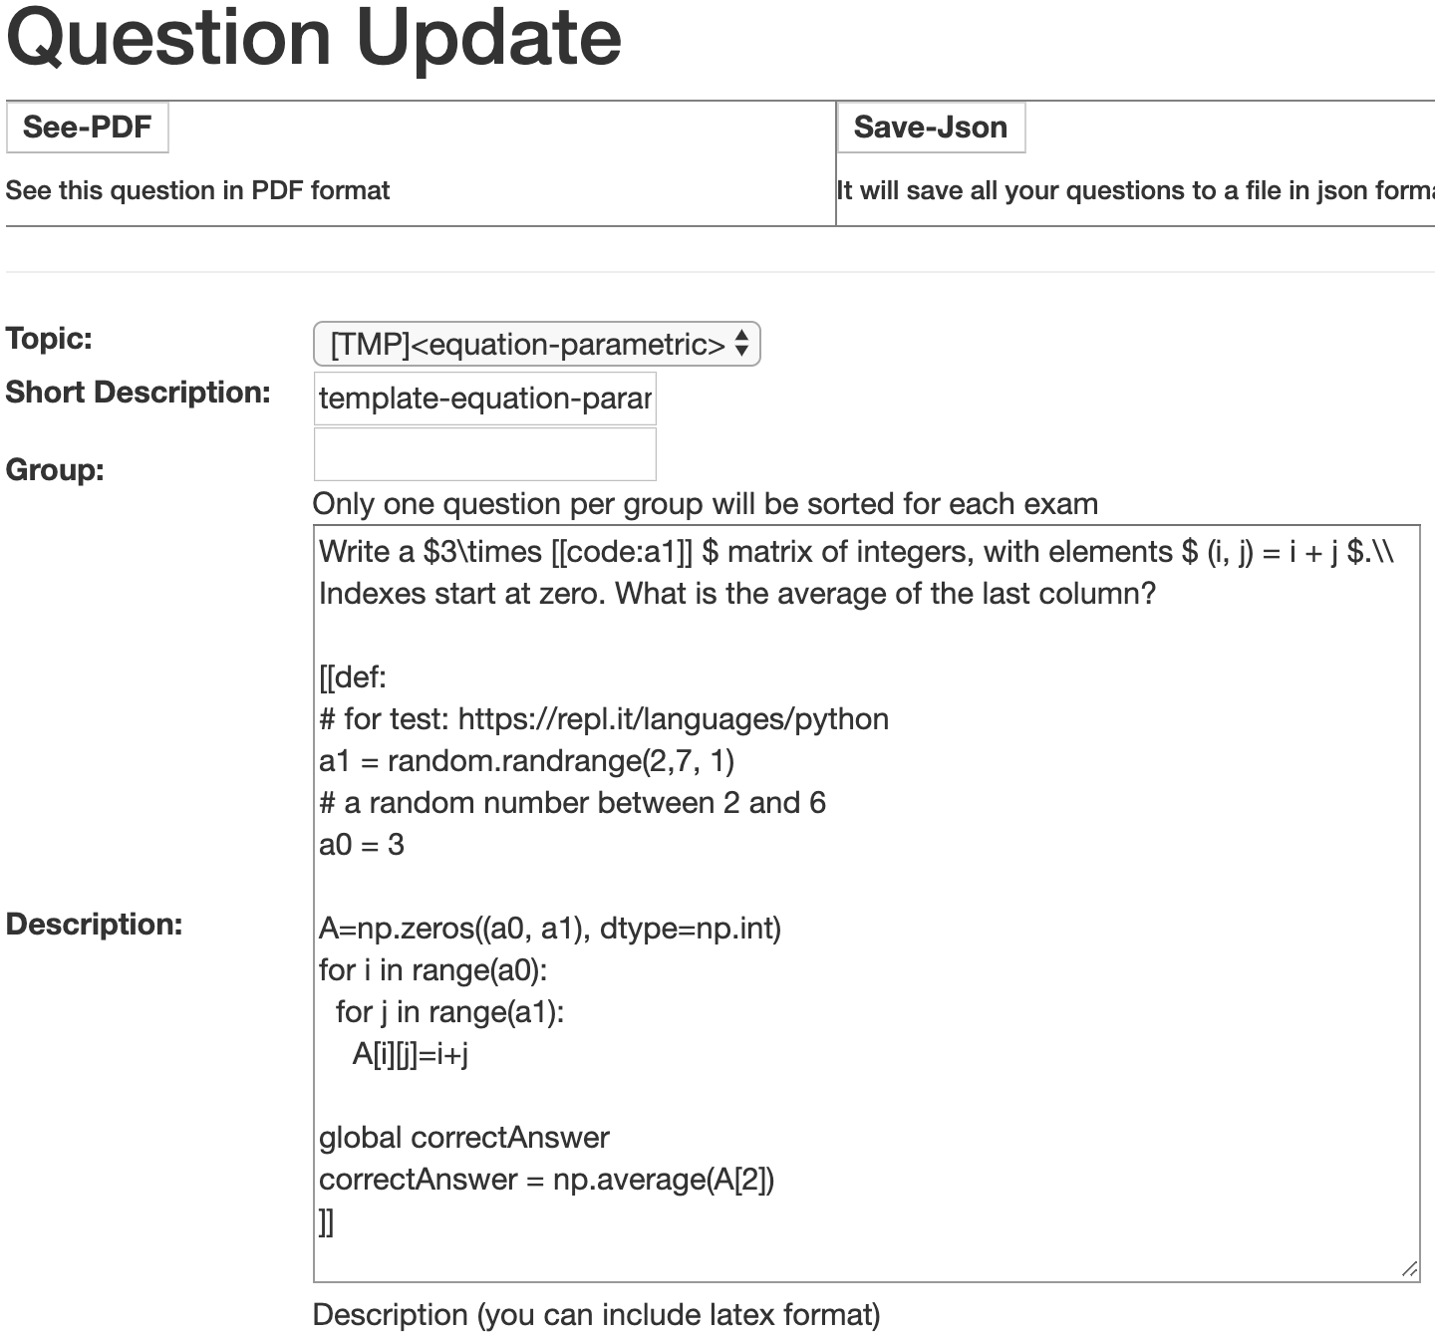
Method:
Notes:
Slide 9.
Method: update question.
In this slide, we can see where we update a question.
Again. Topic.
Short description.
Group.
Description.
Continuing...

Slide 10
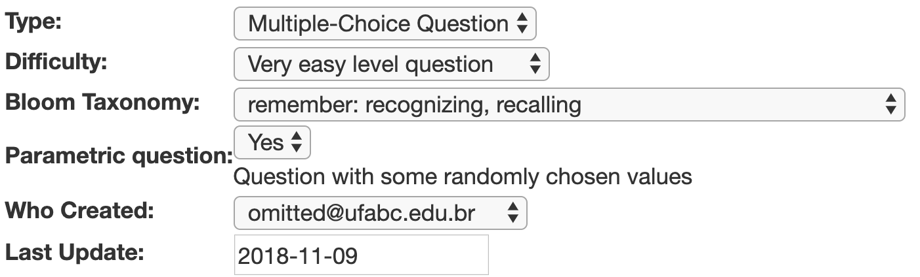
Method:Update Question
Notes:
Slide 10.
Method: update question.
Here, we can see who created this question and the last update.
Continuing...

Slide 11
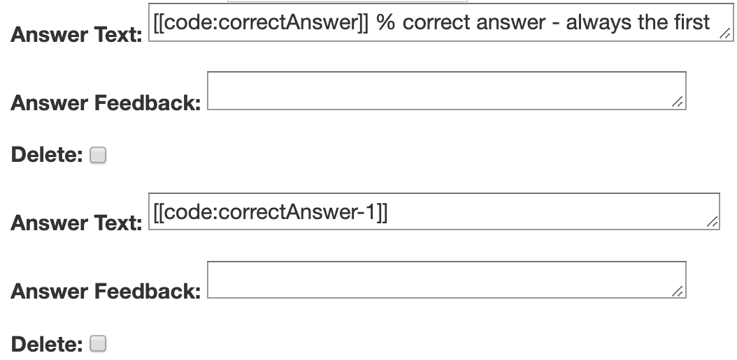
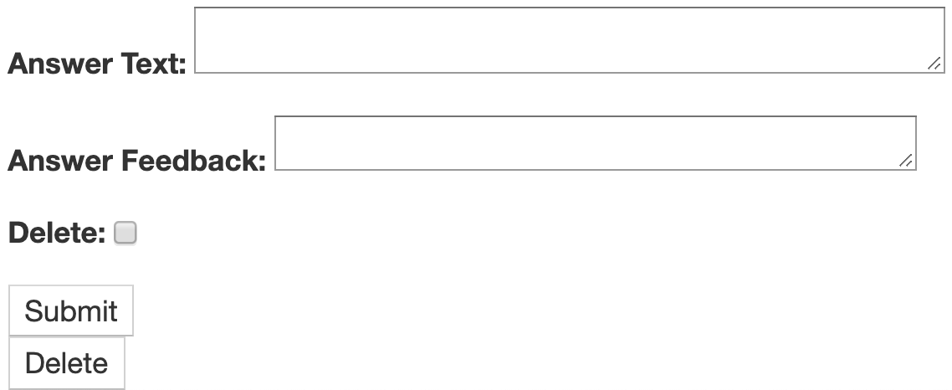
Method:Update Question
Notes:
Slide 11.
Method: update question.
Finally, we can see the answers.
Answer text. And Feedback from each answer.
The first answer is the correct answer.
When we create a question, we can consider the first answer as the most correct. And, the last as the most wrong answer.
The system stores this order.
It is possible to find a student who responds always the most wrong answer.

Slide 12
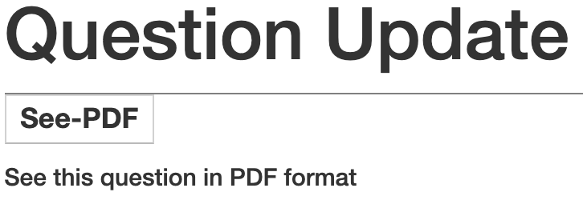
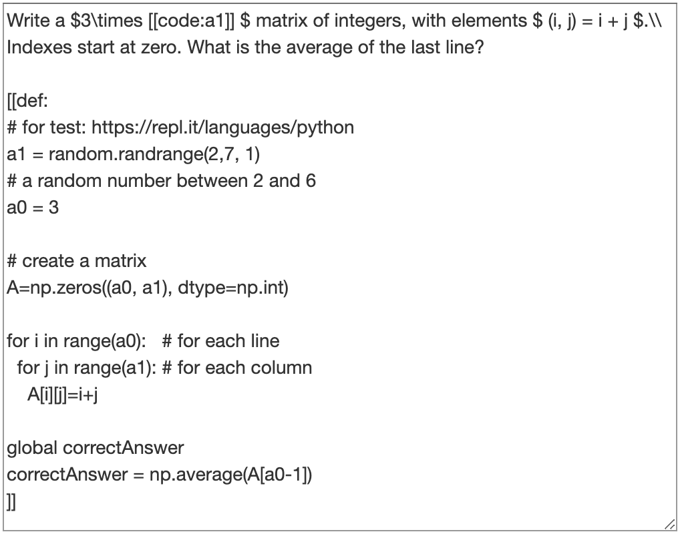
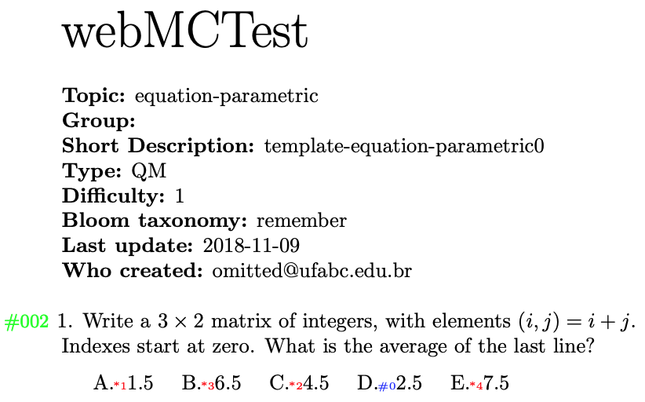
Method:
http://nubisys.ufabc.edu.br:8000/topic/question/2/update/ in English
http://vision.ufabc.edu.br:8000/topic/question/69/update/ in Portuguese
Description of Question:
Notes:
Slide 12.
Method: update question.
In this button. See-PDF. We can see the PDF of this question.
This is the core of our paper!
In this case, the description of the question contains, for example.
Write $ 3 \times [[code: a1]]$ matrix of integers...
Here a1 is equal a random value between 2 and 6.
Using this command in the python.
$ and \times are latex commands.
Finally, the text between brackets. Start which double brackets, def and two points.
And finishing with double brackets. This is the python code.

Slide 13
Contents
Motivation
Method to Generate Parametric Questions
Data-Flow Diagram
Class Diagram
Question
Create
Update
See-PDF
Examples
Exams
Generate PDF
Scan PDF (correcting exams)
Conclusion and Future Works
Notes:
Slide 13.
Now, I will present some examples.

Slide 14
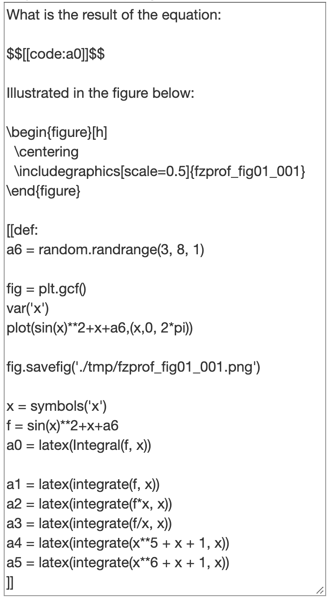
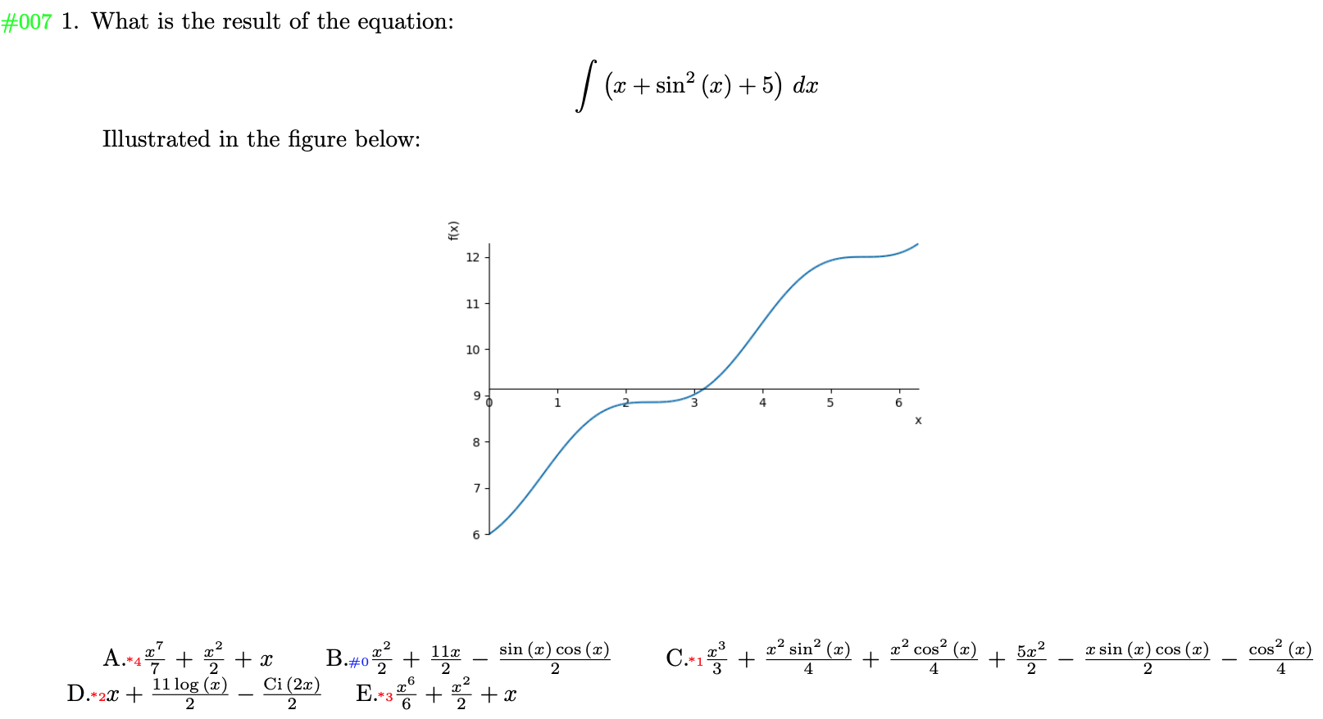
Example with Equation and Figure
http://nubisys.ufabc.edu.br:8000/topic/question/7/update/
SymPy library
Notes:
Slide 14.
Example with Equation and figure.
With SymPy library. For symbolic mathematics.
Here, is the equation $$[[code:a0]]$$, where.
A0 = latex(integral(f,x)).
f = this equation: sin(x) pow 2 + x + a6.
a6 = random.randrange(3,8,1), is a value between 3 and 7.
Finally, it defines the figure here.
Everything automatically, with parametric values!

Slide 15
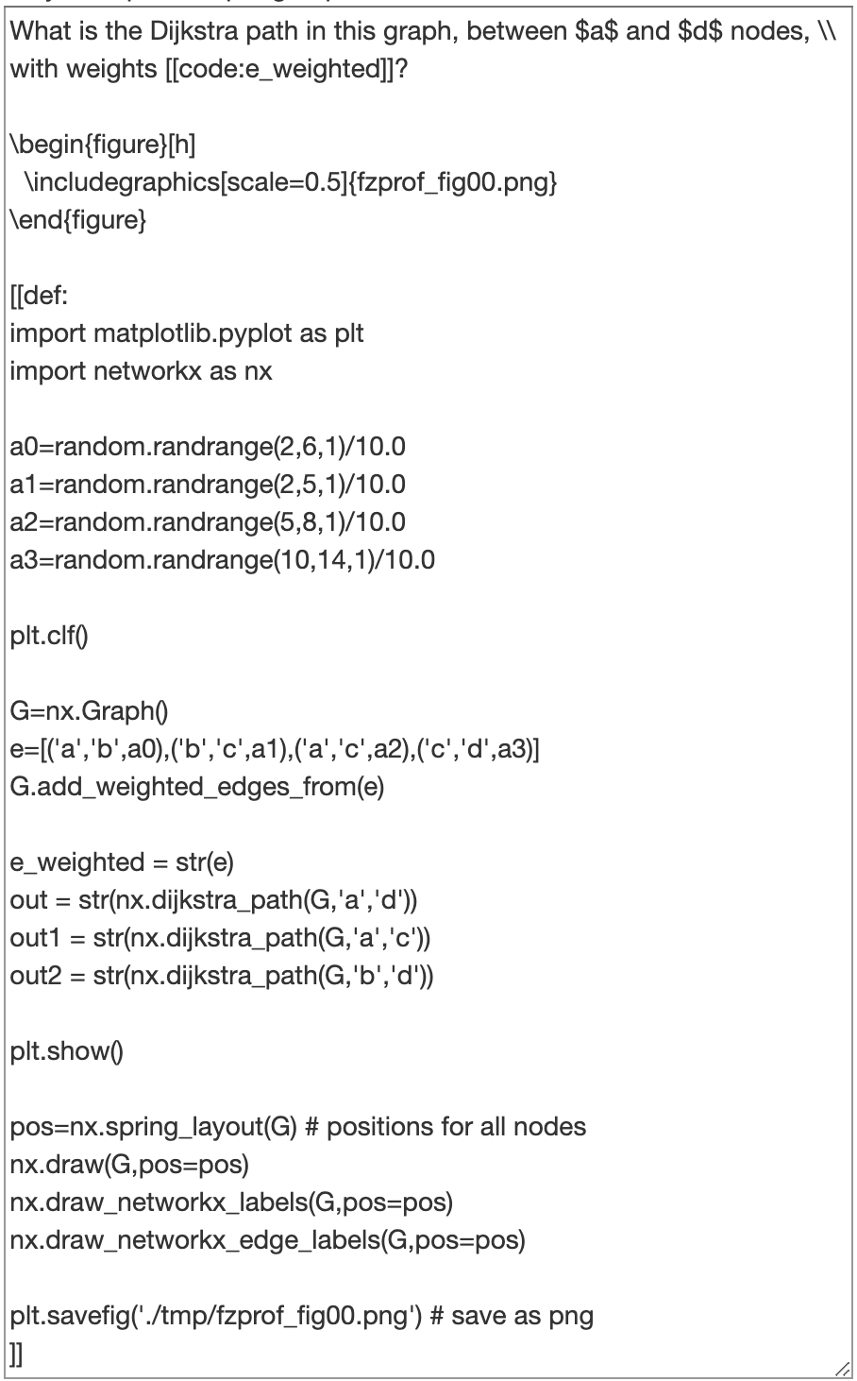
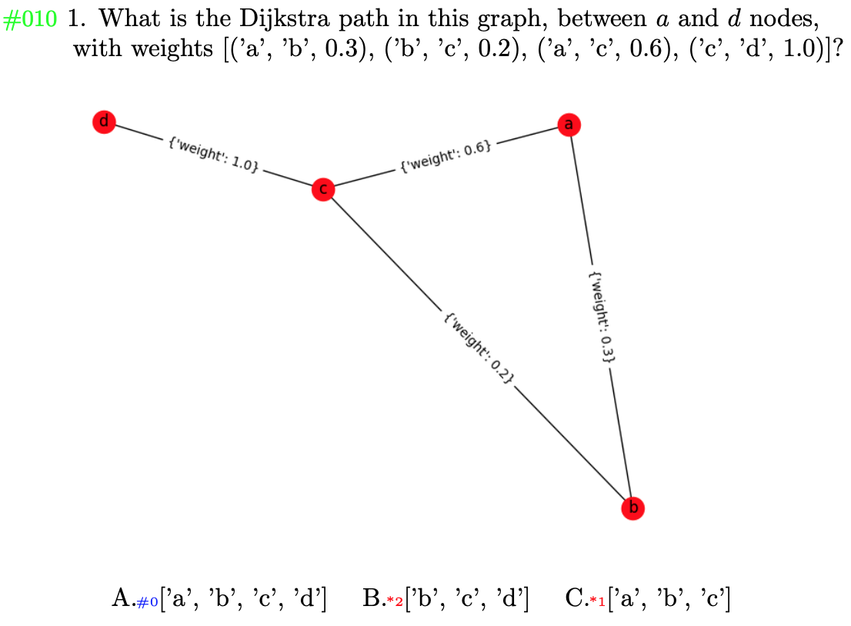
Example with Graph
http://nubisys.ufabc.edu.br:8000/topic/question/10/update/
networkx and matplotlib library
Notes:
Slide 15.
Example with Graph.
Path of Dijkstra.
Using networkx and matplotlib library.
In this example, we can see the short path between nodes. A and D. considering these weights: 0.3; 0.2; 0.6; and 1.0.

Slide 16
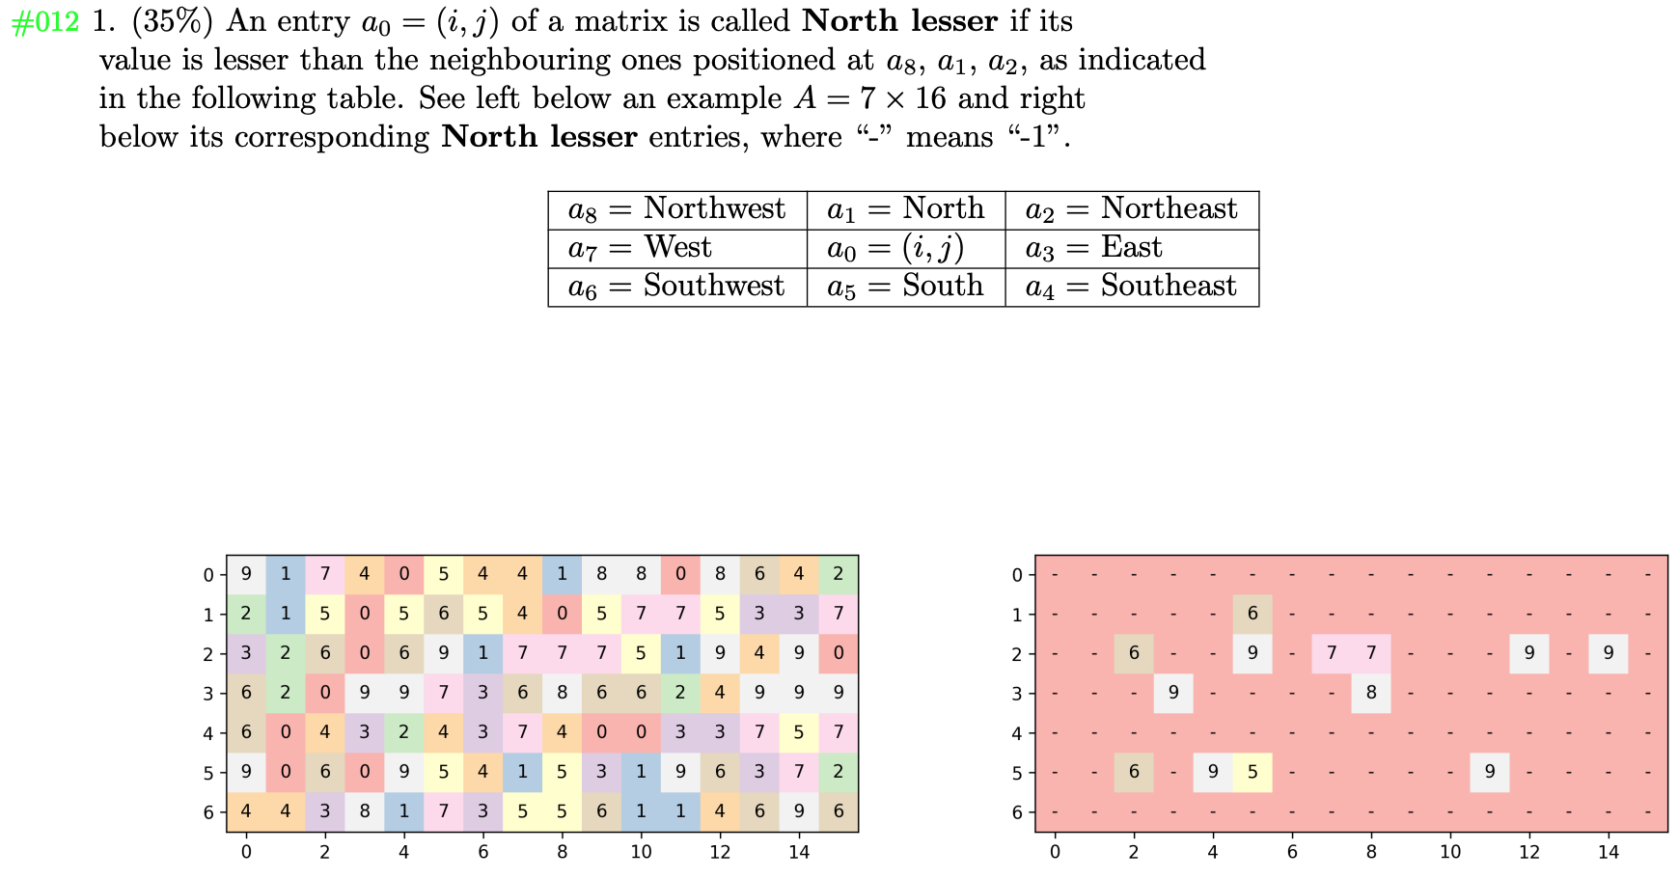
Example with Matrix
http://nubisys.ufabc.edu.br:8000/topic/question/12/update/
Notes:
Slide 16.
Example with Matrix and Figure.
The description of this example is very long.
And it is detailed in the paper.

Slide 17
Contents
Motivation
Method to Generate Parametric Questions
Data-Flow Diagram
Class Diagram
Question
Create
Update
See-PDF
Examples
Exams
Generate PDF
Scan PDF (correcting exams)
Conclusion and Future Works
Notes:
Slide 17.
Now, I will present an Exam.

Slide 18
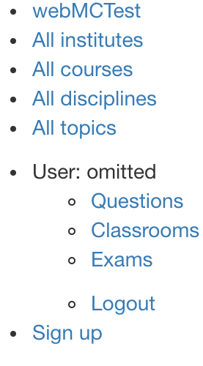
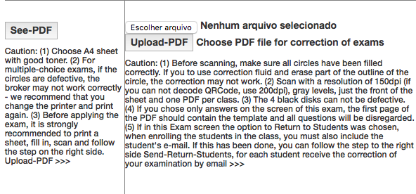
Example of Exam
http://nubisys.ufabc.edu.br:8000/exam/exam/1/update/ in English
http://vision.ufabc.edu.br:8000/exam/exam/50/update/ in Portuguese
Notes:
Slide 18.
Example of Exam.
After choosing. See-PDF...

Slide 19
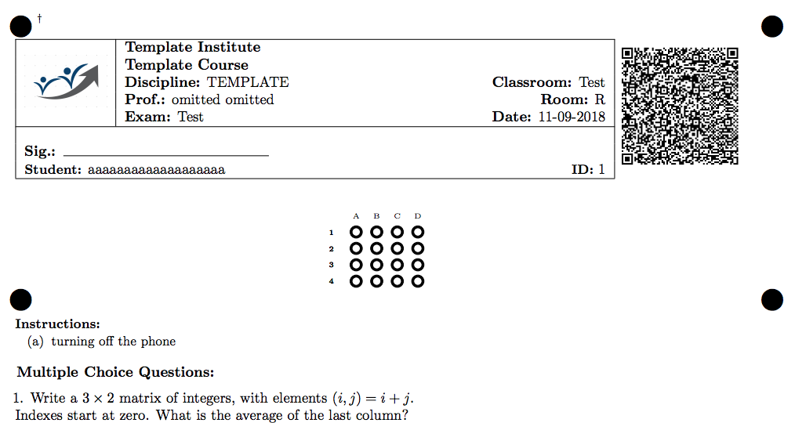
Example of Exam: See-PDF
This QRcode contains both encrypted and compressed informations.
It stores (ID) exam, class and student.
And for each question, it contains the order of the random answers.
Notes:
Slide 19.
In this exam, we can see a header. With.
student' name, student' ID and QRcode.
This QRcode contains both: encrypted. And compressed. Information’s.
It stores (ID) exam, class, and student.
And for each question, it contains the order of the random answers.
And, This is the answer sheet area.

Slide 20
Example of Exam: correct PDF
http://nubisys.ufabc.edu.br:8000/exam/exam/1/update/ in English
http://vision.ufabc.edu.br:8000/exam/exam/50/update/ in Portuguese
Notes:
Slide 20.
After choosing a PDF file with scans and Upload-PDF...

Slide 21
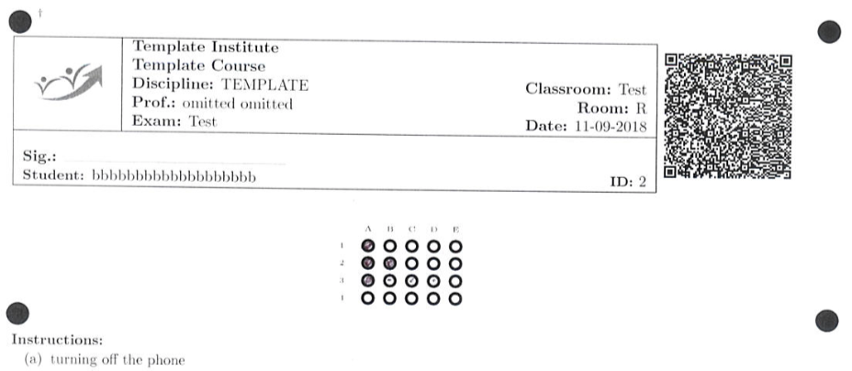
Example of Exam: scan PDF
Notes:
Slide 21.
Here is a CSV file with the exam fixes.
Question 2 has two markings.
And question 4 has no markup.

Slide 22
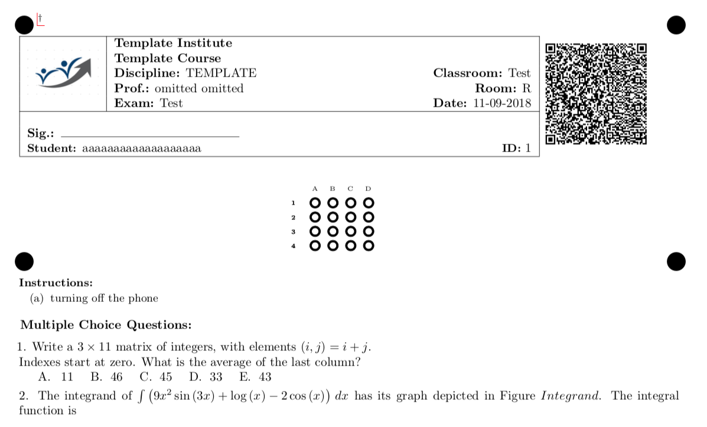
Conclusion
Our solution helps answer the questions:
How to generate exams for many students?
Traditional paper exams are required because
online answers aren't reliable.
How to minimize fraud?
An exams in which the questions are unique to each student.
How to correct exams automatically?
With computer vision applied to the scanned image of the answer sheets.
Notes:
Slide 22.
Conclusion.
Our solution helps answer the questions:
How to generate exams for many students?
Traditional paper exams are required because
Online answers aren't reliable.
How to minimize fraud?
An exam in which the questions are unique to each student.
How to correct exams automatically?
With computer vision applied to the scanned image of the answer sheets.

Slide 23
Future Works
Using eLearning system
such as Moodle
Create the views for the student monitoring
Improve security, including facial and digital recognition in the QRCode
Notes:
Slide 23.
Future works.
Using the eLearning system.
Such as Moodle.
Create visualizations for student monitoring.
Improve security, including facial and digital recognition on QRCode.

Slide 24
Thanks!
Questions?
{fzampirolli, fernando.teubl, valerio.batista}@ufabc.edu.br
Notes:
Slide 24.
Thanks!
Questions?

