Slide 1
An Automatic Generator and Corrector of
Multiple Choice Tests with Random Answer Keys
Francisco de Assis Zampirolli, Valério Ramos Batista, José Artur Quilici-Gonzalez
Federal University of ABC, Brazil
Frontiers in Education 2016, Erie, PA, USA
Notes:
Slide 1.
Good afternoon!
The title of our work is: An Automatic Generator and Corrector of Multiple Choice Tests with Random Answer Keys.
My name is Francisco. and coauthors are, Valério and José Artur.
I'm from Federal University of ABC, Brazil.

Slide 2
Contents
Motivation
Method to Generate Tests
Databanks of Student Classes
Databanks of Questions
Configuration File
Execution of the Test Generator
Method to Correct Tests Automatically
Experiments, Discussions and Performance
Conclusion and Future Works
Notes:
Slide 2.
This talk Contents.
Motivation.
Method to Generate Tests.
Databanks of Student Classes.
Databanks of Questions.
Configuration File.
Execution of the Test Generator.
Method to Correct Tests Automatically.
Experiments, Discussions and Performance.
Conclusion and Future Works.

Slide 3
Motivation
How to generate tests for many students?
For many purposes online test answers aren't reliable.
Traditional paper tests are then required.
How to minimize fraud?
A test whose answer key is unique to each student.
How to correct this test automatically?
With computer vision applied to the scanned answer sheets.
Notes:
Slide 3.
Motivation.
How to generate tests for many students?
For many purposes online test answers aren't reliable.
Traditional paper tests are then required.
How to minimize fraud?
A test whose answer key is unique to each student.
How to correct this test automatically?
With computer vision applied to the scanned answer sheets.

Slide 4
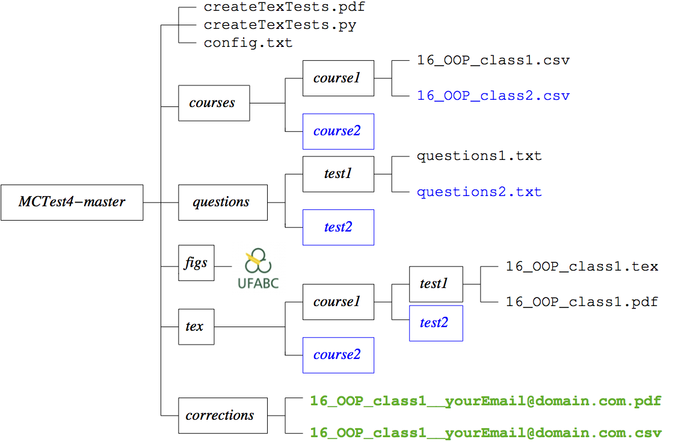
Method to Generate Tests
These files and folders are available in:
vision.ufabc.edu.br/MCTest4
Notes:
Slide 4.
Method to Generate Tests.
These files and folders are available in this link.

Slide 5
Databanks of Student Classes
11000123; Fulano Junior
11000111; Gustavo Neto
Notes:
Slide 5.
Databanks of Student Classes.
This is the structure of files and folders to databanks of student classes. This example contains two files, one each classes. This file contains student’s ID and student’s Name.

Slide 6
Databanks of Questions
QE:: The JAVA command \{\textbackslash\tt for(int i=0;i<5;i++) i=5;\} will attribute 5 to i
A: Just once % first answer is correct
A: Five times
A: Never (the compiler does not accept it)
A: The answer depends on the JAVA version
Notes:
Slide 6.
Databanks of Questions.
This is the structure of files and folders to databanks of questions, contains two files of questions. This example shows a questions with 4 answers. If we choose random testes, the first answer is the corrector answer.

Slide 7
Configuration File
numQE :: 4 :: number of Easy questions
numQM :: 3 :: number of interMediate questions
numQH :: 2 :: number of Hard questions
numQT :: 2 :: number of disserTation questions
folderCourse :: course1 :: folder containing the classes folderQuestions :: test1 :: folder containing the questions
randomTests :: 1 :: =0 for nonrandom
...
Notes:
Slide 7.
Configuration File.
This is an example of the configuration file.
The number 4 means number of Easy questions.
The number 3 means number of interMediate questions.
The number 2 means number of Hard questions.
The number 2 means number of disserTation questions.
Course1 means folder containing the classes.
Test1 means folder containing the questions.
randomTests is equal to 1 means random tests.

Slide 8
Execution of Test Generator
After installing python and Latex
Execute at the shell prompt:
python createTexTests.py config.txt
generator
Notes:
Slide 8.
Execution of Test Generator.
After installing python and Latex. Execute at the shell prompt. With this command.

Slide 9
Execution of Test Generator
In our example, after you get the file 16_OOP_class1.pdf
This one is also created (if randomTests = 1):
16_OOP_class1_GAB
This GAB file contains the right answer for each student and will be used in the automatic correction.
Notes:
Slide 9.
Execution of Test Generator.
In our example, after you get the file pdf.
This one is also created (if randomTests is equal to 1), GAB.
This GAB file contains the right answer for each student and will be used in the automatic correction.

Slide 10
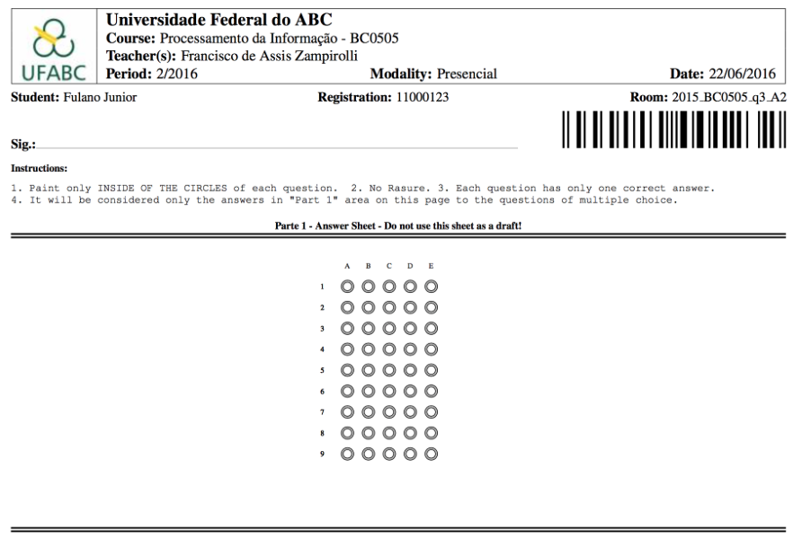
Example of Answer Sheet
Notes:
Slide 10.
Example of Answer Sheet.
Here is the student' name, here is the student' ID and here is the barcode of this student' ID.This is the answer sheet area.

Slide 11
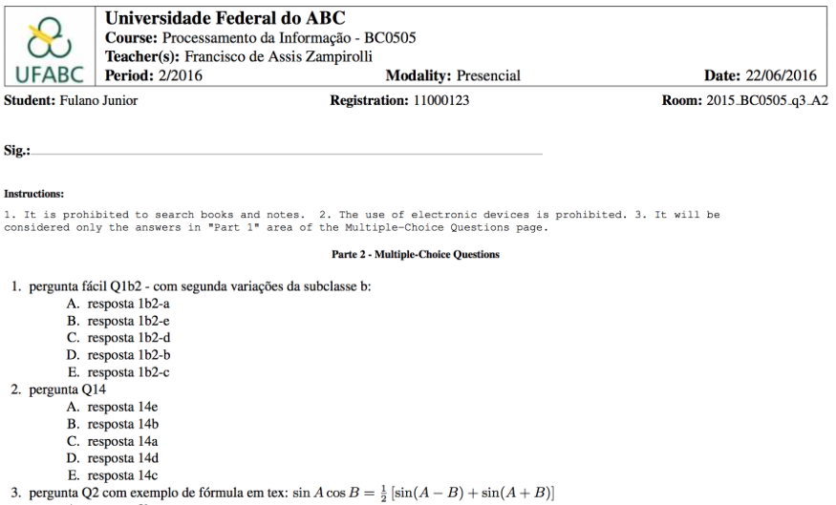
Example of Multiple Choice Questions
Notes:
Slide 11.
Example of Multiple Choice Questions.
Here contains an example of multiple choice questions

Slide 12
Contents
Motivation
Method to Generate Tests
Databanks of Student Classes
Databanks of Questions
File Configuration
Execution of the Test Generator
Method to Correct Tests Automatically
Experiments, Discussions and Performance
Conclusion and Future Works
Notes:
Slide 12.
Contents.
Now, I'll present how we can to correct tests automatically.

Slide 13
Method to Correct Tests Automatically
Rename the aforementioned GAB file as
16_OOP_class1__yourEmail@domain.com_GAB
Scan all students' answer sheets in the file
16_OOP_class1__yourEmail@domain.com.pdf
Notes:
Slide 13.
Method to Correct Tests Automatically.
Rename the aforementioned GAB file as: _GAB.
Scan all students' answer sheets in the file: .pdf.
Notice that the names of these two files are the same, except for the ending.

Slide 14

Method to Correct Tests Automatically
Send these two files by ftp:
ftp vision.ufabc.edu.br
In a few minutes the correction will be sent to:
yourEmail@domain.com
16_OOP_class1__yourEmail@domain.com_GAB
16_OOP_class1__yourEmail@domain.com.pdf
Notes:
Slide 14.
Method to Correct Tests Automatically.
Send these two files by ftp:
ftp vision.ufabc.edu.br.
In a few minutes the correction will be sent to: yourEmail@domain.com. This email contains this CSV file with Page of pdf, student’s ID, number of Answer, number of questions, invalid questions, final grade, and answer marked / correct answer
Here we see that the student didn't mark question 8 and duplicate markings in question 9.

Slide 15
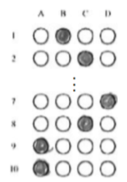
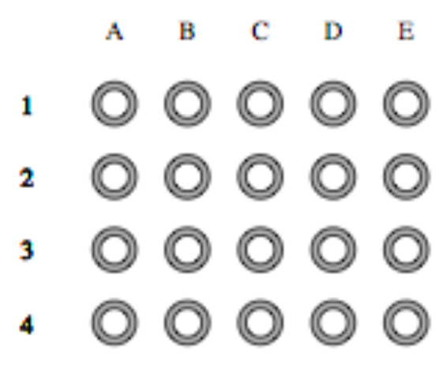
First Experiment
Two classes with 136 students and random tests (10 questions each). Only one failure:
this problem is now minimized in our new version
Notes:
Slide 15.
First Experiment.
Two classes with 136 students and random tests (10 questions each). Only one failure:
this problem is now minimized in our new version.

Slide 16
Second Experiment
Two classes with 130 students and random tests (12 questions each). There wasn't any failure.
In these two experiments we have used:
The good resolution of 150 dpi at scanning.
Our random test generator.
Notes:
Slide 16.
Second Experiment.
Two classes with 130 students and random tests (12 questions each). There wasn't any failure.
In these two experiments we have used:
The good resolution of 150 dpi at scanning.
Our random test generator.

Slide 17
Third Experiment (not random/no databanks)
Bad resolution of 75 dpi at scanning
Comparison with the commercial software REMARK
MCTest (our solution)
Is fully automatic
It runs in a server (vision.ufabc.edu.br)
With REMARK
one must inform both barcode and answer sheet positions manually
It runs on the desktop
Notes:
Slide 17.
Third Experiment.
Bad resolution of 75 dpi at scanning.
Comparison with the commercial software REMARK.
MCTest (our solution).
fully automatic.
runs in a server (vision.ufabc.edu.br).
REMARK.
one must inform barcode and answer sheet positions manually.
runs on the desktop.

Slide 18
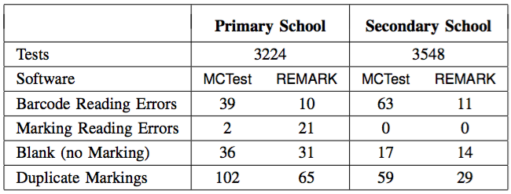

Third Experiment (not random/no databanks)
Comparisons of our solution with REMARK
MCTest marked duplicate: 9B and 9C
only 9B
Notes:
Slide 18.
Third Experiment.
Comparisons of our solution with REMARK.
In this table we can see comparisons between MCTest and REMARK. The filters of MCTest is more tasteful in this case.
MCTest marked duplicate: 9B and 9C.
REMARK marked only 9B.
We can see two markers in 9B and 9C and the MCTest marked correctly.

Slide 19
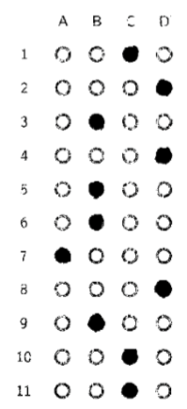
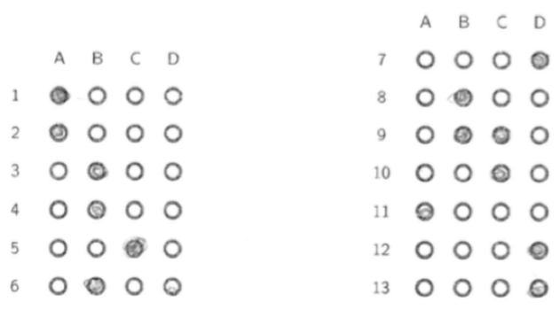
Discussions (3rd Experiment)
Bad resolution of 75 dpi at scanning
Low toner to print tests
Failure to mark answers
Notes:
Slide 19.
Discussions.
Discussions of this third experiments: we used a bad resolution of 75 dpi at scanning, with a low toner and failure to mark answers in some cases.

Slide 20
Performance of MCTest (3rd Experiment)
For 6,772 tests
102 minutes
0.9 second per test
The correction is entirely automatic
Students filled in wrongly on 67 occasions (only 1.88% of the tests)
Notes:
Slide 20.
Performance.
Performance of this third experiments for 6772 tests, spent 102 minutes, or less than one minute per test.
The correction is entirely automatic.
Students filled in wrongly on 67 occasions (only 1.88% of the tests).

Slide 21
Conclusion
Our solution helps answer the questions:
How to generate tests for many students?
Traditional paper tests are required because
online answers aren't reliable.
How to minimize fraud?
A test whose answer key is unique
to each student.
How to correct tests automatically?
With computer vision applied to the scanned answer sheets.
16_OOP_class1__yourEmail@domain.com_GAB
16_OOP_class1__yourEmail@domain.com.pdf
Notes:
Slide 21.
Conclusion.
Our solution helps answer the questions:
How to generate tests for many students?
Traditional paper tests are required because online
answers aren't reliable.
How to minimize fraud?
A test whose answer key is unique
to each student.
How to correct tests automatically?
With computer vision applied to the scanned answer sheets.

Slide 22
Future Works
Create dynamic questions
Using eLearning system
such as Moodle
Notes:
Slide 22.
Future Works.
Create dynamic questions.
Using eLearning system.
such as Moodle.

Slide 23
Thanks!
Questions?
{fzampirolli, valerio.batista, jose.gonzalez}@ufabc.edu.br
Notes:
Slide 23.
Thanks!
Questions?
In Slide No. 7, does REMARK use the same structure of folders, subfolders and files that you use?
No, because REMARK does not use databases and random testing.
Slide 8: Suppose I already have python / Latex. Must I re-install them?
No, but you have to install some libraries.
Side 18: Are Duplicate Markings always made by the student, or a spot on the answer sheet can generate a "Duplicate Marking"?
Yes, it's possible. The teacher has to check all sheets before distributing to students.
1. Does your corrector use the same method applied to lottery tickets? If so, why have you chosen circles instead of rounded-cornered rectangles? Don't you think these are lesser prone to marking failures?
Yes, MCTest uses the same technique of lottery cards (OMR). This demand using circles is to compare with the one used in REMARK. The company that hired REMARK and MCTest for its exams and corrections. I think that, it is important a study to check each strategy: circle or rectangle.
2. Why don't you always work with a resolution of 75 dpi instead of 150?
Because the barcode decoding package (zbar) that we used worked best for a resolution of 150 dpi. And 75 dpi was used the company.
3. On Slide 18 MCTest was better than REMARK at Marking Reading Errors, whereas at Barcode Reading Errors it was the other way round. Do you know the qualitative reasons that explain each case?
I did not have access to the techniques used by REMARK, but I guess that REMARK has a specific method to process barcode and MCTest use a free code library zbar. So, I think that it is possible better this Errors in our solution.
4. What are "dynamic questions"?
Dynamic questions are used in formulas and codes, where the values of variables are inserted randomly. For example, to find the roots of a quadratic equation.
5. What is "Moodle"?
Moodle is a software to support teaching. It offers various resource, such as repositories, forums, online tests, etc.
6. If you make use of the Universal Product Code, then it could happen that a student deciphers the answer key with a smartphone. Can you produce barcodes differently from the UPC? What about QRCodes? Are they difficult to implement?
The barcode is used only to decode the student's ID and it is the same that UPC. He may know the correct answers only if he has access to the GAB file. The QRCode has the same difficult that UPC, because we used the same library zbar.

