Slide 1
The Digital Deluge
Lecture 6
Learning in Retirement
David Coll
Professor Emeritus
Department of Systems and Computer Engineering
Winter 2009
Notes:
Winter 2009
D. C. Coll
Learning in Retirement - The Digital Deluge

Slide 2
Pattern mining
"Pattern mining" is a data mining technique that involves finding existing patterns in data. In this context patterns often means association rules.
The original motivation for searching association rules came from the desire to analyze supermarket transaction data, that is, to examine customer behaviour in terms of the purchased products.
For example, an association rule "beer => chips (80%)" states that four out of five customers that bought beer also bought chips.

Slide 3
In the context of pattern mining as a tool to identify terrorist activity, the National Research Council provides the following definition: "Pattern-based data mining looks for patterns (including anomalous data patterns) that might be associated with terrorist activity — these patterns might be regarded as small signals in a large ocean of noise."^{[8][9][5]}

Slide 4
Subject-based data mining
"Subject-based data mining" is a data mining technique involving the search for associations between individuals in data.
In the context of combatting [sic] terrorism, the National Research Council provides the following definition: "Subject-based data mining uses an initiating individual or other datum that is considered, based on other information, to be of high interest, and the goal is to determine what other persons or financial transactions or movements, etc., are related to that initiating datum."^{[9]}

Slide 5
Business
Data mining in customer relationship management applications can contribute significantly to the bottom line.
Rather than randomly contacting a prospect or customer through a call center or sending mail, a company can concentrate its efforts on prospects that are predicted to have a high likelihood of responding to an offer.

Slide 6
More sophisticated methods may be used to optimize resources across campaigns so that one may predict which channel and which offer an individual is most likely to respond to — across all potential offers.
Finally, in cases where many people will take an action without an offer, modeling can be used to determine which people will have the greatest increase in responding if given an offer.
Data clustering can also be used to automatically discover the segments or groups within a customer data set.

Slide 7
Data mining can also be helpful to human-resources departments in identifying the characteristics of their most successful employees. Information obtained, such as universities attended by highly successful employees, can help HR focus recruiting efforts accordingly
Another example of data mining, often called the market basket analysis, relates to its use in retail sales.
The example deals with association rules within transaction-based data.

Slide 8
Science and Engineering
In recent years, data mining has been widely used in area of science and engineering, such as bioinformatics, genetics, medicine, education and electrical power engineering.
In the area of study on human genetics, the important goal is to understand the mapping relationship between the inter-individual variation in human DNA sequences and variability in disease susceptibility.

Slide 9
In lay terms, it is to find out how the changes in an individual's DNA sequence affect the risk of developing common diseases such as cancer.
This is very important to help improve the diagnosis, prevention and treatment of the diseases.
The data mining technique that is used to perform this task is known as multifactor dimensionality reduction.

Slide 10
Electrical Power Engineering
In the area of, data mining techniques have been widely used for condition monitoring of high voltage electrical equipment.
The purpose of condition monitoring is to obtain valuable information on the insulation's health status of the equipment. Data clustering has been applied on the vibration monitoring and analysis of transformer vibration monitoring to detect abnormal conditions and to estimate the nature of the abnormalities.

Slide 11
Educational Research
Data mining has been used to study the factors leading students to choose to engage in behaviors which reduce their learning and to understand the factors influencing university student retention.[
A similar example of the social application of data mining its is use in expertise finding systems whereby descriptors of human expertise are extracted, normalized and classified so as to facilitate the finding of experts, particularly in scientific and technical fields. In this way, data mining can facilitate Institutional Memory.

Slide 12
Other examples of applying data mining are
  biomedical data
  mining clinical trial data
  traffic analysis
  et cetera.

Slide 13
More:
http://www.thearling.com/text/dmwhite/dmwhite.htm
http://www.statsoft.com/textbook/stdatmin.html

Slide 14
1.”Twisted” light in optical fibers
“Twisted” light has the potential to dramatically increase bandwidth of optical networks.
Already researchers are using various wireless techniques such as phase quadrature phase shift modulation to achieve data rates in excess of 560 Gbps on a single wavelength in a DWDM system, and it is expected that data rates in excess of 1000 Gbps per wavelength will be possible soon.
These techniques will work with existing DWDM networks and dramatically increase their bandwidth capacity to tens if not hundreds of terabits.

Slide 15
Optical Orbital Angular Momentum (OOAM) has the potential to add an almost infinite number of phase states to the modulated signal and further increase the capacity to thousands of terabits.
http://ieeexplore.ieee.org/stamp/stamp.jsp?arnumber=04388855

Slide 16
2. Truphone Brings Skype To iPhone & iTouch http://gigaom.com/2009/01/05/truphone-brings-skype-to-iphone-itouch/
--------------------------------------------
[Now you can make skpe calls on your iTouch or Iphone using any Wifi networks and avoid expensive cell phone charges and long distance fees. Excerpt from the Gigaom web site—BSA]
Geraldine Wilson, who was recently appointed as the chief executive of Truphone, told me in a conversation earlier today that Truphone wants to “offer our users a comprehensive communications experience. We started out as a voice app but now we are broadening it to other applications.”

Slide 17
By doing so, Wilson and Truphone founder James Tagg believe that they will give Truphone users a reason to stay insider the application longer, creating more opportunities to make phone calls and bringing in much-needed revenues. “In a mobile environment it is hard to switch between different applications, and that is why we are creating a single application environment,” Tagg says.

Slide 18
3. New Internet-ready TVs put heat on cable firms http://business.theglobeandmail.com/servlet/story/RTGAM.20090105.wrtvweb06/BNStory/Business/home
For years, technology companies have tried in vain to bring the Internet onto the screen at the centre of North American living rooms. Although TV shows have made the migration to the Web, to date, it has been a one-way road.
Now, a new breed of Internet-connected televisions is threatening to shake up both the technology and broadcasting industries while making millions of recently purchased high-definition TVs yesterday's news.

Slide 19
Immersive Environments http://en.wikipedia.org/wiki/Immersive_digital_environment
“An immersive digital environment is an artificial, interactive, computer-created scene or "world" within which a user can immerse themselves.
Immersive digital environments could be thought of as synonymous with Virtual Reality, but without the implication that actual "reality" is being simulated. An immersive digital environment could be a model of reality, but it could also be a complete fantasy user interface or abstraction, as long as the user of the environment is immersed within it. The definition of immersion is wide and variable, but here it is assumed to mean simply that the user feels like they are part of the simulated "universe".

Slide 20
The success with which an immersive digital environment can actually immerse the user is dependent on many factors such as believable 3D graphics, surround sound, interactive user-input and other factors such as simplicity, functionality and potential for enjoyment.
New technologies are currently under development which claim to bring realistic environmental effects to the players' environment - effects like wind, seat vibration and ambient lighting.”

Slide 21
http://citeseerx.ist.psu.edu/viewdoc/summary?doi=10.1.1.7.7166
“The PlatoCAVE, the MiniCAVE, and the C2 are immersive stereoscopic projection--based virtual reality environments oriented toward group interactions.
As such they are particularly suited to collaborative efforts in data analysis and visual data mining.”

Slide 22
Genome Research http://arxiv.org/ftp/arxiv/papers/0705/0705.1535.pdf
“Biologists are leading current research on genome characterization (sequencing, alignment, transcription), providing a huge quantity of raw data about many genome organisms.
Extracting knowledge from this raw data is an important process for biologists, using usually data mining approaches.”

Slide 23
“However, it is difficult to deals with these genomic information using actual bioinformatics data mining tools, because data are heterogeneous, huge in quantity and geographically distributed.
… we present a new approach between data mining and virtual reality visualization, called visual data mining.
Indeed Virtual Reality becomes ripe, with efficient display devices and intuitive interaction in an immersive context.
Moreover, biologists use to work with 3D representation of their molecules, but in a desktop context.”

Slide 24
Visualization
TOWARDS AN IMMERSIVE TANGIBLE BOARD FOR VISUAL ENVIRONMENTAL DATA MINING
Elaheh Mozzafari (Ph.D candidate) and Ahmed Seffah (Associate Professor)
  Human-Centric Engineering and Visualization Lab
  Department of Computer Science and Software Engineering
  Concordia University, Montreal, Canada
Keywords: Visual Data Mining, Environmental Data, Immersive tangible metaphors, Human Computer Interaction

Slide 25
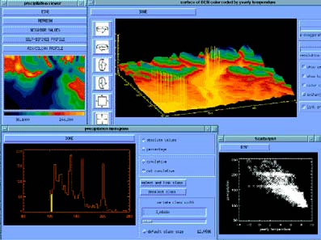
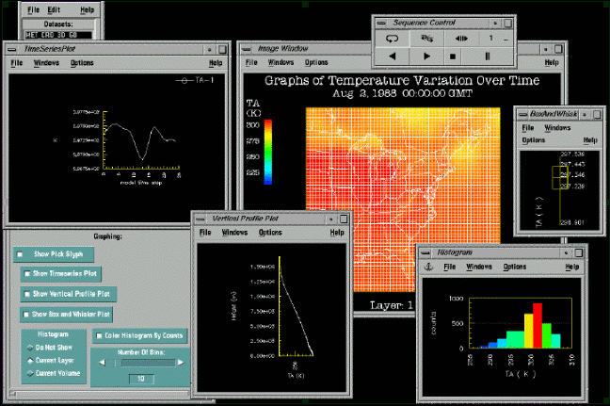
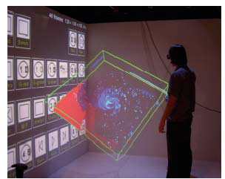
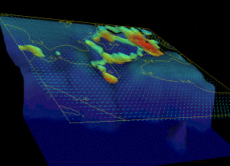
http://www.digitalearth-isde.org/cms/upload/Papers%20and%20Abstracts/Mozzafari.pdf
Simulation
Data Scaping
Immersa-Desk
The CAVE

Slide 26
Molecular imaging and exploratory genome research in Erasmus MC Rotterdam: http://www.barco.com/corporate/en/pressreleases/show.asp?index=1499
“The ‘Barco I-Space’ virtual environment has been officially opened on March 24, 2005 by the mayor of Rotterdam.
“The I-space enables scientists to "walk through" massive volumes of genomic, chemical, and medical information and extract more information in a shorter timeframe than by using conventional approaches.
“Moreover, it enables clinicians and researchers to explore and visualize in 3D Ultrasound, CT and MRI images.

Slide 27
“Molecular Medicine is a fast moving field and a new buzz word.
“Visualization of tracers and molecular markers in medical images (scans) becomes more and more important for clinical diagnostics surgical intervention and drug development.
“The unraveling of the genetic information encoded in the DNA of human cells has generated a rapid progress in understanding the roles of our genes in health and disease.

Slide 28
Visualization http://en.wikipedia.org/wiki/Scientific_visualization
“Scientific visualization (… visualisation … ) is an interdisciplinary branch of science, primarily concerned with the visualization of three dimensional phenomena, such as architectural, meteorological, medical, biological systems.
The emphasis is on realistic rendering of volumes, surfaces, illumination sources, and so forth, perhaps with a dynamic (time) component.
Scientific visualization focuses on the use of computer graphics to create visual images which aid in understanding of complex, often massive numerical representation of scientific concepts or results.

Slide 29
Storage
New Technologies for Data Storage
  New Parameters
    Faster
    Denser
    Cooler
  New Architectures
  New Signal Processing
  New Media
    Fixed
    Portable

Slide 30
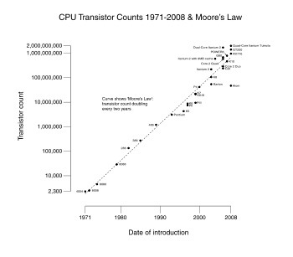

Slide 31
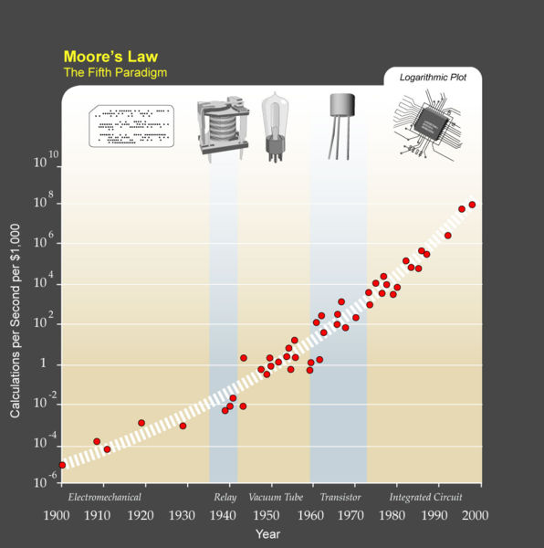

Slide 32
Communications
More Bandwidth
Wired
  Fibre Optics
Wireless
  WiFi
  WiMax
  3G - 4G Cellular Radio
  Satellite
  BFWA

Slide 33
DVE Tele-Immersive RoomTM
“The world’s most realistic group-teleconferencing experience where the conferees appear in the 3D space of the room.
The DVE-Tele-Immersion RoomTM provides:
  Eye level mounted camera behind the image
  Full presentation environment
  Fully immersive where the imaged people can be seen sitting and standing in the physical room
  High end digital cinema
  Stunning corporate marketing tool with recorded presentation for visiting clients
  Volumetric 3D visualization of 3D objects up to 9 feet wide floating in air
  Optional stereoscopic 3D visualizationTrue augmented reality conferencing

Slide 34
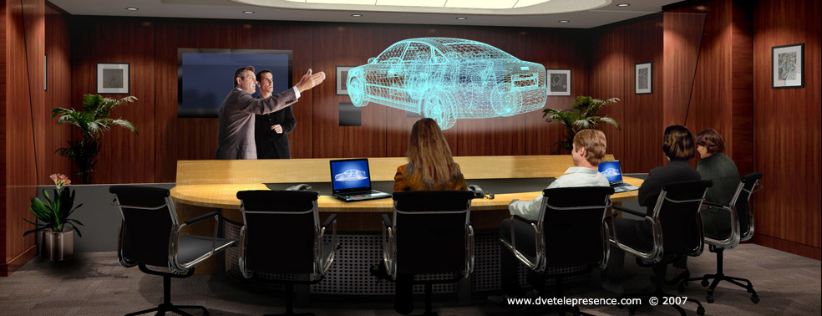
DVE Tele-Immersive RoomTM
http://www.dvetelepresence.com/products/immersion_room.asp

Slide 35
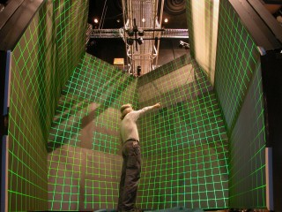
STAR CAVE - UCSD

Slide 36
The StarCAVE http://ivl.calit2.net/wiki/index.php/Infrastructure
Five walls with three screens each, plus a floor we project on.
Two JVC HD2K projectors generate a stereo image for each screen, plus four projectors for the floor, totalling 34 projectors in the StarCAVE.
Every projector pair is driven by an Intel quad core Dell XPS computer, with dual Nvidia Quadro 5600 graphics cards.
We use an additional XPS machine as the head node to control the rendering nodes, for a total of 18 nodes.

Slide 37
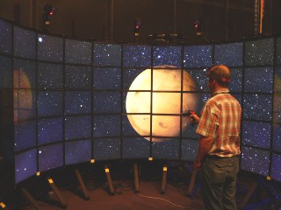
Varrier Wall - UCSD

Slide 38
The Varrier wall consists of 60 LCD monitors, arranged in a semi cylinder.
It can generate autostereoscopic images, which means that the user can see 3D images without glasses.
The resolution of the wall is about 40 million pixels per eye.

Slide 39
The System
The system consists of
16 AMD Opteron based workstations
each equipped with
4GB RAM
2.0 TB disk arrays
dual gigabit ethernet network ports, and
dual Nvidia Geforce 7900 video cards.
Each display node drives four 20" NEC LCD monitors at 1600x1200 pixels per screen

Slide 40
The system is running on Suse Linux 10.0
We support three software environments to drive the Varrier: Electro, SAGE, and COVISE.
For head tracking and user input we use a wireless, optical tracking system from Advanced Realtime Tracking (ART).
For audio we are using a high-end multi-channel sound system with a subwoofer.

Slide 41
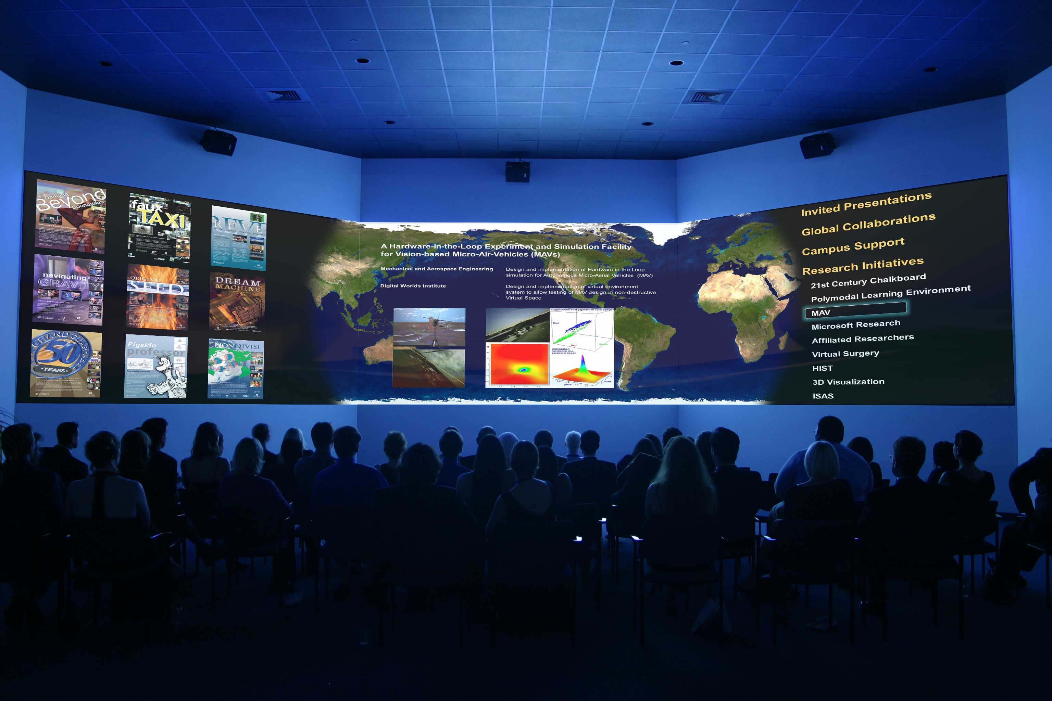
REVE: Research, Education and Visualization Environment Digital Worlds Institute University of Florida

Slide 42
VRFire: an Immersive Visualization Experience for Wildfire Spread Analysis Sherman, W.R.; Penick, M.A.; Su, S.; Brown, T.J.; Harris, F.C. Virtual Reality Conference, 2007. VR apos;07. IEEE, Volume , Issue , 10-14 March 2007 Page(s):243 – 246
“Wildfires are a frequent summer-time concern for land managers and communities neighboring wildlands throughout the world. Computational simulations have been developed to help analyze and predict wildfire behavior, but the primary visualization of these simulations has been limited to 2-dimensional graphics images.
We are currently working with wildfire research groups and those responsible for managing the control of fire and mitigation of the wildfire hazard to develop an immersive visualization and simulation application.
In our visualization application, the fire spread model will be graphically illustrated on a realistically rendered terrain created from actual DEM data and satellite photography. We are working to improve and benefit tactical and strategic planning, and provide training for firefighter and public safety with our application”

Slide 43
http://www.essc.psu.edu/genesis/viz.html
http://www.technovelgy.com/ct/Science-Fiction-News.asp?NewsNum=2053
http://blog.mlive.com/chronicle/2008/08/googles_street_view_brings_wor.html
http://www.ariadne.ac.uk/issue56/houghton-jan/

Slide 44
The Digital Deluge 11
Learning in Retirement
Digital Physics

Slide 45
http://www.calculator.org/CalcHelpCD/particle.htm
The view of atoms as electrons orbiting a nucleus as the planets orbit the sun is not an accurate one.
The temptation is to think of electrons, protons and even photons as behaving like miniature billiard balls.
But the at subatomic scales this kind of understanding based on everyday experience simply does not work.
These particles have no definite position and it is more useful to think in terms of probability distributions or wave functions. Their existence must be deduced from subtle interactions with other particles and the detectors physicists use to study them.

Slide 46
In this way, physicists have discovered whole families of fundamental particles, most of which exist only fleetingly, and which are able to transform into each other provided that energy, spin, charge and other properties are conserved.
The Standard Model is a theoretical framework used to organise and understand these fundamental particles;
  the quarks,
  leptons (which include the electron).
  gauge bosons

Slide 47
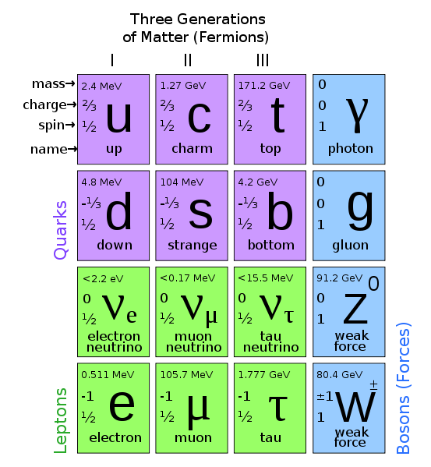

Slide 48
Fermions (quarks and leptons) with ½ spins are matter constituents.
Quarks are the only particles in the Standard Model to experience all four fundamental forces: electromagnetic, gravitational strong and weak interactions.
There are six different types of quarks, known as flavors: up, down , charm, strange, top and bottom
Quarks have various properties, such as electric and color, charge, spin and mass

Slide 49
Leptons, like quarks, are fermions (spin-¹⁄₂ particles) and are subject to the electromagnetic force, the gravitational force, and weak interaction.
But unlike quarks, leptons do not participate in the strong interaction.

Slide 50
In nature, quarks are never found on their own; rather, they are bound together in composite particles named hadrons
Hadrons are made up of elementary quarks
  in groups of two (mesons, containing a quark/antiquark pair) or
  in groups of three (baryons).
For example, the neutron and proton are types of baryon, i.e., they are hadrons.

Slide 51
Bosons (particles with integer spin) W and Z bosons) mediate forces, while the Higgs boson (spin-0) is responsible for particles having intrinsic mass.

Slide 52
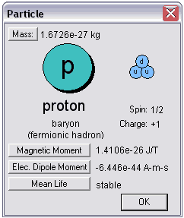

Slide 53
Digital Physics http://en.wikipedia.org/wiki/Digital_physics
“In physics and cosmology, digital physics is a collection of theoretical perspectives that start by assuming that the universe is, at heart, describable by information, and is therefore computable.
“Given such assumptions, the universe can be conceived as either the output of some computer program, or as being some sort of vast digital computation device.

Slide 54
“Digital physics is grounded in one or more of the following hypotheses, listed in order of increasing boldness. The universe or reality is:
  Essentially informational (although not every informational ontology need be digital);
  Essentially digital;
  Itself a colossal computer;
  The output of a simulated reality exercise.

Slide 55
Digital Physics
Zuse was the first to propose that physics is just computation, suggesting that the history of our universe is being computed on, say, a cellular automaton. His "Rechnender Raum" (Computing Cosmos / Calculating Space) started the field of Digital Physics in 1967. Today, more than three decades later, his paradigm-shifting ideas are becoming popular.
  Konrad Zuse (1910-1995) not only built the first programmable computers (1935-1941) and devised the first higher-level programming language (1945), but also was the first to suggest (in 1967) that the entire universe is being computed on a computer, possibly a cellular automaton (CA).
  He referred to this as "Rechnender Raum" or Computing Space or Computing Cosmos.
  Many years later similar ideas were also published / popularized / extended by Edward Fredkin and more recently Stephen Wolfram.

Slide 56
http://en.wikipedia.org/wiki/Digital_physics
“Some try to identify single physical particles with simple bits.
For example, if one particle, such as an electron, is switching from one quantum state to another, it may be the same as if a bit is changed from one value (0, say) to the other (1).
A single bit suffices to describe a single quantum switch of a given particle. As the universe appears to be composed world of elementary particles whose behavior can be completely described by the quantum switches they undergo, that implies that the universe as a whole can be described by bits.

Slide 57
Every state is information, and every change of state is a change in information (requiring the manipulation of one or more bits).
Setting aside dark matter and dark energy, which are poorly understood at present, the known universe consists of about 10⁸⁰ protons and the same number of electrons.
Hence the universe could be simulated by a computer capable of storing and manipulating about 10⁹⁰ bits and manipulating them.

