Slide 1

Data Analysis Assignment
FANG Zhang
CWID: 10433041

Slide 2
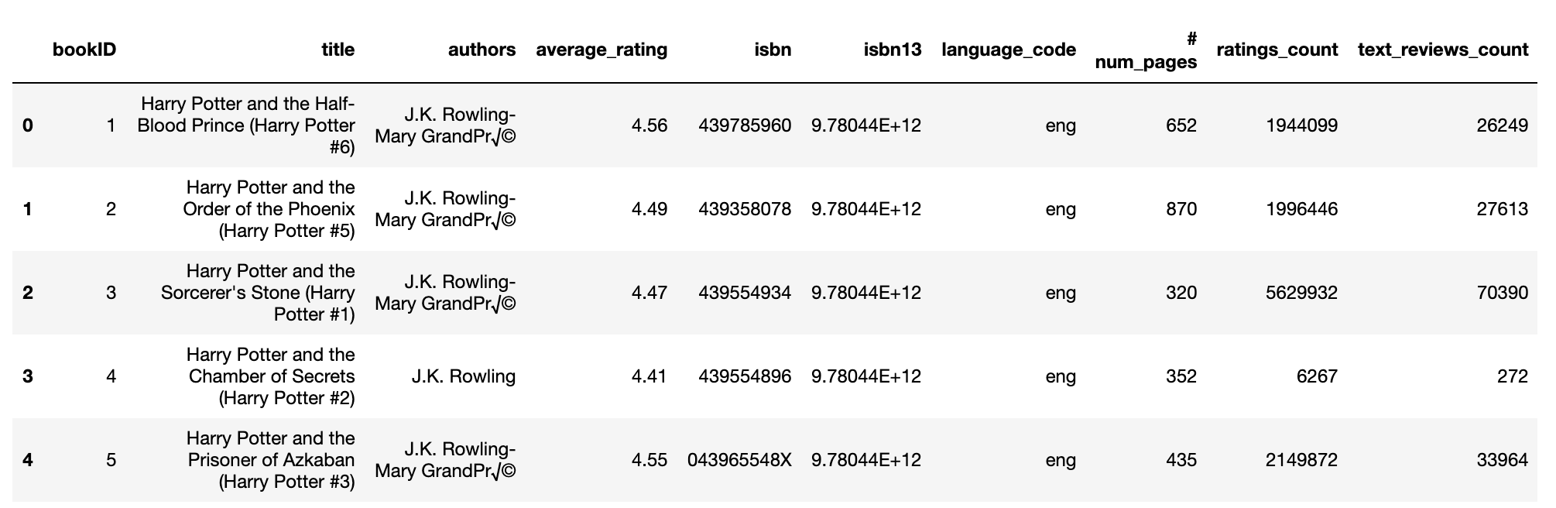
1. Dataset
The dataset name is Goodreads-books, available at Kaggle: https://www.kaggle.com/jealousleopard/goodreadsbooks
It is a CSV file with a comprehensive list of all books listed in Goodreads
This data was entirely scraped via the Goodreads API, so kudos to them for providing such a simple interface to scrape their database.
The dataset contains 13,719 records. Each record of them has 10 attributes. The dataset looks like:

Slide 3
Dataset Columns
Column Name | Column Description
bookID | A unique Identification number for each book.
title | The name under which the book was published.
authors | Names of the authors of the book. Multiple authors are delimited with -.
average_rating | The average rating of the book received in total.
isbn | Another unique number to identify the book, the International Standard Book Number.
isbn13 | A 13-digit ISBN to identify the book, instead of the standard 11-digit ISBN.
language_code | Helps understand what is the primary language of the book. For instance, eng is standard for English.
# num_pages | Number of pages the book contains.
ratings_count | Total number of ratings the book received.
text_reviews_count | Total number of written text reviews the book received.

Slide 4
2. Tools / method
Use Python Pandas package to analyze the book dataset
For descriptive analysis, I will explore the dataset by finding the correlations between variables. In specific, I will perform multiple ways of aggregations such as summation, count, sort, etc. within the dataset.
In such way, I try to answer some questions from query analysis results. E.g. Who is the most popular authors that have the most number of rating counts? Or which authors wrote most of the books?
The code for this assignment can be found at my GitHub:
https://github.com/fzhang22/BIA686-Practicum-in-Analytics/blob/master/Data_Analysis/Individual_analysis.ipynb

Slide 5
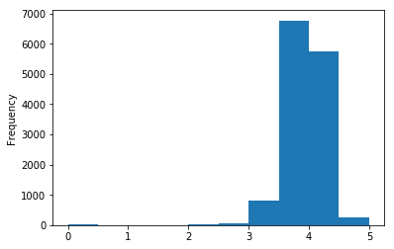
3. Descriptive analysis
Find the distributions of average rating of all books in data set
From the chart, we can see that most of the book ratings are ranged from 3 to 4.5

Slide 6
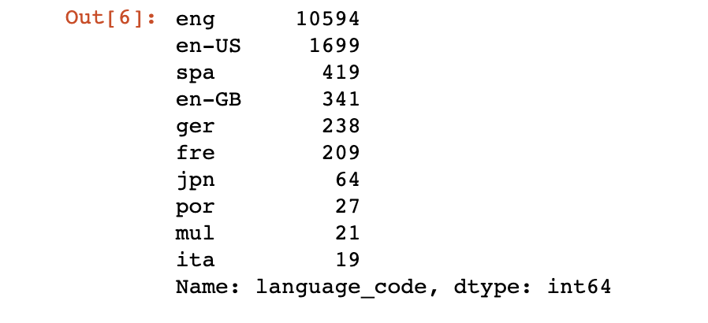
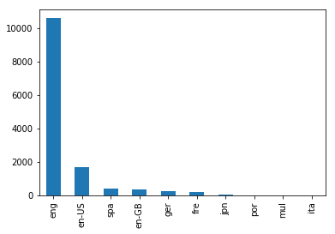
Find the top 10 languages for written books
From the result, we can see that English is the primary language for the Written books, followed by Spanish, Germany, French, Japanese, and so on.

Slide 7
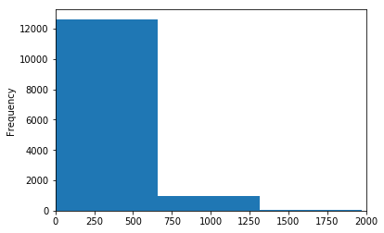
Page number of most books are less than 700. Few books are greater than 700, their pages ranged from around 750 to 1250
Find the number of pages distribution in book dataset

Slide 8
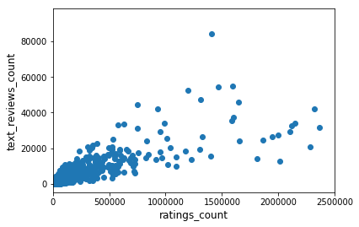
It seems like that the more ratings the book get, the more likely the reader will write a reviews for this book.
Is there any linear relationship between ratings count and text reviews count?

Slide 9
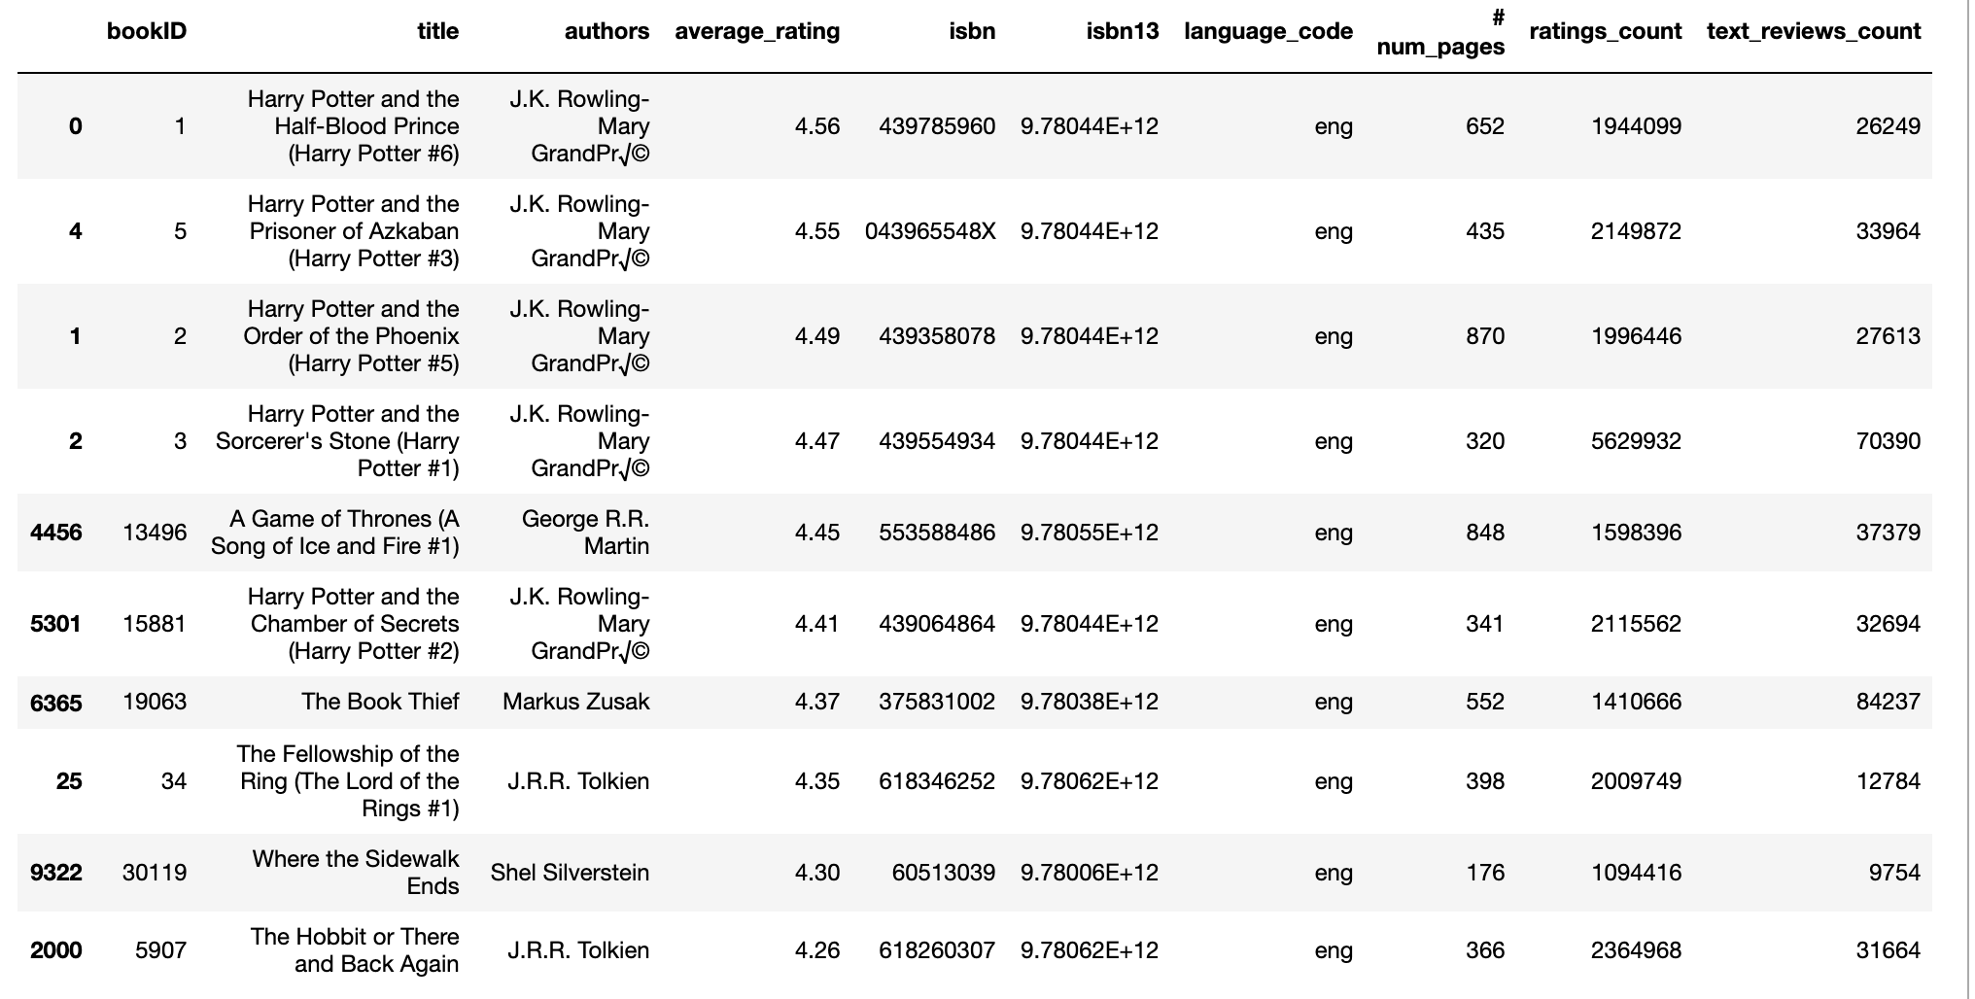
Find the top 10 books that receive over 1,000,000 ratings have the highest average ratings
It seems J.K Rowling’s Harry Potter series have the highest average ratings with a lot of readers.

Slide 10
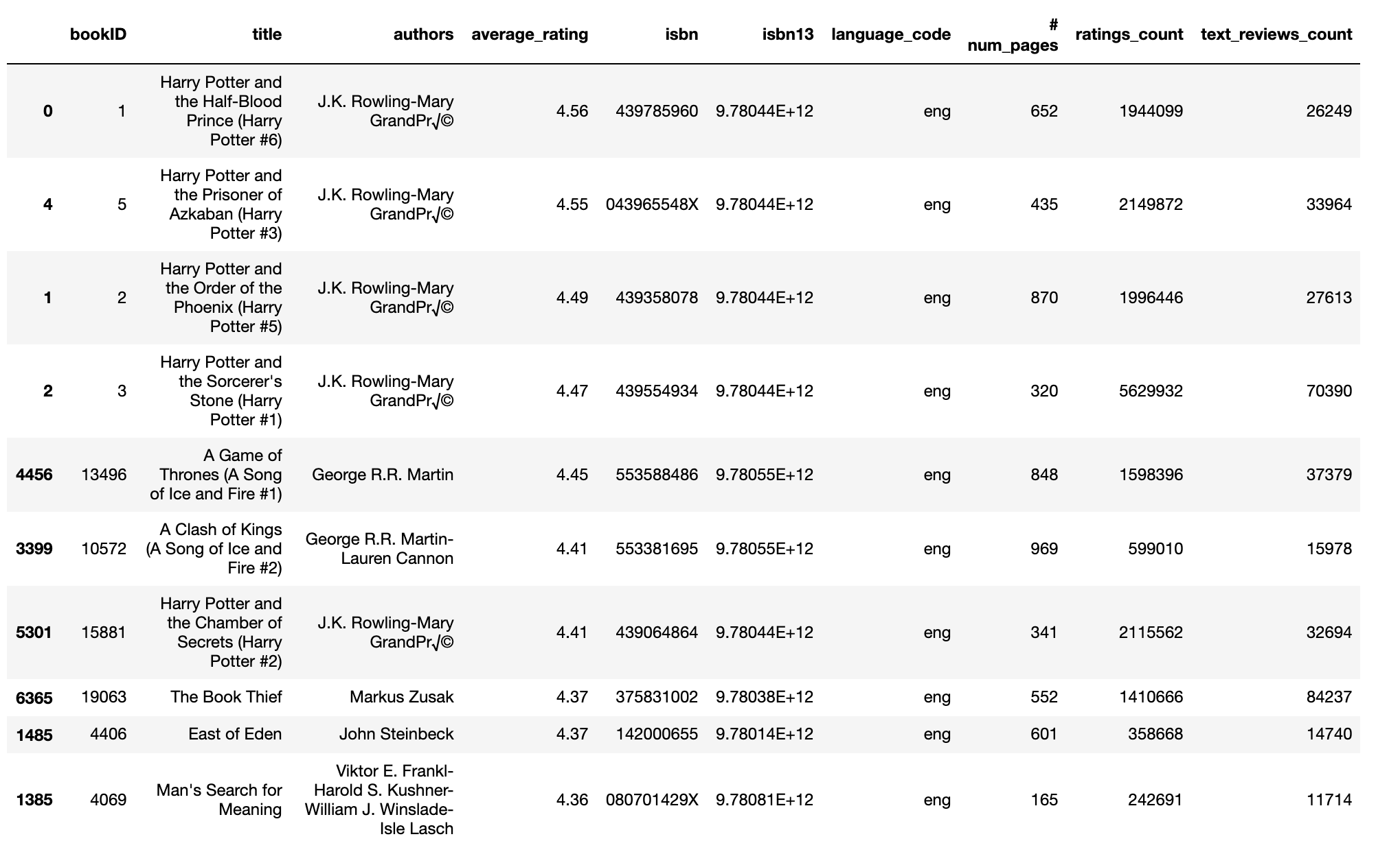
Find the top 10 books that receive over 10,000 reviews have the highest average ratings
Harry Potter series is still the champion, followed by A Song of Ice and Fire

Slide 11
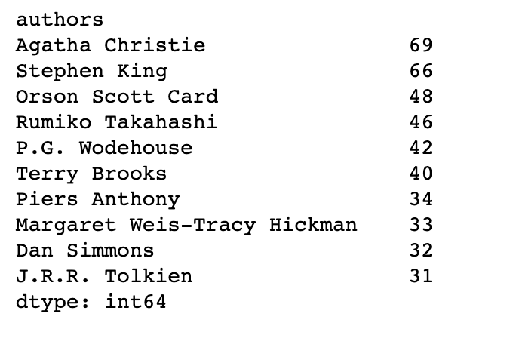
Find top 10 authors wrote most number of books
Agatha Christie, Stephen King and Orson Scott Card
are the most productive authors.

Slide 12
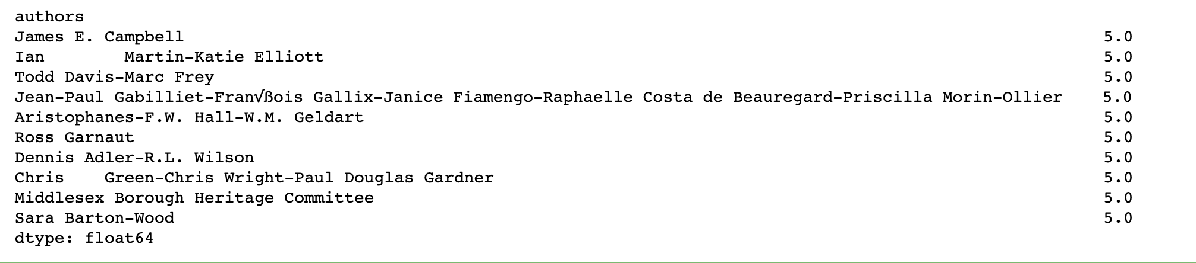
Find top 10 authors with highest average ratings of his all written books
From the result, we can infer that maybe these authors have less written book numbers but receive highest ratings from his written books.

Slide 13
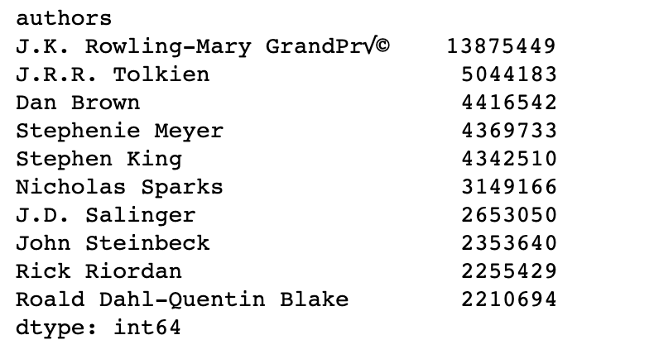
Find top 10 authors who have the most total number of ratings from his all books
JK Rowling received nearly as twice number of ratings as the 2nd place author did. She is the most popular author from the result given. In addition, the novelists are most welcomed by readers, so do their books.

