Slide 1
RVD2: An ultra-sensitive variant detection model for low-depth heterogeneous next-generation sequencing data
Yuting He
Advisor: Professor Flaherty
Biomedical Engineering, WPI
Notes:
Good afternoon, everyone! My name is Yuting He. It’s a great honor to have you all here attending my introduction presentation for my thesis project. I really appreciate that you can make your time from your very busy schedule to be here, and you care enough to serve my committee. Thank you very much. So today I would like to present to you an ultra-sensitive variant detection model recently developed in our lab, RVD2, which is able to detect rare mutations in heterogeneous next-generation sequencing data.

Slide 2
Outline
Background
Single-nucleotide polymorphism (SNP)
Next-Generation Sequencing technology
Synthetic DNA sequence Data
Methodology
Graphical Model
Metropolis-within-Gibbs sampling
Bayesian Posterior Density Test
Results
Synthetic DNA sequence Data
HCC1187 PAXIP1 sequence Data
Future work

Slide 3
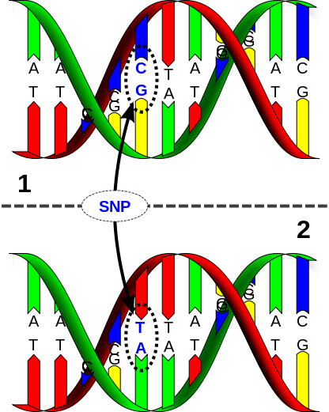
Background
Single-nucleotide polymorphism (SNP)
A Single Nucleotide — A, T, C, or G —
in the genome differs between members
of a biological species or paired chromosomes.
Application of ultra-sensitive variant detection
Rare cancer-specific mutations in primary tumors
Microbial or viral population sequencing
…
Notes:
these genetic variations underlie differences in our susceptibility to disease. The severity of illness and the way our body responds to treatments are also manifestations of genetic variations

Slide 4
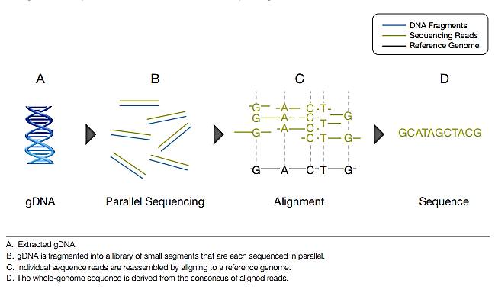
Next-Generation DNA Sequencing
Massive parallel sequencing: 1 million to 43 billion short reads.
High throughput: One billion bases of sequence data in 27hours for approximately $1000.
Notes:
Prequisist commercially available since 2005;
These technologies use miniaturized and parallelized platforms for sequencing of 1 million to 43 billion short reads (50-400 bases each) per instrument run.
With next-generation DNA sequencing technologies, one can interrogate a specific genomic region of interest at very high depth of coverage and identify less prevalent rare mutation in clinical samples.
Deep sequencing analysis with very high coverage on smaller targeted regions can sensitively detect less prevalent, minor alleles and mutations from admixed samples.

Slide 5
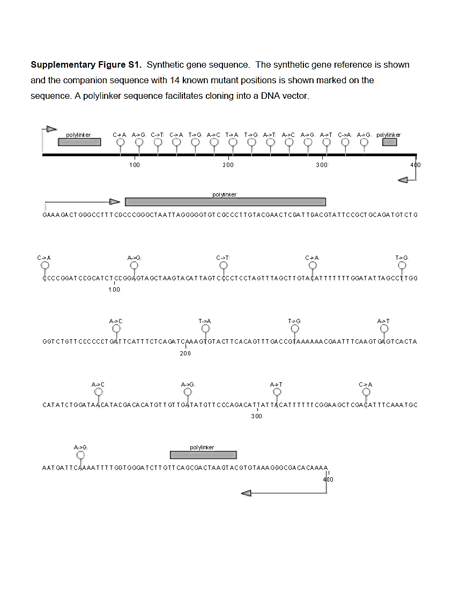
Synthetic DNA Sequence Dataset
(a)
(b)
Synthetic Gene (WT)
Synthetic Gene
(Containing 14 mutations)
PCR & quantitate
PCR & quantitate
Mix in Known proportion and split in three technical replicates
Concatenate and fragment
Fig. a) Synthetic gene sequence;
b) Sequencing experiment design
End-repair and A-tail
Ligate Indexed adapters and PCR enrich
Paired end sequencing 40 by 40 bases on Illumina GAIIX
Notes:
Two versions of a 300-bp completely synthetic sequence were synthesized, which differ by a single base substitution in 14 positions spaced 20 bases apart.

Slide 6
Synthetic DNA Sequence Data
Two 400bp DNA sequences that are identical except at 14 positions spaced 20 bases apart;
MAFs: 0.1%, 0.3%, 1%, 10%, and 100%;
Three replicates and pair ended sequenced
Normal-tumor paired dataset
Notes:
Two versions of a 300-bp completely synthetic sequence were synthesized, which differ by a single base substitution in 14 positions spaced 20 bases apart.

Slide 7
Synthetic DNA Depth Matrix

Slide 8
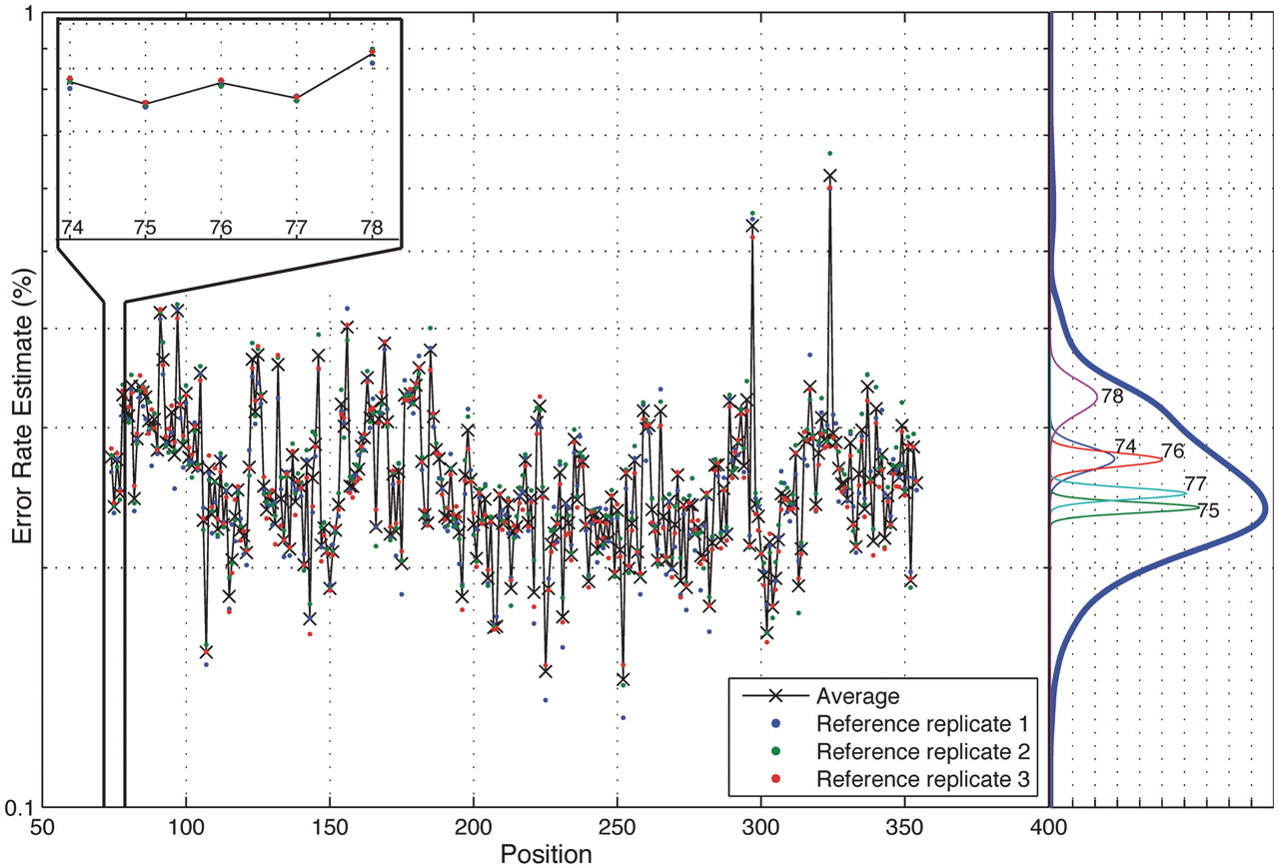
Position-specific error rate
Figure. Position-specific error rate distribution.
Notes:
Position-specific error rate distribution. The average sequence error rate variance across positions is significantly greater than the average variability at each position. The across-position distribution is shown on the right side in dark blue and a sample of five within-position density estimates is shown below it. The empirical within-position and across-position distribution estimates show that a small number of outlying positions contribute to the excessive variance in the across-position distribution.

Slide 9
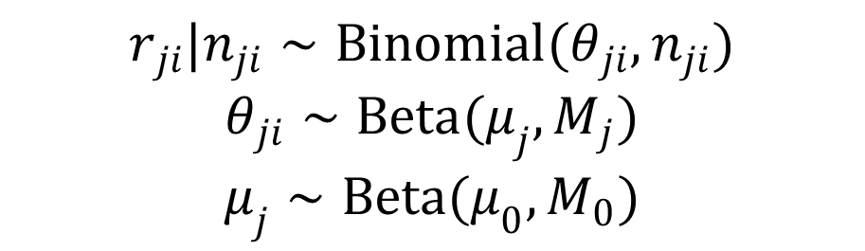
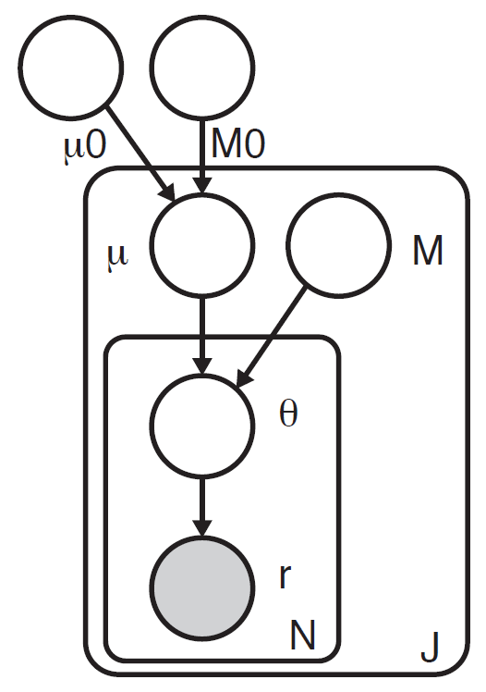
Model Structure
Fig. 1. Position-specific error rate distribution.
Fig. 2. RVD2 Graphical Model

Slide 10
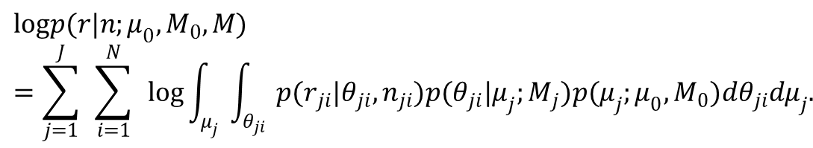
Bayesian Inference
The joint distribution over the latent and observed variables：
The log-likelihood of the data set is
$$logp(r|n;μ_{0},M_{0},M)=\sum_{j=1}^{J}{ }\sum_{i=1}^{N}{ }log\int_{μ_{j}}{ }\int_{θ_{ji}}{ }p(r_{ji}|θ_{ji},n_{ji})p(θ_{ji}|μ_{j};M_{j})p(μ_{j};μ_{0},M_{0})dθ_{ji}dμ_{j}.$$
Notes:
The joint distribution over the latent and observed variables for data at location j in replicate I given the parameters can be factorized as

Slide 11
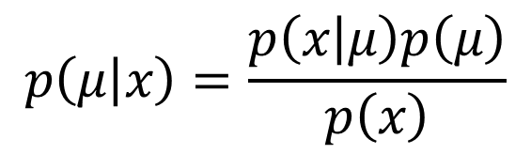

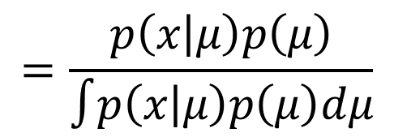
Bayes’ Theorem
How to obtain posterior distribution of variable $μ$ for each position in order to do inference?
$$p\left(μ | x\right)=\frac{p\left(x | μ\right)p\left(μ\right)}{p\left(x\right)}$$
$$=\frac{p\left(x | μ\right)p\left(μ\right)}{∫p\left(x | μ\right)p\left(μ\right)dμ}$$
No close form
$$∝p(x|μ)p(μ)$$
Likelihood
Prior
Notes:
In statistics and in statistical physics, Gibbs sampling or a Gibbs sampler is a Markov chain Monte Carlo (MCMC) algorithm for obtaining a sequence of observations which are approximated from a specified multivariate probability distribution (i.e. from the joint probability distribution of two or more random variables), when direct sampling is difficult. This sequence can be used to approximate the joint distribution (e.g., to generate a histogram of the distribution); to approximate the marginal distribution of one of the variables.
Gibbs sampling is applicable when the joint distribution is not known explicitly or is difficult to sample from directly, but the conditional distribution of each variable is known and is easy (or at least, easier) to sample from.

Slide 12
M-H sampling from $p(μ_{j}|θ_{ji},M_{j},μ_{0},M_{0})$
Metropolis-Hasting sampling is a Markov chain Monte Carlo (MCMC) algorithm.
$$p(μ_{j}|θ_{ji},M_{j},μ_{0},M_{0})∝p(μ_{j}|μ_{0},M_{0})p(θ_{ji}|μ_{j},M_{j})$$

Slide 13
Gibbs sampling from $p(θ_{ji}|r_{ji},n_{ji},μ_{j},M_{j})$
Gibbs sampling is a Markov chain Monte Carlo (MCMC) algorithm for obtaining a sequence of observations which are approximated from a specified multivariate probability distribution when direct sampling is difficult. This sequence can be used to approximate the joint distribution of two or more random variables.
Conditional distribution of each variable is known and is easy to sample from.
$$p(θ_{ji}|r_{ji},n_{ji},μ_{j},M_{j})∼Beta(r_{ji}+M_{j}μ_{j},n_{ji}+M_{j}−r_{ji}−M_{j}μ_{j})$$
Notes:
In statistics and in statistical physics, Gibbs sampling or a Gibbs sampler is a Markov chain Monte Carlo (MCMC) algorithm for obtaining a sequence of observations which are approximated from a specified multivariate probability distribution (i.e. from the joint probability distribution of two or more random variables), when direct sampling is difficult. This sequence can be used to approximate the joint distribution (e.g., to generate a histogram of the distribution); to approximate the marginal distribution of one of the variables
Gibbs sampling is applicable when the joint distribution is not known explicitly or is difficult to sample from directly, but the conditional distribution of each variable is known and is easy to sample from.

Slide 14
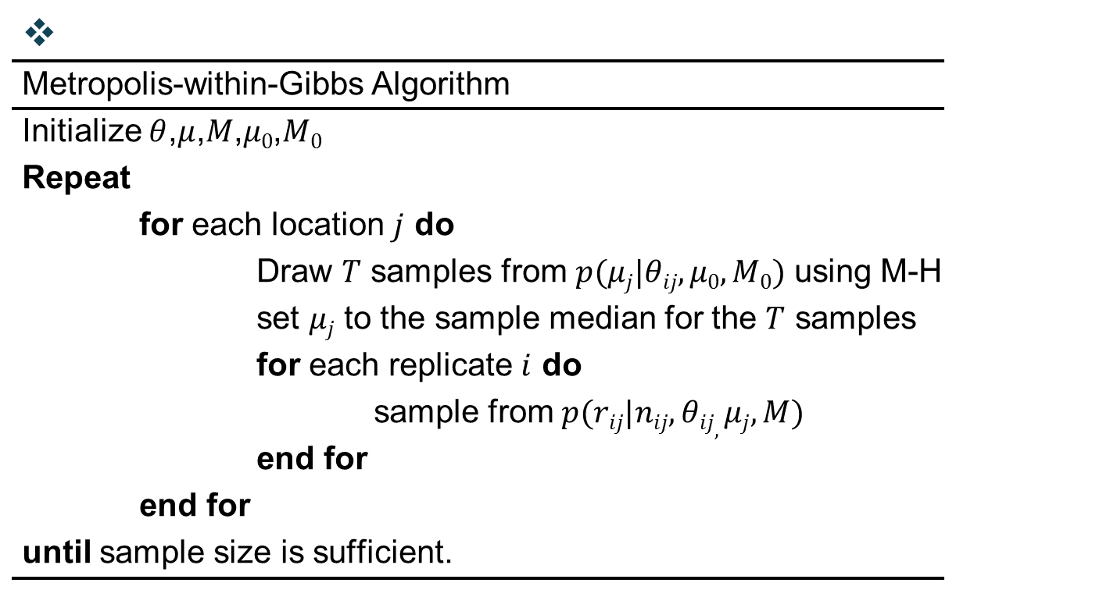

$$p(θ_{ji}|r_{ji},n_{ji},μ_{j},M_{j})∼\text{Beta}(r_{ji}+M_{j}μ_{j},n_{ji}+M_{j}−r_{ji}−M_{j}μ_{j})$$
$$p(μ_{j}|θ_{ji},M_{j},μ_{0},M_{0})∝p(μ_{j}|μ_{0},M_{0})p(θ_{ji}|μ_{j},M_{j})$$

Slide 15
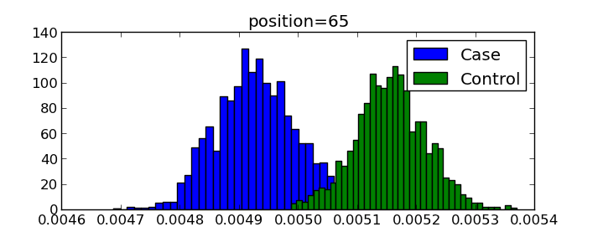
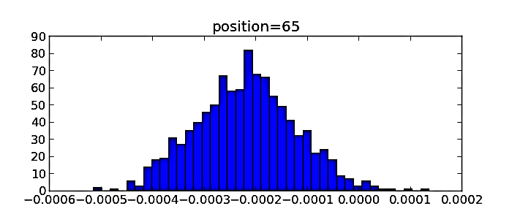



Bayesian Posterior Distribution Testing
$${\overset{ }{μ}}_{j}^{\text{case}}>{\overset{ }{μ}}_{j}^{\text{control}}$$
A variant is called if with high confidence,
Where $τ$ is a detection threshold and $1−α$ is a confidence level.
frequency
$${\overset{\sim }{μ}}_{j}^{}$$
$${\overset{\sim }{μ}}_{j}^{Δ}≜{\overset{\sim }{μ}}_{j}^{case}−{\overset{\sim }{μ}}_{j}^{control}$$
Histograms of posterior distribution
Notes:
Metropolis-within-Gibbs provides samples from the posterior distribution of $\mu_j$ given the case or control data. For notational simplicity, we define the random variables associated with these two distributions $\mu_j^{\text{case}}$ and $\mu_j^{\text{control}}$ and the associated samples as $\tilde{\mu}_j^{\text{case}}$ and $\tilde{\mu}_j^{\text{control}}$.

Slide 16
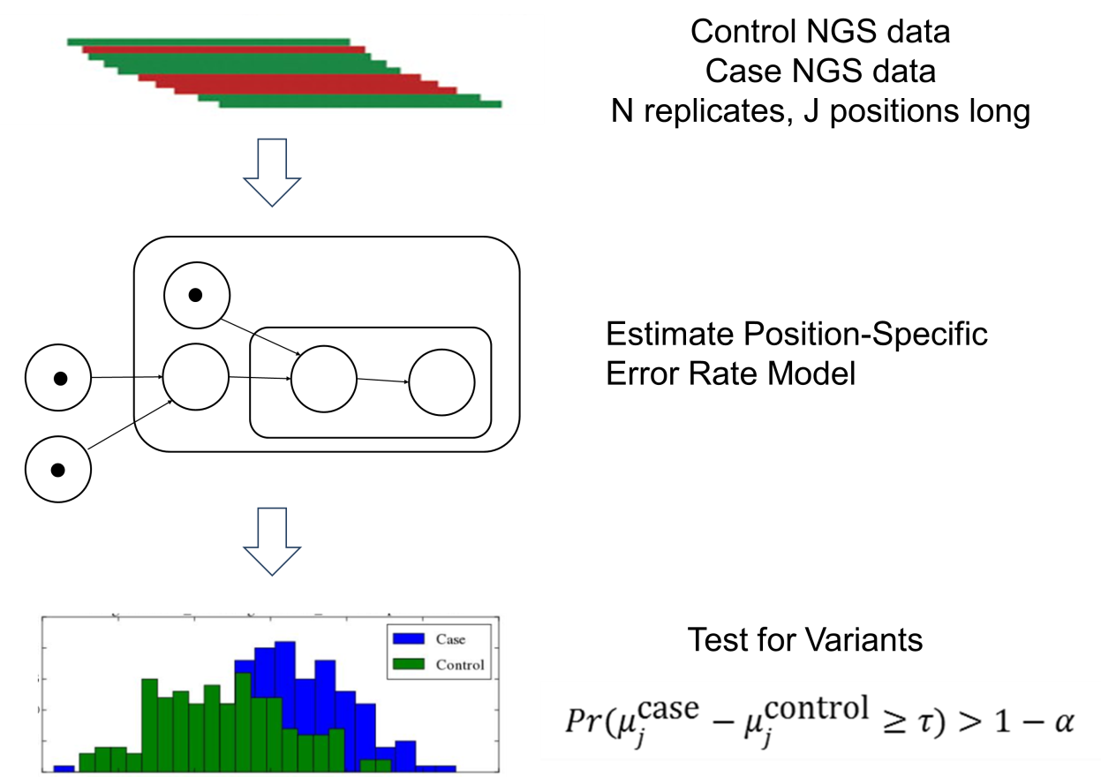
Methodology
Fig. Method Flowchart
Notes:
RVD2 uses a two-stage approach for detecting rare variants. First, it estimates the parameters of a hierarchical Bayesian model under two sequencing data sets: one from the sample of interest (case) and one from a known reference sample (control). Then, it tests for a significant difference between key model parameters in the case and control samples and returns called variant positions.

Slide 17
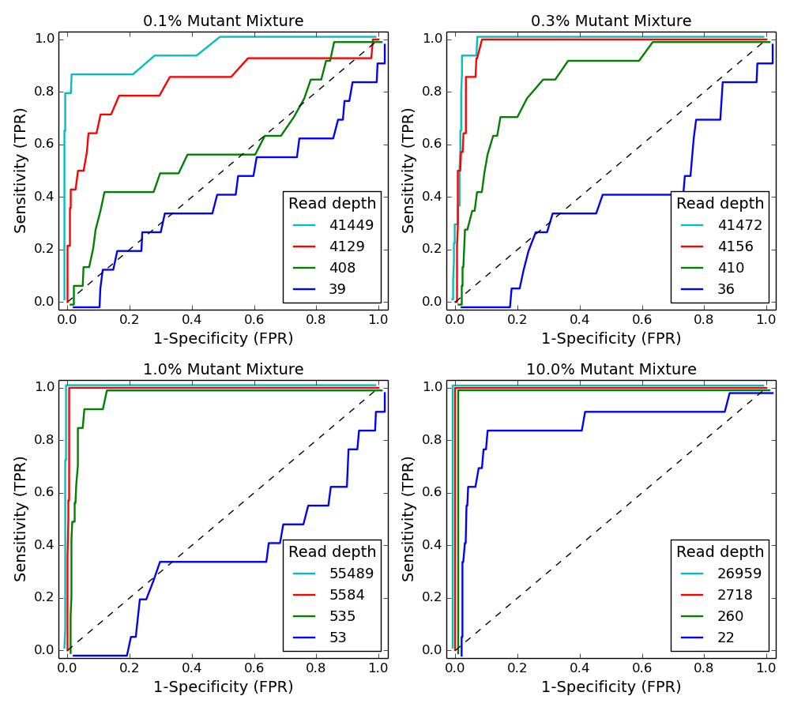
Result – Performance with read depth
Fig. ROC curve varying read depth showing detection performance of RVD2 in synthetic data
Notes:
We generated receiver-operating characteristic curves (ROCs) for a range of median read depth and a range of minor allele frequencies (MAFs). For these ROC curves, we used the posterior distribution test without the $\chi^2$ test. Adding the $\chi^2$ improves specificity at the expense of sensitivity. Figure~\ref{fig:ROC} shows ROC curves generated by varying the threshold $\tau$ with a fixed $\alpha=0.05$. Figure~\ref{fig:ROC}A shows ROC curves for a true 0.1\% MAF for a range of median coverage depths. At the lowest depth the sensitivity and specificity is no better than random. However, we would not expect to be able to call a 1 in 1000 variant base with a coverage of only 43. The performance improves monotonically with read depth. Figures~\ref{fig:ROC}B-C show a similar relationship between coverage depth and accuracy for higher MAFs.

Slide 18
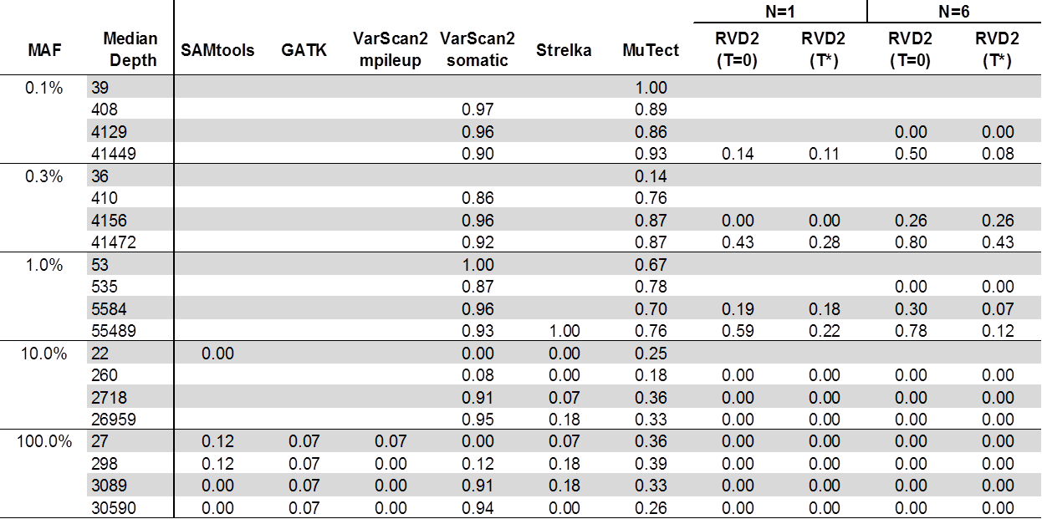
Result – Performance compared with other algorithms
Table 1. False discovery rate comparison of RVD2 with other variant calling algorithms. Blank cells indicate no locations were called variant.
Notes:
Samtools performs well on 100\% MAF sample and performance improves for read depths 3,089 and 30,590. GATK performs well on both the 10\% and 100\% variants, but makes a false positive call at the 100\% MAF level for all read depth levels. VarScan2-pileup performs perfectly for all but the lowest depth for the 100\% MAF.

Slide 19
Result – Performance compared with other algorithms
Table 1. False discovery rate comparison of RVD2 with other variant calling algorithms. Blank cells indicate no locations were called variant.
Notes:
VarScan2-somatic is able to make calls for all but the lowest MAF and coverage level. However, the FDR is high due to many false positives. Interestingly, at a MAF of 100\% the FDR is zero for lowest read depth and over 0.9 for the highest read depth. Strelka has a better FDR than the samtools, GATK or Varscan2-somatic algorithms for almost all read depths at the 10\% and 100\% MAF. However, it does not call any variants at or below 1\% MAF. MuTect has the best FDR performance of the other algorithms we tested over a wide range of MAF and depths. But the FDR level is relatively high at around 0.7 for 0.1\% -- 1\% MAF and 0.3 for 10\% -- 100\% MAF.

Slide 20
Result – Performance compared with other algorithms
Table 1. False discovery rate comparison of RVD2 with other variant calling algorithms. Blank cells indicate no locations were called variant.
Notes:
RVD2 has a lower FDR than other algorithms when the read depth is greater than $10\times$ the MAF with $N=1$ and $\tau$ set to the default value of zero or to the optimal value. The FDR is higher when $N=6$ because the variance of the control error rate distribution $P(\mu_j^{\text{control}} | r^{\text{control}})$ is smaller. The smaller variance yields improvements in sensitivity at the expense of more false positives. Since the FDR only considers positive calls, the performance degrades.

Slide 21
HCC1187 PAXIP1 gene data
The HCC1187 dataset is a well-recognized baseline dataset from Illumina for evaluating sequence analysis algorithms.
The HCC1187 cell line was derived from epithelial cells from primary breast tissue from a 41 y/o adult with TNM stage IIA primary ductal carcinoma.
Matched normal cells were derived from lymphoblastoid cells from peripheral blood.
The estimated tumor purity was reported to be 0.8.
The aligned data had an average read depth of 40x for the normal sample and 90x for the tumor sample with about 96% coverage with 10 or more reads.

Slide 22
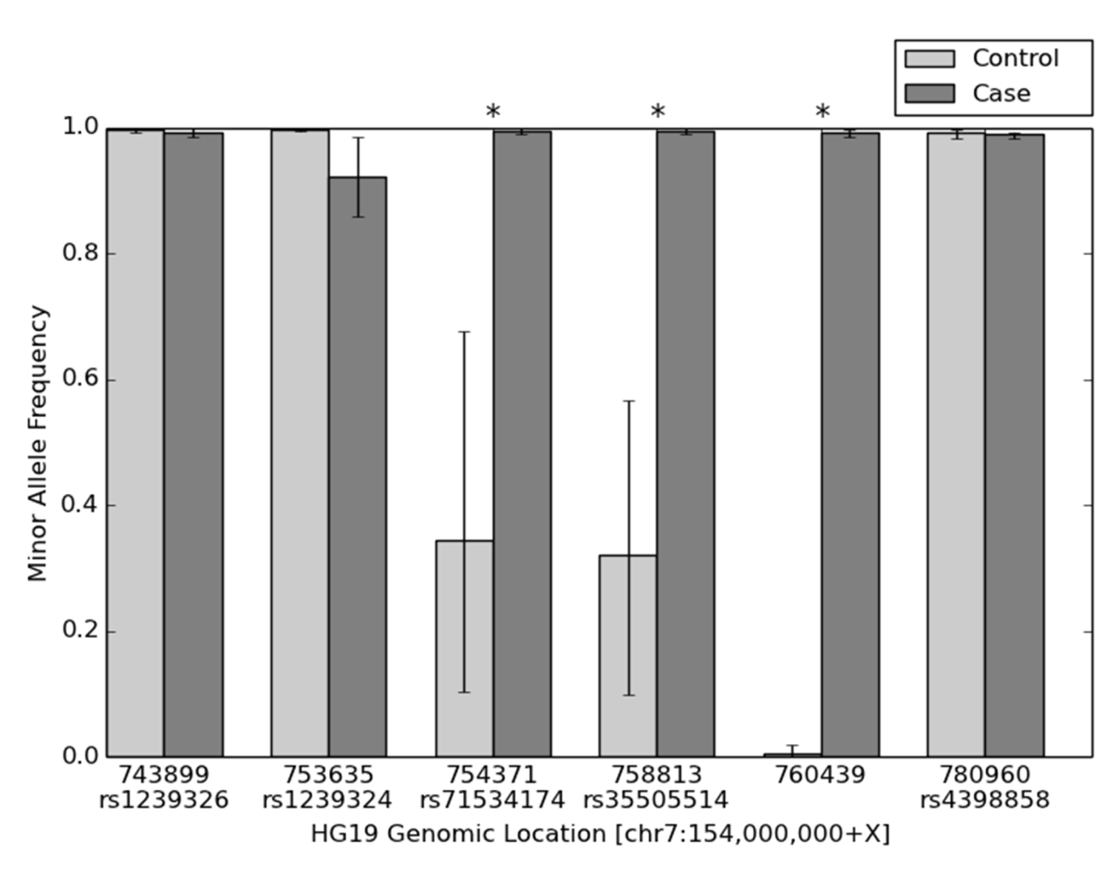

Result: Performance with clinical dataset
Fig. Estimated minor allele fraction for called variants in HCC1187 PAXIP1 gene. Star(*) indicates
$$μ_{j}^{\text{case}}−μ_{j}^{\text{control}}≥τ$$
Notes:
RVD2 identified six variants in the 44kbp PAXIP1 gene from chr7:154738059 to chr7:154782774. Of the six called variants, three were homozygous germline variants and two were heterozygous germline variants. The two heterozygous variants had a loss-of-heterozygosity in the tumor sample. The remaining one is a homozygous somatic variant. Because the median read depth for the case sample is 60, we set the threshold of the test for $\mu^\Delta$ to $\tau = 16\%$ to minimize the false discovery rate (Figure~\ref{tbl:comparison_fdr}).

Slide 23
Future work
Perfect the algorithm
Initialization
Model structure
Implement variational approximation to reduce time complexity
Try other datasets

Slide 24
References
Alkan, C., Kidd, J. M., Marques-Bonet, T., Aksay, G., Antonacci, F., Hormozdiari, F., Kitzman, J. O., Baker, C., Malig, M., Mutlu, O., Sahinalp, S. C., Gibbs, R. A., and Eichler, E. E. (2009). Personalized copy number and segmental duplication maps using next-generation sequencing. Nature Genetics, 41(10), 1061–1067.
Allen, E. (2013). Molecular characterization of tumors using next-generation seque- ncing. Technical Report 770-2013-011, 2013 Illumina, Inc.
Benjamini, Y. and Hochberg, Y. (1995). Controlling the false discovery rate: a practical and powerful approach to multiple testing. Journal of the Royal Statistical Society. Series B (Methodological), pages 289–300.
Capobianchi, M. R., Giombini, E., and Rozera, G. (2012). Next-generation sequencing technology in clinical virology. Clinical Microbiology and Infection, 19(1), 15–22.
Cibulskis, K., Lawrence, M. S., and Carter, S. L. (2013). Sensitive detection of somatic point mutations in impure and heterogeneous cancer samples. Nature.
from 1,092 human genomes. Nature, 490(7422), 56–65.
Consortium, T. H. M. P. (2013). A framework for human microbiome research. Nature,
486(7402), 215–221.
Cressie, N. and Read, T. R. (1984). Multinomial goodness-of-fit tests. Journal of the Royal Statistical Society. Series B (Methodological), pages 440–464.
Cushing, A., Flaherty, P., Hopmans, E., Bell, J. M., and Ji, H. P. (2013). Rvd: a command-line program for ultrasensitive rare single nucleotide variant detection using targeted next-generation dna resequencing. BMC research notes, 6(1), 206.
DePristo, M. A., Banks, E., Poplin, R., Garimella, K. V., Maguire, J. R., Hartl, C., Phi- lippakis, A. A., del Angel, G., Rivas, M. A., Hanna, M., et al. (2011). A framework for variation discovery and genotyping using next-generation dna sequencing data. Nature genetics, 43(5), 491–498.
Efron, B. (2010). Large-scale inference: empirical Bayes methods for estimation, testing, and prediction, volume 1. Cambridge University Press.
Fan, H. C., Blumenfeld, Y. J., Chitkara, U., Hudgins, L., and Quake, S. R. (2008). Noni- nvasive diagnosis of fetal aneuploidy by shotgun sequencing DNA from maternal blood. PNAS, 105(42), 16266–16271.
Fisher, S. R. A., Genetiker, S., Fisher, R. A., Genetician, S., Britain, G., Fisher, R. A., and Ge´ne´ticien, S. (1970). Statistical methods for research workers, volume 14. Oliver and Boyd Edinburgh.
Flaherty, P., Natsoulis, G., Muralidharan, O., Winters, M., Buenrostro, J., Bell, J., Brown, S., Holodniy, M., Zhang, N., and Ji, H. P. (2011). Ultrasensitive dete- ction of rare mutations using next-generation targeted resequencing. Nucleic Acids Research.

Slide 25
Thank You !
Add your company slogan

