Slide 1

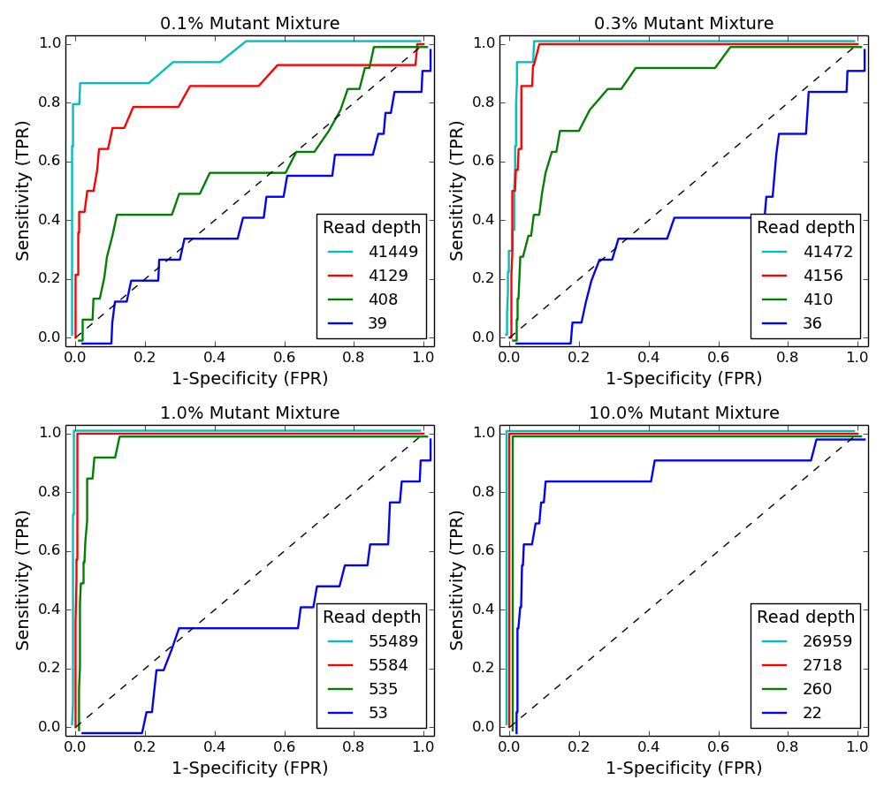
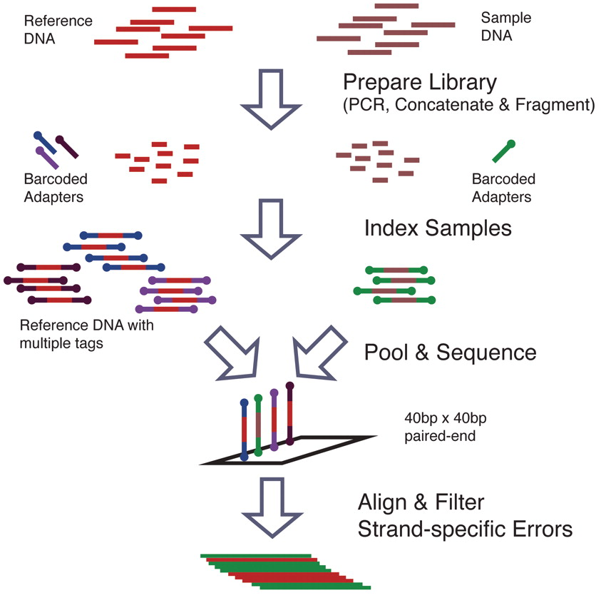
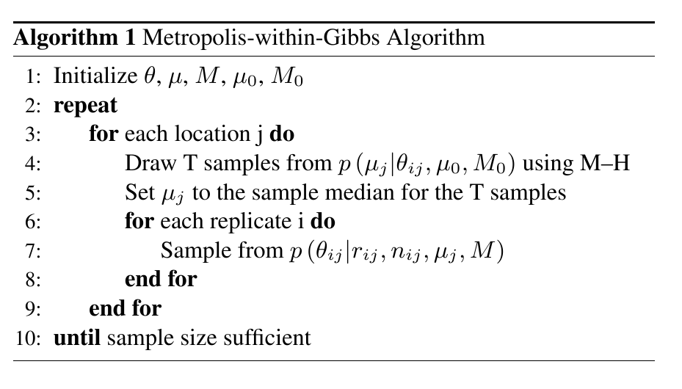
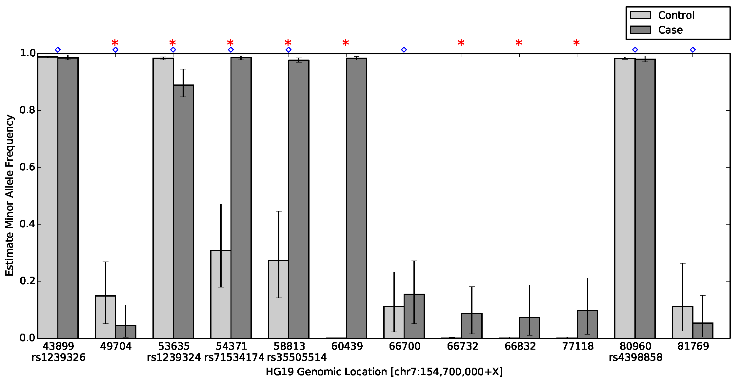
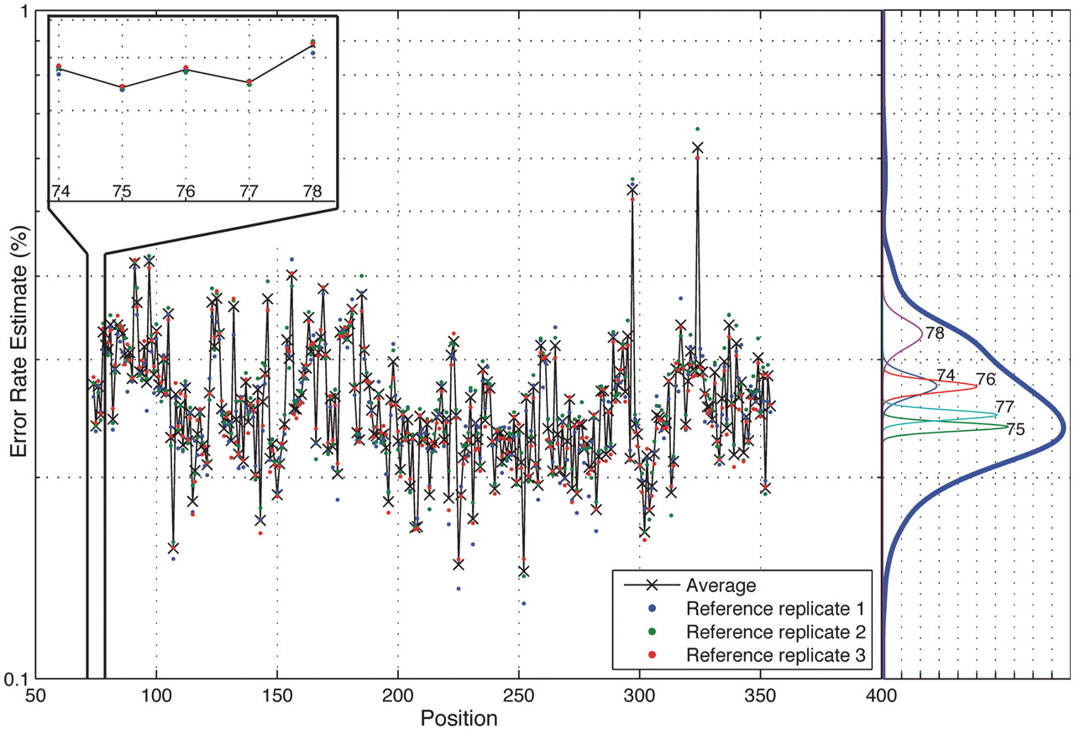
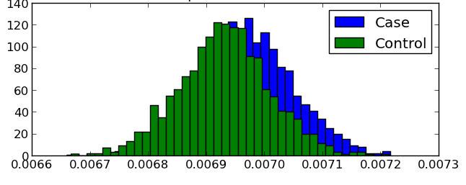
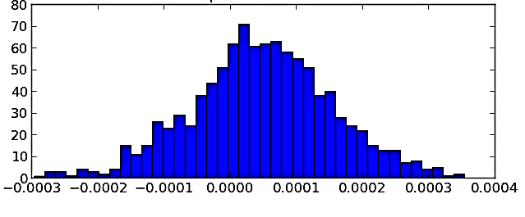
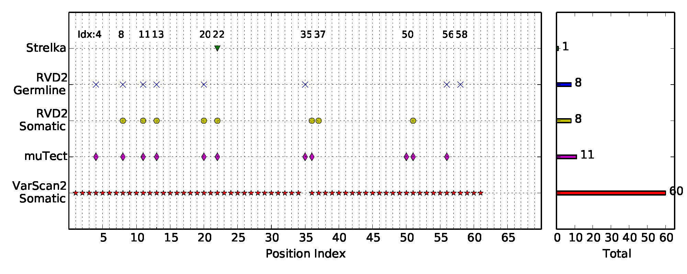
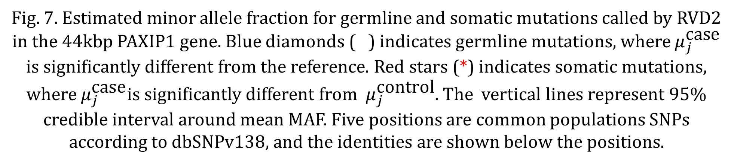


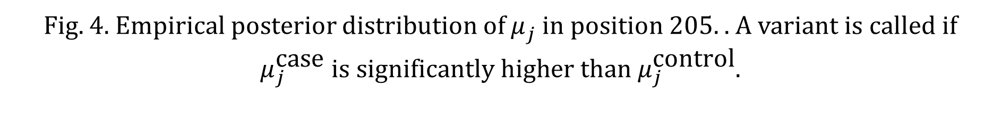


RVD2: An ultra-sensitive variant detection model for
low-depth targeted next-generation sequencing data
Yuting He, Patrick Flaherty
Biomedical Engineering Department , Worcester Polytechnic Institute, Worcester, MA
Abstract
Methodology
Results
Next-generation sequencing technology is increasingly being used for clinical diagnostic tests^{[1-3].} Unlike research cell lines, clinical samples are often genomically heterogeneous due to low sample purity or the presence of genetic subpopulations. However, many variant calling algorithms are optimized to call single nucleotide polymorphisms in homogeneous rather than heterogeneous samples.
We present a novel variant calling algorithm that uses a hierarchical Bayesian model to estimate allele frequency and call variants in heterogeneous samples. Our algorithm improves upon current classifiers and has higher sensitivity and specificity over a wide range of median read depth and minor allele frequency. We identify twelve mutations in the PAXP1 gene in a matched clinical breast ductal carcinoma tumor sample; two of which are loss-of-heterozygosity events.
Overall Process
RVD2 uses a two-stage approach for detecting rare variants. First, it estimates the parameters of the Bayesian model under case sample and control sample independently. Then it tests for a significant difference between key model parameters in the case and control samples and returns called variant positions.
$$r_{ji}|n_{ji}∼\text{Binomial}(θ_{ji},n_{ji})$$
$$θ_{ji}∼\text{Beta}(μ_{j},M_{j})$$
$$μ_{j}∼\text{Beta}(μ_{0},M_{0})$$
Fig. 3.Graphical model for RVD2
Fig. 5. ROC curve varying read depth showing performance of RVD2 in synthetic data
Metropolis-within-Gibbs Sampling
A Metropolis-within-Gibbs sampling procedure was used to estimate the RVD2 model, which can identify the global optimal parameter settings asymptotically.
Dataset
Synthetic DNA Sequence Data
Two 400bp DNA sequences that are identical except at 14 loci with variant bases were labeled as case and control;
MAFs: 0.1%, 0.3%, 1%, 10%, and 100%;
Six replicates for the control and case at each MAF level.
Fig. 6. False discovery rate comparison of RVD2 with other variant calling algorithms using synthetic data. Blank cells indicate no locations were called variant.
Fig. 1. DNA synthesis flow chart.
Bayesian Posterior Density Test
frequency
frequency
$$τ$$
$${\overset{ }{ μ}}_{j}^{ }$$
$$μ_{j}^{\text{case}}−μ_{j}^{\text{control}}$$
Fig. 4. Empirical posterior distribution of ${\overset{ }{μ}}_{j}^{ }$ in position 205. . A variant is called if ${\overset{ }{μ}}_{j}^{\text{case}} is significantly higher than {\overset{ }{μ}}_{j}^{\text{control}}$.
Future work
Fig. 7. Estimated minor allele fraction for germline and somatic mutations called by RVD2 in the 44kbp PAXIP1 gene. Blue diamonds ( ) indicates germline mutations, where ${\overset{ }{μ}}_{j}^{\text{case}}$ is significantly different from the reference. Red stars (*) indicates somatic mutations, where ${\overset{ }{μ}}_{j}^{\text{case}}$is significantly different from ${\overset{ }{μ}}_{j}^{\text{control}}$. The vertical lines represent 95% credible interval around mean MAF. Five positions are common populations SNPs according to dbSNPv138, and the identities are shown below the positions.
Develop a variational approach to estimate RVD2 model aiming at improving time efficiency;
Improve the model structure for RVD2
Apply RVD2 to various clinical dataset.
Fig. 2. Position-specific error rate distribution.
References
HCC1187 Sequence Data^{[4]}
[1] Kitzman, Jacob O., et al. "Noninvasive whole-genome sequencing of a human fetus." Science translational medicine 4.137 (2012): 137ra76-137ra76.
[2] Capobianchi, M. R., E. Giombini, and G. Rozera. "Next‐generation sequencing technology in clinical virology." Clinical Microbiology and Infection 19.1 (2013): 15-22.
[3] Navin, Nicholas, et al. "Inferring tumor progression from genomic heterogeneity.“ Genome research 20.1 (2010): 68-80.
[4] Allen, E. “Molecular characterization of tumors using next-generation sequencing. ” Technical Report 770-2013-011, 2013 Illumina, Inc.
Was derived from epithelial cells from primary breast tissue;
Estimated tumor purity: 0.8;
Average read depth 40x to 90x.
Fig. 8. Positions called by VarScan2-somatic, muTect, RVD2 and Strelka in the 44kbp PAXIP1 gene from chr7:154738059 to chr7:154782774. VarScan2-somatic reported 60 positions, muTect 11 positions, RVD2 12 positions and Strelka only 1 position.

