Slide 1

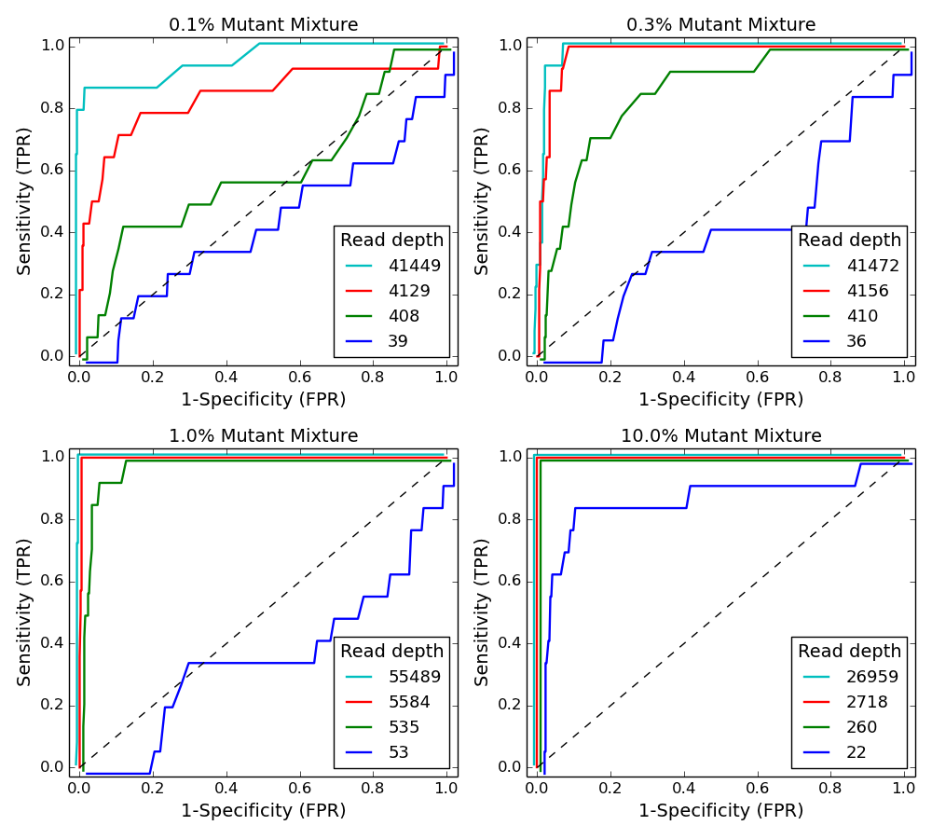
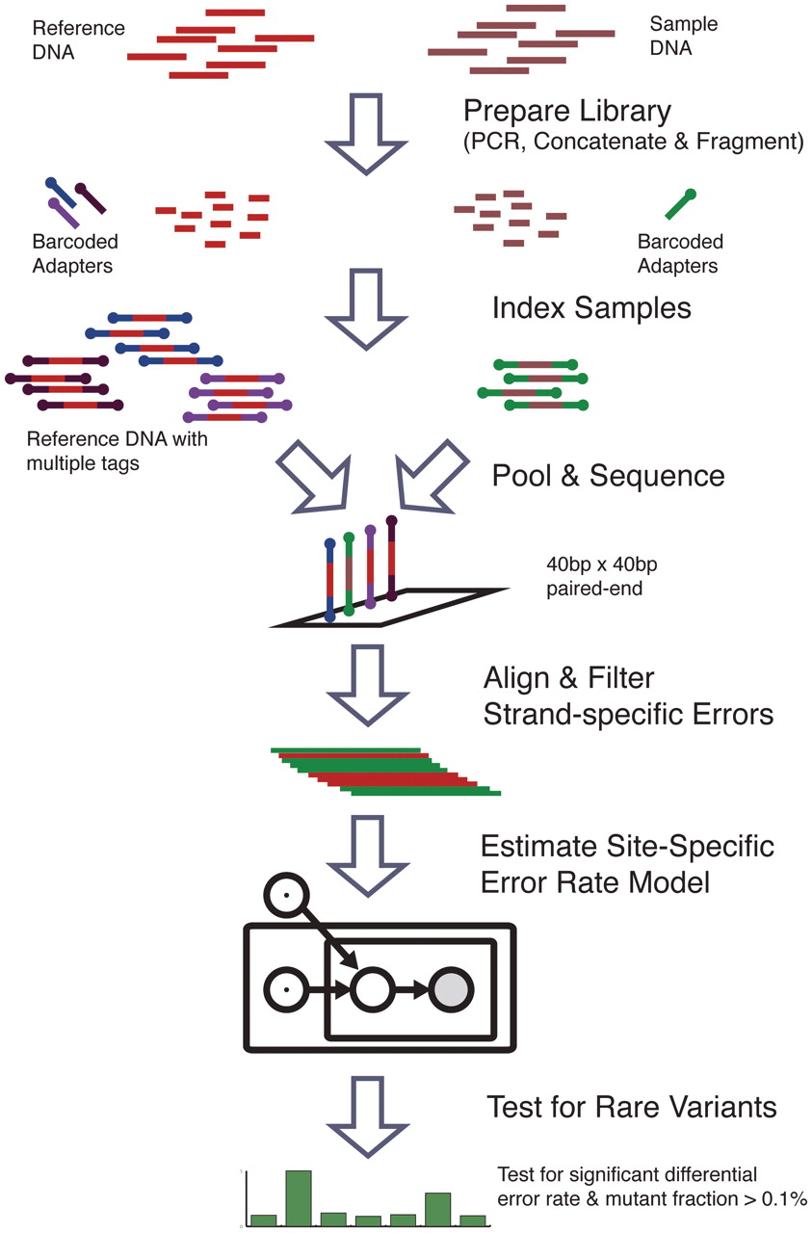
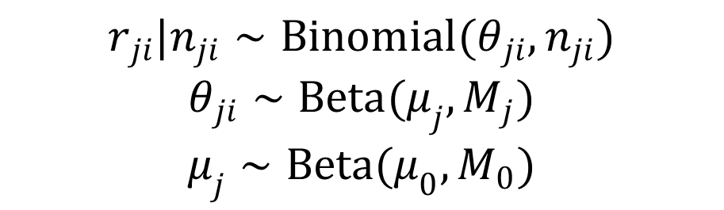
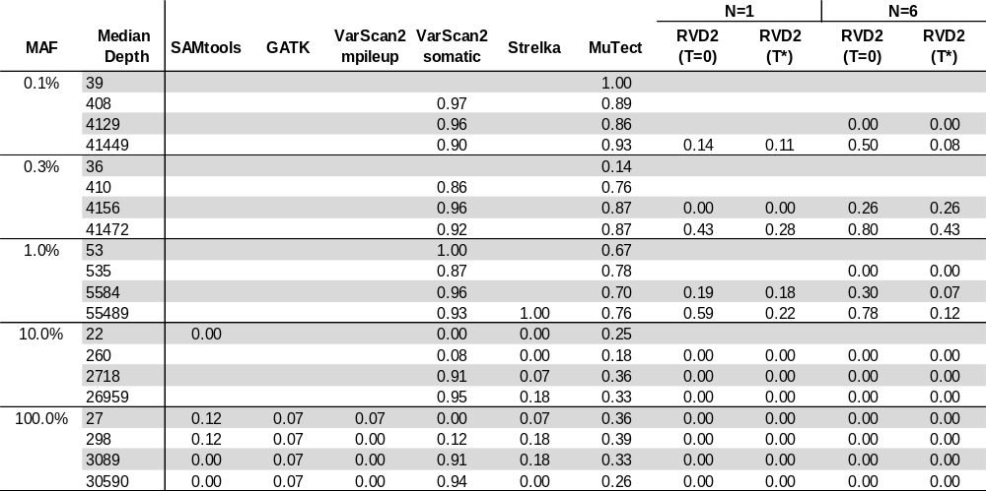
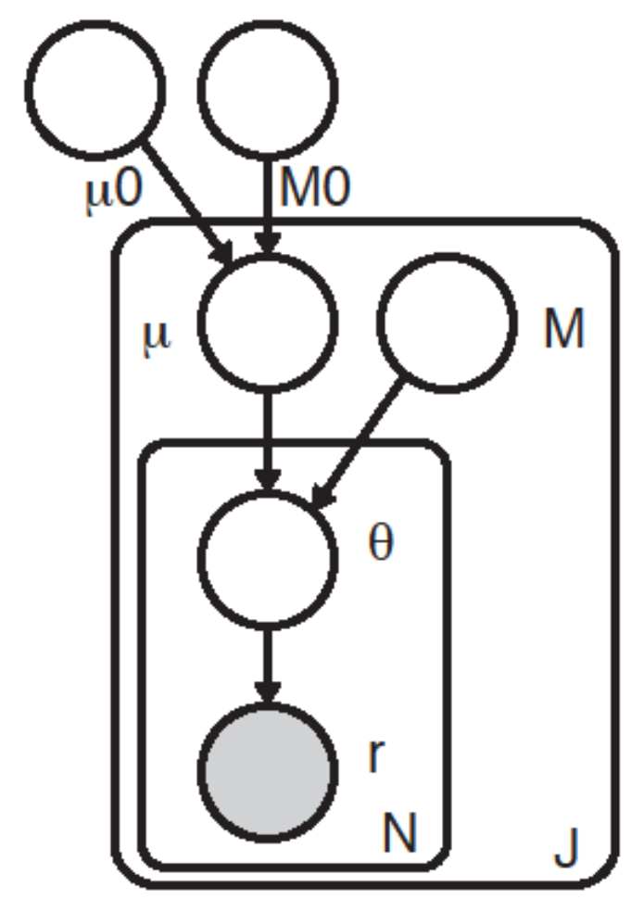
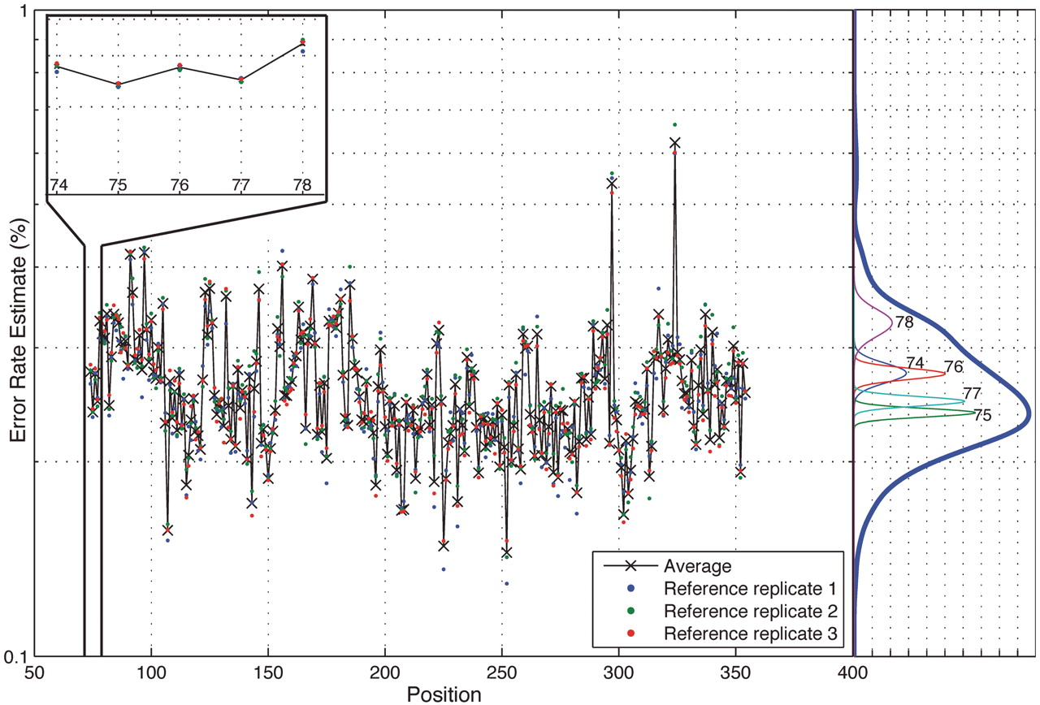
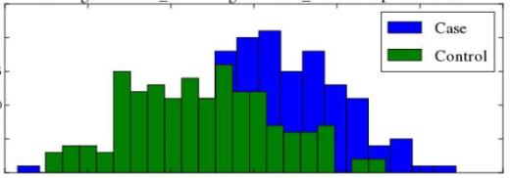

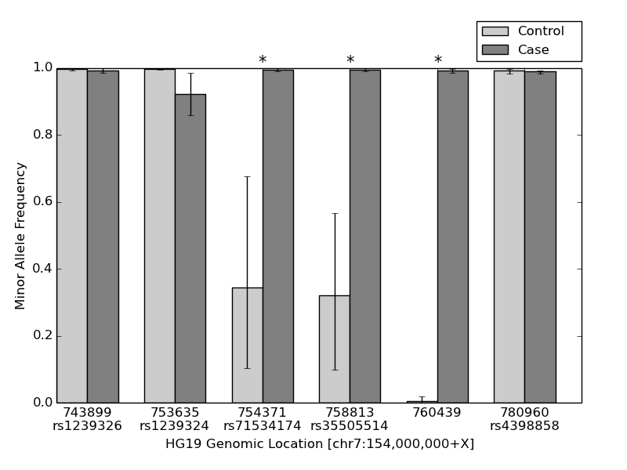
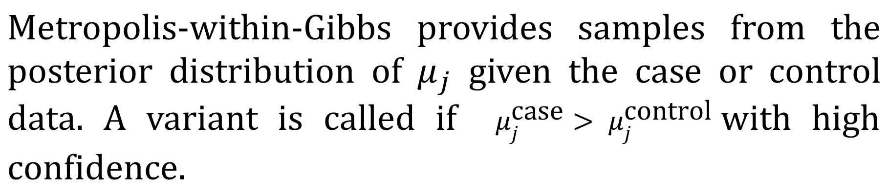
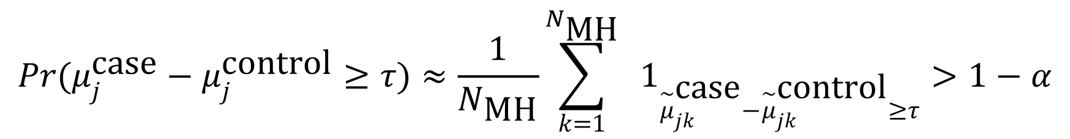
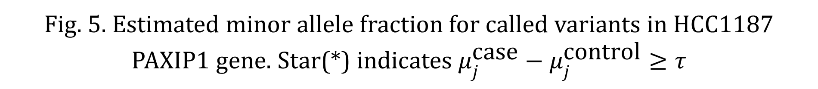
RVD2: An ultra-sensitive variant detection model for
low-depth targeted next-generation sequencing data
Yuting He, Patrick Flaherty
Biomedical Engineering Department , Worcester Polytechnic Institute, Worcester, MA
Abstract
Methodology
Results
Next-generation sequencing technology is increasingly being used for clinical diagnostic tests^{[1-3].} Unlike research cell lines, clinical samples are often genomically heterogeneous due to low sample purity or the presence of genetic subpopulations. However, many variant calling algorithms are optimized to call single nucleotide polymorphisms in homogeneous rather than heterogeneous samples.
We present a novel variant calling algorithm that uses a hierarchical Bayesian model to estimate allele frequency and call variants in heterogeneous samples. Our algorithm improves upon current classifiers and has higher sensitivity and specificity over a wide range of median read depth and minor allele frequency. We identify six mutations in the PAXP1 gene in a matched clinical breast ductal carcinoma tumor sample; two of which are loss-of-heterozygosity events.
RVD2 uses a two-stage approach for detecting rare variants. First, it estimates the parameters of the Bayesian model under sample of interest sequencing data (case) and a known reference sample (control) respectively. Then it tests for a significant difference between key model parameters in the case and control samples and returns called variant positions.
Fig. 3. ROC curve varying read depth showing detection performance of RVD2 in synthetic data
Dataset
Synthetic DNA Sequence Data
Two 400bp DNA sequences that are identical except at 14 loci with variant bases were labeled as case and control;
MAFs: 0.1%, 0.3%, 1%, 10%, and 100%;
Six replicates for the control and case at each MAF level.
Fig. 2. a) Method flowchart; b) Graphical model for RVD2
Metropolis-within-Gibbs Sampling
Fig. 4. False discovery rate comparison of RVD2 with other variant calling algorithms using synthetic data. Blank cells indicate no locations were called variant.
Our inference algorithm uses a Metropolis-within-Gibbs sampling procedure to estimate the RVD2 hierarchical empirical Bayes model, a procedure which is able to identify the global optimal parameter settings asymptotically.
Bayesian Posterior Density Test
Fig. 1. Position-specific error rate distribution.
HCC1187 Sequence Data^{[4]}
Was derived from epithelial cells from primary breast tissue;
Estimated tumor purity: 0.8;
Average read depth 40x to 90x.
References
[1] Kitzman, Jacob O., et al. "Noninvasive whole-genome sequencing of a human fetus." Science translational medicine 4.137 (2012): 137ra76-137ra76.
[2] Capobianchi, M. R., E. Giombini, and G. Rozera. "Next‐generation sequencing technology in clinical virology." Clinical Microbiology and Infection 19.1 (2013): 15-22.
[3] Navin, Nicholas, et al. "Inferring tumor progression from genomic heterogeneity.“ Genome research 20.1 (2010): 68-80.
[4] Allen, E. “Molecular characterization of tumors using next-generation sequencing. ” Technical Report 770-2013-011, 2013 Illumina, Inc.

