Slide 1


Towards Fast Rates for Federated and Multi-Task Reinforcement Learning
Feng Zhu
Department of Electrical and Computer Engineering
North Carolina State University
Advisors: Robert W. Heath Jr., and Aritra Mitra
Notes:
Hi everyone, my name is Feng Zhu and I’m from the Department of Electrical and Computer Engineering of North Carolina State University. It’s a great honor to be here presenting our work of Towards Fast Rates for Federated and Multi-Task Reinforcement Learning. This work is advised by Prof. Aritra Mitra, who’s also from NC state, and Prof. Robert Heath Jr., who’s from UCSD.

Slide 2


What makes RL challenging?
High-dimensional data
Massive state and action spaces
Data hungry algorithms
Proposal: Use data samples from multiple environments.
Autonomous driving
Robotics
Q. Can we reduce the sample-complexity for learning by using data collected from diverse environments in RL?
Notes:
Before we start, we want to raise the question: what makes RL challenging?
Contemporary RL is extremely nontrivial in real-world applications such as autonomous driving and robotics, mainly for the following reasons:
High-dimensional data
Massive state and action spaces
Data hungry algorithms
In light of this, our proposal in this work is: To use data samples from multiple environments.
With this proposal in mind, we ask: Can we reduce the sample-complexity for learning by using data collected from diverse environments in RL?
(In other words, can we expedite the learning process by using data from multiple agents compared to each agent learning alone?)

Slide 3
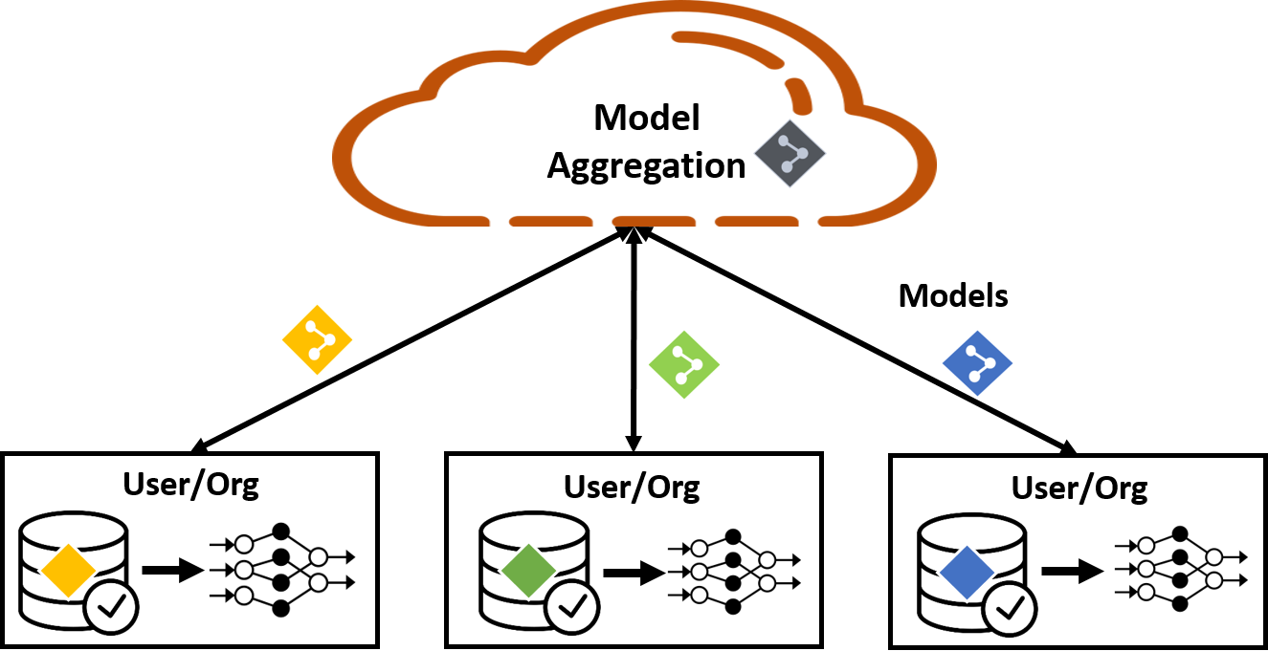
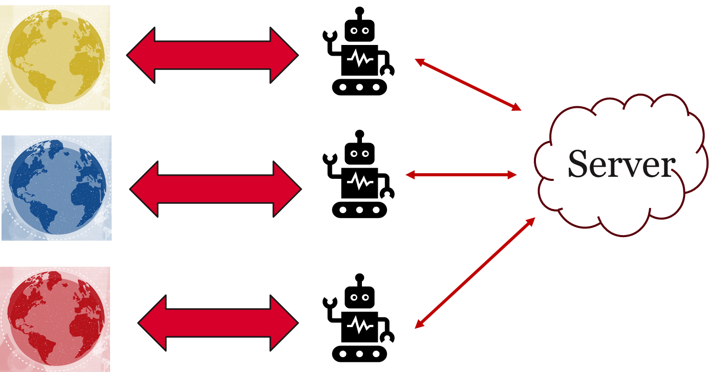
Towards federated reinforcement learning (FRL)
Fig: A typical FL architecture
Collaborative speedups?
Goals:
To learn a policy that can perform well in all environments.
To demonstrate collaborative speedup in the sample-complexity bounds, i.e., multiple agents do help expedite the learning.
Notes:
To answer this question, we make the natural connection between federated learning (FL) and federated reinforcement learning (FRL).
In FL, we have a central server acting as a model aggregator, and several users who update their local models based on their local datasets. The users then upload their computed model gradients to the server for aggregation. This process is then repeated till convergence.
Similarly, for FRL, we also have a central server for model aggregation, and multiple agents interacting with their distinct environments (here, one can interpret the environment as the dataset). The agents also upload the computed models or model differentials to the server for aggregation.
We then ask the natural question: Can we achieve collaborative speedups w.r.t. the # agents in FRL as we do in FL?
So our goals in this work are the following:
To learn a policy that can perform well in all environments.
To demonstrate collaborative speedup in the sample-complexity bounds, i.e., multiple agents do help expedite the learning.

Slide 4
Our contributions
Contribution 1: A novel FRL algorithm Fast-FedPG that performs well under diverse/heterogeneous environments.
Contribution 2: Collaborative speedup w.r.t. the number of agents under the gradient-domination condition (a weaker assumption than strong-convexity).
Contribution 3: Collaborative speedup w.r.t. the number of agents without the gradient-domination condition (non-convex objective).
Notes:
Informally, our contributions can be listed as follows:

Slide 5
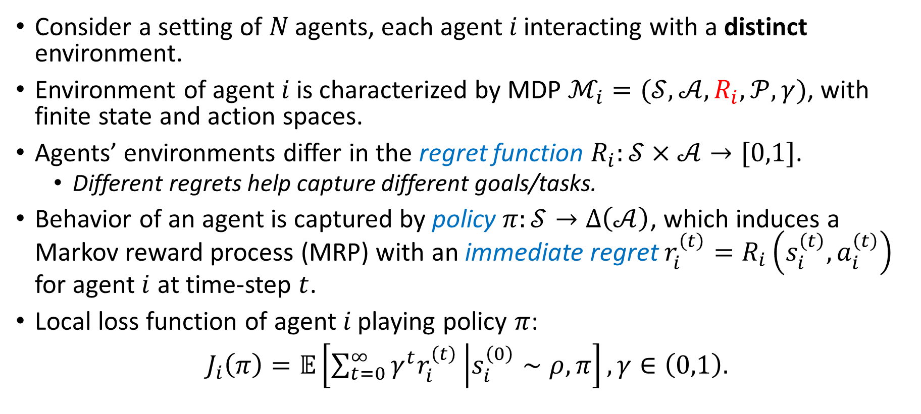
Basic RL setup
Consider a setting of 𝑁 agents, each agent 𝑖 interacting with a distinct environment.
Environment of agent 𝑖 is characterized by MDP $ℳ_{i}=(𝒮,𝒜,R_{i},𝒫,γ)$, with finite state and action spaces.
Agents’ environments differ in the regret function $R_{i}:𝒮×𝒜→[0,1]$.
Different regrets help capture different goals/tasks.
Behavior of an agent is captured by policy $π:𝒮→Δ\left(𝒜\right)$, which induces a Markov reward process (MRP) with an immediate regret $r_{i}^{\left(t\right)}=R_{i}\left(s_{i}^{\left(t\right)},a_{i}^{\left(t\right)}\right)$ for agent $i$ at time-step $t$.
Local loss function of agent 𝑖 playing policy $π$:
$J_{i}\left(π\right)=𝔼\left[\sum_{t=0}^{∞}{γ^{t}r_{i}^{\left(t\right)}} | s_{i}^{\left(0\right)}∼ρ,π\right], γ∈\left(0,1\right).$
Notes:
Before we start, we need to introduce the basic RL setup that is used throughout our work.
We consider a setting of N agents, where each agent I interacts with a distinct environment.
The environment of agent I is then characterized by MDP M_i, with finite state and action spaces.
Here we note that the agents’ environments differ in the regret function R_i, where different regrets help capture different goals or tasks. (Here we make the regret function as the negative reward, just to phrase our analysis in the language of optimization.)
The behavior of an agent is captured by policy $π:𝒮→Δ\left(𝒜\right)$ which induces a Markov reward process (MRP) with an immediate regret $r_{i}^{\left(t\right)}=R_{i}\left(s_{i}^{\left(t\right)},a_{i}^{\left(t\right)}\right)$ for agent $i$ at time-step $t$.
We can then construct the local loss function of agent I by playing policy pi: That is, we take the expectation of the cumulative discounted regret over all the randomness, given the initial state distribution rho, and by playing policy pi throughout.

Slide 6
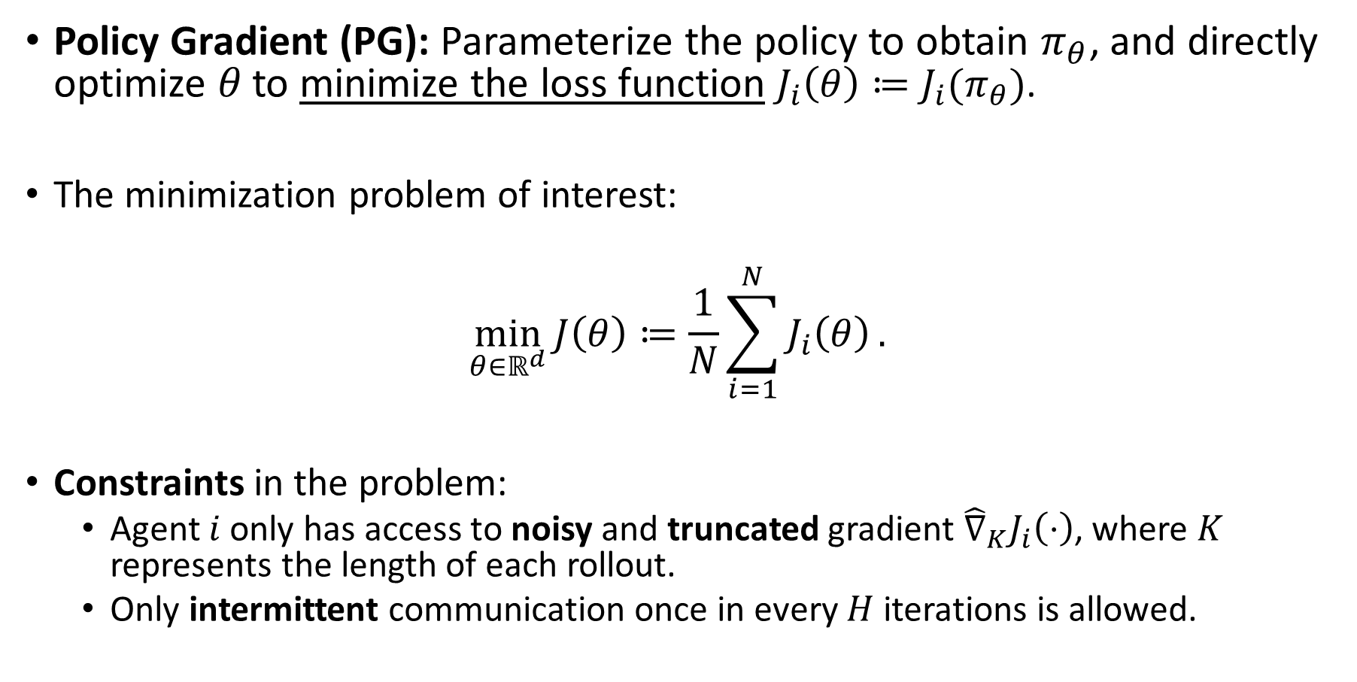
Heterogeneous FRL with PG
Policy Gradient (PG): Parameterize the policy to obtain $π_{θ}$, and directly optimize 𝜃 to minimize the loss function $J_{i}\left(θ\right)≔J_{i}(π_{θ})$.
The minimization problem of interest:
$$\min_{θ∈ℝ^{d}}{J\left(θ\right)≔\frac{1}{N}\sum_{i=1}^{N}{J_{i}\left(θ\right)}}.$$
Constraints in the problem:
Agent $i$ only has access to noisy and truncated gradient ${\hat{∇}}_{K}J_{i}\left(⋅\right)$, where $K$ represents the length of each rollout.
Only intermittent communication once in every $H$ iterations is allowed.
Notes:
In this slide, we introduce the method we use to minimize the loss function, that is the policy gradient method.
The PG method parameterizes the policy to obtain $π_{θ}$, and then we directly optimize 𝜃 to minimize the loss function $J_{i}\left(θ\right)≔J_{i}(π_{θ})$, here we slightly abused the notation.
The minimization problem of interest is then similar to that one used in FL in thousands of papers: To minimize the average loss function J(\theta) across N agents.
We also have the following constraints in the problem:
First, it’s not a perfect world, so agent $i$ only has access to noisy and truncated gradient ${\hat{∇}}_{K}J_{i}\left(⋅\right)$, where $K$ represents the length of each rollout. (Ideally, at each time step, to compute the policy gradient, the agent needs to go over an entire trajectory, which is not practical. Thus, instead of going over infinite horizons, the agent goes over K steps of the trajectory.)
Second, we only allow intermittent communication once in every H iterations between agents and the server to increase communication efficiency, which is consistent with most FL algorithms.

Slide 7
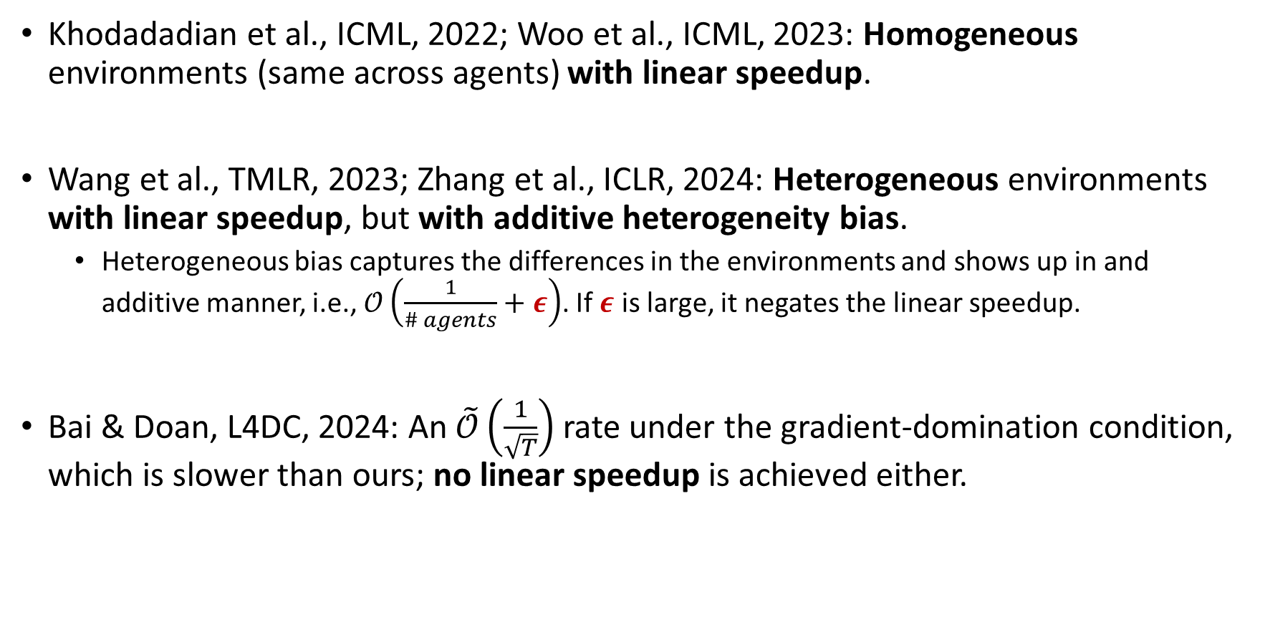
Gaps in the literature of FRL
Khodadadian et al., ICML, 2022; Woo et al., ICML, 2023: Homogeneous environments (same across agents) with linear speedup.
Wang et al., TMLR, 2023; Zhang et al., ICLR, 2024: Heterogeneous environments with linear speedup, but with additive heterogeneity bias.
Heterogeneous bias captures the differences in the environments and shows up in and additive manner, i.e., $𝒪\left(\frac{1}{\# agents}+ε\right)$. If $ε$ is large, it negates the linear speedup.
Bai & Doan, L4DC, 2024: An $\tilde{𝒪}\left(\frac{1}{\sqrt{T}}\right)$ rate under the gradient-domination condition, which is slower than ours; no linear speedup is achieved either.
Q. Can we achieve linear speedup with no additive heterogeneity bias?
Notes:
In this slide, we introduce the gaps in the literature, which are then all bridged by our work.
The papers by Khodadadian and Woo focus on homogeneous environments and they achieved linear speedup.
The papers by Wang and Zhang look at heterogeneous environments. They achieved linear speedup but there is a bias term in their final result due to environmental heterogeneity.
The paper by Bai and Doan is a concurrent work of ours that also focuses on heterogeneous environments, and it demonstrates a 1/\sqrt(T) rate under the g-d condition, which is slower than ours. No linear speedup is achieved either.
So the question here is, Can we achieve linear speedup with no heterogeneity bias?

Slide 8
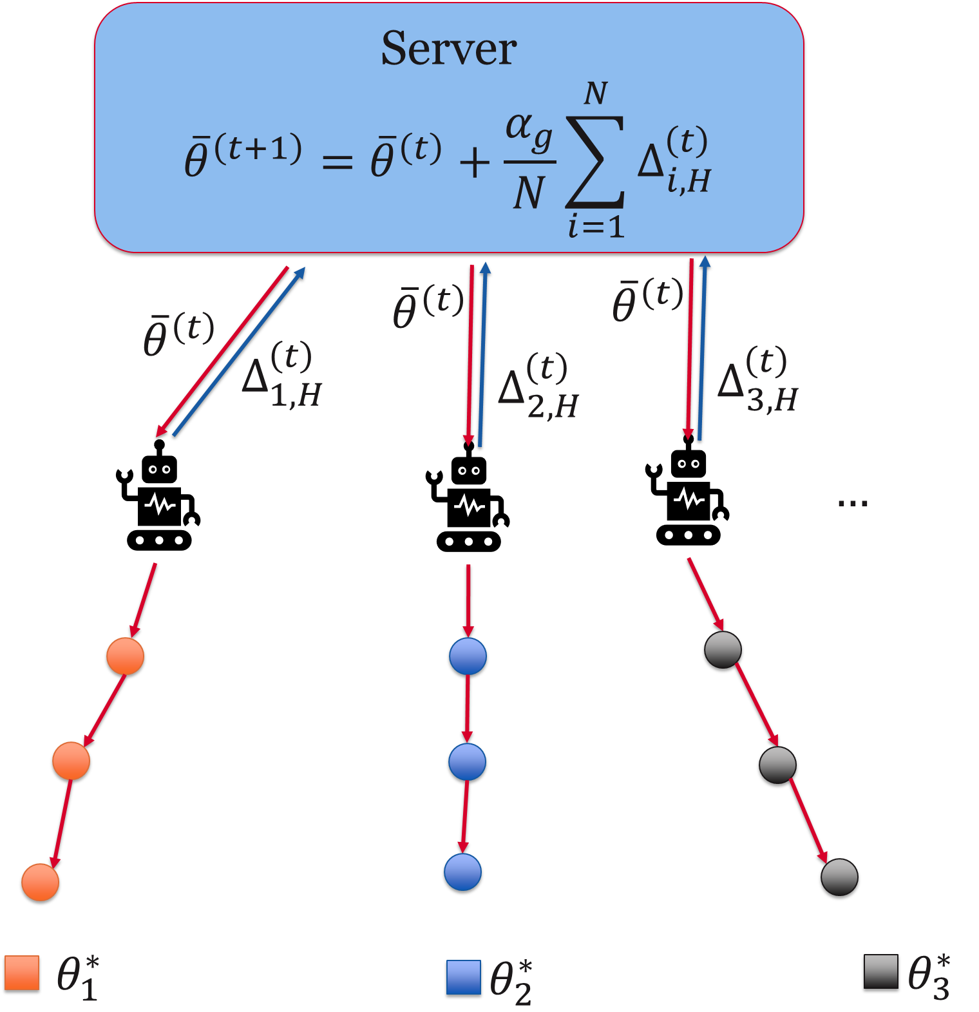
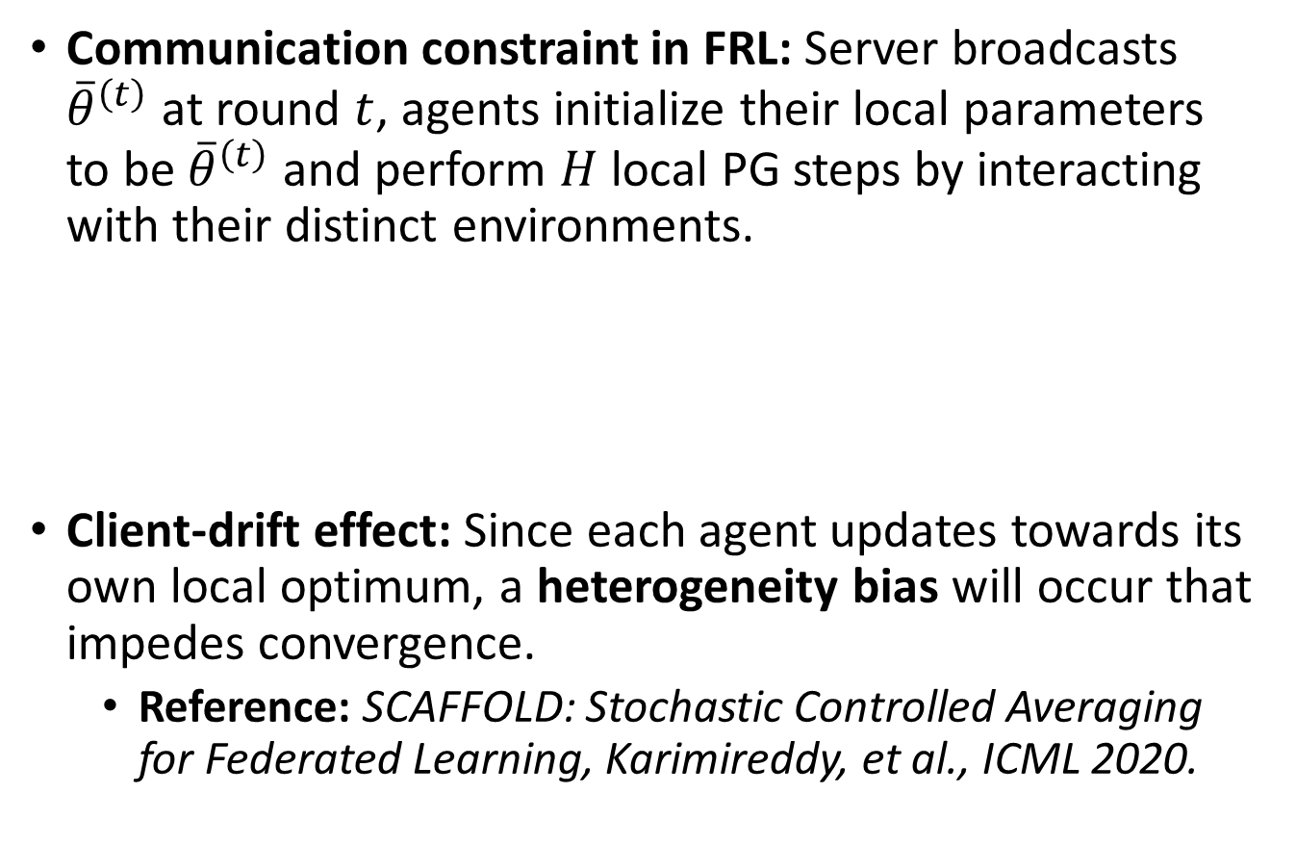
Algorithm: Fast-FedPG
Communication constraint in FRL: Server broadcasts ${\overline{θ}}^{\left(t\right)}$ at round $t$, agents initialize their local parameters to be ${\overline{θ}}^{\left(t\right)}$ and perform $H$ local PG steps by interacting with their distinct environments.
Client-drift effect: Since each agent updates towards its own local optimum, a heterogeneity bias will occur that impedes convergence.
Reference: SCAFFOLD: Stochastic Controlled Averaging for Federated Learning, Karimireddy, et al., ICML 2020.
clients drift towards their local optima
Notes:
Then we proceed to introduce our Fast-FedPG algorithm.
First, as we talked about in the constraints of the problem, we have the communication constraints in FRL, so our algorithm adopts the central server-client communication mechanism. To be concrete, the server broadcasts ${\overline{θ}}^{\left(t\right)}$ at round $t$, and agents initialize their local parameters to be ${\overline{θ}}^{\left(t\right)}$ and perform $H$ local PG steps. By interacting with their local environments.
Second, since each agent interacts with a distinct environment, and multiple local steps are taken before server aggregation, clients tend to drift towards their local optima, as illustrated in the figure, causing a heterogeneity bias that will impede the convergence result. In this figure, \alpha_g is the global stepsize taken by the server, \Delta_i,H^t is the difference between the locally updated parameter after H local steps for agent i and the broadcast global parameter theta^t at communication round t.
We point to this famous paper that intends to solve the client-drift effect in optimization in FL for reference.

Slide 9
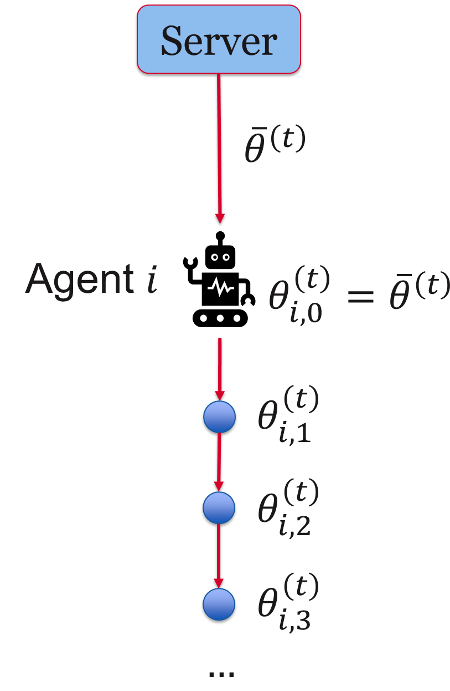
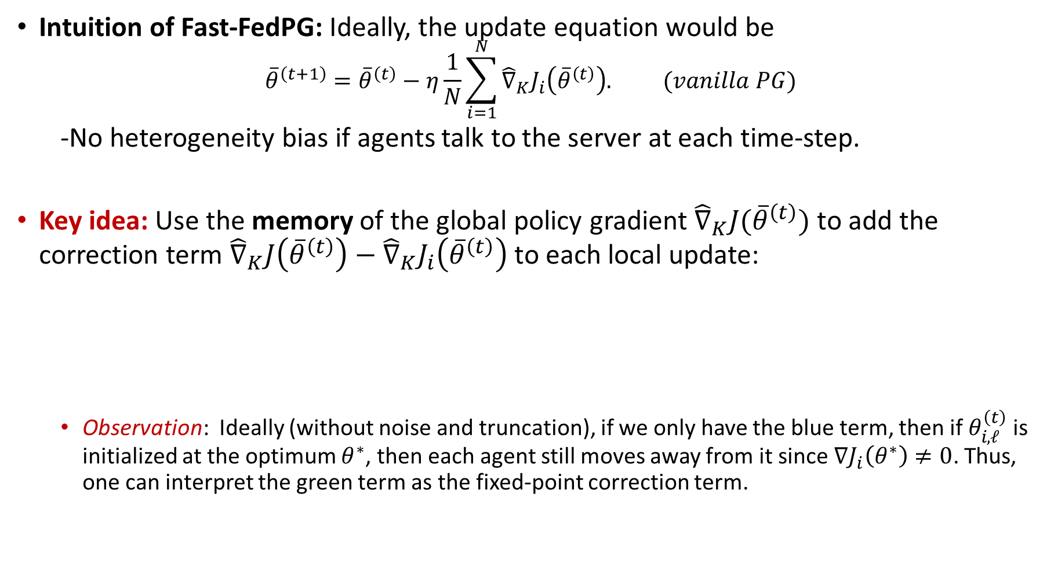
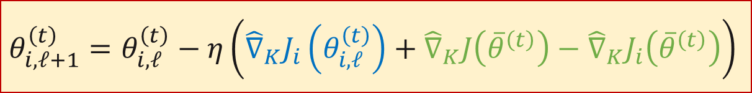
Algorithm: Fast-FedPG
Intuition of Fast-FedPG: Ideally, the update equation would be
$${\overline{θ}}^{\left(t+1\right)}={\overline{θ}}^{\left(t\right)}−η\frac{1}{N}\sum_{i=1}^{N}{{\hat{∇}}_{K}J_{i}\left({\overline{θ}}^{\left(t\right)}\right).} (vanilla PG)$$
-No heterogeneity bias if agents talk to the server at each time-step.
Key idea: Use the memory of the global policy gradient ${\hat{∇}}_{K}J({\overline{θ}}^{\left(t\right)})$ to add the correction term ${\hat{∇}}_{K}J\left({\overline{θ}}^{\left(t\right)}\right)−{\hat{∇}}_{K}J_{i}\left({\overline{θ}}^{\left(t\right)}\right)$ to each local update:
Observation: Ideally (without noise and truncation), if we only have the blue term, then if $θ_{i,ℓ}^{\left(t\right)}$ is initialized at the optimum $θ^{∗}$, then each agent still moves away from it since $∇J_{i}\left(θ^{∗}\right)≠0$. Thus, one can interpret the green term as the fixed-point correction term.
$$θ_{i,ℓ+1}^{\left(t\right)}=θ_{i,ℓ}^{\left(t\right)}−η\left({\hat{∇}}_{K}J_{i}\left(θ_{i,ℓ}^{\left(t\right)}\right)+{\hat{∇}}_{K}J\left({\overline{θ}}^{\left(t\right)}\right)−{\hat{∇}}_{K}J_{i}\left({\overline{θ}}^{\left(t\right)}\right)\right)$$
vanilla PG direction
correction
Notes:
Here we explain the intuition of our Fast-FedPG algorithm:
Ideally, if the agent gets to talk to the server at each round t, then the update equation would then be of this form, which is the vanilla SGD equation.
In this case, no heterogeneity bias is present since the gradients are aggregated at every time step.
In reality, however, agents have to talk intermittently. So the key idea of our algorithm is to use the memory of the global policy gradient to add the correction term to each local update, where the correction term is the difference between the global gradient and the local gradient at the beginning of each round.
As we can see in the update formula of our algorithm, the blue part is the vanilla SGD direction and the green one is then the correction. Here \eta is the local stepsize taken by each agent. And we note here that $θ_{i,ℓ}^{\left(t\right)}$ is the local parameter of agent I at round t and local iteration \ell.
We will show in the following analysis that by doing this, the heterogeneity bias will completely go away and we can still achieve linear speedup.

Slide 10
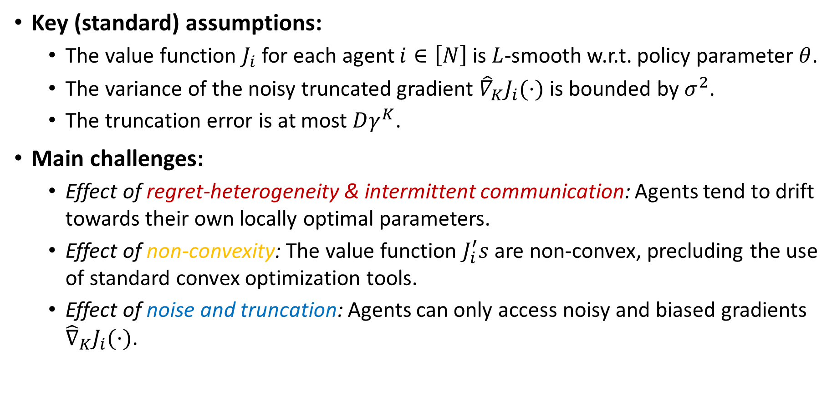
Assumptions and main challenges in analysis
Key (standard) assumptions:
The value function $J_{i}$ for each agent $i∈\left[N\right]$ is $L$-smooth w.r.t. policy parameter $θ$.
The variance of the noisy truncated gradient ${\hat{∇}}_{K}J_{i}(⋅)$ is bounded by $σ^{2}$.
The truncation error is at most $Dγ^{K}$.
Main challenges:
Effect of regret-heterogeneity & intermittent communication: Agents tend to drift towards their own locally optimal parameters.
Effect of non-convexity: The value function $J_{i}^{′}s$ are non-convex, precluding the use of standard convex optimization tools.
Effect of noise and truncation: Agents can only access noisy and biased gradients ${\hat{∇}}_{K}J_{i}(⋅)$.
Notes:
The key standard assumptions we make in this work are listed here:
First, we assume that The value function $J_{i}$ for each agent $i∈\left[N\right]$ is $L$-smooth w.r.t. policy parameter $θ$.
Second, we assume that The variance of the noisy truncated gradient ${\hat{∇}}_{K}J_{i}(⋅)$ is bounded by $σ^{2}$.
Third, we assume that the truncation error is at most …, where D is a constant, gamma is between 0 and 1, and K is the rollout factor. This is also a standard assumption made when dealing with truncated policy gradients.
We also list the main challenges that arise during the analysis of our algorithm.

Slide 11
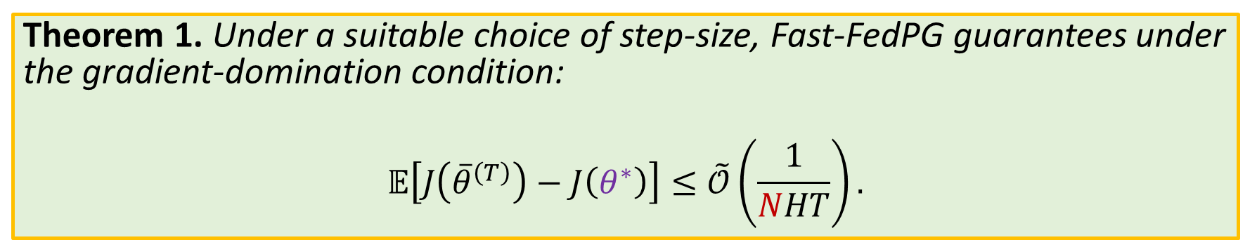
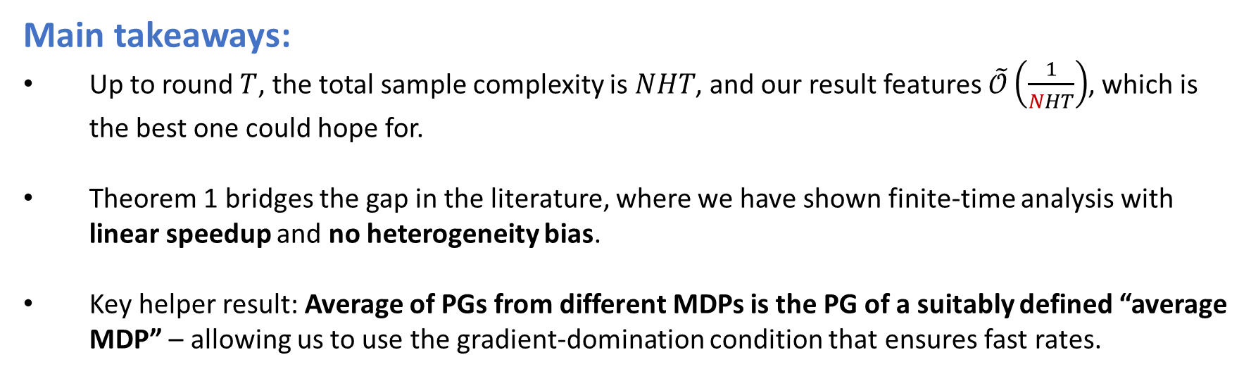
Main results (w/ gradient-domination)
Theorem 1. Under a suitable choice of step-size, Fast-FedPG guarantees under the gradient-domination condition:
$$𝔼\left[J\left({\overline{θ}}^{\left(T\right)}\right)−J\left(θ^{∗}\right)\right]≤\tilde{𝒪}\left(\frac{1}{NHT}\right).$$
Optimal point of global loss fnc.
# of agents
Main takeaways:
Up to round $T$, the total sample complexity is $NHT$, and our result features $\tilde{𝒪}\left(\frac{1}{NHT}\right)$, which is the best one could hope for.
Theorem 1 bridges the gap in the literature, where we have shown finite-time analysis with linear speedup and no heterogeneity bias.
Key helper result: Average of PGs from different MDPs is the PG of a suitably defined “average MDP” – allowing us to use the gradient-domination condition that ensures fast rates.
Notes:
Our first result is the one under the gradient-domination condition:
So under a suitable choice of stepsize, and under the g-d condition, Theorem 1 states that our algorithm achieves 1/NHT convergence rate, where N is the number of agents, H is the # local steps and T the # of communication rounds. Here theta star is the optimal point of the global loss function J.
There are a couple of takeaways in this result:
First, Up to round $T$, the total sample complexity is $NHT$, and our result features $\tilde{𝒪}\left(\frac{1}{NHT}\right)$, which is the best one could hope for.
Second, Our final result exhibits $N$-fold speedup and no heterogeneity bias is present,
which bridges the gap in the literature, where we have shown finite-time analysis with linear speedup and no heterogeneity bias.
To arrive at this result, we proved a key helper result, that is, the Average of gradients from different MDPs is the gradient of a suitably defined “average MDP” – to allow us to use the gradient-domination condition that ensures fast rates.

Slide 12
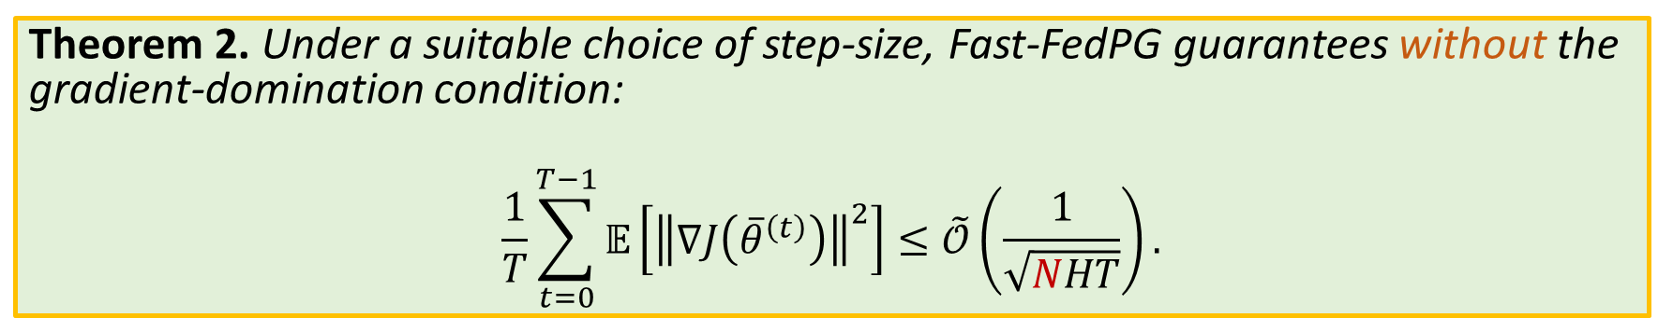
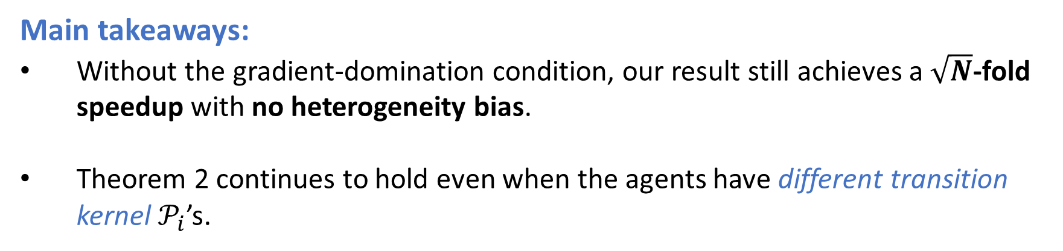
Main results (w/o gradient-domination)
Theorem 2. Under a suitable choice of step-size, Fast-FedPG guarantees without the gradient-domination condition:
$$\frac{1}{T}\sum_{t=0}^{T−1}{𝔼\left[{\left\|∇J\left({\overline{θ}}^{\left(t\right)}\right)\right\|}^{2}\right]}≤\tilde{𝒪}\left(\frac{1}{\sqrt{NHT}}\right).$$
Main takeaways:
Without the gradient-domination condition, our result still achieves a $\sqrt{N}$-fold speedup with no heterogeneity bias.
Theorem 2 continues to hold even when the agents have different transition kernel $𝒫_{i}$’s.
Notes:
The second result is without the g-d condition.
Theorem 2 states that under a suitable choice of stepsize, our algorithm ensures that the expectation of the average squared gradient norm is upper=bounded by 1/sqrt(NHT), which is also the best one could hope for with nonconvex objectives.
The takeaways here are then
First, Without the gradient-domination condition, our result still achieves a $\sqrt{N}$-fold speedup with no heterogeneity bias.
Second, in the setup we assumed that the agents have different regrets but same transition kernels. But here, Theorem 2 still holds even if the agents have different transition kernels

Slide 13
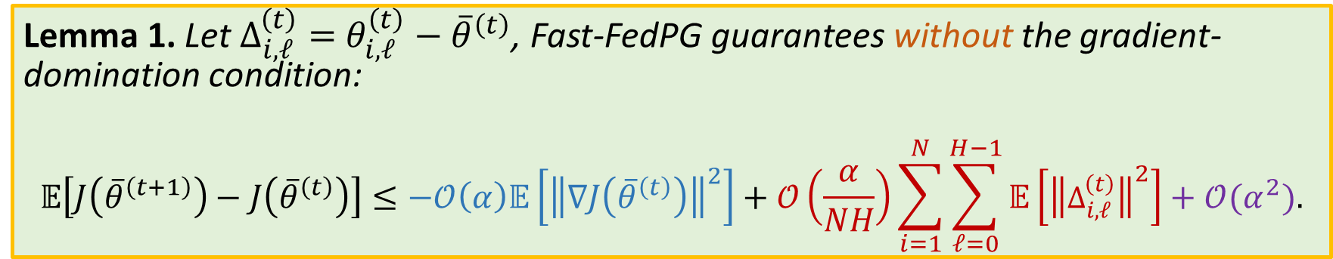
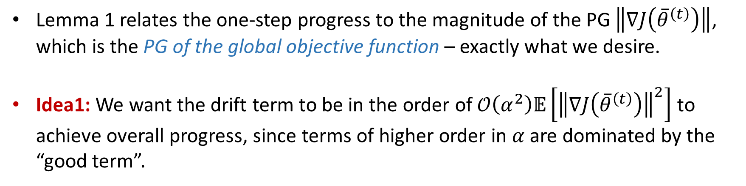
Main Ideas in Proof
Lemma 1. Let $Δ_{i,ℓ}^{\left(t\right)}=$ $θ_{i,ℓ}^{\left(t\right)}−{\overline{θ}}^{\left(t\right)}$, Fast-FedPG guarantees without the gradient-domination condition:
$$𝔼\left[J\left({\overline{θ}}^{\left(t+1\right)}\right)−J\left({\overline{θ}}^{\left(t\right)}\right)\right]≤−𝒪\left(α\right)𝔼\left[{\left\|∇J\left({\overline{θ}}^{\left(t\right)}\right)\right\|}^{2}\right]+𝒪\left(\frac{α}{NH}\right)\sum_{i=1}^{N}{\sum_{ℓ=0}^{H−1}{𝔼\left[{\left\|Δ_{i,ℓ}^{\left(t\right)}\right\|}^{2}\right]}}+𝒪(α^{2}).$$
“good term”
drift term
noise, truncation bias
Lemma 1 relates the one-step progress to the magnitude of the PG $\left\|∇J\left({\overline{θ}}^{\left(t\right)}\right)\right\|$, which is the PG of the global objective function – exactly what we desire.
Idea1: We want the drift term to be in the order of $𝒪\left(α^{2}\right)𝔼\left[{\left\|∇J\left({\overline{θ}}^{\left(t\right)}\right)\right\|}^{2}\right]$ to achieve overall progress, since terms of higher order in $α$ are dominated by the “good term”.
Notes:
We then provide the main ideas used in the proof.
First we introduce Lemma 1, which bounds the one-step progress of the objective function. As we can see on the RHS of the inequality, the one-step progress of the global loss function J is bounded above by the negative squared gradient norm, which is the good term, plus the drift term caused by the client-drift effect, and the term caused by noise and truncation bias. Since the red and purple terms are always non-negative, they can be regarded as the bad term and needs to be controlled by the good term, which is our primary goal here.
So Lemma 1 relates the one-step progress to the magnitude of the PG $\left\|∇J\left({\overline{θ}}^{\left(t\right)}\right)\right\|$, which is the PG of the global objective function – exactly what we desire.
And our idea, as we just said, is to control the drift term in the order of $𝒪\left(α^{2}\right)𝔼\left[{\left\|∇J\left({\overline{θ}}^{\left(t\right)}\right)\right\|}^{2}\right]$ to achieve overall progress, since terms of higher order in $α$ are dominate by the “good term”.

Slide 14
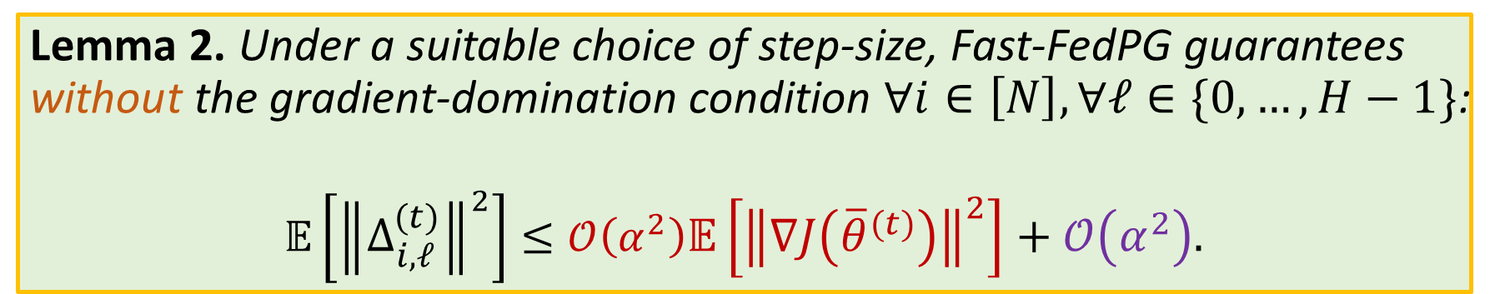
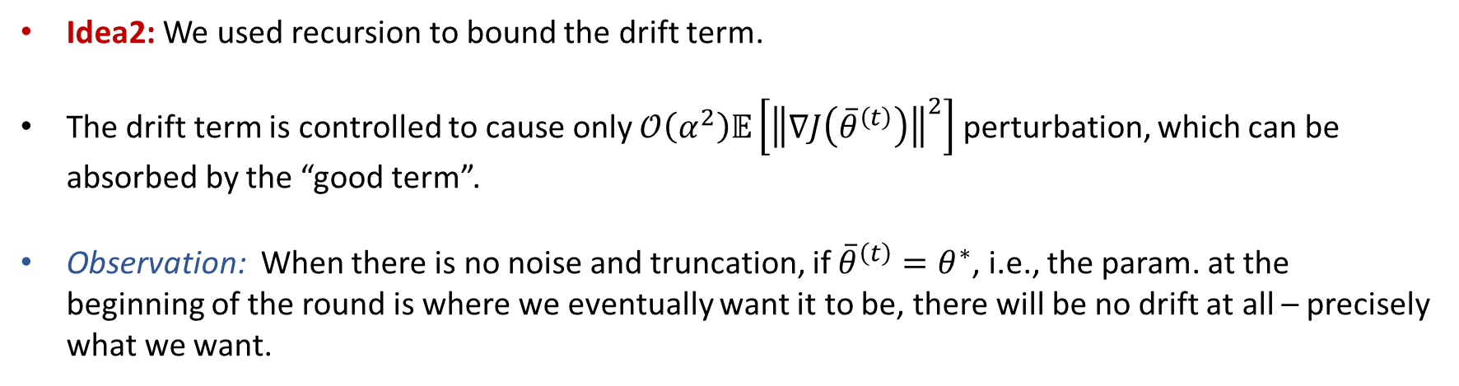
Main Ideas in Proof
Lemma 2. Under a suitable choice of step-size, Fast-FedPG guarantees without the gradient-domination condition $∀i∈\left[N\right], ∀ℓ∈\{0,…,H−1\}$:
$$𝔼\left[{\left\|Δ_{i,ℓ}^{\left(t\right)}\right\|}^{2}\right]≤𝒪\left(α^{2}\right)𝔼\left[{\left\|∇J\left({\overline{θ}}^{\left(t\right)}\right)\right\|}^{2}\right]+𝒪\left(α^{2}\right).$$
“bad term”
noise, truncation bias
Idea2: We used recursion to bound the drift term.
The drift term is controlled to cause only $𝒪\left(α^{2}\right)𝔼\left[{\left\|∇J\left({\overline{θ}}^{\left(t\right)}\right)\right\|}^{2}\right]$ perturbation, which can be absorbed by the “good term”.
Observation: When there is no noise and truncation, if ${\overline{θ}}^{\left(t\right)}=θ^{∗}$, i.e., the param. at the beginning of the round is where we eventually want it to be, there will be no drift at all – precisely what we want.
Notes:
With this in mind, we then proceed to bound the drift term, and arrive at Lemma 2:
Here in Lemma 2, we used recursion to bound the drift term.
As the result demonstrates, The drift term is controlled to cause only $𝒪\left(α^{2}\right)𝔼\left[{\left\|∇J\left({\overline{θ}}^{\left(t\right)}\right)\right\|}^{2}\right]$ perturbation, which can be absorbed by the “good term”.
In retrospect, to validate our algorithm, we observe that If ${\overline{θ}}^{\left(t\right)}=θ^{∗}$, i.e., the param. at the beginning of the round is where we eventually want it to be, there will be no drift at all – precisely what we want.
Observation only when there is no noise and trunc.

Slide 15
Summary
Presented a novel algorithm for FRL to find a policy that performs well across multiple heterogeneous environments.
Provided the first federated PG algorithm that
Achieves fast linear rates
Establishes a linear speedup
Incurs no heterogeneity bias.
- Even if we collect data from different environments, we can still increase sample efficiency.
Our algorithm outputs a policy that is good on all environments. For each individual environment, however, the learned policy is not necessarily the optimal one -> How do we develop personalized policies for distinct environments?
Notes:
Even if we collect data from different envs, we can increase sample efficiency
Only a policy good on all envs ->personalized

Slide 16
Key Selected References
FRL:
Federated reinforcement learning: Linear speedup under markovian sampling, Khodadadian, S., Sharma, P., Joshi, G., and Maguluri, S. T., ICLR, 2022.
The blessing of heterogeneity in federated Q-learning: Linear speedup and beyond, Woo, J., Joshi, G., and Chi, Y., ICML, 2023.
Federated temporal difference learning with linear function approximation under environmental heterogeneity, Wang, H., Mitra, A., Hassani, H., Pappas, G. J., and Anderson, J., arXiv, 2023.
Finite-time analysis of on-policy heterogeneous federated reinforcement learning, Zhang, C., Wang, H., Mitra, A., and Anderson, J., arXiv, 2024.
FL:
SCAFFOLD: Stochastic Controlled Averaging for Federated Learning, Karimireddy, S. P., Kale, S., Mohri, M., Reddi, S., Stich, S., & Suresh, A. T., ICML 2020.

