Slide 1
Quick intro into
Machine Learning for
MRI Reconstruction
Felix Zimmermann

Slide 2


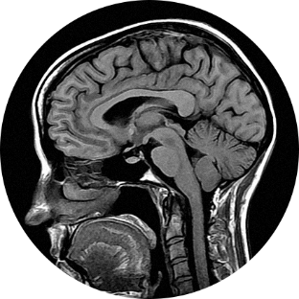
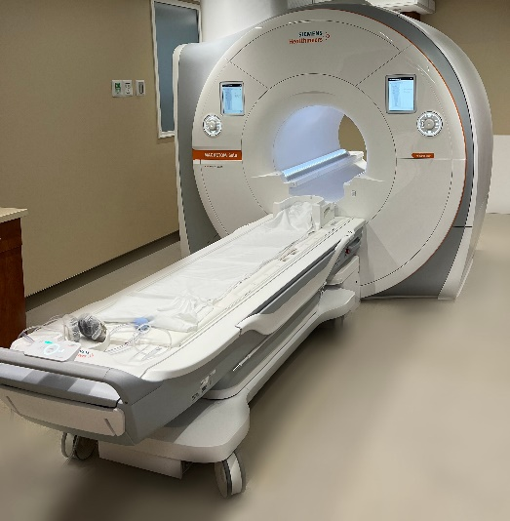
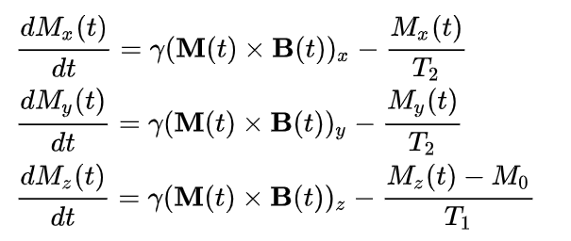
What is „Magnetic Ressonance Imaging“

Slide 3
What is „Magnetic Ressonance Imaging“
For our purpose
“Some Medical Imaging Method” …
.. for more details, there is a nice lecture by
Prof. T. Schaeffter @ TU Berlin

Slide 4
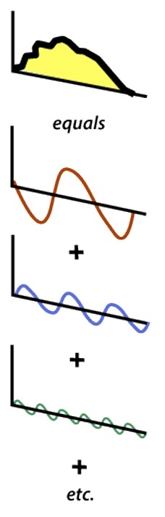
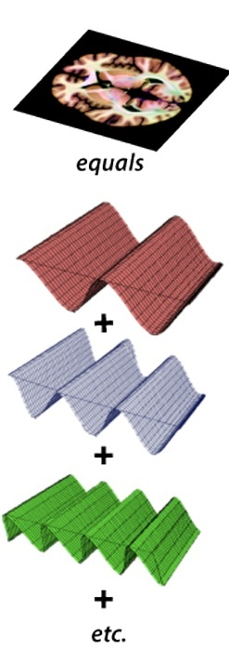
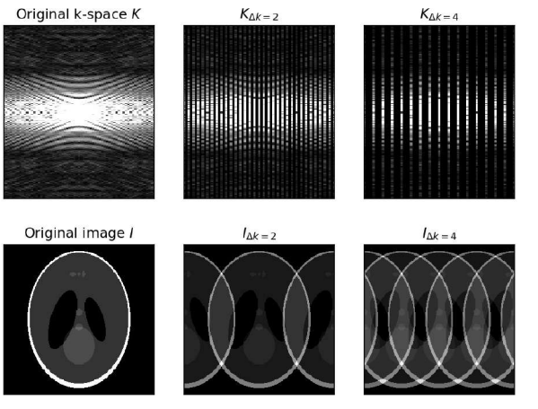
What is „MRI Reconstruction“?
Fourier Transform
MRI data is recorded in „k-space“
Fourier
Transform
Patient
K-space Data
Image from https://mriquestions.com/what-are-2d---3d-fts.html

Slide 5

What is „MRI Reconstruction“?
MRI data is recorded in „k-space“
To get the image,
we need to invert this
Inverse
Fourier
Transform
Fourier
Transform
Patient
K-space Data

Slide 6

What is „MRI Reconstruction“?
MRI data is recorded in „k-space“
To save time, not all data is recorded
Fourier
Transform
Patient
K-space Data

Slide 7

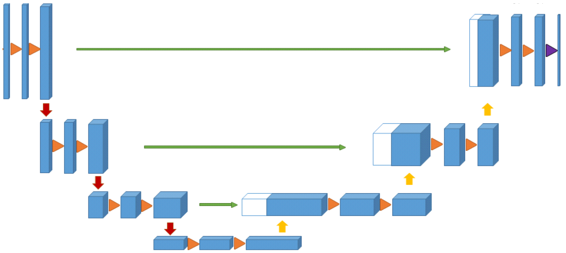
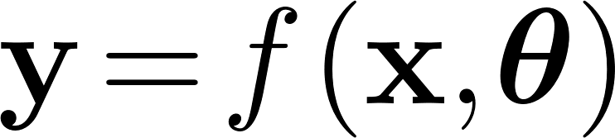
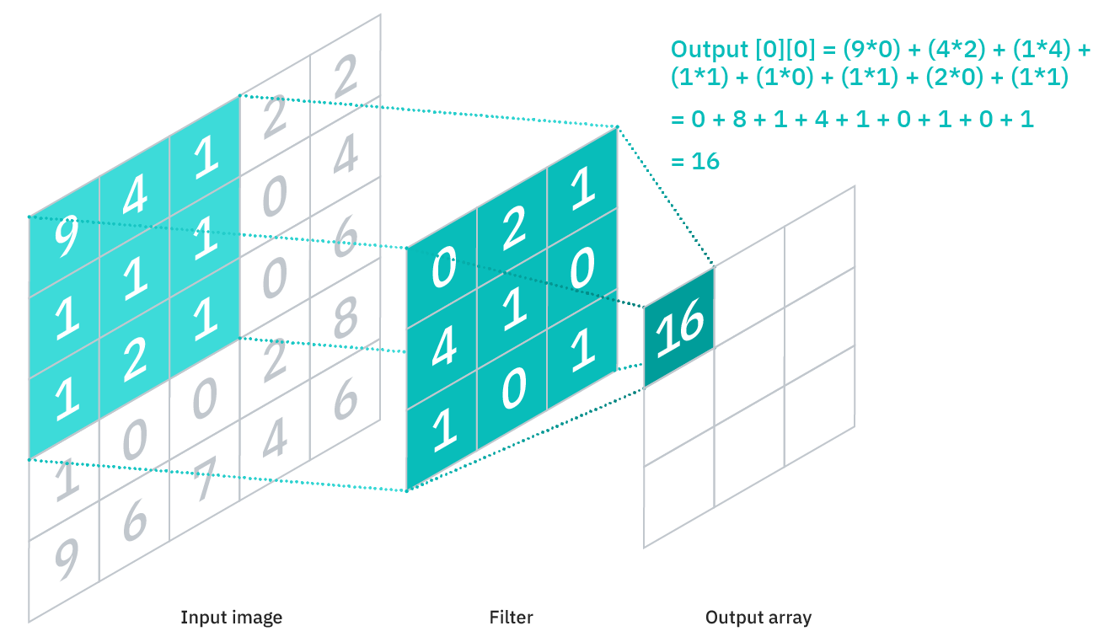
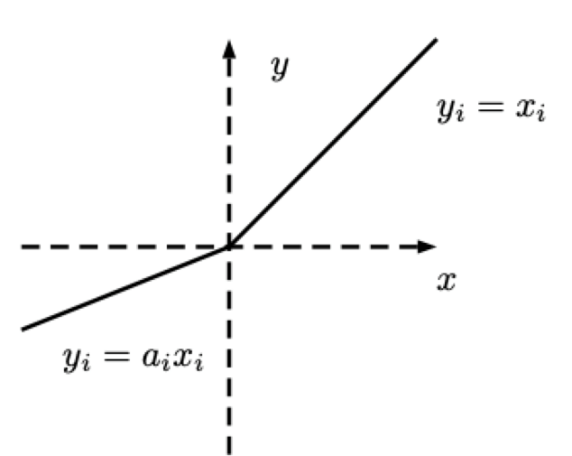
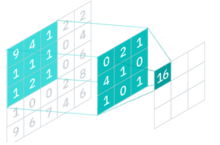
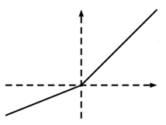
What is a „Neural Network“
Image from https://www.ibm.com/cloud/learn/convolutional-neural-networks

Slide 8
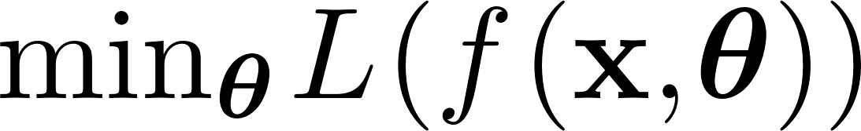
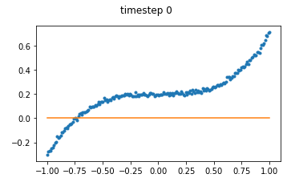
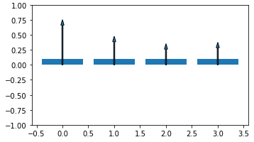
How to „Train“ a Neural Network
Finding Optimal Weights
Non-Linear Regression
with a Function with many Parameters
Example of a Polynomial Fit
Repeat:
- Evaluate f
- Find direction of optimal change for each weight
(derivative of loss with regard to weight)
- Taking a small step in this direction

Slide 9
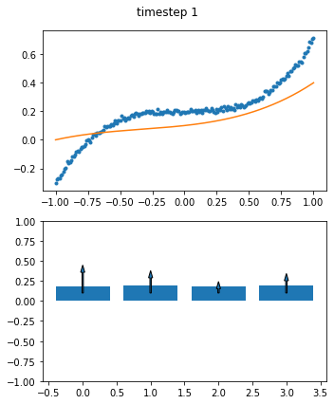
How to „Train“ a Neural Network
Finding Optimal Weights
Non-Linear Regression
with a Function with many Parameters
Repeat:
- Evaluate f
- Find direction of optimal change for each weight
(derivative of loss with regard to weight)
- Taking a small step in this direction
Example of a Polynomial Fit

Slide 10
How to „Train“ a Neural Network
Finding Optimal Weights
Non-Linear Regression
with a Function with many Parameters
Repeat:
- Evaluate f
- Find direction of optimal change for each weight
(derivative of loss with regard to weight)
- Taking a small step in this direction
Example of a Polynomial Fit

Slide 11
How to use a NN for MRI Reconstruction
Idea: Find a function that
Takes an image with artifacts and
Returns a guess for the artifact-free image
Issues:
→ Use network only to fill in missing data, keep “Data Consistency” with recorded k-space data
Difficult Problem…

Slide 12
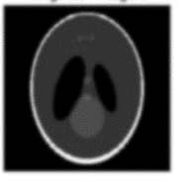
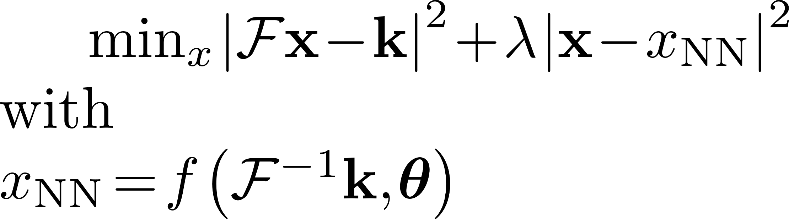
Combining Data and Neural Network
inv.
Fourier
Transform
Fourier Transform
Fourier Transform
Fill missing Data
Keep recorded Data
Repeat Combining Neural Network Prediction with Recorded Data

Slide 13

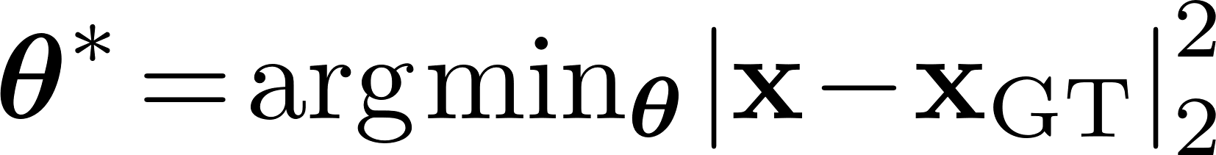

Combining Data and Neural Network
Final Result
inv.
Fourier
Transform
….
Compare to Optimize Weights
Some Repeats
CAVE: This is not the best way to do it, but the simplest to show ☺
More arxiv.org/2004.06688, arxiv.org/1712.02862 etc
Ground Truth

Slide 14
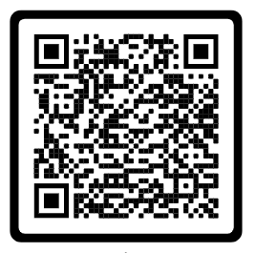
Demo and Hands-On
https://t1p.de/mtdum
Physikalisch-Technische Bundesanstalt
Braunschweig und Berlin
Abbestrasse 2-12
10587 Berlin
Felix Zimmermann
E-Mail: felix.zimmermann@ptb.de
www.ptb.de
Notes:
https://colab.research.google.com/gist/fzimmermann89/6331868b3a42bf504c10b63c7675b05b/mri_demo.ipynb
And
https://gist.github.com/fzimmermann89/6331868b3a42bf504c10b63c7675b05b

Slide 16
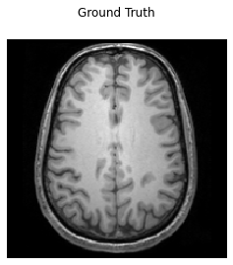
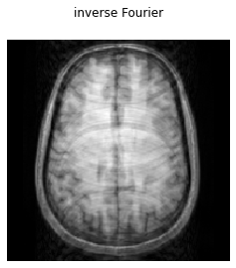
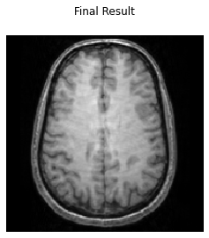
Example from Demo

Slide 18

Combining Data and Neural Network
„Neural Network as a
Regularization learned from Data“
inv. Fourier
Transform
Combination
Solve with CG
Compare to Optimize Weights
Ground Truth Reference

