Slide 1
Sensitivity ranks model responses, not engineering value
168 original runs; one factor changed by ±10% at a time.
Approved: body mass alone; engine eta_max only; fixed petrol laps.
Rank by endpoint span; a gap under 2% of a tie group's largest span is ≈.
Elasticities normalize comparison but still depend on the sampling interval.
Extensions test ranges, curve shape, mass definition, grid, lap generation and interactions.
Study B | Owner review draft | 1/5 | EU grid; fixed traces
Notes:
Owner-review draft. Regenerate with python -m pwt.sensitivity_report. All numerical findings come from current tables. See docs/study-b-sensitivity.md for assumptions and flagged comparisons. No final approval or merge implied.

Slide 2
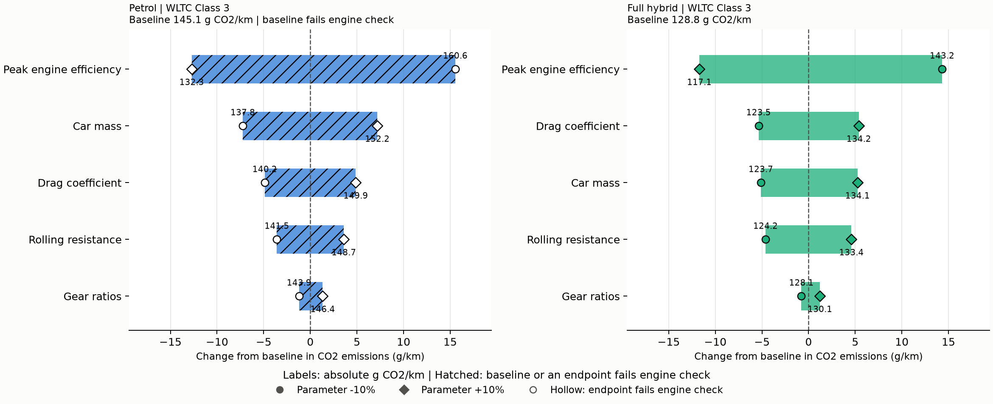
WLTC leaders: petrol Peak engine efficiency; hybrid Peak engine efficiency
WLTC engine-efficiency spans: petrol 28.3 and full hybrid 26.0 g/km (20.2% of the hybrid baseline). Fuel demand divides engine work by efficiency. Scaling eta_max changes the whole power curve; idle fuel is fixed. A large effect does not establish low cost.
Study B | Owner review draft | 2/5 | Hollow: endpoint fails engine check | Hatched: comparison provisional
Notes:
Owner-review draft. Regenerate with python -m pwt.sensitivity_report. All numerical findings come from current tables. See docs/study-b-sensitivity.md for assumptions and flagged comparisons. No final approval or merge implied.

Slide 3
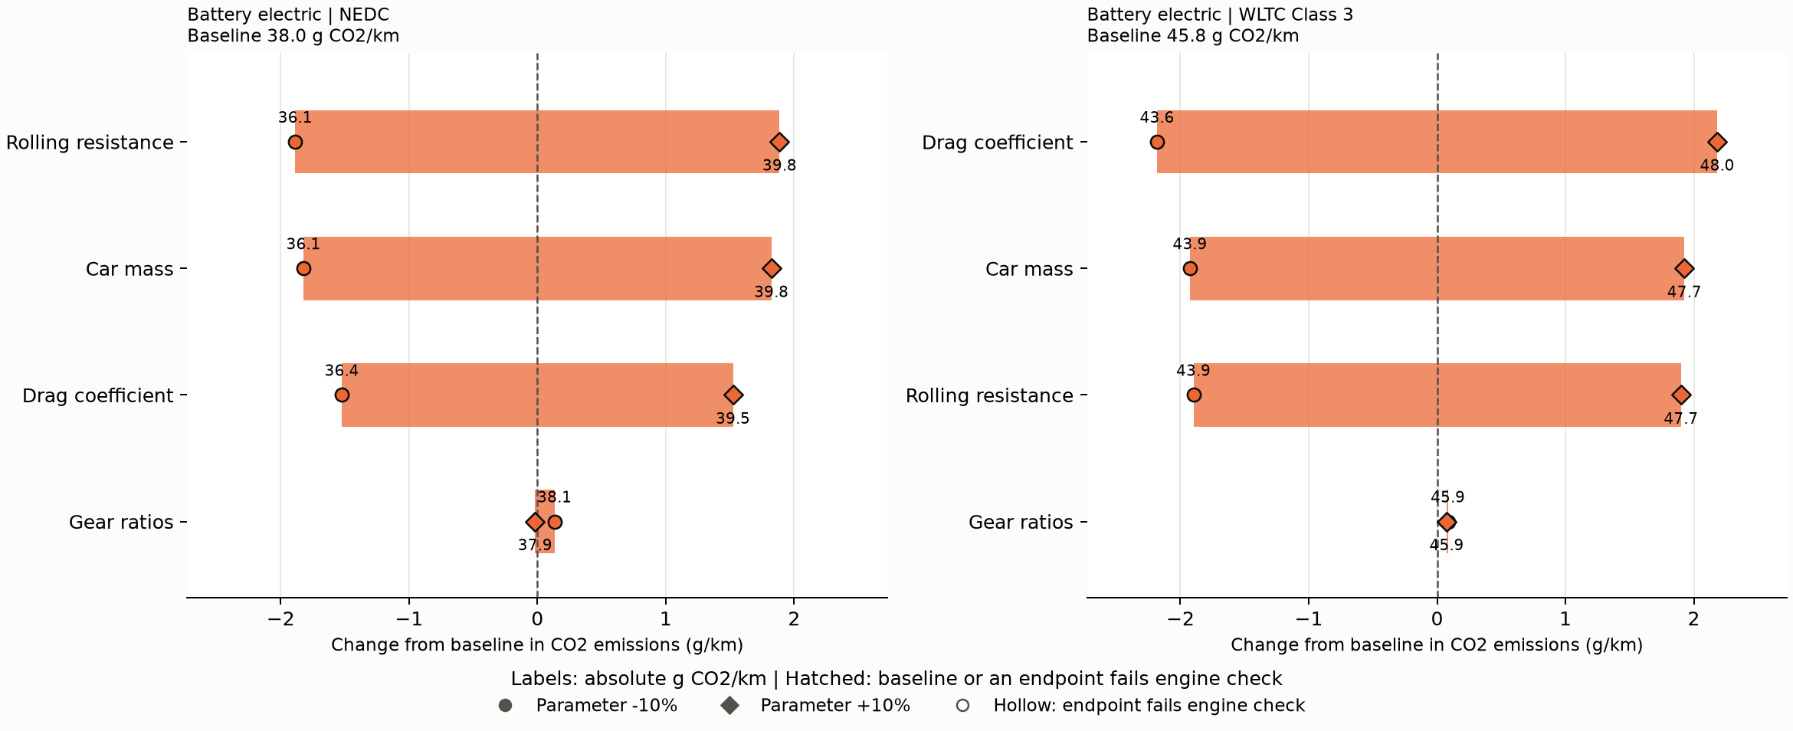
BEV leaders: NEDC Rolling resistance; WLTC Drag coefficient
BEV NEDC rolling and mass spans: 3.77 and 3.64 g/km; WLTC drag span: 4.36 g/km. Drag force grows with speed squared; mass affects acceleration, rolling and climbing work, with partial recovery. Small gaps require caution.
Study B | Owner review draft | 3/5 | Hollow: endpoint fails engine check | Hatched: comparison provisional
Notes:
Owner-review draft. Regenerate with python -m pwt.sensitivity_report. All numerical findings come from current tables. See docs/study-b-sensitivity.md for assumptions and flagged comparisons. No final approval or merge implied.

Slide 4
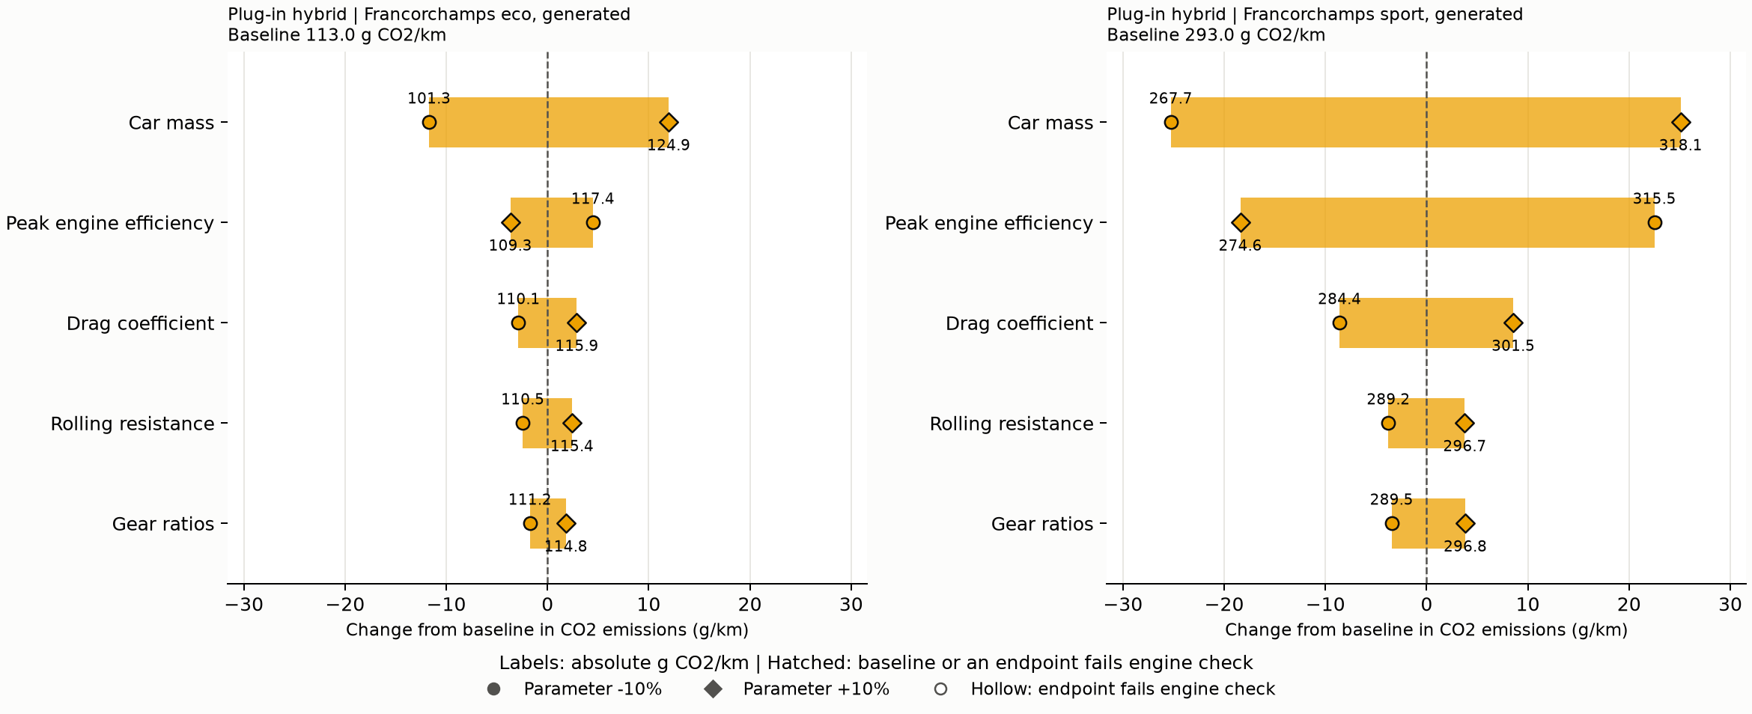
PHEV lap leaders: eco Car mass; sport Car mass
PHEV mass spans: eco 23.7 and sport 50.4 g/km. Mass affects both electric and fuel work; engine efficiency affects fuel conversion. Regulatory results include R101 weighting.
Study B | Owner review draft | 4/5 | Hollow: endpoint fails engine check | Hatched: comparison provisional
Notes:
Owner-review draft. Regenerate with python -m pwt.sensitivity_report. All numerical findings come from current tables. See docs/study-b-sensitivity.md for assumptions and flagged comparisons. No final approval or merge implied.

Slide 5
Capability and engineering trade-offs limit the ranking
42 of 168 original rows flag engine-power shortfalls. Petrol sport rankings are provisional.
Regenerated laps change speed and use engine-only acceleration; no BEV capability model is supplied.
Mass/shape checks, French-grid rankings, intermediate points and interaction grids are in the report.
Technology-inspired ranges are screening assumptions; gears are exploratory. No cost ranking is justified.
Next: owner review, validate ranges/capability, then refine minima and interactions.
Study B | Owner review draft | 5/5 | Technical review addressed; owner approval pending
Notes:
Owner-review draft. Regenerate with python -m pwt.sensitivity_report. All numerical findings come from current tables. See docs/study-b-sensitivity.md for assumptions and flagged comparisons. No final approval or merge implied.

