Slide 1
Graduate Group 5: Database Project
Fatemeh Jamshidi
Korsha Brown
Pravallika Suryadevara

Slide 2
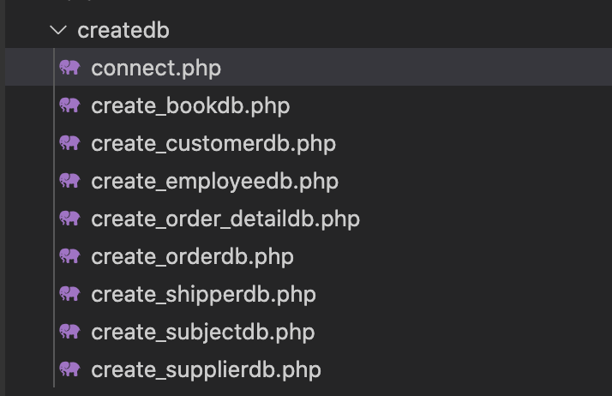
Problem Definition
Setup an online bookstore system, with MySQL as the backend database.
In summary,
1.Setup a database with the provided data.
2.Create a web interface interacting with the
backend database to perform queries on the
database.
3.Correctly Implement the queries in SQL.
4- Deploy the website, server, and database.

Slide 3
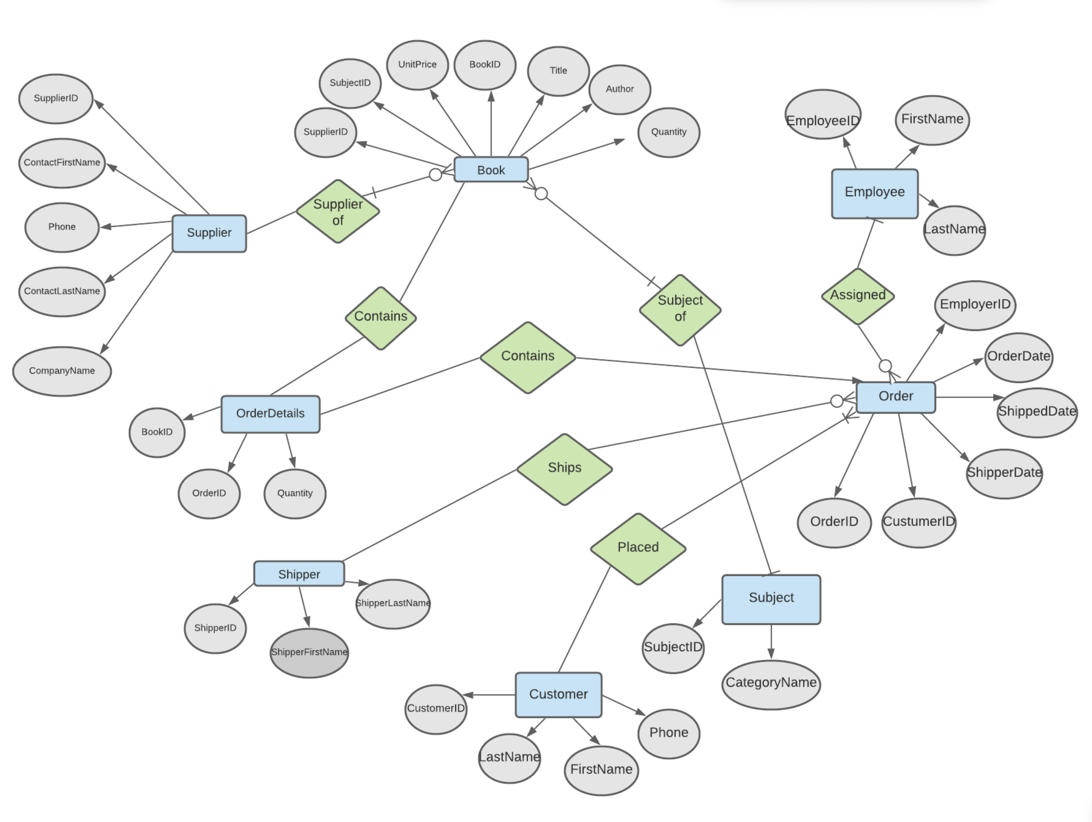
ER Diagram:

Slide 4
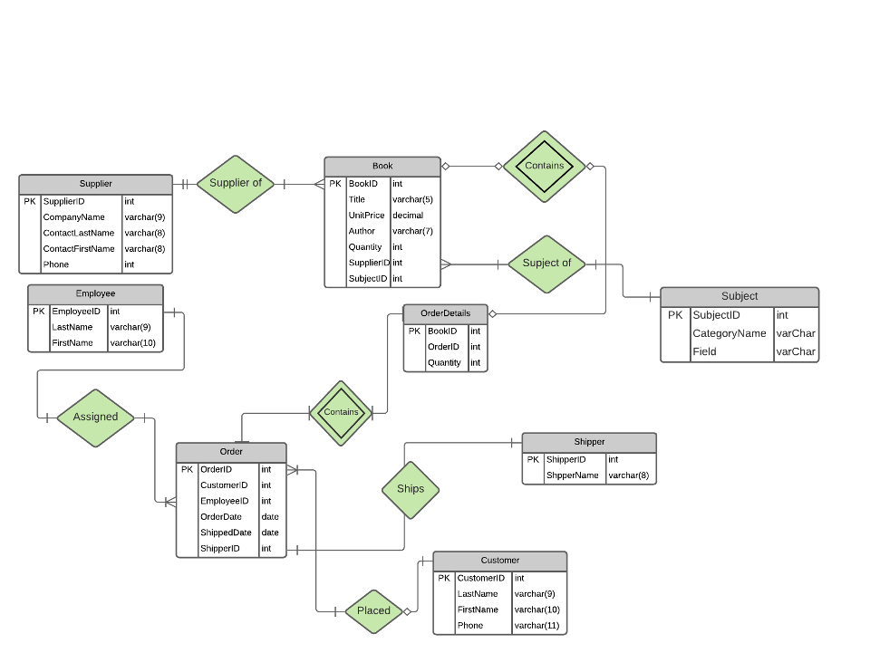
Database Schema:

Slide 5
SQL codes
$qr = "CREATE TABLE book(
bookid INT(10),
title VARCHAR(10),
unitprice VARCHAR(10),
author VARCHAR(32),
quantity INT(10),
supplierid INT(10),
subjectid INT(10),
PRIMARY KEY(bookid),
FOREIGN KEY(supplierid) REFERENCES supplier(supplierid),
FOREIGN KEY(subjectid) REFERENCES subject(subjectid)
)";
$qr = "CREATE TABLE customer(
customerid INT(10),
lastname VARCHAR(20),
firstname VARCHAR(20),
phone VARCHAR(15),
PRIMARY KEY(customerid)
)";
$qr = "CREATE TABLE employee(
employeeid INT(10),
lastname VARCHAR(20),
firstname VARCHAR(20),
PRIMARY KEY(employeeid)
)";

Slide 6
SQL codes
$qr = "CREATE TABLE orderdb(
orderid INT(10),
customerid INT(10),
employeeid INT(10),
orderdate VARCHAR(10),
shippeddate VARCHAR(10),
shipperid INT(10),
PRIMARY KEY(orderid),
FOREIGN KEY(customerid) REFERENCES customer(customerid),
FOREIGN KEY(employeeid) REFERENCES employee(employeeid),
FOREIGN KEY(shipperid) REFERENCES shipper(shipperid)
)";
$qr = "CREATE TABLE order_detail(
bookid INT(10),
orderid INT(10),
quantity INT(10),
FOREIGN KEY(bookid) REFERENCES book(bookid),
FOREIGN KEY(orderid) REFERENCES orderdb(orderid)
)";

Slide 7
SQL codes
$qr = "CREATE TABLE shipper(
shipperid INT(10),
)";
$qr = "CREATE TABLE subject(
subjectid INT(10),
)";
shippername VARCHAR(20),
PRIMARY KEY(shipperid)
categoryname VARCHAR(20),
PRIMARY KEY(subjectid)
$qr = "CREATE TABLE supplier(
supplierid INT(10),
companyname VARCHAR(20),
contactlastname VARCHAR(20),
contactfirstname VARCHAR(20),
phone INT(10),
PRIMARY KEY(supplierid)
)";

Slide 8
Program Demo
Website Demo:
http://auburn.edu//~fzj0007/database_6120/src/index.php
Code: https://github.com/fzj0007/database_6120

