Slide 1

Dependency Injection Pattern
A 25-Dollar Term for A 5-Cent Concept
Telkom University Surabaya
Ahmad Mu’min Faisal
Core Team, GDSC TUS

Slide 2




Ahmad Mu’min Faisal
“A dedicated Flutter development enthusiast with
a profound love for Linux and Free/Libre and
Open-Source Software (FLOSS)”
Frontend Engineer Intern at ADS Digital Partner, Feb 2024 – Now
Mobile Developer at Weza Group, Feb 2024 – Now
Core Team at GDSC Telkom University Surabaya, Aug 2023 - Now
Find Me:
github.com/fzl-22
linkedin.com/in/ahmadmfaisal
Core Team at

Slide 3

“Dependency Injection is a 25-dollar term for a 5-cent concept”
James Shore

Slide 4
Dependency Injection is a pattern where an object receives the thing it needs (dependencies) instead of creating them itself.

Slide 5
Let’s see some code...

Slide 6
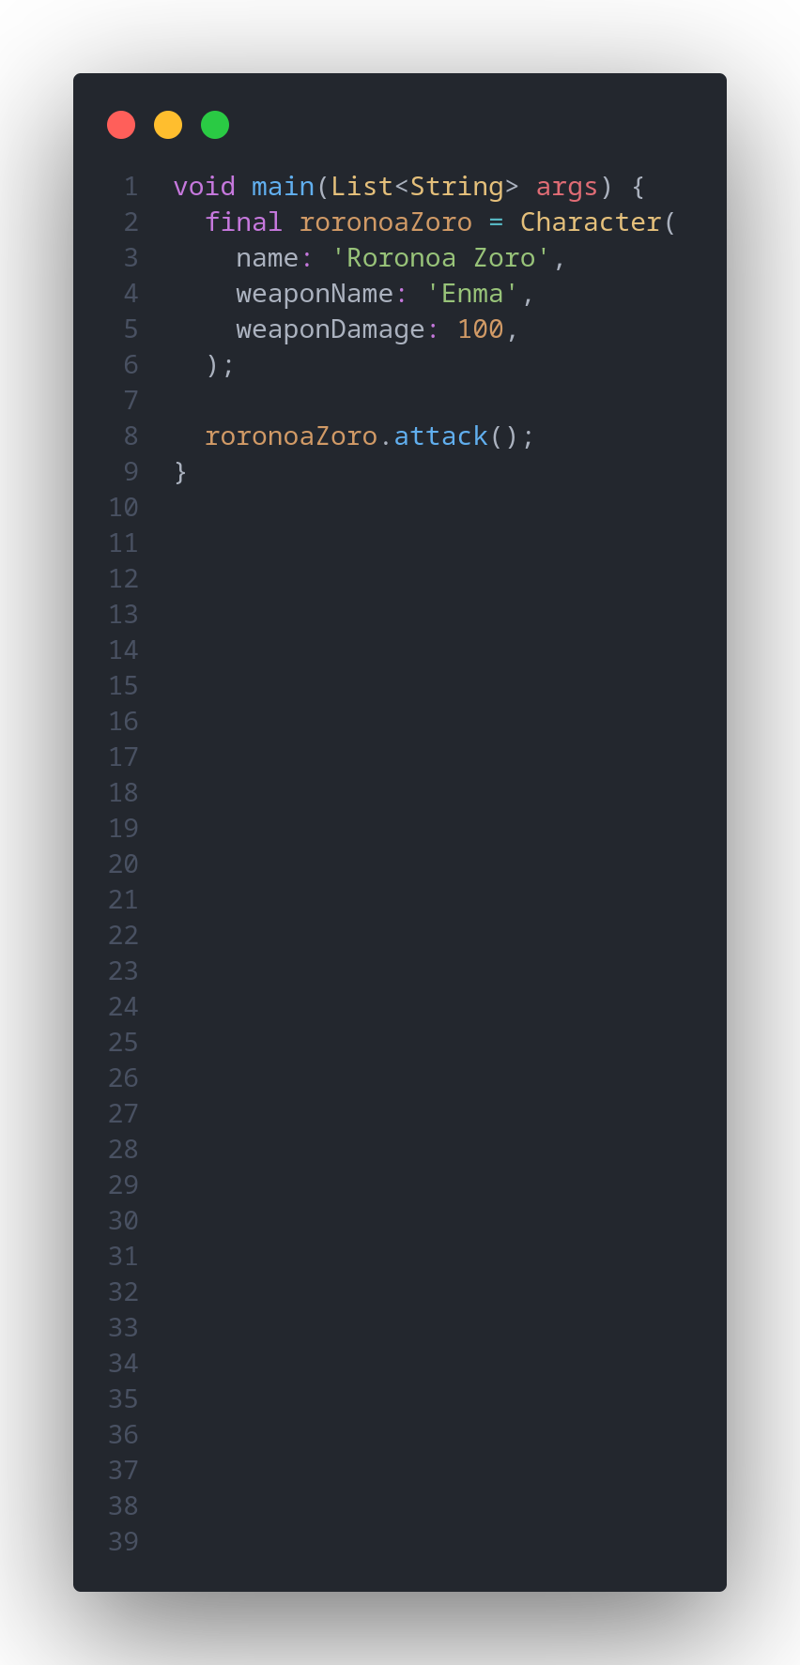
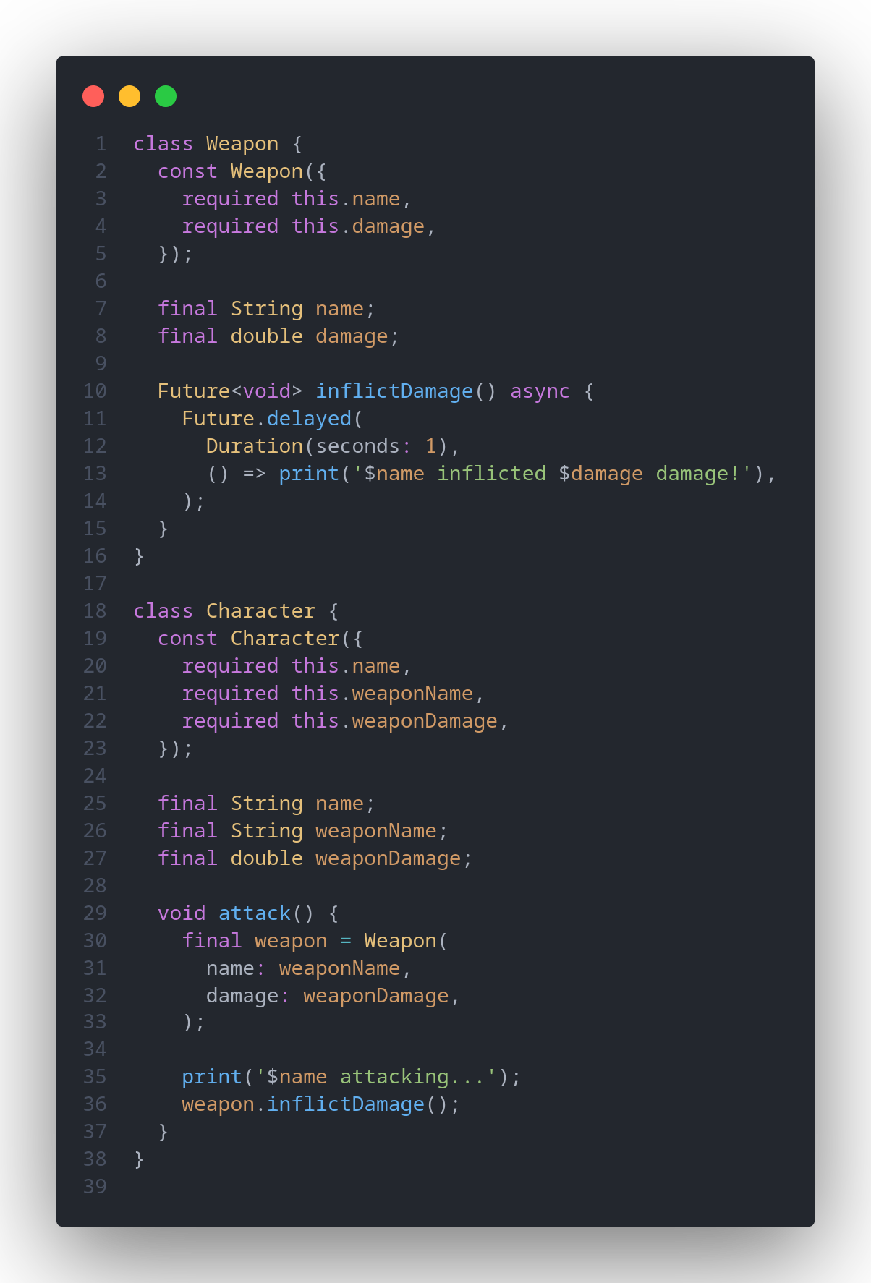
Did you see any problem
with this code?

Slide 7

The problems are...
Lack of separation of concern.
Character and Weapon are tightly coupled.
Reusability issue?
Hard to test.

Slide 8
Use Dependency Injection!

Slide 9
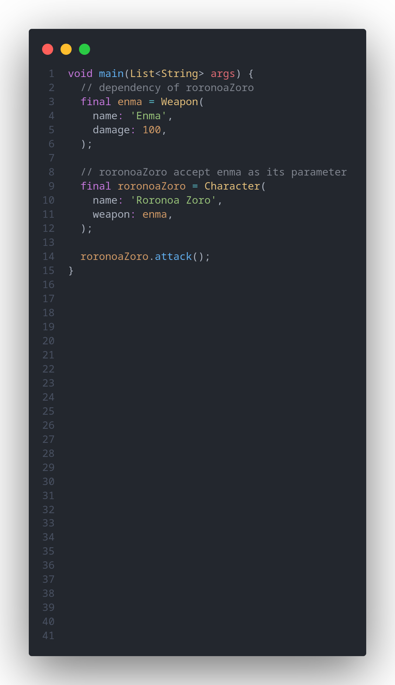
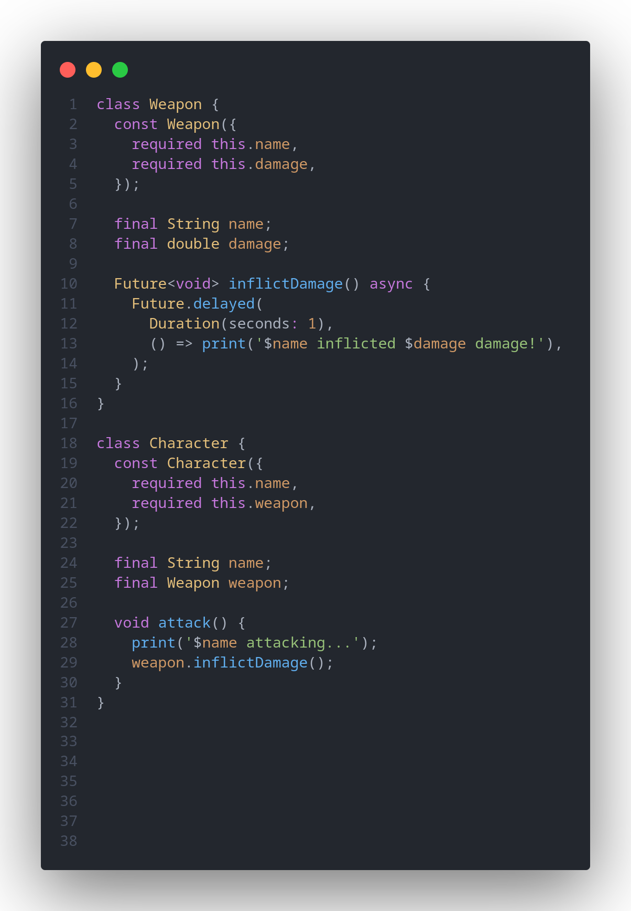
Yay, we have already
done Dependency
Injection!
Weapon and Character are well-separated

Slide 10
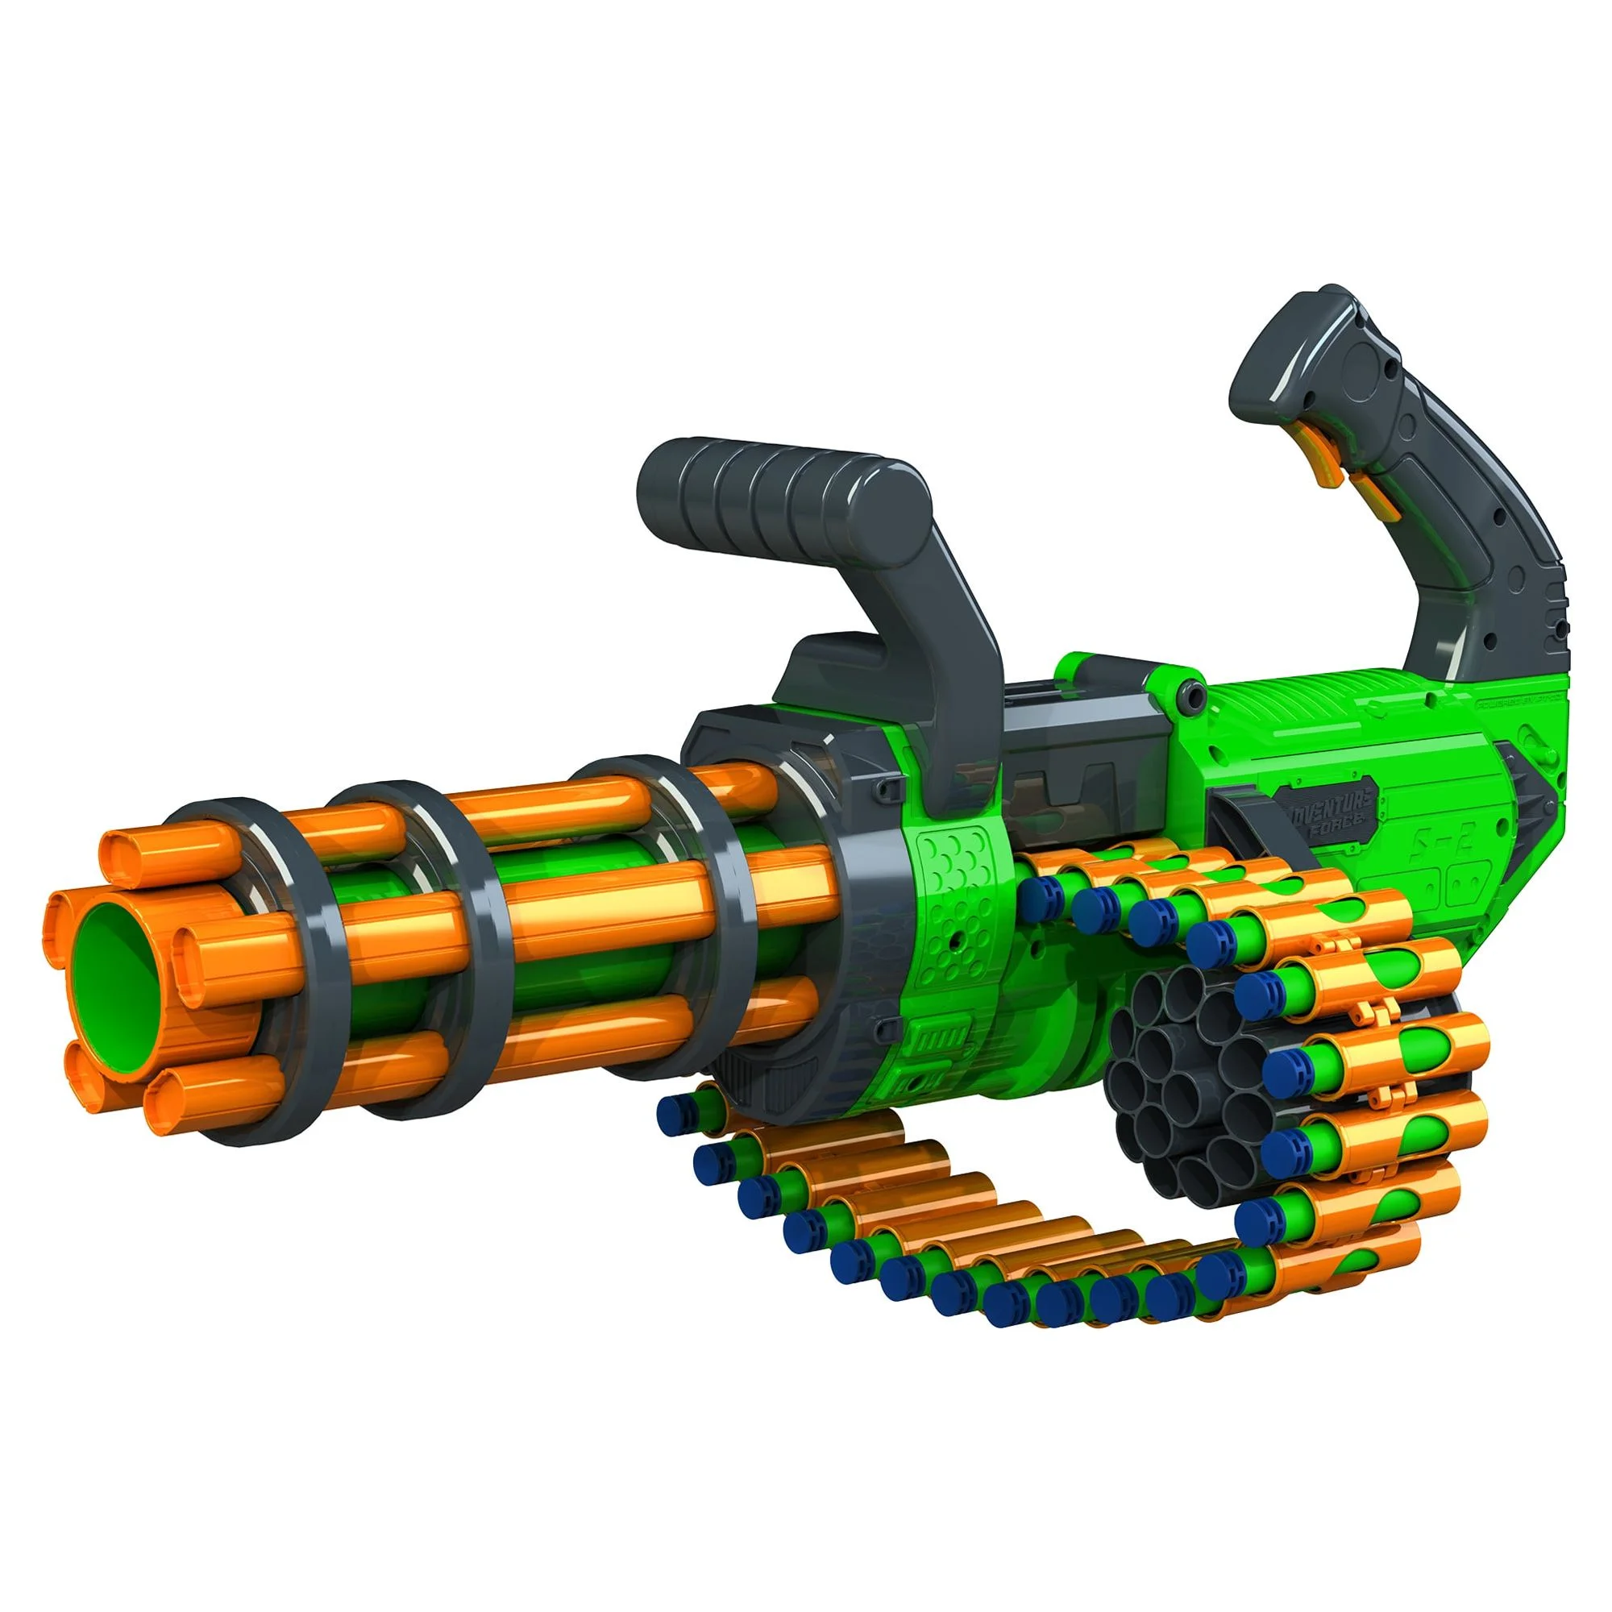

What if Zoro want to use Gatling Gun instead of regular Sword?

Slide 11
By adhering to the Dependency Inversion Principle (remember, part of SOLID), we can achieve greater decoupling and enhance reusability.

Slide 12
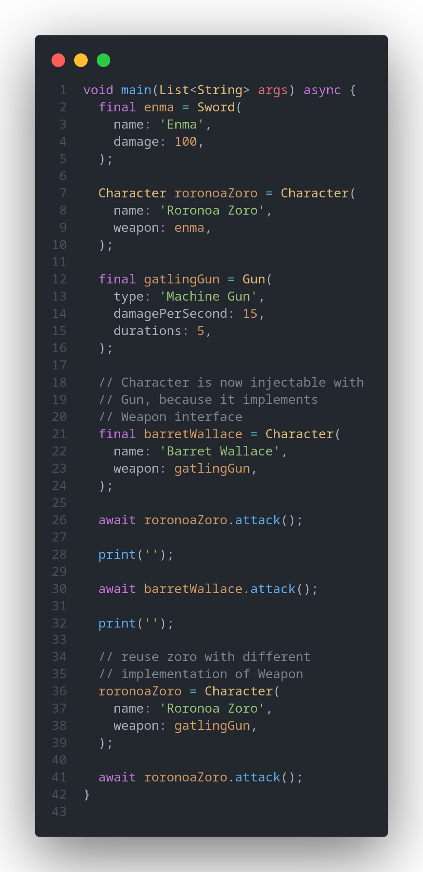
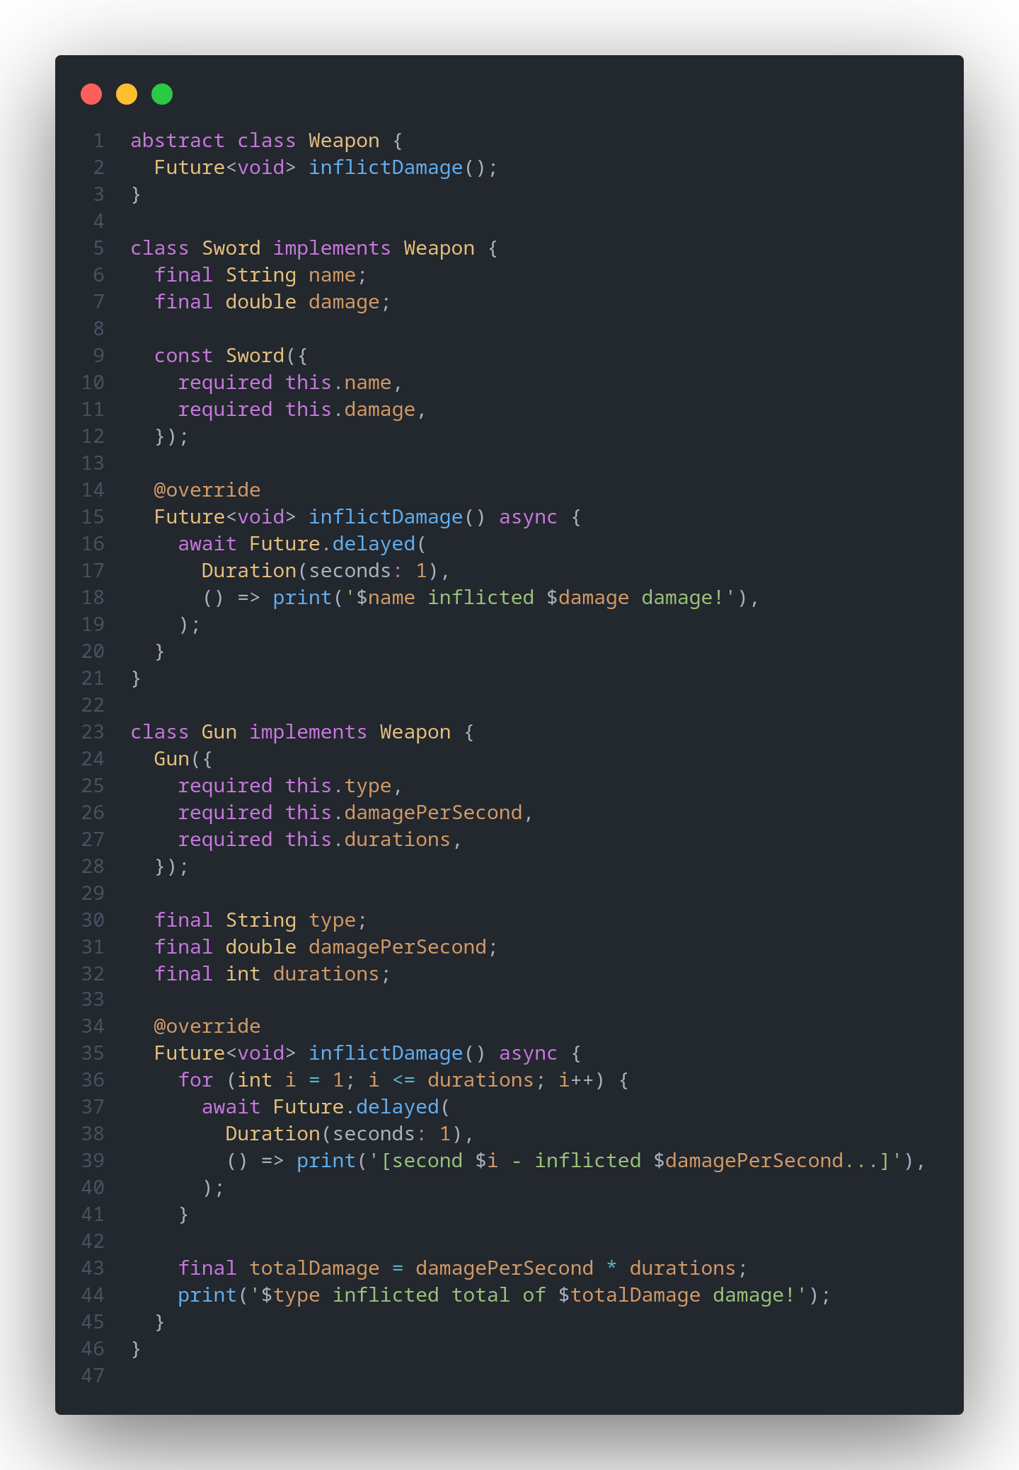
We depends on abstraction
instead of concrete
implementations
Weapon and Character are well-separated
The two objects are also loosely-coupled.
Character is reusable with different implementation of Weapons

Slide 13
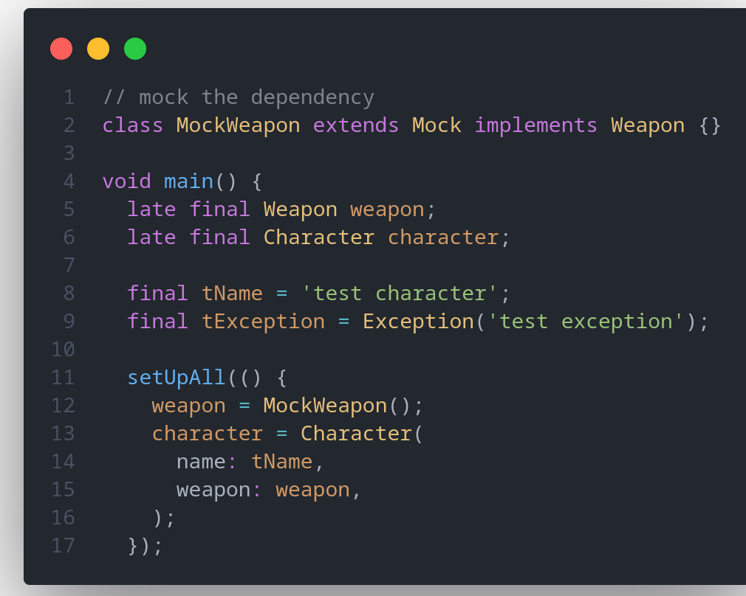
Dependency Injection also gives us the possibility to pass a test double for different test scenarios using a Mock object.
For example, we can create a MockWeapon and configure it for each of those scenarios.

Slide 14
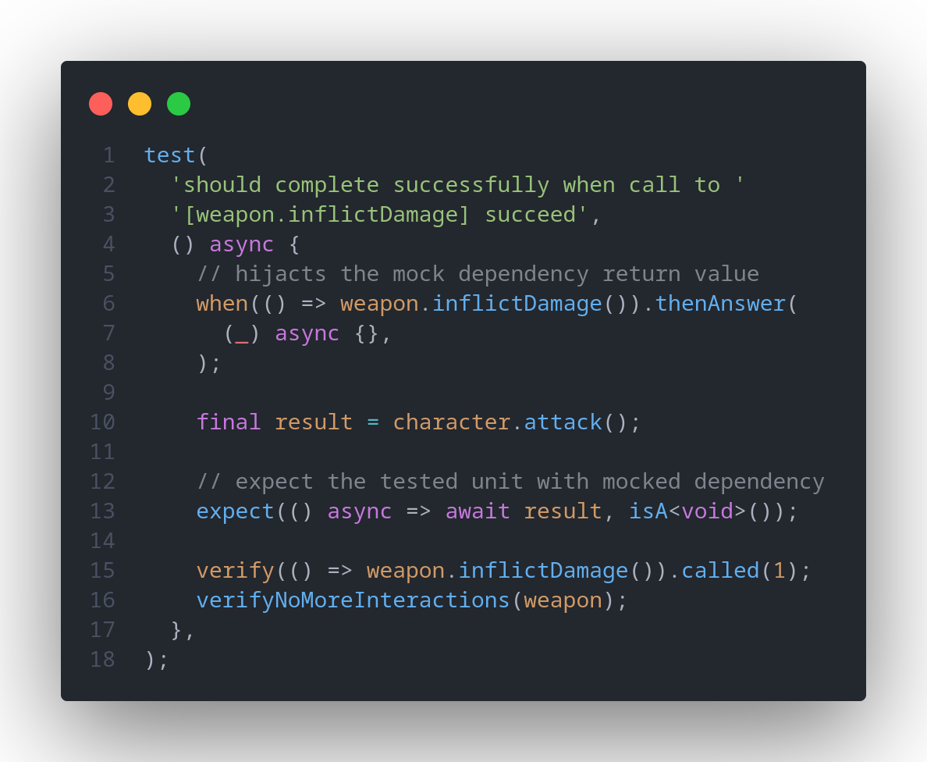
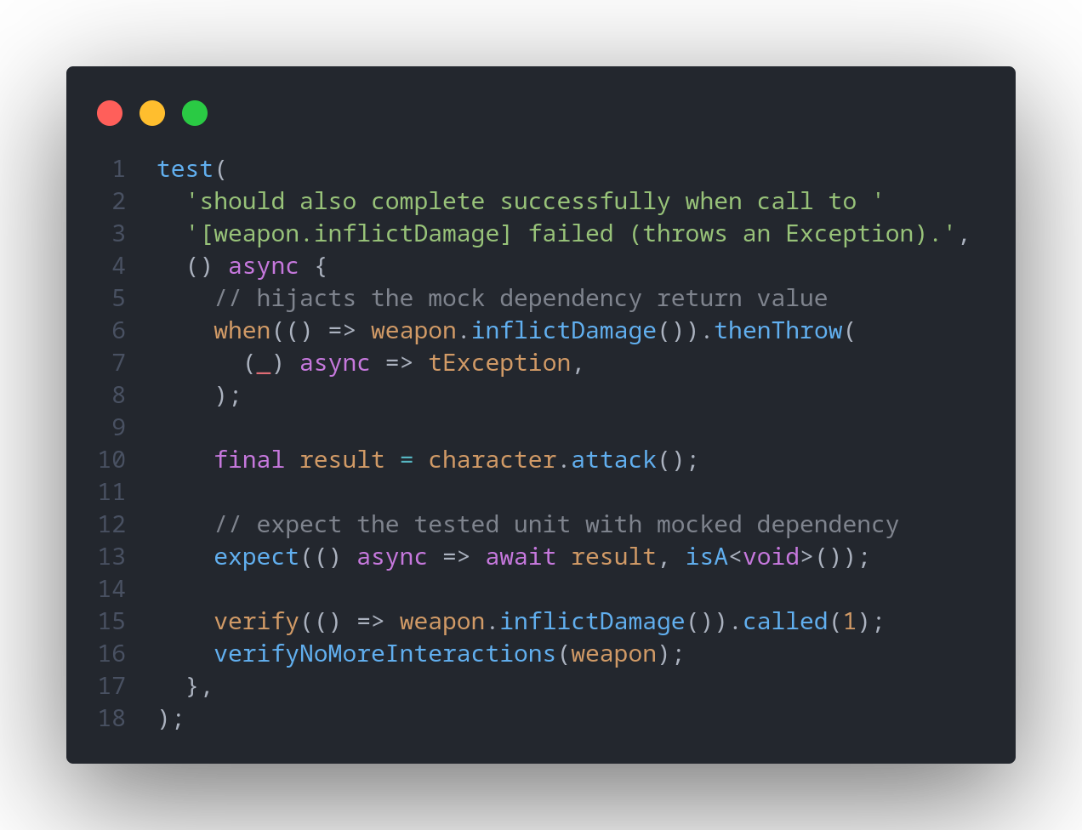
Scenario 1
Scenario 2
We can simulate the behaviour
of the dependency (stubbing)
for different test cases.
Weapon and Character are well-separated
The two objects are also loosely-coupled.
Character is reusable with different implementation of Weapons
Easily testable

Slide 15

Forms of Dependency Injection
According to Martin Fowler’s “Inversion of Control Containers and Dependency Injection pattern” article, there are 3 main styles of Dependency Injection.
Constructor Injection
Setter Injection
Interface Injection
Martin Fowler (Image source: Wikipedia)

Slide 16
Let’s get practical

Slide 17

https://github.com/fzl-22/faisal-starter-code-flutter

Slide 18
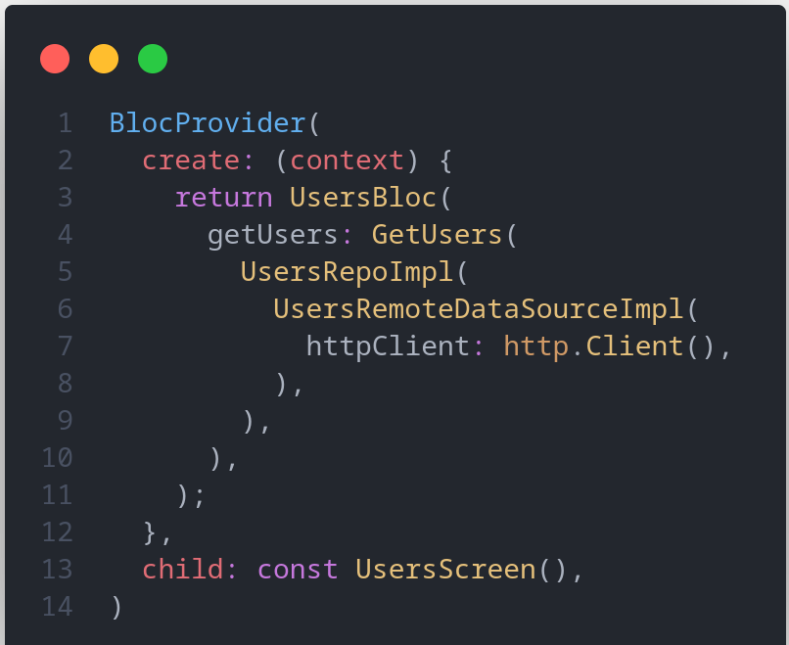
What do you think about this code?
*Imagine if we need more that one instance of UsersBloc, how many times we must pass the dependencies down to each layers?

Slide 19
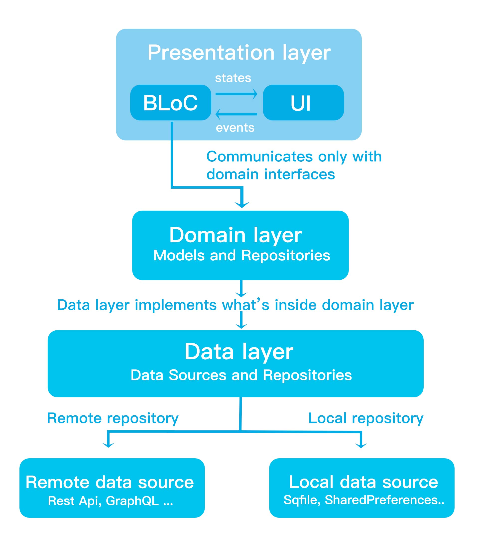
When building a multi-layered application, managing dependency injection for each feature can become cumbersome.
This is because we need to pass dependencies down through every layer as they’re needed.
Example of multi-layered application (source: www.dbestech.com)

Slide 20
Use Service Locator!

Slide 21
Service Locator is a design pattern for managing dependencies within an application. It provides a centralized registry or repository where objects (services) can be registered and later retrieved by other parts of the application.
Service locators can help decouple components within an application by abstracting away the details of how dependencies are obtained

Slide 22
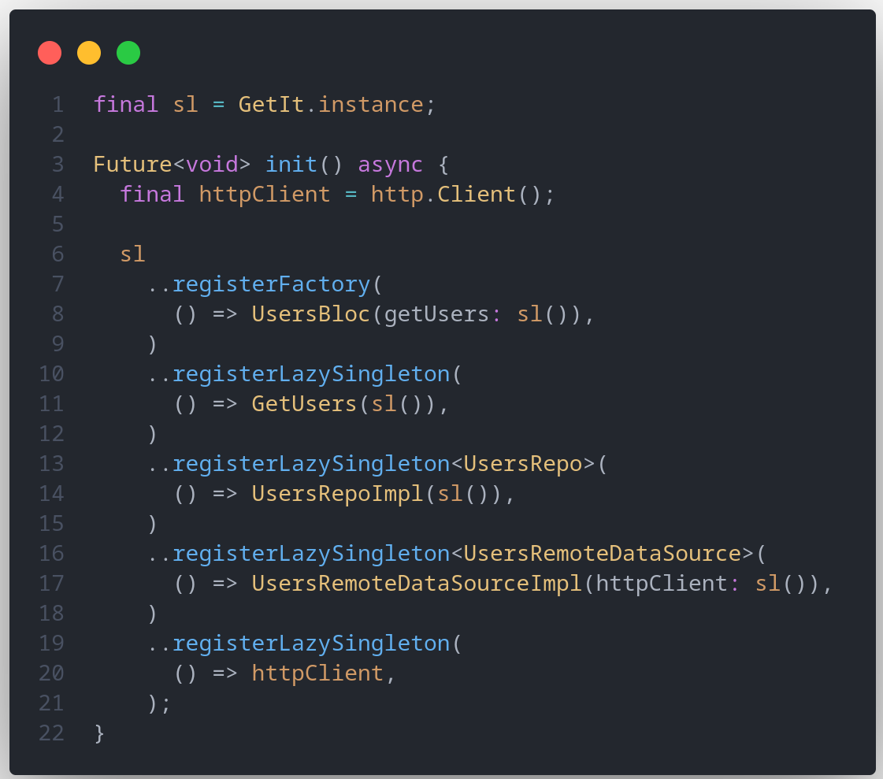
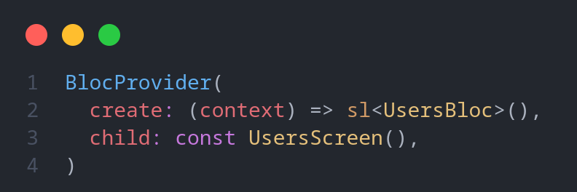

In typical Dart / Flutter project, we can use get_it package as service locator.
First, we abstract the dependency details in the injection container, then let the service locator find the related dependencies as we need them.

Slide 23
Conclusions
Dependency injection provides separation of concern, decoupled object, code reusability, and ease of testing.
In practice, we can use service locator pattern along with dependency injection for managing the dependencies of the application.
For further reading, you can check the references in the next slides

Slide 24
References
James Shore: Dependency Injection Demystified https://www.jamesshore.com/v2/blog/2006/dependency-injection-demystified
Android Developers: Dependency Injection in Androidhttps://developer.android.com/training/dependency-injection
Martin Fowler: Inversion of Control Containers and the Dependency Injection pattern https://martinfowler.com/articles/injection.html
Dbestech: Flutter Clean Architecture with TDD https://www.dbestech.com/tutorials/flutter-bloc-clean-architecture-and-tdd

Slide 25
Thank you!
Any question?

