Slide 1
RpcCalc Writeup
—— SJTU Ph0t1n1a ——

Slide 2
Basic Functions
0-4：Mentioned in template
5：if_you_forget_your_expr_id()
It can achieve same function as get_result() (case 2)
However it can return the result of given user without providing the expr_id directly
6：status_extant_for_checker()
Used for checker to check whether the flag exists in program memory

Slide 3
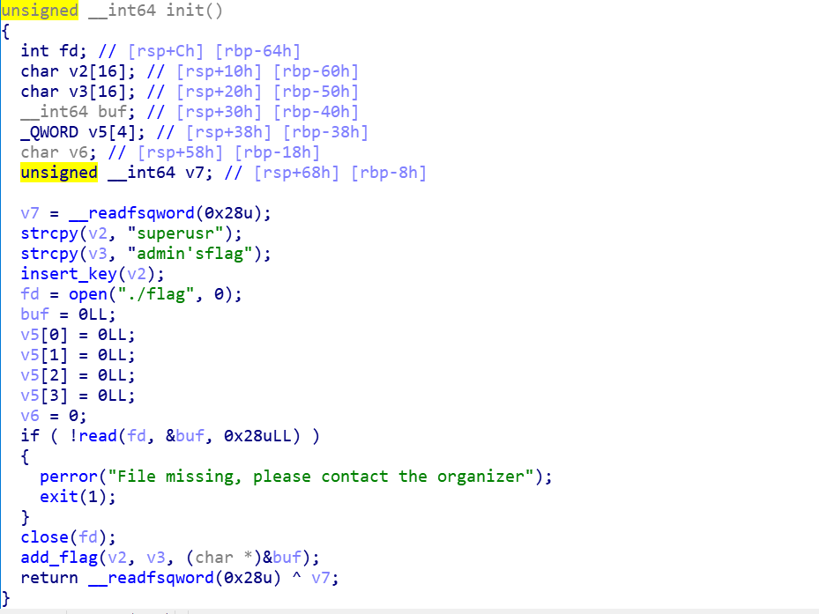
Init()
Read the flag to the buffer
New user “superusr”
New corrid “admin’sflag”
Corr result = flag’s address

Slide 4
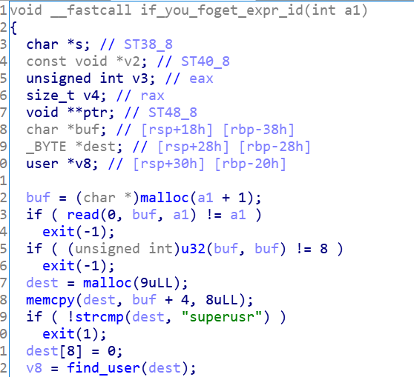
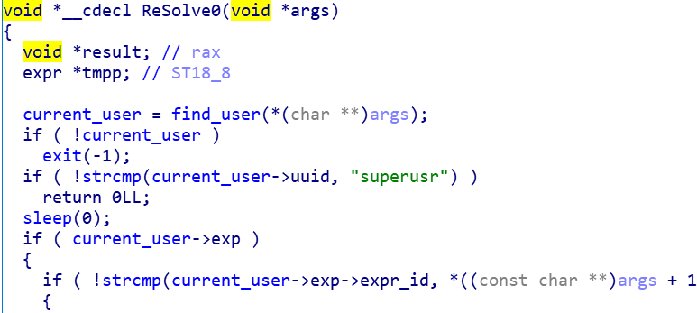
Problem is ...
However you cannot directly read the flag / flag’s address

Slide 5
Vulnerabilities
1. Double Fetch
Leak the flag address
2. Uninitialized variables
Read 8 bytes from any given address

Slide 6
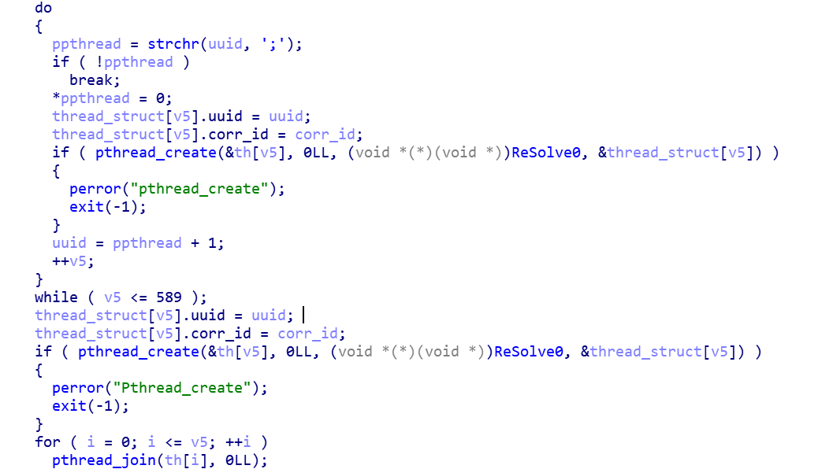
Double Fetch
Get_result()
uuid can be divided by ‘;’ to multiuser
Server will create multi-subthread to fetch these results

Slide 7
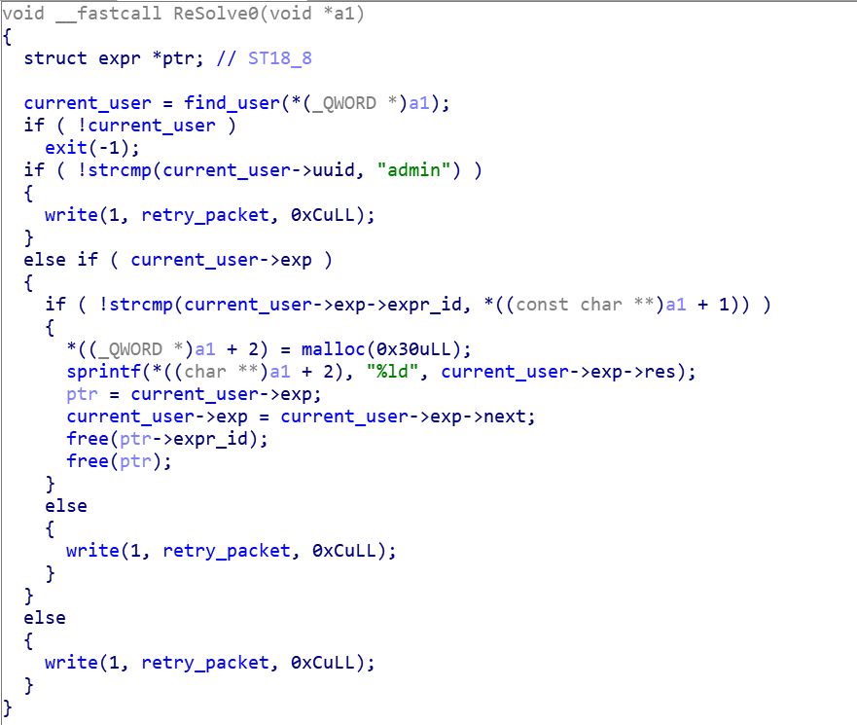
Double Fetch
ReSolve0()
When multi-thread is executing, current_user (global var in .bss) can be tampered after check

Slide 8
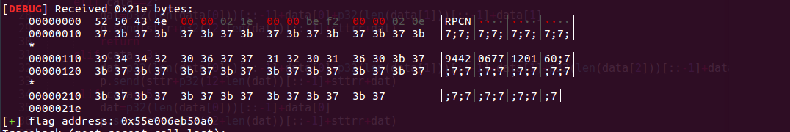
Get the flag’s address

Slide 9
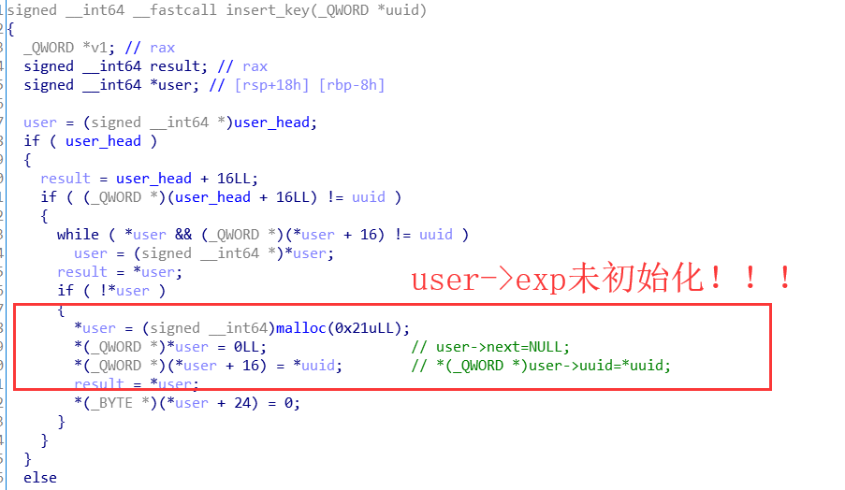
Uninitialized Data

Slide 10
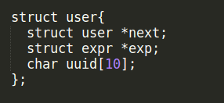
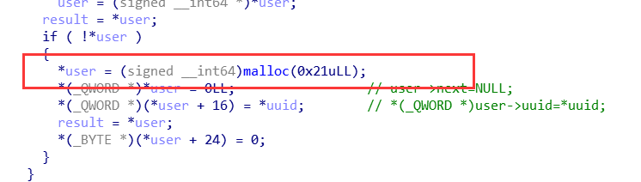
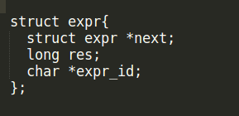
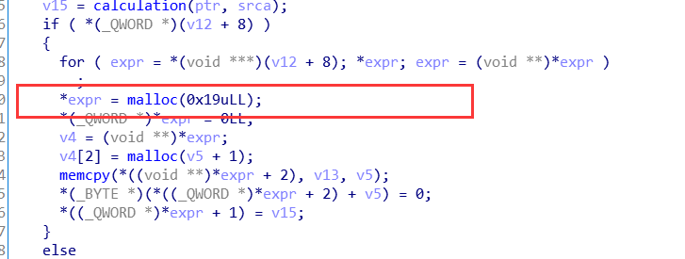
Forge the struct
Notes:
Malloc 0x21与0x19都得到0x30的堆空间，expr中对应于user->exp的是expr->res,所以可以构造一个expr结构体,使其res等于一个地址addr,free掉这个结构体后，再创建一个user,对应的exp为addr

Slide 11
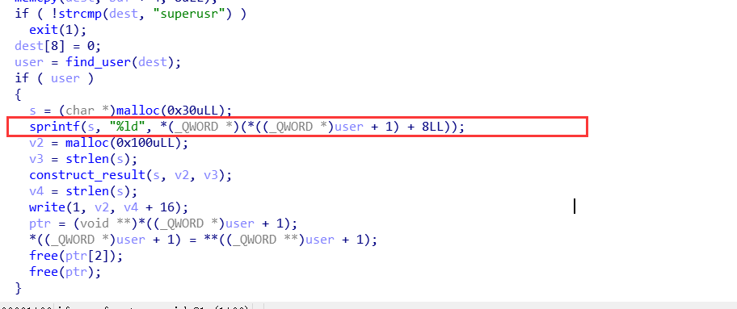
Arbitrary read
Notes:
通过发送类型为5的包，调用if_you_forget_expr_id（）函数，这个函数将用户的第一个expr的结果res以10进制长整数打印出来。通过之前的构造，可以读出目标地址处的8个字节，分多次可以读出flag

Slide 12
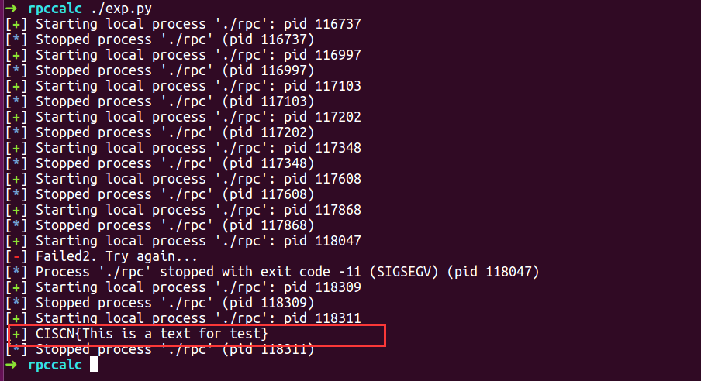
GET FLAG! It can really take much time

Slide 13
Thank you
Q&A?
—— SJTU Ph0t1n1a ——

