Slide 1
INTRODUCTORY COMPUTER SCIENCES 2023 SPRING PROJECT OF GROUP 8

Slide 2
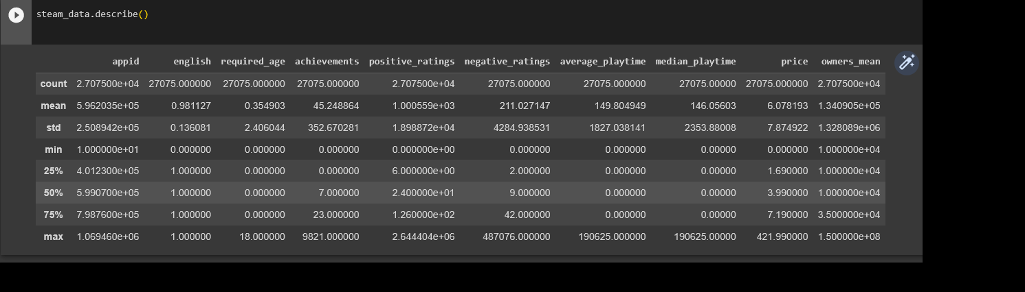
We use ‘Steam Store Games’ dataset from kaggele
https://www.kaggle.com/datasets/nikdavis/steam-store-games

Slide 3
First we came up with two hypothesis reading through the data. Following is what we wanted to see if they are actually true:
Hypothesis 1:Most played genre on average would likely be multiplayer games because they are ongoing games and playing with others means it’s never the same gameplay ever thus increasing the chances of an average person playing them more than they would games from different genres.
Hypothesis 2: Average positive ratings would increase with the said games being available on more than one platform. If this is true it might indicate when a good games popularity increases developers port them to other platforms.

Slide 4
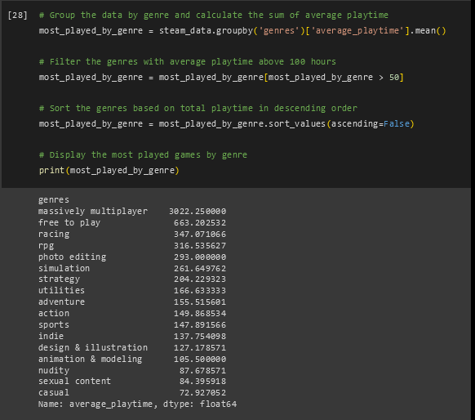
To prove these hypotheses we used data exploratory visualization techniques.

Slide 5
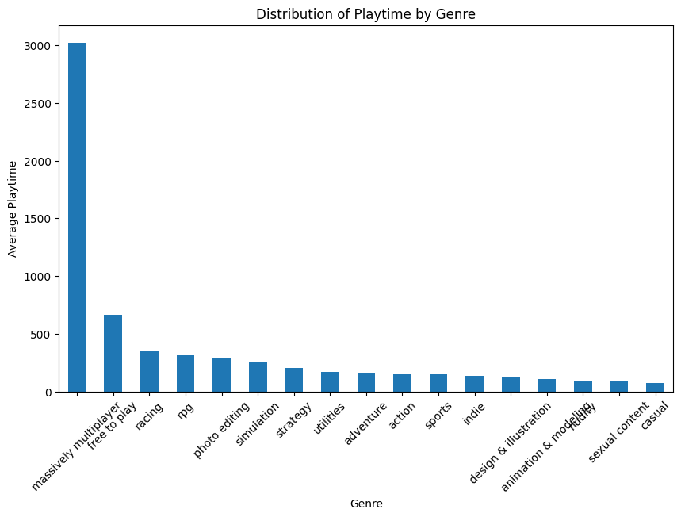
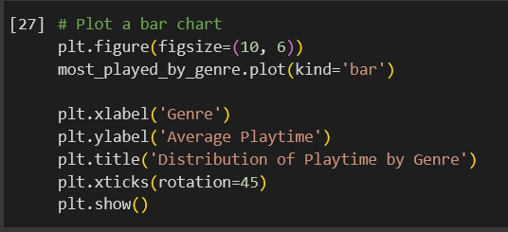
We’ve visualized this information a bar chart:
Hypothesis 1

Slide 6
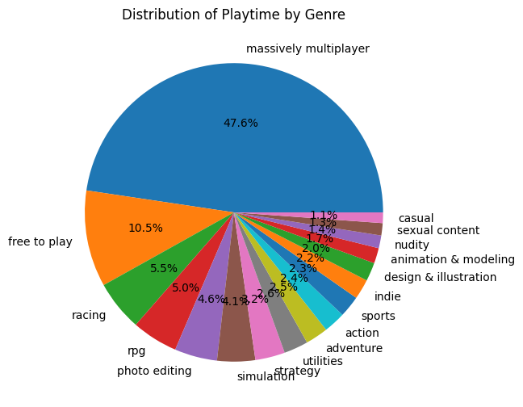
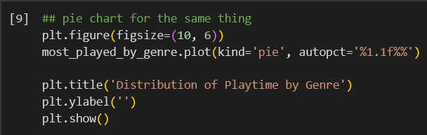
Additional pie chart:
Hypothesis 1

Slide 7
This proved our first hypothesis which was multiplayer genre was played more on the average. Of course why that is , while based on real life experiences we thought it’s because of the social aspect of these games and always changing, is not something that this dataset could prove.
**Most played genre on average would likely be multiplayer games because they are ongoing games and playing with others means it’s never the same gameplay ever thus increasing the chances of an average person playing them more than they would games from different genres.

Slide 8
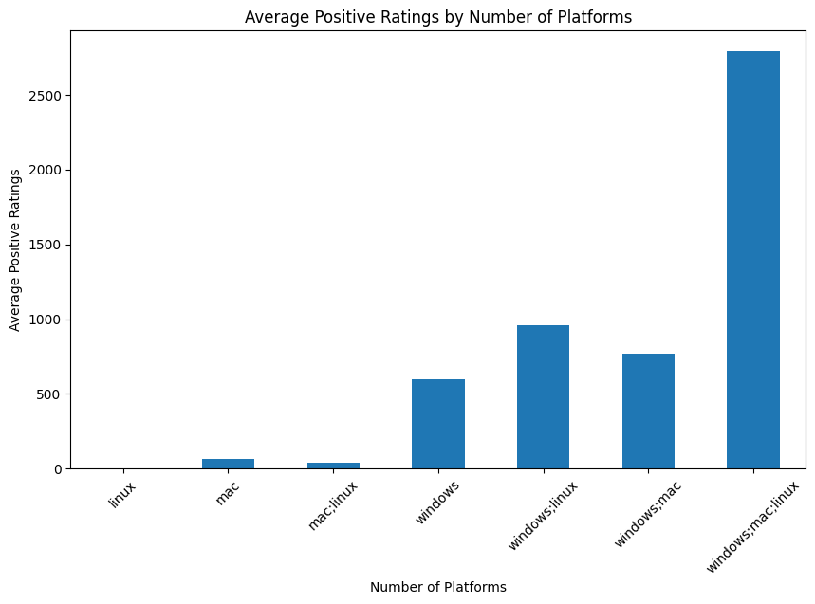
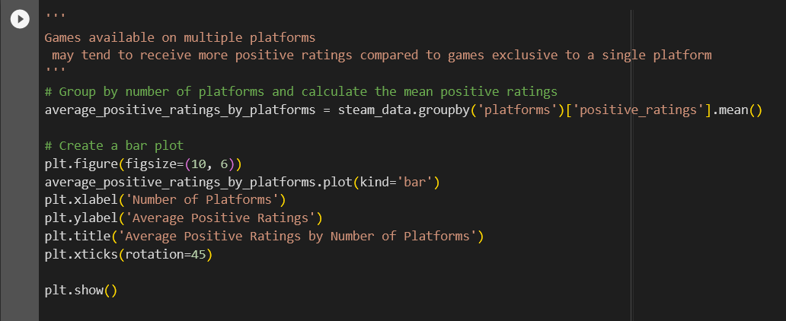
Hypothesis 2
A bar plot

Slide 9
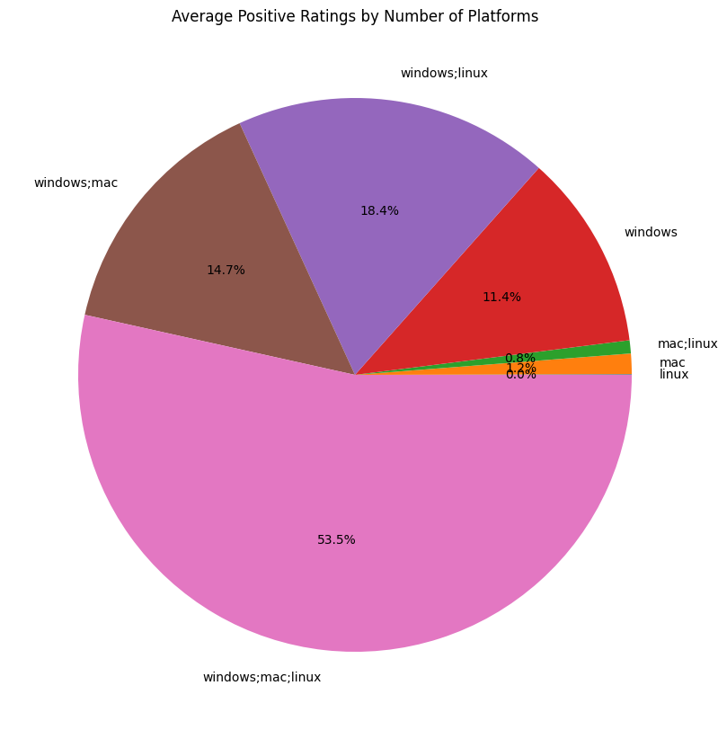
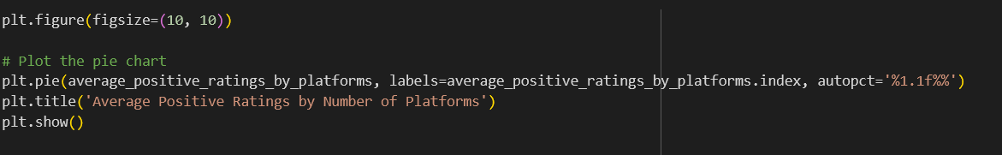
Hypothesis 2
Another way of showing this our favorite pie chart

Slide 10
This also confirmed our hypothesis the more platforms a game averaging on a good score has more it has more people giving it good ratings.
This concludes our answer to the Question 1.

