Slide 1
Predicting and Pre-empting Retry-Storm-Induced Livelock in Microservice Architectures
Review 2
BCSE303L - Operating Systems
Vellore Institute of Technology, Vellore
Varun G A (24BCE0479)
Satwik Som (24BCE2822)
Notes:
Introduce the project title and team. Say that Review 1 defined the problem, and Review 2 shows the working implementation and the results we measured.

Slide 2
The Problem
When a microservice becomes slow, every service calling it starts retrying.
Those retries are extra load on a service that is already struggling.
More requests fail, so more retries are sent. The loop feeds itself.
The system stays fully busy but stops completing useful work.
This is livelock: nothing is blocked, everything is running, no progress is made.
Service
becomes slow
Callers
time out
Callers retry
(extra load)
More failures
feedback loop
2
Notes:
Explain the loop in your own words. Key sentence: the response to the problem is what makes the problem worse. Mention Twitter's 2013 outage as a real example if asked.

Slide 3
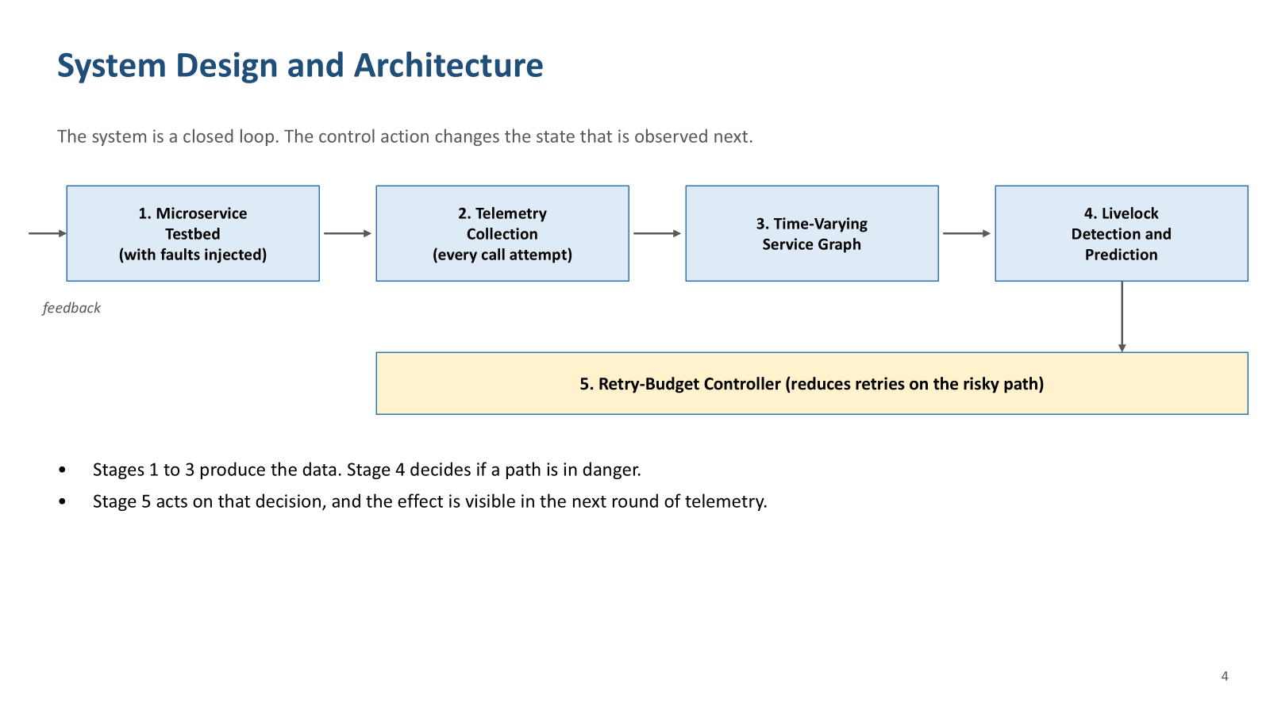
System Design and Architecture
The system is a closed loop. The control action changes the state that is observed next.
1. Microservice Testbed
4 services, bounded worker slots
2. Telemetry Collection
every call attempt logged
3. Time-Varying Service Graph
per-edge features, 2 s windows
4. Livelock Detection and Prediction
four conditions, 10 s ahead
retry budget update (feedback)
5. Retry-Budget Controller
reduces the retry budget on the edge that is amplifying
Stages 1 to 3 produce the data. Stage 4 decides whether a call edge is heading into livelock.
Stage 5 acts on that decision, and the effect appears in the next round of telemetry.
3
Notes:
Walk this left to right, then point at the arrow that comes back.
Stage 1 is the testbed: four services, each with a bounded number of worker slots, which is what makes a retry cost something rather than being free.
Stage 2 is the part that is unusual. We log every call attempt, not every request. Without the attempt number there is no way to compute retry amplification at all, which is also why no public trace could have been used for this.
Stage 3 turns that log into a graph that changes over time. Every measurement is per call edge, never per service, because a service can be healthy for one caller and drowning for another.
Stage 4 applies the four conditions, and predicts about ten seconds ahead rather than only reporting the present.
Stage 5 is what makes this a control system instead of a dashboard. It reduces the retry budget on the specific edge that is amplifying.
The arrow along the bottom is the important one. The controller's output changes the retry policy that Stage 1 applies, so the next round of telemetry is measuring a system the controller has already modified. That is the closed loop, and it is why the diagram is a cycle and not a pipeline.

Slide 4
Related Work
Retry-induced failure is a known problem. This is what the published work covers.
Work | What it contributes | What it does not do
Bronson et al. HotOS 2021 | Named the failure class: a trigger pushes the system into a bad state that persists after the trigger is gone | Conceptual only. No metric, no detector, no experiment
Huang et al. OSDI 2022 | Studied real incident reports from 11 organisations. Retries are the sustaining cause in over half of them | Describes incidents after the fact. No online detection or prediction
Isaacs et al. HotOS 2025 | Queueing models and simulation to find configurations that will fail before they are deployed | Offline and pre-deployment. States that online prediction is still an open problem
Gan et al. (Seer) ASPLOS 2019 | Deep learning predicts QoS violations about 100 ms ahead using per-service queue depths | Does not model retries at all. Reacts by resizing containers, not by changing retry policy
Google SRE 2016 | Retry budget: a client may retry only while retries stay under 10 percent of its requests | Fixed threshold and reactive. Same budget applied no matter which edge is amplifying
Mehan and Saluja arXiv 2026 | Defines a Retry Amplification Factor and an adaptive retry budget, tested in simulation | Analysis and simulation. No ahead-of-time prediction and no definition of livelock
Luo et al. (Alibaba) SoCC 2021 | Public trace of about 20,000 microservices and over 10 billion calls over 7 days | Has no per-attempt field, so retry amplification cannot be measured from it
4
Notes:
The problem itself is not new. Bronson's group at Meta named this failure class in 2021, and the OSDI 2022 follow-up showed retries are the sustaining cause in more than half of real incidents, so the mechanism we are attacking is the one that actually bites in production.
The important column is the right one. Every one of these either explains the failure after it happened, or analyses it offline before deployment. The HotOS 2025 paper says in its own words that online prediction is still open.
Seer is the closest on method because it does predict ahead, but it predicts QoS violations from queue depths and never looks at retries, and its response is to give the container more resources.
Google's retry budget is the standard production answer. It works, but the 10 percent cap is a fixed number applied everywhere, and it only reacts once retries are already high.
The arXiv paper from last month is the closest to us in subject. It defines a Retry Amplification Factor, which is essentially the same quantity as our rho. We are not claiming to have invented that metric. What they do not do is predict ahead or define when the system is actually in livelock.
The Alibaba row explains why we built our own testbed. We checked the largest public microservice trace and it has no attempt number per call, so retry amplification simply cannot be computed from it.

Slide 5
Research Gap and Our Contribution
No existing work predicts retry-induced livelock ahead of time and then acts on the retry policy itself.
Capability | Metastable failure studies | Seer | SRE retry budget | Ours
Measures retry amplification per call edge | No | No | Indirectly | Yes
Test that separates livelock from ordinary overload | No | No | No | Yes
Predicts before the bad state is reached | No | Yes, but for QoS | No | Yes
Acts by changing the retry policy itself | Suggested | No | Yes | Yes
Control driven by a measured per-edge risk score | No | No | No | Yes
Checked against a shuffled-label control run | No | No | No | Yes
We are not claiming to handle failures better than a production system at Google or Meta.
The contribution is the combination: retry amplification measured per call edge from per-attempt telemetry, a four-condition test that tells livelock apart from overload that is recovering, and a controller that changes the retry budget from that signal before the system reaches the bad state.
5
Notes:
Reading down the last column, three of these six rows are things no other row in the table does at all.
The second row is the one to stress. An overloaded system and a livelocked system look identical on a latency graph. Both are slow, both are busy. The difference is whether retries are still climbing while the success rate is flat, and that is our fourth condition. Without it you cannot tell a system that is about to recover on its own from one that never will.
The last row matters for whether you believe the model at all. We trained the same model on randomly shuffled labels. If it had still scored well, that would have meant the task was trivially predictable and the model had learned nothing real. It collapsed to near zero, which is the result we wanted.
If she asks whether ours is better than Seer or better than Google's retry budget, the honest answer is that they solve different problems. Seer predicts latency violations and scales containers. Google caps retries at a fixed ratio after the fact. Neither one predicts livelock and neither one adapts the budget per edge. That is the gap we fill.

Slide 6
Implemented Testbed Architecture
e3
Payment Service
S3 (c = 2)
Client
(load generator)
e1
Gateway
S1
e2
Order Service
S2 (c = 8)
e4
Inventory Service
S4 (c = 2)
Fig. 2. Implemented microservice testbed. Each service Si has a bounded concurrency limit c; each edge ei retries on failure and is instrumented.
Every internal call retries on failure, up to 3 attempts with exponential backoff.
Worker slots are limited, so retries compete with new requests for the same capacity.
This is what makes the retry storm cause real harm instead of being only extra traffic.
One user request can become 9 calls to a failing service (3 retries at two levels).
6
Notes:
The worker slots are the most important design decision. Without a capacity limit, retries would be free and there would be no feedback loop to study. Be ready to explain the 9 calls: gateway retries order 3 times, and each of those causes 3 payment attempts.

Slide 7
Module Identification
Module | Function
1. Microservice Testbed | Services communicating over HTTP in a call chain
2. Retry and Fault Injection | Inject latency or failures, retry with backoff
3. Telemetry Pipeline | Record every call attempt into structured files
4. Livelock Detection | Apply the four conditions and label time windows
5. Graph Representation | Build a time-varying service call graph
6. Prediction Model | Predict livelock risk a few seconds ahead
7. Retry Controller | Reduce retry budget on a high-risk path
7
Notes:
Explain that modules 1 to 4 were the minimum needed to measure anything at all, so they were built first. 5 to 7 build on top of that data.

Slide 8
Module Completion
Module | Status | Evidence
1. Microservice Testbed | Completed | 4 services run and communicate
2. Retry and Fault Injection | Completed | Retry storm reproduced on demand
3. Telemetry Pipeline | Completed | 13,214 call records collected
4. Livelock Detection | Completed | 8 windows detected, 0 false alarms
5. Graph Representation | Completed | Graph snapshots exported per window
6. Prediction Model | Completed | F1 0.55, verified against a control test
7. Retry Controller | Completed | Wasted work reduced by 28 percent
8
Notes:
Be honest here. All seven run, but module 6 uses logistic regression instead of the temporal graph neural network, because the environment has no PyTorch. The limitations slide covers this.

Slide 9
Implementation Details
Language and libraries
Python 3, Flask for the services, scikit-learn for the model, NetworkX for the graph.
Fault injection
Each service reads a small config file per request, so faults can be changed while the system runs.
Telemetry recorded for every call
Timestamp, source service, destination service, attempt number, backoff delay, response code, latency.
Two separate logs
One for internal call attempts (how hard the system is working) and one for user requests (what users actually got).
The two separate logs are what allow livelock to be shown: high activity together with near-zero progress.
9
Notes:
If asked why two logs: you cannot demonstrate livelock with only one of them. You need to show work going up while useful output goes down.

Slide 10
Livelock Detection Logic
A time window is labelled livelock only if all four conditions hold for two windows in a row.
Condition | Meaning
1. Retry amplification is high | More retry calls than fresh calls on the edge
2. Useful throughput collapsed | Edge delivers less than half its healthy rate
3. Concurrency is not draining | Work in flight stays high instead of clearing
4. Positive feedback is present | Retries not falling while success rate is not improving
Retry amplification: rho = retry calls per second / fresh calls per second
Healthy traffic gives rho near 0. During a storm we measured rho between 1.4 and 4.5.
Condition 4 is what separates livelock from ordinary overload. An overloaded system that is recovering fails this condition.
Requiring all four together is why we got zero false alarms on healthy traffic.
10
Notes:
Condition 4 is the important one. Any overloaded system satisfies conditions 1 to 3. Condition 4 says the retries are holding up while success refuses to improve, which is the self-feeding signature.

Slide 11
Results and Analysis: Does Retrying Help?
The same fault was applied three times, changing only the retry policy.
Retry policy | Success (normal) | Success (during fault) | Calls made | Avg latency
No retries | 88.5 % | 0.7 % | 475 | 1337 ms
Always retry (3 attempts) | 100.0 % | 1.4 % | 1036 | 3473 ms
Adaptive controller | 99.4 % | 1.7 % | 747 | 2353 ms
Retrying during the fault gave no extra useful output, but more than doubled the work (475 to 1036 calls) and made users wait 2.6 times longer.
Turning retries off is not a solution either. Without retries, normal traffic drops from 100 percent to 88.5 percent.
The adaptive controller keeps success at 99.4 percent when healthy and still cuts wasted work by about 28 percent when the system is struggling.
11
Notes:
Spend the most time on this slide. Read the 'calls made' column against the 'success during fault' column. That gap is the livelock. Then explain why we cannot simply switch retries off.

Slide 12
Results and Analysis: Detection and Prediction
Detection
Prediction
6 test runs, 13,214 call records, 660 time windows analysed.
8 windows labelled as livelock.
5 in the sustained degraded period, 3 during the ramps into it.
0 false alarms during healthy traffic.
Predicting livelock 4 to 12 seconds ahead:
 | Precision | Recall | F1
Our model | 0.38 | 1.00 | 0.55
Shuffled labels (control) | 0.06 | 0.60 | 0.12
The control test trains the same model on random labels. It scores at chance level (F1 0.12 against a chance level of 0.05), which shows our model is learning real signal and not leaking the answer.
Recall 1.00 means no coming livelock was missed. Precision 0.38 means some warnings were false alarms.
For an early warning system this trade is acceptable, because a missed storm costs far more than an unnecessary caution.
12
Notes:
The control test is the strongest point here. If the model were cheating, training on random labels would still score well. It does not, so the result is real. Expect a question about the low precision and answer with the cost asymmetry.

Slide 13
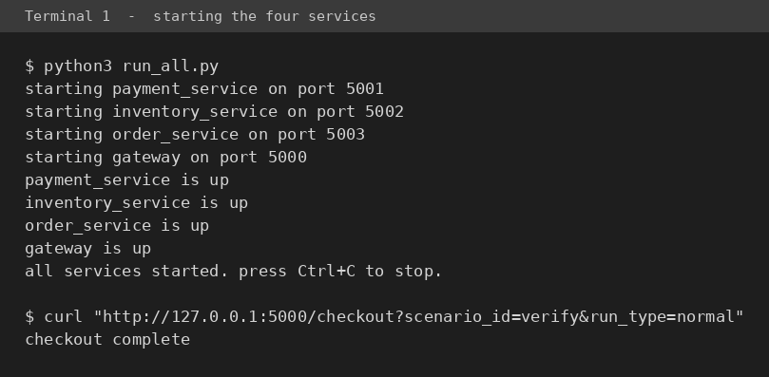
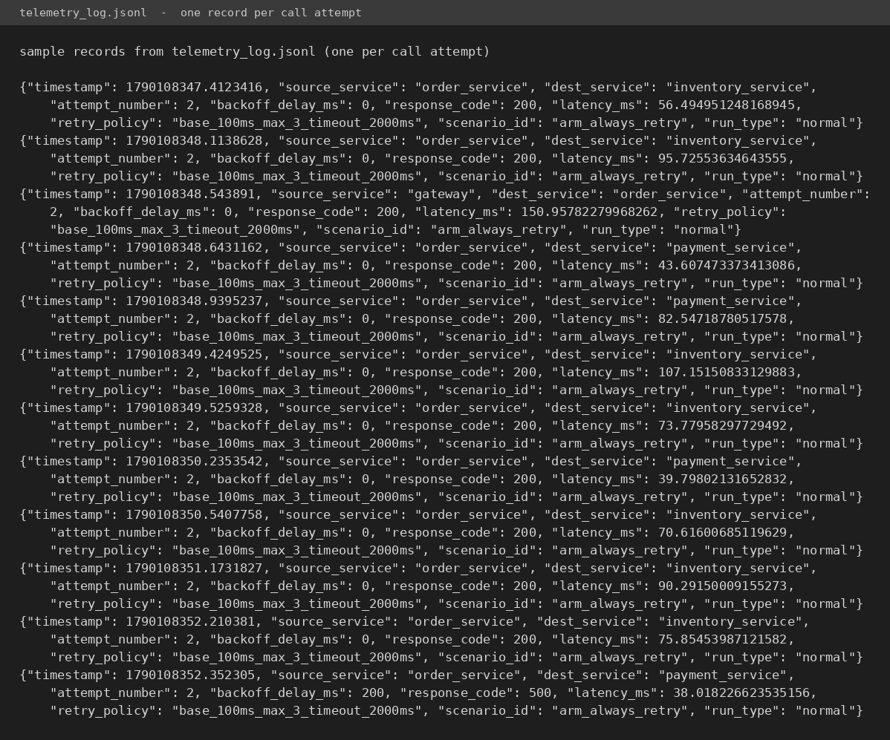
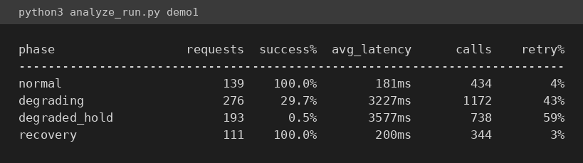
Output: Services Running and Telemetry Collected
Four services start, each with its worker slot count
Per-phase summary of one gradual-degradation run
Raw records showing retry attempts
13
Notes:
Read the analyze_run table out loud: success falls from 100 percent to 0.5 percent while the system keeps making over 700 calls. That contrast is the livelock, in one table.

Slide 14
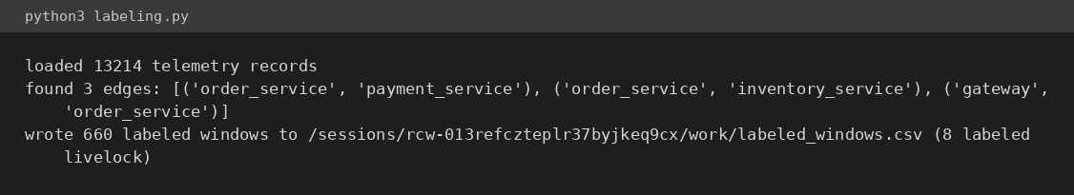
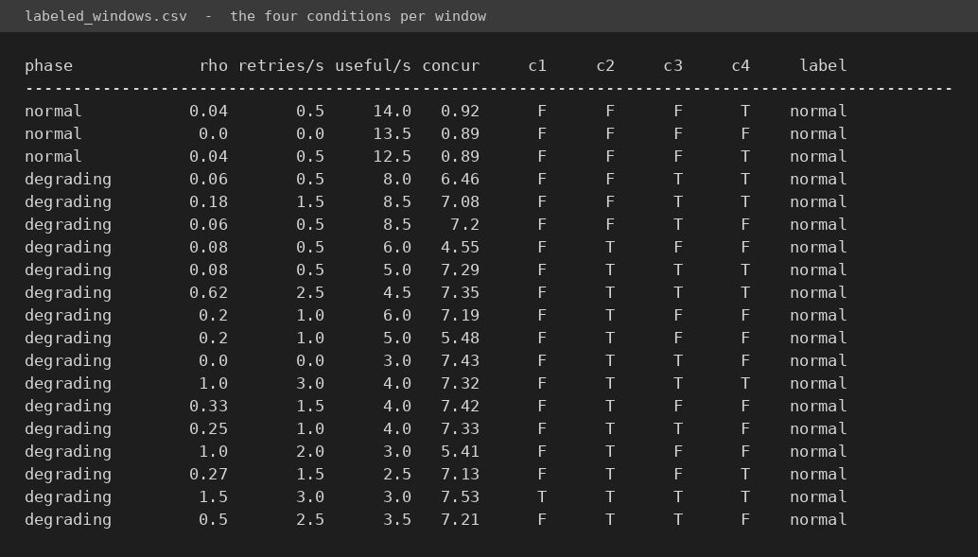
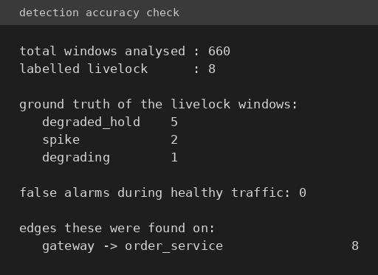
Output: Livelock Detection
Conditions switching on one by one as the service degrades
Checked against the injected fault
14
Notes:
The CSV has a separate column for each of the four conditions, so you can point at exactly why any window was labelled. Note the zero false alarms during healthy traffic.

Slide 15
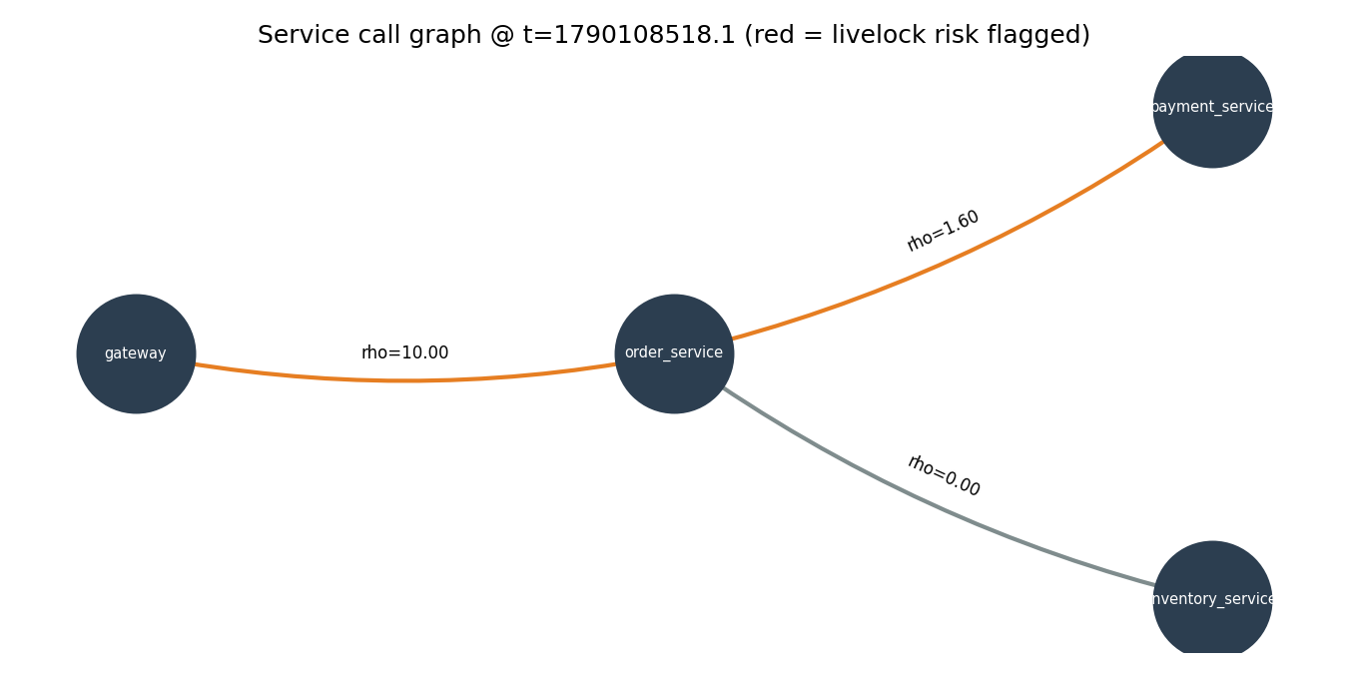
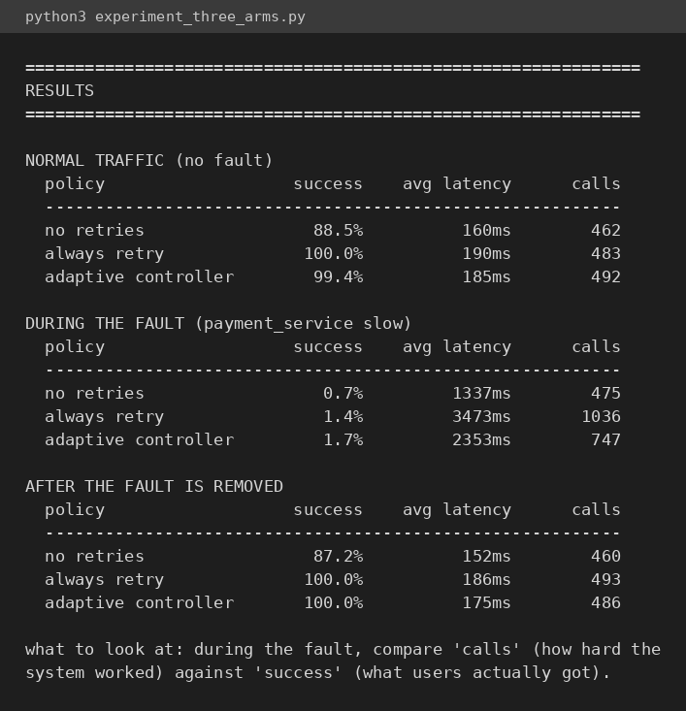
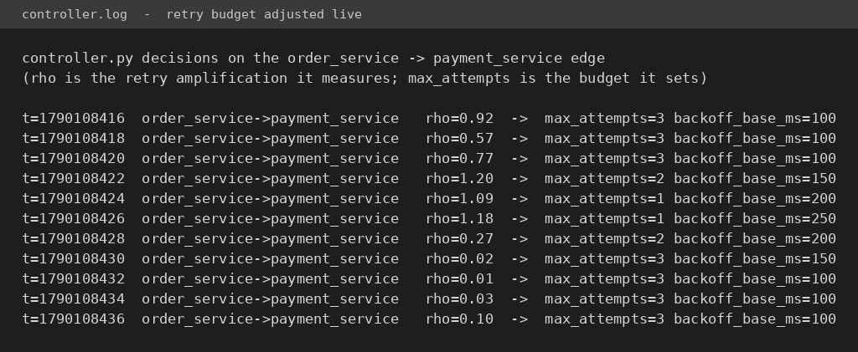
Output: Service Graph and Controller Action
Red edges are the ones flagged as livelock risk
Retry budget cut as rho rises, restored as it falls
15
Notes:
On the controller log, trace the budget going 3 to 2 to 1 as rho crosses 1.0, and back to 3 once it drops. That is the closed loop working.

Slide 16
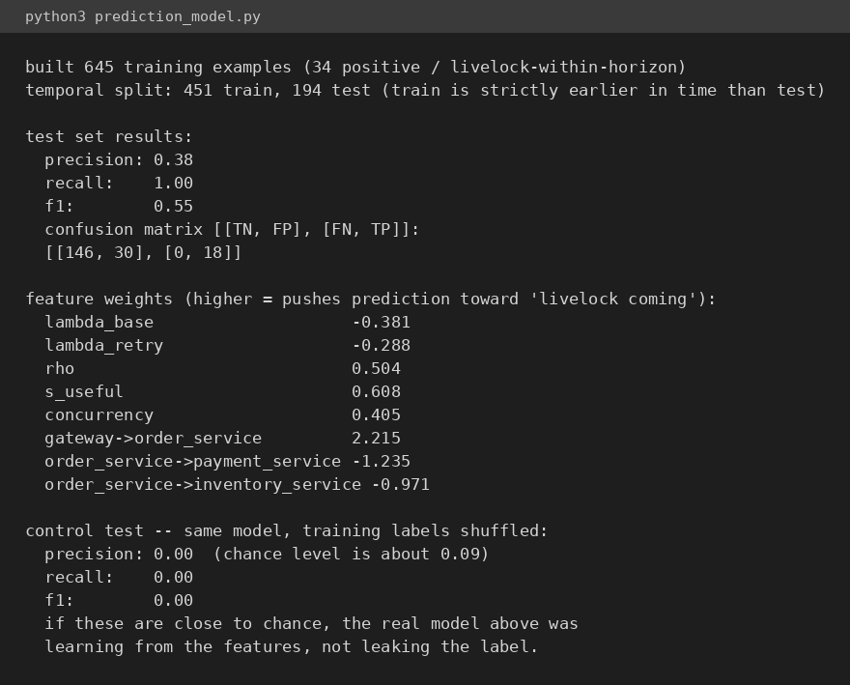
Output: Prediction Results
Recall 1.00 means no coming livelock was missed. The shuffled-label control scoring 0.00 is the evidence that the real result is not leakage.
16
Notes:
This is the slide to invite the leakage question on. The control test trains the identical model on randomised labels and scores zero, well under the 0.09 chance level.

Slide 17
Future Work
Implement the TGN-Edge model now that the prediction task is shown to be learnable.
Calibrate thresholds using a public production trace such as the Alibaba microservice dataset.
Add the remaining two controller stability mechanisms.
Extend to a deeper call chain, since retry amplification compounds with every additional layer.
17
Notes:
Raising the limitations yourself is better than being caught out on them. The self-sustaining storm point is a real finding: we tested four configurations and the system recovered each time, because a healthy service answers the first attempt so amplification collapses immediately.

Slide 18
Conclusion
A working microservice testbed was built in which a retry storm can be triggered and measured.
Livelock detection was implemented directly from the four formal conditions, and produced no false alarms on healthy traffic.
Livelock can be predicted a few seconds in advance, and this was verified against a control test rather than assumed.
An adaptive retry controller reduced wasted work by about 28 percent without losing the benefit of retries in normal conditions.
All seven identified modules are implemented and can be demonstrated live.
Main finding: retries are helpful for short-lived faults and harmful during saturation. A fixed retry policy cannot be correct in both situations, which is why the control has to adapt at runtime.
18
Notes:
End on the main finding. It connects the Operating Systems concept to a practical engineering result, which is what the project set out to do.

Slide 19
Thank You
Notes:
Thank the panel and invite questions.

