Slide 1
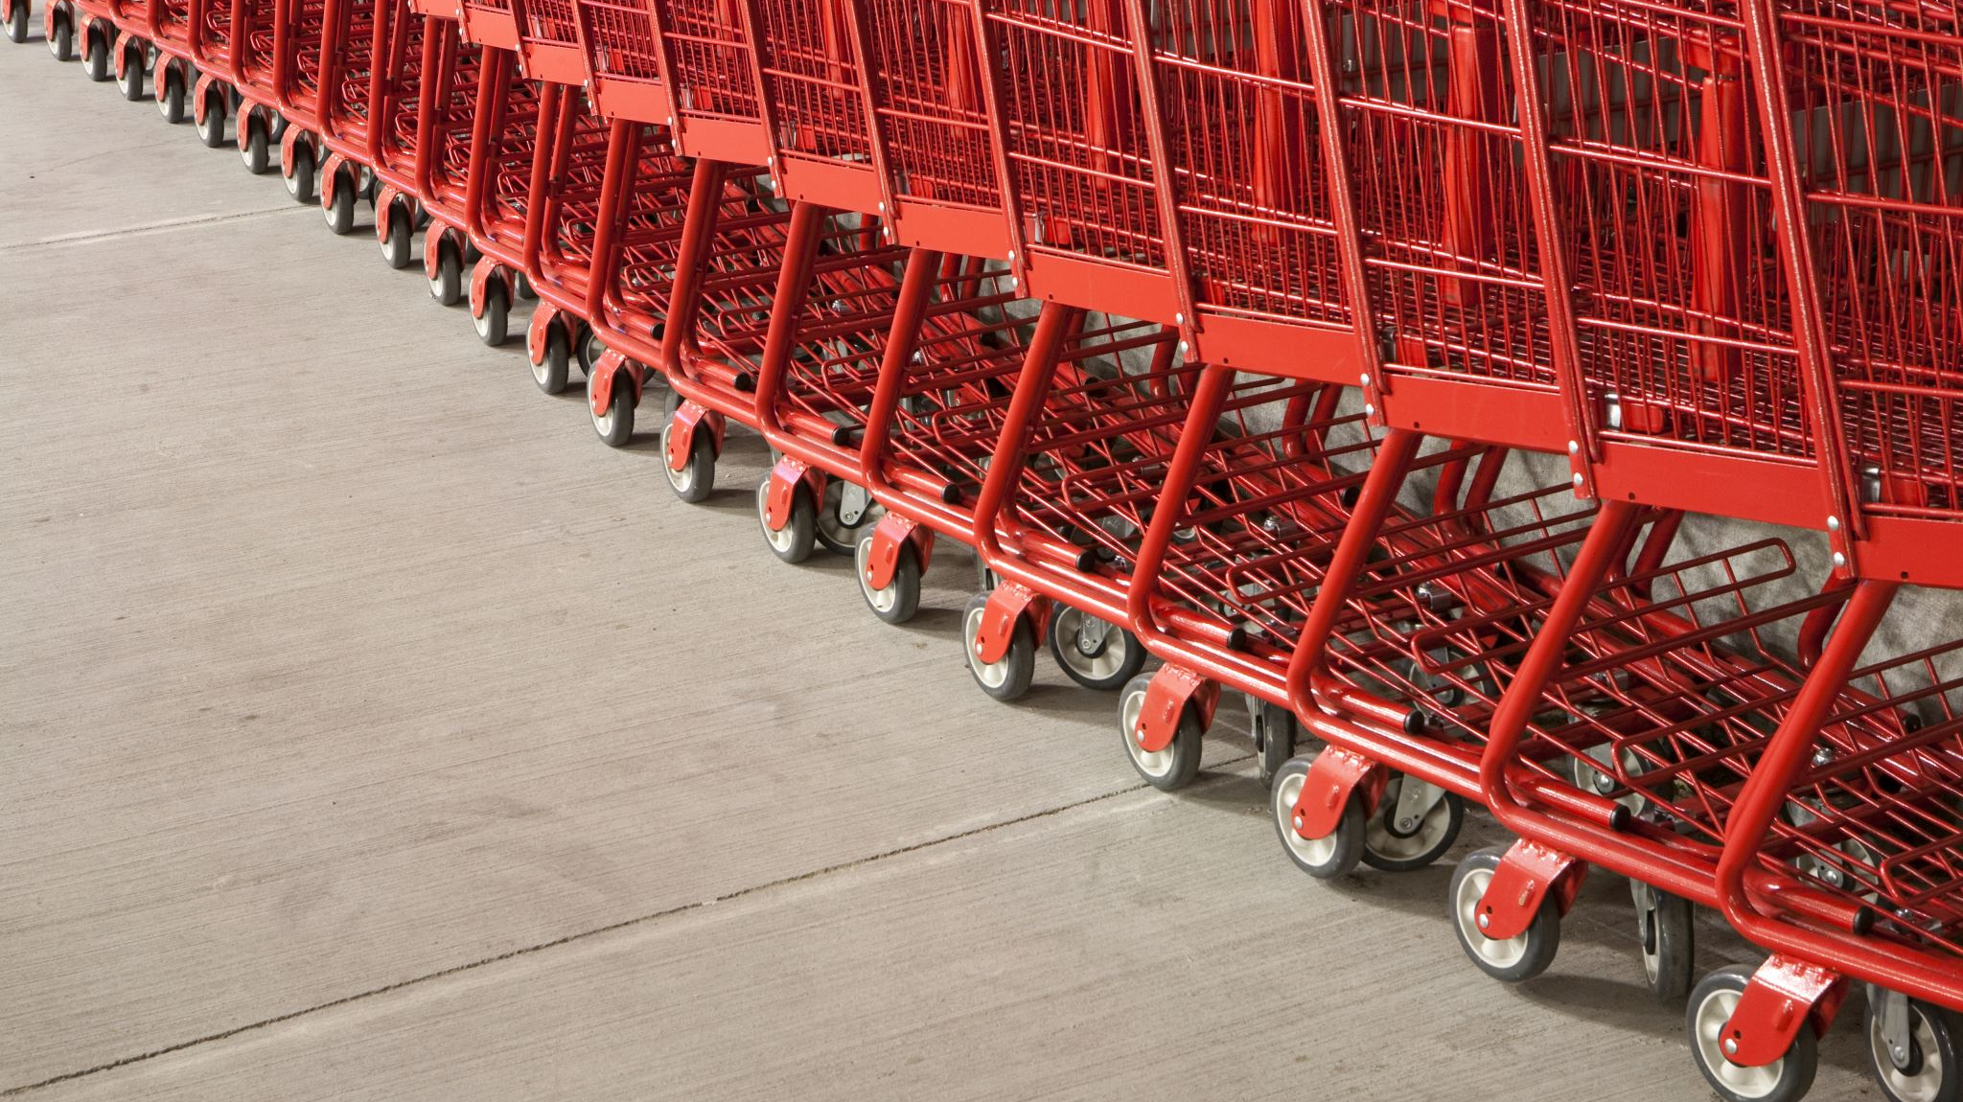
When Did I Make That Purchase?
George Athitakis

Slide 2


Why Is this an issue?
108 million daily credit card transaction
$\sim$40 billion per year
$5.8 billion reported in 2021
70% increase
$3.4 billion in 2020
Stake Holders
Account Providers
Consumers

Slide 3

What’s the Plan?
Use classical machine learning tactics
Statistical algorithms
Dataframe sourced from IBM
24 million transaction
Account information
Card Holder information
Unemployment rates from 1991 to 2020
United States
Averages of all 6 continents

Slide 4
Did it Work?
Accuracy
90%
Recall
85%
Precision
74%

Slide 5
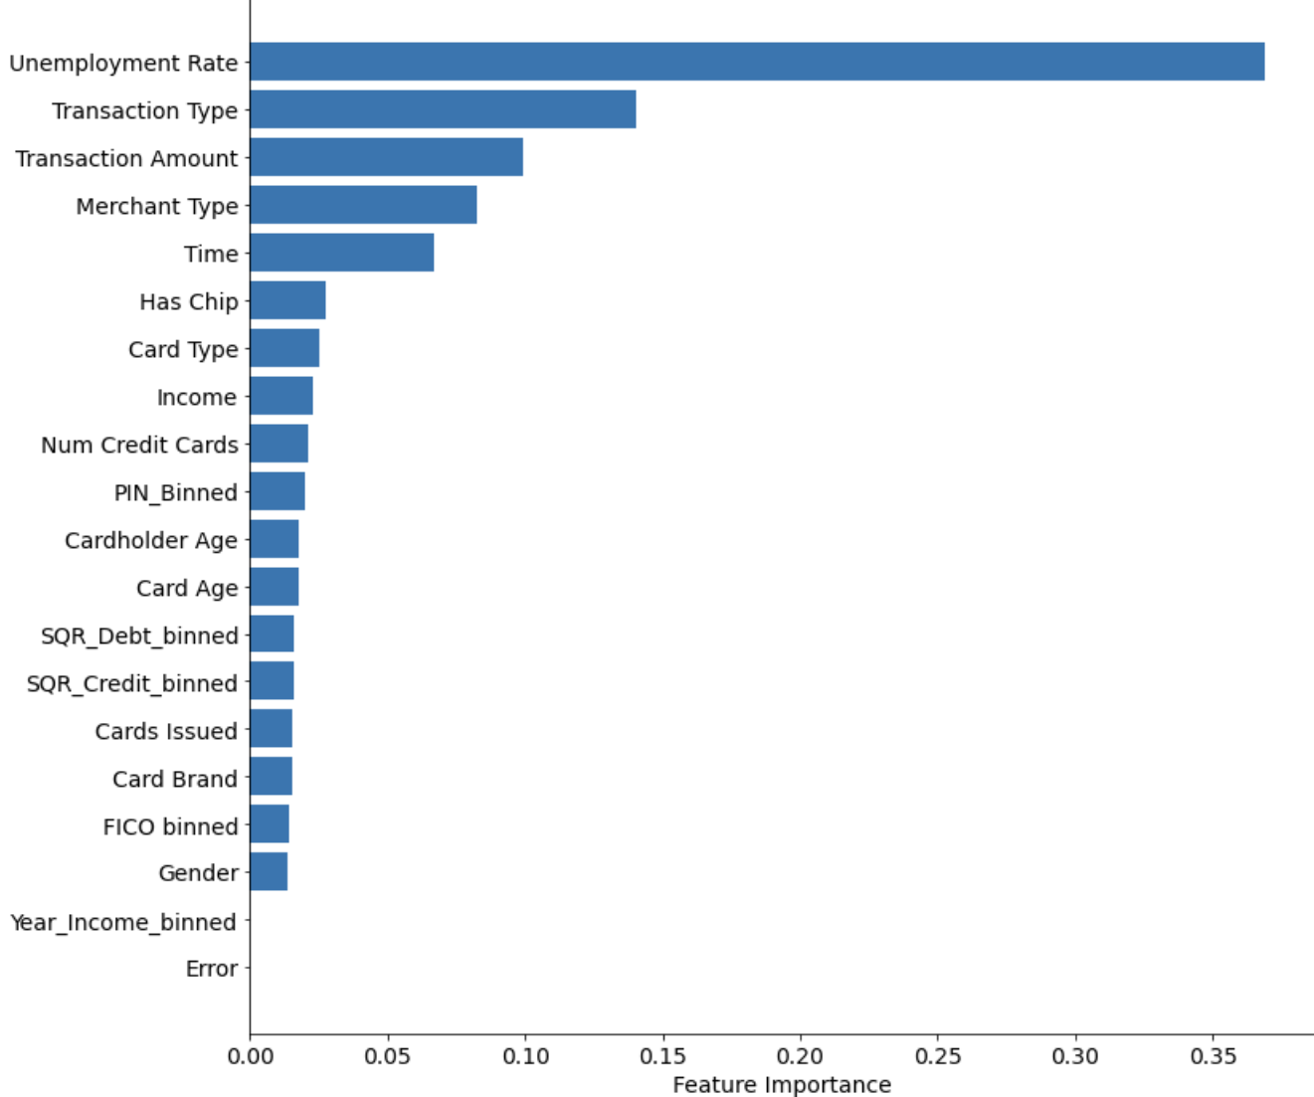
What Did I find?
Top 10 Features based on their importance
Unemployment Rate
Type of Transaction
Online
Swipe
Chip

Slide 6
Let's Dig Deeper
62% of all fraudulent transaction take place in areas where unemployment rates are 10% or above
62% of the fraudulent transactions are Online

Slide 7
Future Direction
Determine whether the card was included in one of the many data breaches that occur every year

