Slide 1
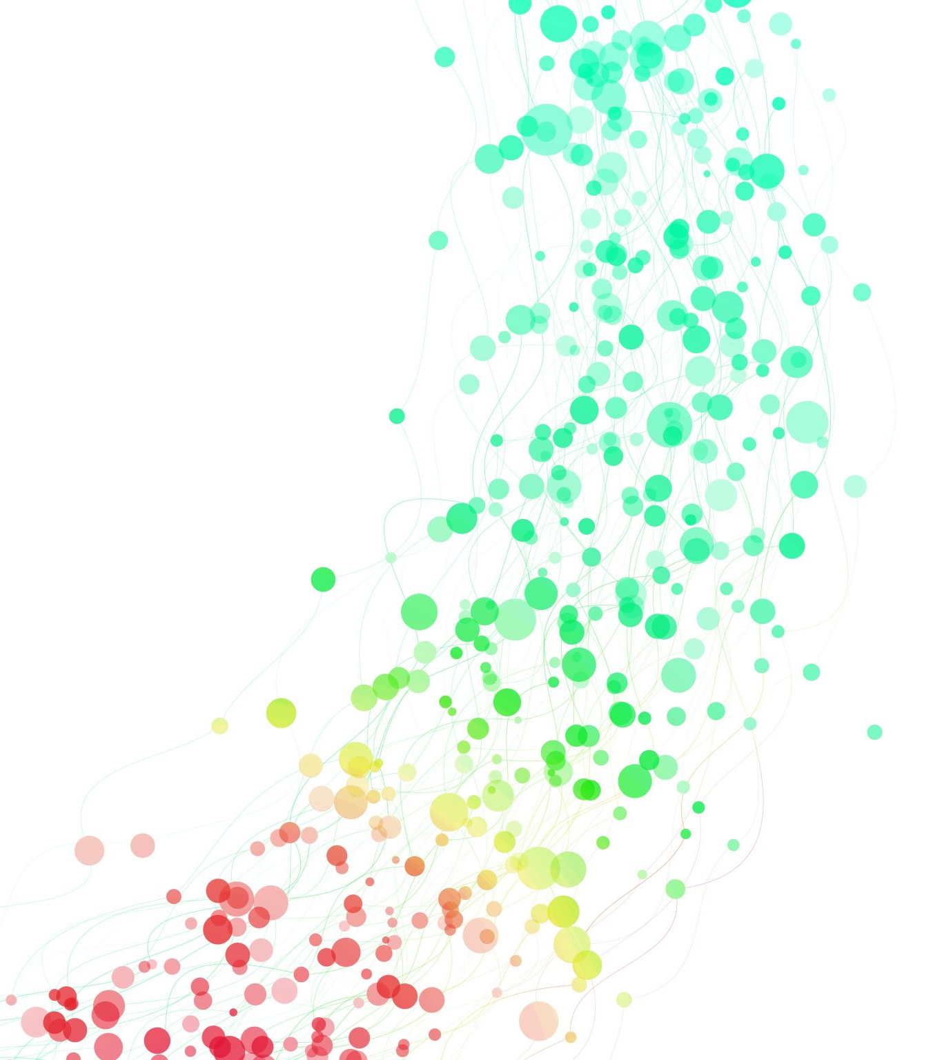
Data Analysis of NBA Minutes Played
By: Grant Bartow-Winstel

Slide 2
Background
My goal of this assignment was to analyze NBA players minutes played to see if the minutes played was deserved and if this is hindering or helping team success
Analyzing player and team success is a major aspect of data science in sports, a massive business industry, and is growing rapidly with the big data era we are in

Slide 3

Question for Analysis
Can I predict a better minutes played rotation in the NBA to increase team success?

Slide 4
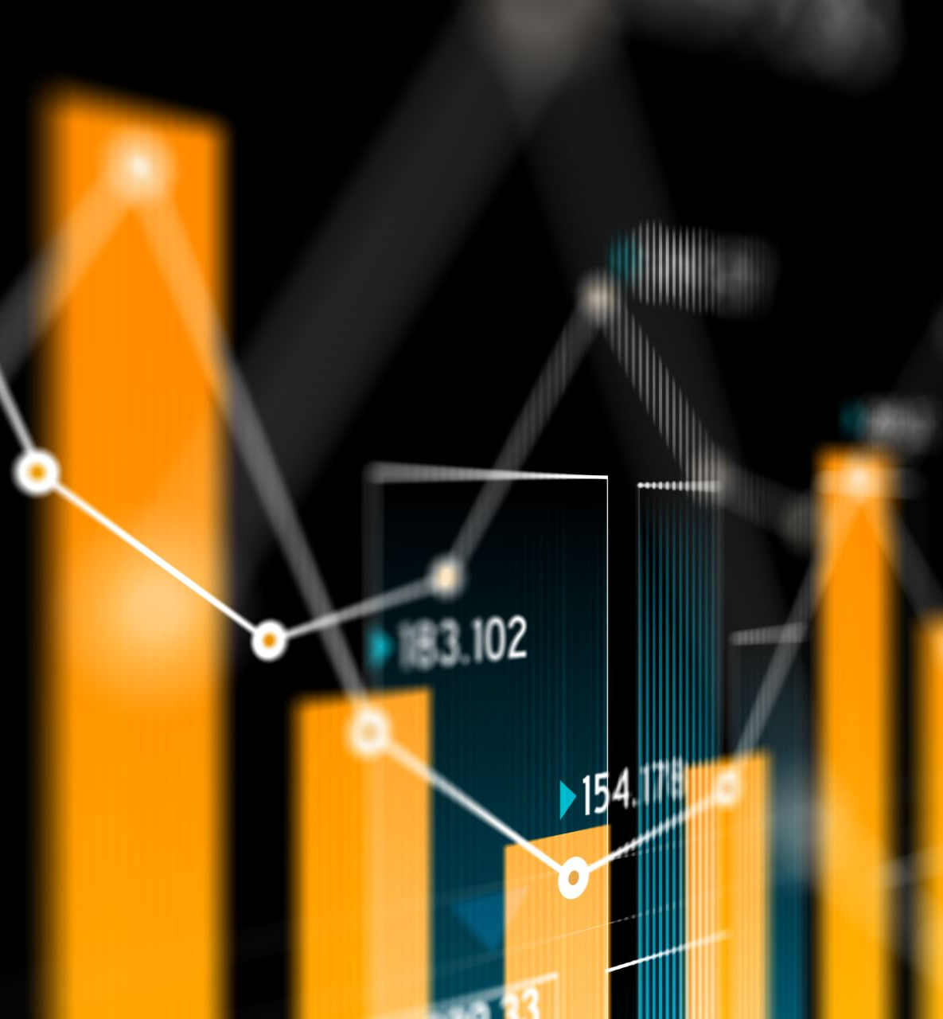
The Dataset
Excel - NBA player statistics for last 20 years
Sports and Business Fields
Minutes Played, Effective Field Goal Percentage, Three Pointer Percentage, Total Rebounds, Assists, Steals, Blocks, Points, Win-Loss Record, Games Behind, and Team
From Kaggle

Slide 5
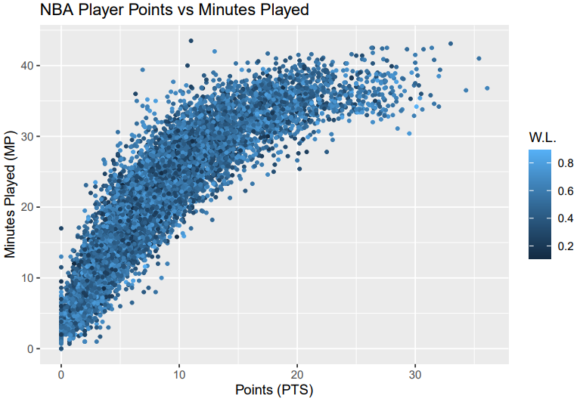
Exploratory Data Analysis
Looking for outliers or trends and what color those dots are to gain understanding behind players minutes played
Outliers tend to be lower winning percentage

Slide 6
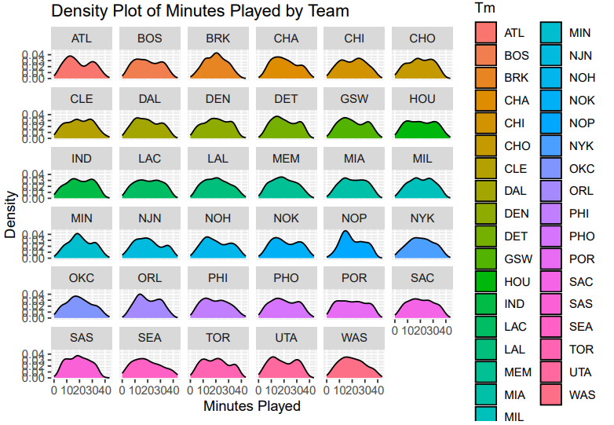
Exploratory Data Analysis
Looking for common trends amongst teams that are successful or unsuccessful
Plateau of minutes played typically shows success
A large hump at top typically shows lack of success

Slide 7
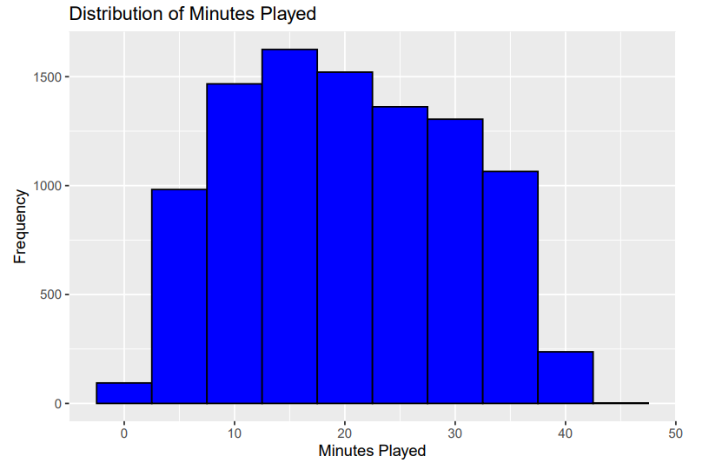
Exploratory Data Analysis
Finding graph central tendency
Skewed to the right, showing most players being bench or role players
A select few superstars who play 40 minutes or more

Slide 8
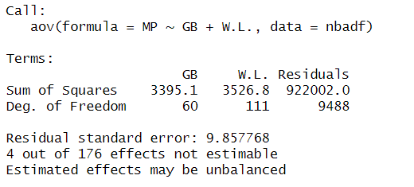
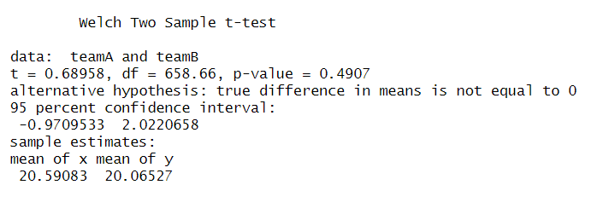
Exploratory Data Analysis
P-Value of .4907 means we do not reject the null hypothesis.
The mean playing time is not different enough to reject hypothesis
Gauging contribution of independent variables
Win-Loss has a more direct impact

Slide 9
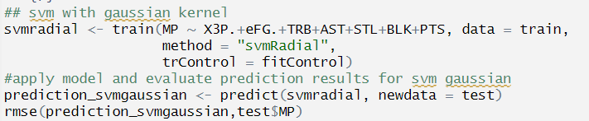
Models
Gaussian Kernal model after splitting into training and testing datasets and setting cross validation
Root Mean Square Error: 2.497955
2.50 minutes of deviation in the model

Slide 10
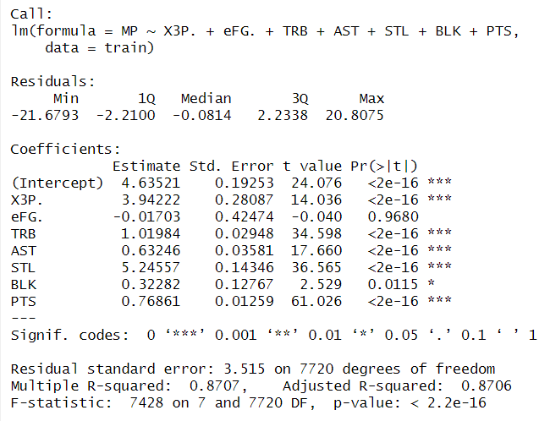
Models
Linear Regression Model
R-squared: .8707
87% of variability shown in model
Higher Coefficients: Steals and 3-Point Percentage
Lower Coefficients: Overall Shooting, Blocks

Slide 11
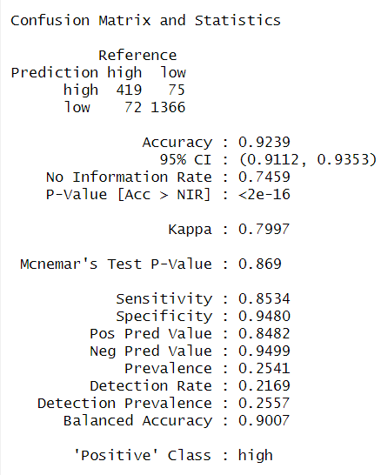
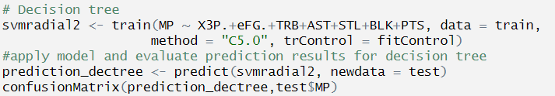
Models
Decision Tree Model after Converting Minutes Played to Labels
Model Picked correctly at 92%
Overall performs well and could help teams perfect playing time when the model differs

Slide 12
Conclusion
Holistic Approach
Required Critical Thinking
Forced Understanding Beyond Coding
Trial and Error Modeling
Cyclic Nature of Data Science
Needed Comprehension of Modeling Stats

