Slide 1
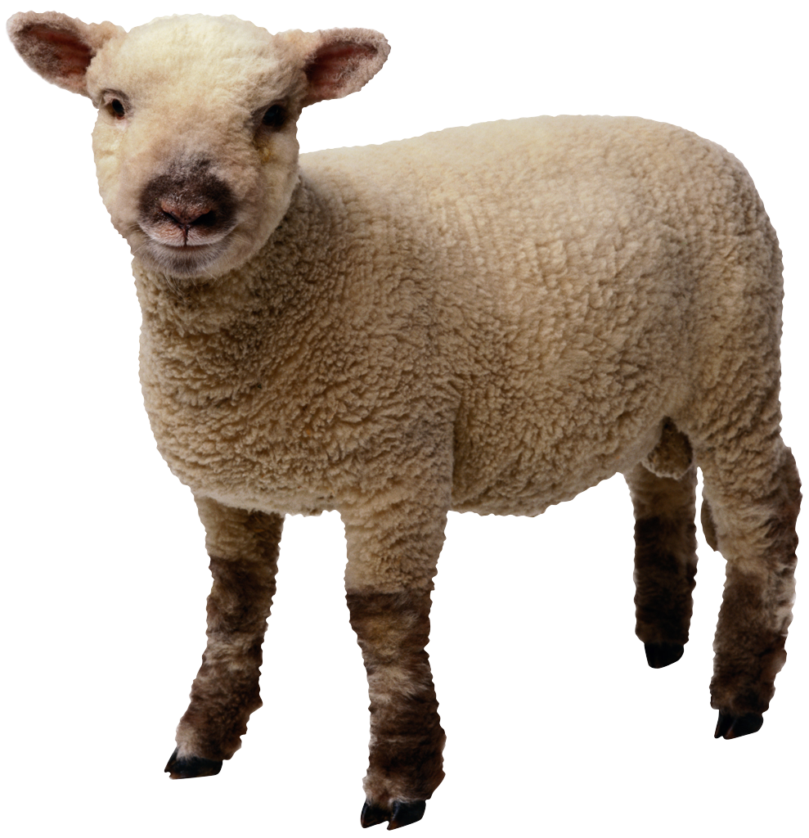

Login Screen and Main Screen
User Profile and Settings
I know its not a goat!
Science
Technology
YodelIt!
Life
Username:
Food
Login

Slide 2
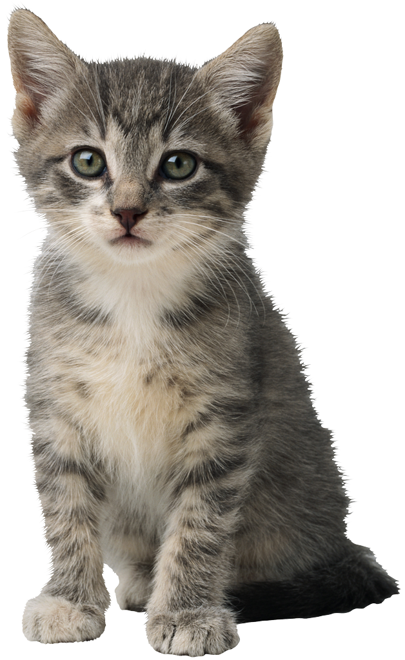

Profile and Certain Topic Page
YodelIt!
Food
Rodney Rabbit Yodeled: I am getting sick of my old carrot soup recipe, any ideas on how I can spice it up?
Username: purrincess_with_catitude
Name: Tibby
Favorites:
-How to make your own Cat Food
Questions Asked:
What is the best way to catch a mouse?
Sort topics by ☑ Day ☐ Month
Users Click on the Up-vote Or Down Vote Buttons
Tibby echoed: Have you tried Catnip?
Enter Echo Here:
EchoIt

Slide 3
Multiple Questions Page
Food
Users Click on Text Boxes to expand and see other comments, up-votes etc.
Rodney Rabbit: I am getting sick of my old carrot soup recipe….,
Mary Cow: This is a great beef free stir fry that want to share.
Tibby: How to make Homemade Cat Food

