Slide 1
📊 Sales Dashboard Using Power BI
By: G. Chandra Sekhar Reddy

Slide 2
🗂 Dataset Overview
Dataset: Sales Transactions Dataset (Kaggle)
✅ Columns:
ORDERNUMBER
ORDERDATE
QUANTITYORDERED
PRICEEACH
SALES
PRODUCTLINE
COUNTRY
CUSTOMERNAME
DEALSIZE
and more...

Slide 3
📌 Key Performance Indicators (KPIs)
Total Sales
Total Profit
Average Profit Margin
Total Orders

Slide 4
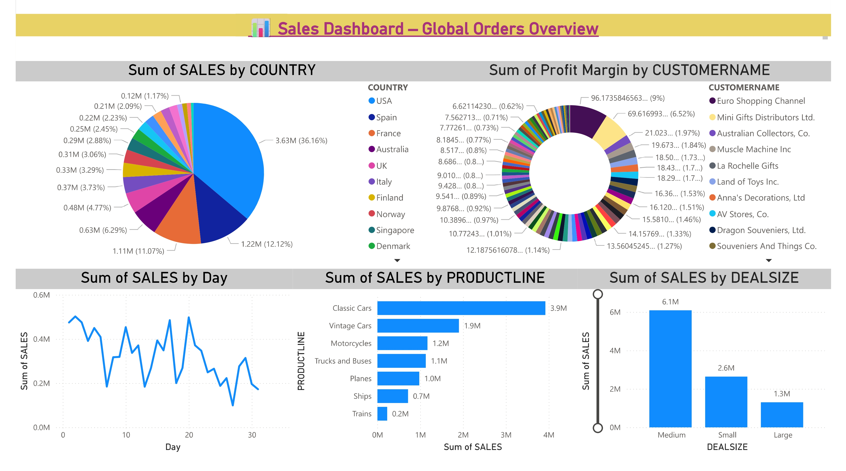
🖼 Dashboard Screenshot

Slide 5
📈 Business Insights
Highest Sales observed in "USA".
🏎 Best Performing Product Line: "Classic Cars".
💼 Deal Size “Medium” generates the most Profit.
🕒 Sales peaked in “Q4”, suggesting seasonal buying trends.
🏙 Denmark has the highest average profit per order, indicating a strong premium market with high-margin deals in that region.

