Slide 1


HELM
Le gestionnaire de paquets pour Kubernetes

Slide 2
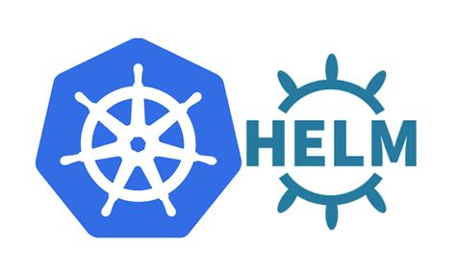




Qu'est ce que Helm ?
Helm vous aide a gérer vos applications Kubernetes — Les Charts de Helm peuvent même vous aider à définir, installer et mettre à jour les architectures Kubernetes les plus complexes.
(helm.sh)

Slide 3
Installer MongoDB: Apt vs Helm
Debian
Kubernetes
echo "deb http://repo.mongodb.org/apt/debian buster/mongodb-org/5.0 main“ > /etc/apt/sources.list.d/mongodb-org-5.0.list
apt update
apt install mongodb-org-server
helm repo add bitnami https://charts.bitnami.com/bitnami
Helm repo update bitnami
helm install mymongo bitnami/mongodb
Notes:
Package Management: Tooling that enables
someone who has knowledge of an application and a
platform to package up an application so that
someone else who has neither extensive knowledge
of the application or the way it needs to be run on the
platform can use it.

Slide 4



La vie sans helm ?

Slide 5

Kubectl apply : Les absents
Variables
Structures de contrôle
Normes
Scalabilite
Notes:
Microservice yamls = Deployment + Service + Ingress + Persistent Volumes + configmaps + secrets + RBAC…
As soon as your projects grow, you may end up editing dozens or hundreds of yaml files stored.

Slide 6
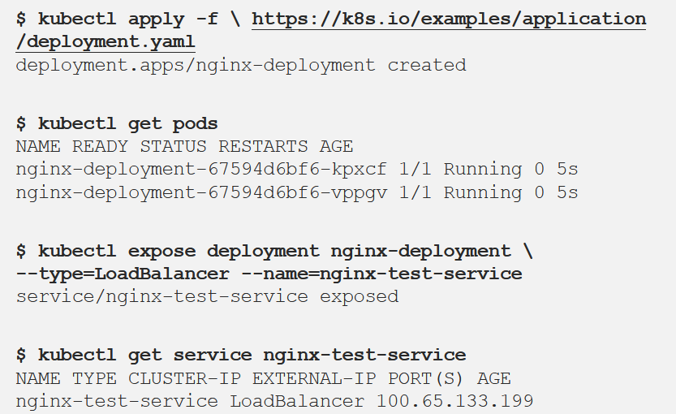
Error: too many operations

Slide 7

50 shades of kind
Namespace
NetworkPolicy
ResourceQuota
LimitRange
PodSecurityPolicy
PodDisruptionBudget
ServiceAccount
Secret
SecretList
ConfigMap
StorageClass
PersistentVolume
PersistentVolumeClaim
CustomResourceDefinition
ClusterRole
ClusterRoleList
ClusterRoleBinding
ClusterRoleBindingList
Role
RoleList
RoleBinding
RoleBindingList
Service
DaemonSet
Pod
ReplicationController
ReplicaSet
Deployment
HorizontalPodAutoscaler
StatefulSet
Job
CronJob
Ingress
APIService
Notes:
Rappel de la liste des kinds

Slide 8

Happy HELMing !

Slide 9
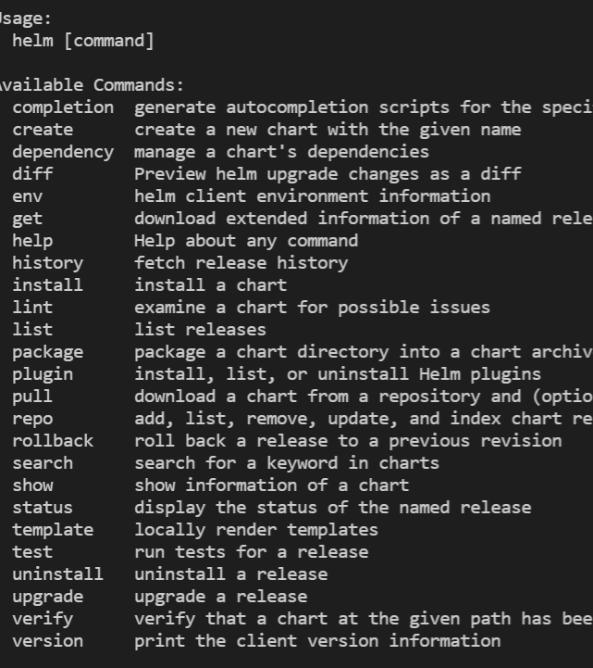
HELM: cmd line
Notes:
root@debian:~# helm completion bash > /etc/bash_completion.d/helm

Slide 10
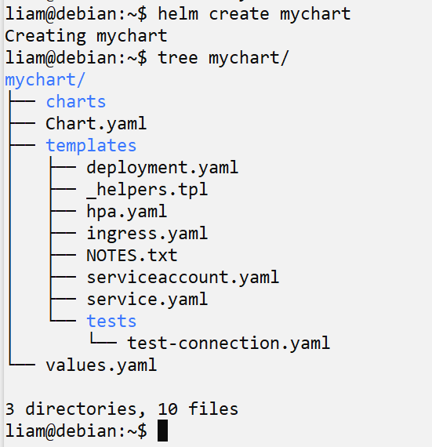
Mon 1er Chart
Notes:
Chart.yaml # A YAML file containing information about the chart
values.yaml # The default configuration values for this chart
charts/ # A directory containing any charts upon which this chart depends.
templates/ # A directory of templates that, when combined with values, # will generate valid Kubernetes manifest files.

Slide 11
Des mots sur des maux
(demo)
Notes:
helm repo add bitnami https://charts.bitnami.com/bitnami
helm repo list
helm search repo bitnami
helm search repo bitnami/nginx
helm create mynginx
cd mynginx

Slide 12
TIPS

Slide 13
Bonnes pratiques
https://helm.sh/docs/chart_best_practices/

Slide 14

Bitnami : Copiez lez tous !
https://github.com/bitnami/charts/tree/master/bitnami

Slide 15


Le plugin qui fait la diff !
https://github.com/databus23/helm-diff

Slide 16
Lint ‘em all !
helm lint

Slide 17
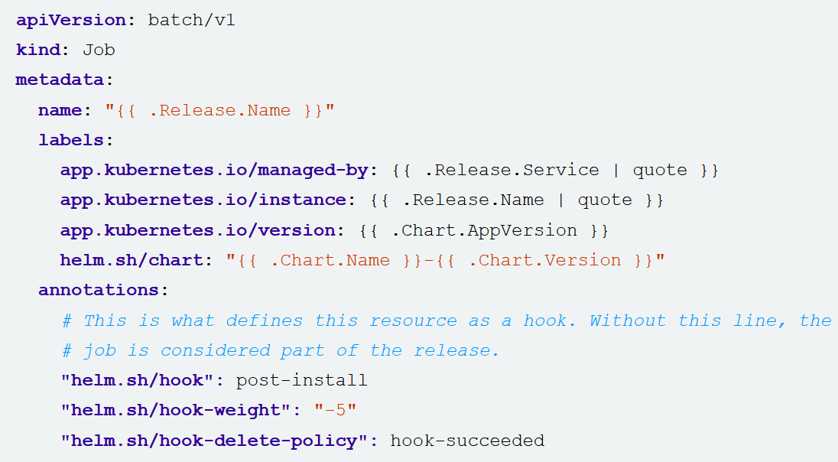
(Capt’n) Hooks
https://helm.sh/docs/topics/charts_hooks/

Slide 18
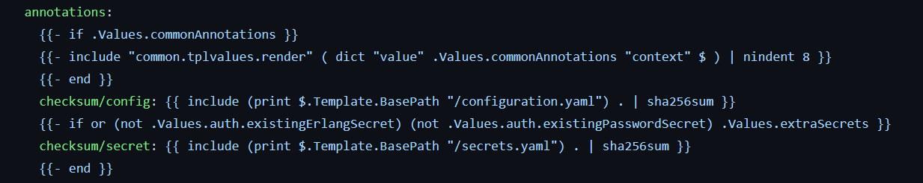
Annotation + Sha = auto restart !

Slide 19
Merci !

