Slide 1
UITextField 使用小结

Slide 2
主要内容
1. 除了代理方法外需要注意的
2. UIStepperTextField ：事件触发机制以及代理方法中转的实现
3. UIStepperTextField 与 LDPMBuySellCountFastInputView 配合使用
4. 如何在扩展中中转代理
5. 使输入框露在可视区域的方法小结
6. LDPMKeyboardToolbar:scrollToRowAtIndexPath:atScrollPosition:animated
7. UIScrollView (LDPMAdditions):scrollRectToVisible

Slide 3
1. 除了代理方法外需要注意的
通过何种方式修改text的值 | setText: | UIControlEventEditingChanged
通过吊起键盘输入修改文字 | 不会触发 | 会触发 （每输入一个字符都会触发一次，键盘吊起和落下时不会调用）
直接调用text的setter, e.g. textFiedl.text = @“test" | 是 | 否

Slide 4
2. UIStepperTextField中的代理中转
LDProtocolInterceptor.h
@interface LDProtocolInterceptor : NSObject
@property (nonatomic, readonly, copy) NSArray * interceptedProtocols;
@property (nonatomic, weak) id receiver;//用来保存外部代理
@property (nonatomic, weak) id middleMan;//中转站, 要设成自己
//以下几个初始化方法的Protocol 用来解决键盘依赖的控件(TextField/TextView), 在发送的selector (e.g keyboardInputChangedSelection: & keyboardInputChanged:) 不包含在protocol(s)时,在respondsToSelector方法中, 应该让父类来处理. 如果直接让中转来处理, 则系统会再调forwardingTargetForSelector返回middleMan 而middleMan没有实现该方法,系统加又开始调respondsToSelector导致无限死循环.
- (instancetype)initWithInterceptedProtocol:(Protocol *)interceptedProtocol;
- (instancetype)initWithInterceptedProtocols:(Protocol *)firstInterceptedProtocol, ... NS_REQUIRES_NIL_TERMINATION;
- (instancetype)initWithArrayOfInterceptedProtocols:(NSArray *)arrayOfInterceptedProtocols;
@end

Slide 5
LDProtocolInterceptor.m
- (BOOL)respondsToSelector:(SEL)aSelector
{
if ([self.middleMan respondsToSelector:aSelector] &&
[self isSelectorContainedInInterceptedProtocols:aSelector])
return YES;
if ([self.receiver respondsToSelector:aSelector])
return YES;
return [super respondsToSelector:aSelector];
}

Slide 6
LDProtocolInterceptor.m
static inline BOOL selector_belongsToProtocol(SEL selector, Protocol * protocol);
@implementation LDProtocolInterceptor
- (id)forwardingTargetForSelector:(SEL)aSelector
{
if ([self.middleMan respondsToSelector:aSelector] &&
[self isSelectorContainedInInterceptedProtocols:aSelector])
return self.middleMan;
if ([self.receiver respondsToSelector:aSelector])
return self.receiver;
return [super forwardingTargetForSelector:aSelector];
}

Slide 7
LDProtocolInterceptor.m
- (BOOL)isSelectorContainedInInterceptedProtocols:(SEL)aSelector
{
__block BOOL isSelectorContainedInInterceptedProtocols = NO;
[self.interceptedProtocols enumerateObjectsUsingBlock:^(Protocol * protocol, NSUInteger idx, BOOL *stop) {
isSelectorContainedInInterceptedProtocols = selector_belongsToProtocol(aSelector, protocol);
* stop = isSelectorContainedInInterceptedProtocols;
}];
return isSelectorContainedInInterceptedProtocols;
}

Slide 8
/**
* `selector_belongsToProtocol` solves a common problem in proxy objects for delegates where selectors that are not part of the protocol may be unintentionally forwarded to the actual delegate.
*/
BOOL selector_belongsToProtocol(SEL selector, Protocol * protocol)
{
// Reference: https://gist.github.com/numist/3838169
for (int optionbits = 0; optionbits < (1 << 2); optionbits++) {
BOOL required = optionbits & 1;
BOOL instance = !(optionbits & (1 << 1));
struct objc_method_description hasMethod = protocol_getMethodDescription(protocol, selector, required, instance);
if (hasMethod.name || hasMethod.types) {
return YES;
}
}
return NO;
}

Slide 9
UIStepperTextField
- (void)initContentWithbuySellType:(UIStepperBuySellType)buySellType
{
//delegateInterceptor
self.delegateInterceptor = [[LDProtocolInterceptor alloc]initWithInterceptedProtocol:@protocol(UITextFieldDelegate)];
self.delegateInterceptor.middleMan = self;
super.delegate = (id<UITextFieldDelegate>)self.delegateInterceptor;
…
}

Slide 10
UIStepperTextField
//Override supper setter
-(id<UITextFieldDelegate>)delegate
{
return self.delegateInterceptor.receiver;
}
-(void)setDelegate:(id<UITextFieldDelegate>)delegate
{
super.delegate = nil;
self.delegateInterceptor.receiver = delegate;
super.delegate = (id<UITextFieldDelegate>)self.delegateInterceptor;
}

Slide 11
UITextFieldDelegate
-(void)textFieldDidBeginEditing:(UITextField *)textField
{
if ([textField.text rangeOfString:@"."].location == NSNotFound) {
self.isPriceInputHaveDot = NO;
} else {
self.isPriceInputHaveDot = YES;
}
if ([self.delegate respondsToSelector:@selector(textFieldDidBeginEditing:)]) {
return [self.delegate textFieldDidBeginEditing:textField];
}
}

Slide 12
UITextFieldDelegate
-(void)textFieldDidEndEditing:(UITextField *)textField
{
[self checkInputValid];
//此处是为了如果用户输入38.0或者38, 在允许的范围之内, 则自动格式化为38.00
if (([textField.text rangeOfString:@"."].location != NSNotFound) && ([textField.text rangeOfString:@"."].location >= textField.text.length - 2)) {
super.text = [NSString stringWithFormat:@"%.2f", textField.text.doubleValue];
}
if ([self.delegate respondsToSelector:@selector(textFieldDidEndEditing:)]) {
return [self.delegate textFieldDidEndEditing:textField];
}
}

Slide 13
UITextFieldDelegate
- (BOOL)textField:(UITextField *)textField shouldChangeCharactersInRange:(NSRange)range replacementString:(NSString *)string
{
if (textField.text.length == self.maxLength) {
if (range.location >= self.maxLength) {
return NO;
}
} else {
if ([self.delegate respondsToSelector:@selector(textField:shouldChangeCharactersInRange:replacementString:)]) {
return [self.delegate textField:textField shouldChangeCharactersInRange:range replacementString:string];
}
}
…

Slide 14
重复第3页
通过何种方式修改text的值 | setText: | UIControlEventEditingChanged
通过吊起键盘输入修改文字 | 不会触发 | 会触发 （每输入一个字符都会触发一次，键盘吊起和落下时不会调用）
直接调用text的setter, e.g. textFiedl.text = @“test" | 是 | 否

Slide 15
实现方式
//hack:保存监听UIControlEventEditingChanged事件的target 和 action,限制: 只保存一个
- (void)addTarget:(id)target action:(SEL)action forControlEvents:(UIControlEvents)controlEvents
{
if (controlEvents & UIControlEventEditingChanged) {
_target = target;
_action = action;
}
[super addTarget:target action:action forControlEvents:controlEvents];
}

Slide 16
手工数值改变
- (void)valueChanged
{
//iOS6 以上，代码改变textFiled的值，不会触发editingchange事件 ，或者iOS5当前无焦点时
if (([[UIDevice currentDevice].systemVersion integerValue] >= 6 || ![self isFirstResponder]) && _target) {
#pragma clang diagnostic push
#pragma clang diagnostic ignored "-Warc-performSelector-leaks"
[_target performSelector:_action withObject:self];
#pragma clang diagnostic pop
}
}

Slide 17
手动调用valueChanged
- (void)addText
{
double value = [self.text doubleValue];
if (value < self.maxValue) {
if (self.stepperType == UIStepperContentTypeDouble) {
self.text = [NSString stringWithFormat:@"%.2lf", value + 0.01];
} else {
self.text = [NSString stringWithFormat:@"%.0lf", value + 1];
}
[self checkInputValid];
[self valueChanged];
}
}

Slide 18
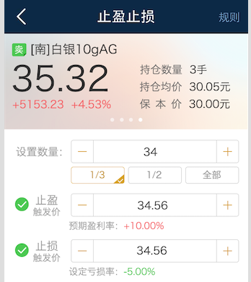
3. LDPMBuySellCountFastInputView
@property (weak, nonatomic) IBOutlet UIStepperTextField *amountTextfield;
#pragma mark - LDPMBuySellCountFastInputViewDelegate
-(void)countFastInputViewPressedWithPercent:(double)percent
{
…
self.amountTextfield.text = [NSString stringWithFormat:@“%.0f”,
ceil(self.product.maxExecNum.doubleValue * percent)];
}

Slide 19
3. 配合UIStepperTextField使用
…
[self.amountTextfield addTarget:self action:@selector(textFieldEditingChanged:) forControlEvents:UIControlEventEditingChanged];
…
-(void)textFieldEditingChanged:(UITextField *)sender
{
self.fastInputView.selectedButton = nil;
…
}

Slide 20
4. 如何在扩展中中转代理
需要多增加一步替换系统对delegate的getter 和 setter 方法
- (void)swizzlingOriSelector:(SEL)oriSelector newSelector:(SEL)newSelector
{
Method ori_Method = class_getInstanceMethod([self class], oriSelector);
Method my_Method = class_getInstanceMethod([self class], newSelector);
method_exchangeImplementations(ori_Method, my_Method);
}
2. 同样增加代理中转的调用, 注意没有super, 全是self调用.

Slide 21
@implementation UIScrollView (LDSegmentedControl)
-(LDProtocolInterceptor *)interceptor
{
return objc_getAssociatedObject(self, @selector(interceptor));
}
-(void)setInterceptor:(LDProtocolInterceptor *)interceptor
{
objc_setAssociatedObject(self, @selector(interceptor), interceptor, OBJC_ASSOCIATION_RETAIN_NONATOMIC);
}

Slide 22
@implementation UIScrollView (LDSegmentedControl)
- (void)bindSegmentedControl:(LDPMSegmentedControl*)segment
{
self.segment = segment;
self.interceptor = [[LDProtocolInterceptor alloc]initWithInterceptedProtocol:@protocol(UIScrollViewDelegate)];
self.interceptor.middleMan = self;
self.delegate = (id<UIScrollViewDelegate>)self.interceptor;
[self swizzlingOriSelector:@selector(delegate) newSelector:@selector(my_delegate)];
[self swizzlingOriSelector:@selector(setDelegate:) newSelector:@selector(my_setDelegate:)];
}

Slide 23
@implementation UIScrollView (LDSegmentedControl)
-(id<UIScrollViewDelegate>)my_delegate
{
return self.interceptor.receiver;
}
-(void)my_setDelegate:(id<UIScrollViewDelegate>)delegate
{
self.interceptor.receiver = delegate;
[self my_setDelegate:(id<UIScrollViewDelegate>)self.interceptor];
}

Slide 24
@implementation UIScrollView (LDSegmentedControl)
- (void)scrollViewDidScroll:(UIScrollView *)scrollView
{
……
self.segment.selectionIndicatorStripLayer.frame = newFrame;
if (self.delegate && [self.delegate respondsToSelector:@selector(scrollViewDidScroll:)]) {
[self.delegate scrollViewDidScroll:self];
}
}

Slide 25
@implementation UIScrollView (LDSegmentedControl)
- (void)scrollViewWillBeginDragging:(UIScrollView *)scrollView {
self.isPageScrollingFlag = YES;
self.segment.userInteractionEnabled = NO;
if (self.delegate && [self.delegate respondsToSelector:@selector(scrollViewWillBeginDragging:)]) {
[self.delegate scrollViewWillBeginDragging:self];
}
}

Slide 26
@implementation UIScrollView (LDSegmentedControl)
- (void)scrollViewDidEndDecelerating:(UIScrollView *)scrollView {
self.isPageScrollingFlag = NO;
self.segment.userInteractionEnabled = YES;
self.segment.selectedSegmentIndex = scrollView.contentOffset.x / CGRectGetWidth(self.bounds);
if (self.delegate && [self.delegate respondsToSelector:@selector(scrollViewDidEndDecelerating:)]) {
[self.delegate scrollViewDidEndDecelerating:self];
}
}

Slide 27
5. 使输入框露在可视区域的方法小结
1. 通过UITableViewController 加载的UITextField
2. 通过设置UIScrollView的contentInset
3. 调用UITableView的scrollToRowAtIndexPath:atScrollPosition:animated
4. 调用UIScrollView的scrollRectToVisible

Slide 28
6. LDPMKeyboardToolbar
//#4 the following need to copy
self.toolbar = [[LDPMKeyboardToolbar alloc]init];
self.toolbar.kbDelegate = self;
self.textFieldsIndexPaths = [self createInputIndexPaths];
//self.textFieldDictionary = [NSMutableDictionary dictionary];

Slide 29
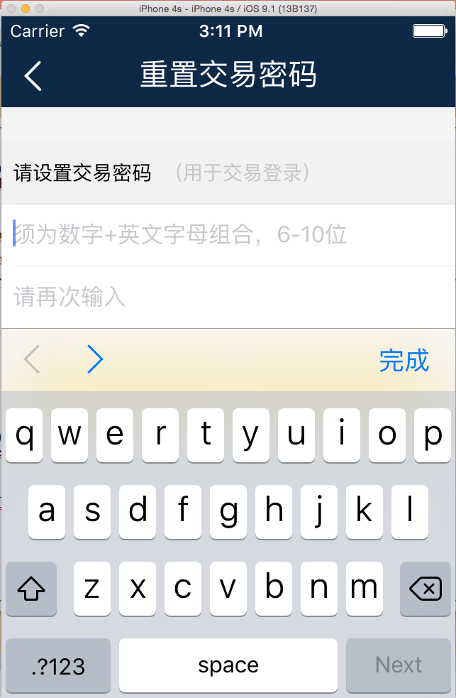
LDPMKeyboardToolbar
-(void)viewDidAppear:(BOOL)animated
{
[super viewDidAppear:animated];
self.toolbar.active = YES;
}
-(void)viewWillDisappear:(BOOL)animated
{
[super viewWillDisappear:animated];
self.toolbar.active = NO;
}

Slide 30
//#6 if use tableView then need to implement this with same logic with tableView:cellForRowAtIndexPath
- (NSArray *)createInputIndexPaths
{
NSMutableArray *indexPaths = [NSMutableArray array];
for (int section = 0; section < [self numberOfSectionsInTableView:self.tableView]; section++) {
for (int row = 0; row < [self tableView:self.tableView numberOfRowsInSection:section]; row++) {
[indexPaths addObject:[NSIndexPath indexPathForRow:row inSection:section]];
return [NSArray arrayWithArray:indexPaths];
}

Slide 31
- (UITableViewCell *)tableView:tableView cellForRowAtIndexPath:(NSIndexPath *)indexPath
{……
NSInteger index = [self.textFieldsIndexPaths indexOfObject:indexPath];
if (index != NSNotFound) {
cell.passwordTextField.tag = index + tagConstant;
cell.passwordTextField.inputAccessoryView = self.toolbar;
//self.textFieldDictionary[indexPath] = cell.passwordTextField;
}
}

Slide 32
//#5 need to impliments all delegate methods
-(BOOL)kbToobar:(LDPMKeyboardToolbar *)kbToolbar isNextButtonEnableForTextInputView:(id<UITextInput>)textInputView
{
self.activeTextField = (UITextField *)textInputView;
NSInteger index = ((UIView *)textInputView).tag - tagConstant;
if (index < self.textFieldsIndexPaths.count - 1) {
return YES;
} else {
return NO;
}
}
-(BOOL)kbToobar:(LDPMKeyboardToolbar *)kbToolbar isPreButtonEnableForTextInputView:(id<UITextInput>)textInputView
{
return (((UIView *)textInputView).tag > tagConstant);
}

Slide 33
- (void)preButtonDidPressed:(LDPMKeyboardToolbar *)kbToolbar
{
if (!self.activeTextField) {
return;
}
NSInteger index = self.activeTextField.tag - tagConstant;
if (index > 0) {
NSIndexPath *preIndexPath = [self.textFieldsIndexPaths objectAtIndex:index-1];
[self.tableView scrollToRowAtIndexPath:preIndexPath atScrollPosition:UITableViewScrollPositionMiddle animated:YES];
LDPMResetPWPWSetCell *preCell = (LDPMResetPWPWSetCell *)[self.tableView cellForRowAtIndexPath:preIndexPath];
if ([preCell.passwordTextField respondsToSelector:@selector(becomeFirstResponder)]) {
[preCell.passwordTextField becomeFirstResponder];
}
// if ([self.textFieldDictionary[preIndexPath] respondsToSelector:@selector(becomeFirstResponder)]) {
// [self.textFieldDictionary[preIndexPath] becomeFirstResponder];
// }
}
}

Slide 34
- (void)nextButtonDidPressed:(LDPMKeyboardToolbar *)kbToolbar
{
if (!self.activeTextField) {
return;
}
NSInteger index = self.activeTextField.tag - tagConstant;
if (index < self.textFieldsIndexPaths.count - 1) {
NSIndexPath *nextIndexPath = [self.textFieldsIndexPaths objectAtIndex:index + 1];
[self.tableView scrollToRowAtIndexPath:nextIndexPath atScrollPosition:UITableViewScrollPositionMiddle animated:YES];
LDPMResetPWPWSetCell *nextCell = (LDPMResetPWPWSetCell *)[self.tableView cellForRowAtIndexPath:nextIndexPath];
if ([nextCell.passwordTextField respondsToSelector:@selector(becomeFirstResponder)]) {
[nextCell .passwordTextField becomeFirstResponder];
}
// if ([self.textFieldDictionary[nextIndexPath] respondsToSelector:@selector(becomeFirstResponder)]) {
// [self.textFieldDictionary[nextIndexPath] becomeFirstResponder];
// }
}
}

Slide 35
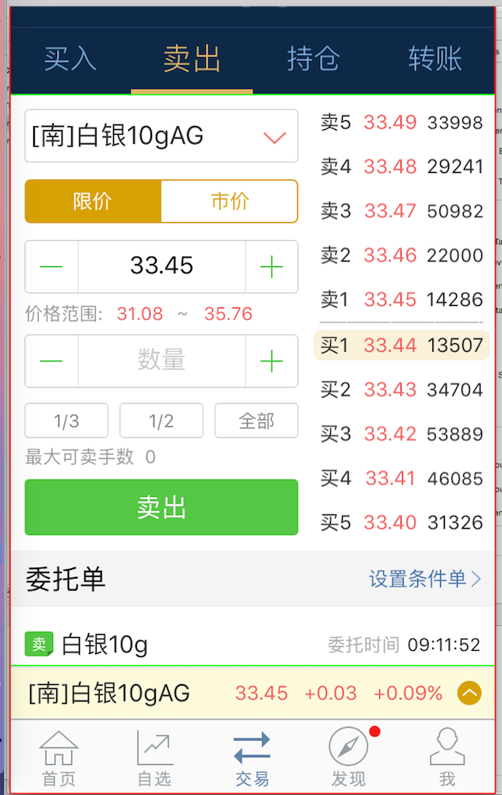
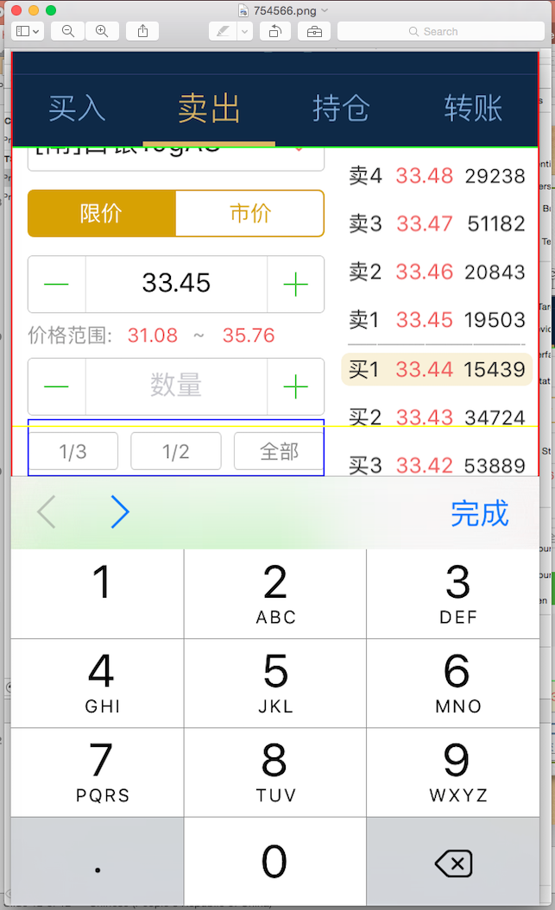
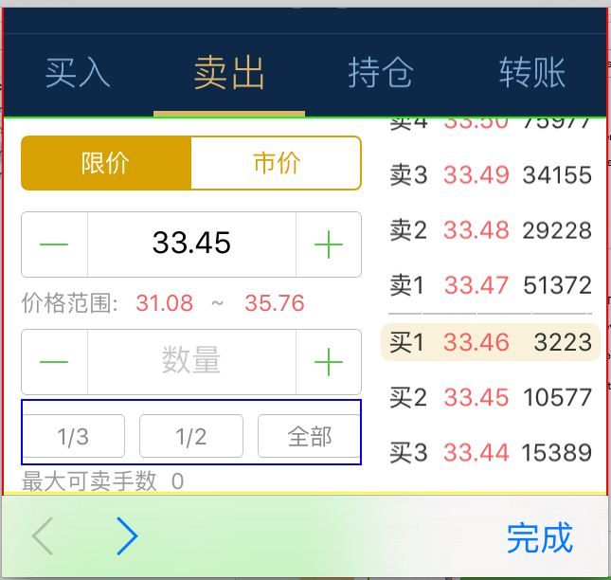
7. UIScrollView (LDPMAdditions)

Slide 36
运行时增加一个属性
- (void)setTranslateOffSet:(CGFloat)offSet
{
objc_setAssociatedObject(self, @selector(translateOffSet), [NSNumber numberWithDouble:offSet], OBJC_ASSOCIATION_RETAIN_NONATOMIC);
}
- (CGFloat)translateOffSet
{
return [objc_getAssociatedObject(self, @selector(translateOffSet)) doubleValue];
}

Slide 37
(void)keyBoardWillPop:(NSNotification*)notification{
__block UIWindow *keyWindow = [UIApplication sharedApplication].keyWindow;
if (![[keyWindow findFirstResponder] isKindOfClass:[UITextField class]] &&
![[keyWindow findFirstResponder] isKindOfClass:[UITextView class]]) {
return;
}
NSDictionary* info = [notification userInfo];
NSTimeInterval duration = [[info objectForKey:UIKeyboardAnimationDurationUserInfoKey] doubleValue];
//当前窗口用红色边框标识
keyWindow.layer.borderColor = [UIColor redColor].CGColor;
keyWindow.layer.borderWidth = 1;
//scrollview用绿色边框标识
self.layer.borderColor = [UIColor greenColor].CGColor;
self.layer.borderWidth = 1;
//这个offset是TabBar的高度 + 底部小黄条的高度, 设的很必要，在有TabBar的页面，如果不设这个，会导致输入框抬得太高。
__block CGFloat offset = CGRectGetMaxY(keyWindow.bounds) - CGRectGetMaxY([keyWindow convertRect:self.bounds fromView:self]);
__block UIView *currentInputView = (UIView *)[keyWindow findFirstResponder];
__block CGSize kbSize = [[info objectForKey:UIKeyboardFrameEndUserInfoKey] CGRectValue].size;
__weak typeof(self) weakSelf = self;

Slide 38
[UIView animateWithDuration:duration animations:^{
//这里根据scrollView距离屏幕底部的高度，算还需要抬多高
UIEdgeInsets contentInsets = UIEdgeInsetsMake(0.0, 0.0, kbSize.height - offset, 0.0);
weakSelf.contentInset = contentInsets;
weakSelf.scrollIndicatorInsets = contentInsets;
CGRect aRect = weakSelf.frame;
//这里根据scrollView的大小，减去键盘屏幕实际抬起的高度，再根据contentOffset调整origin，得到实际上的屏幕可视区域
aRect.size.height -= (kbSize.height - offset);
aRect.origin.x += weakSelf.contentOffset.x;
aRect.origin.y += weakSelf.contentOffset.y;
//创建一个带黄色边框的View用于显示可视区域的范围
UIView *aRectVeiw = [[UIView alloc]initWithFrame:aRect];
aRectVeiw.backgroundColor = [UIColor clearColor];
aRectVeiw.layer.borderColor = [UIColor yellowColor].CGColor;
aRectVeiw.layer.borderWidth = 1;
[weakSelf addSubview:aRectVeiw];

Slide 39
//这里inputAbsoluteRect的rect才是真正的文本框的位置
CGRect inputAbsoluteRect = [keyWindow convertRect:currentInputView.bounds fromView:currentInputView];
CGRect scrollViewAbsoluteRect = [keyWindow convertRect:weakSelf.bounds fromView:weakSelf];
//inputRectToScroll是通过折算后的需要显示在可视范围之内的，用蓝框显示
CGRect inputRectToScroll = CGRectMake(CGRectGetMinX(inputAbsoluteRect) - CGRectGetMinX(scrollViewAbsoluteRect) + weakSelf.contentOffset.x, CGRectGetMinY(inputAbsoluteRect) - CGRectGetMinY(scrollViewAbsoluteRect) + weakSelf.contentOffset.y + weakSelf.translateOffSet, inputAbsoluteRect.size.width, inputAbsoluteRect.size.height);
CGPoint bottomLeft = CGPointMake(inputRectToScroll.origin.x, inputRectToScroll.origin.y + inputRectToScroll.size.height);
UIView *aView = [[UIView alloc]initWithFrame:inputRectToScroll];
aView.backgroundColor = [UIColor clearColor];
aView.layer.borderColor = [UIColor blueColor].CGColor;
aView.layer.borderWidth = 1;
[weakSelf addSubview:aView];
if (!CGRectContainsPoint(aRect, bottomLeft)) {
[weakSelf scrollRectToVisible:inputRectToScroll animated:YES];
NSLog(@"不在可视区域内");
}
}];

