Slide 1
QtNoidCommon
Collection of common API for Qt Projects
User Stories

Slide 2
Can read or write to the clipboard

Slide 3
FileListPathRecursively can be stopped using a semaphore.

Slide 4
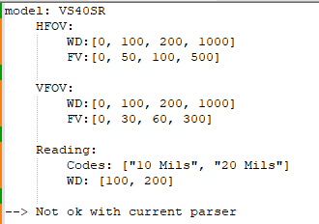
QtNoidCommonText::jsonPlainTextToJson()
Need to manage also multi-level docs

Slide 6
Release 2.0.1

Slide 7
QtNoidCommonFile::fileAutoNaming
Can be used also with a full path name string

