Slide 1
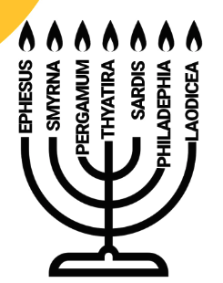
Rapture - Christ calls
up His Church
God’s Plan of the Ages....
Return/ w His Church
Ascension/ Christ to Heaven
The Flood
Tribulation
The Fall
Eternity Past
Millennium & Eternity
Future
“What is to come”
“What was”
The Church...in seven forms over a period of at least 2000 years.
Rev. 1:19 “Write...the things which you have seen, and the things which are, and the things which shall take place after these things.”
Revelation has it’s own outline and promises to be in clock and calendar order.
“What is”

Slide 2
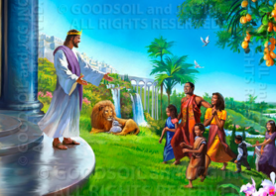
Inside the book of Revelation - only
Rapture/ Christ in
the “Harpazo” the Snatch
During the Tribulation Chaps10-15, there is an Intermission.
Christ’s Ascension to Heaven is long past
Chap 4
“Come up here”
“what is to come”
Christ Returns/ w His Church the “Perusia” ends the
Tribulation
Chap. 19
The Church for 2000 yrs
Chap
1
Tribulation
7 years-Chaps 5 - 18
Millennium & Eternity
Future
John on his island
“What was”
The Church...each “flame” lit up the world for a specific period....all produced believers
“ What is”
Christ reigns on Earth for a thousand years.
Chapters 2 & 3

Slide 3
Chapter 10.....the Great Angel..one foot on land and sea.
Chapter 11.....the two witnesses....the theme of the two throughout the Bible
Chapter 12...the sign of the woman....who will bear the Child
Chapter 13.....Satan and the Beast...monsters erupting from a darkened sea
Chapter 14.....the fall of Babylon...the woman who rode the Beast
Chapter 15....the Song of Moses

Slide 4
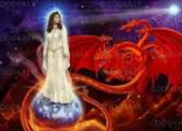
.... The Intermission, which interrupts the flow of the Tribulation, discusses over arching Bible Themes. (Chaps 10-15) for the whole redemption of mankind.
And we just finished Revelation 12:4....the dragon stands before the woman about to give birth,.so he might devour her child.” A picture of Israel giving birth to Christ and the Dragon (the enemy, always attempting to destroy the Child) is carried over into Revelation 13. This is the greatest theme of the whole Bible and starts in the Garden and goes to the end of Time.
This Woman is discussed in such a way as harkening back to Joseph’s sheaves, the sheaves of Israel, and the sun and the moon. She stands on the moon with the sun in her face and delivers Messiah.

Slide 5
God reveals mysteries to those who love Him. Often “Mysteries” things intimated in the Old Testament are revealed in the New. The Old Testament is like the moon (which appears to have light, but has no light of its own, being a reflection of the light of the sun) In Rev. 12 the moon (the Old Testament) is the foundation upon which the woman stands, it can only reflect the truth as found in the New Testament, the light which illumens her face. The old intimates and the New illuminates. There are many of these mysteries:
The Church for 2000 yrs
1. The mystery of the Kingdom...Mat. 13
2. The mystery of the Church ....Rev. 1-3
3. The mystery of the Body of Christ....Eph. 5
4. The mystery of the Rapture....1 Thes. 4
5. The mystery of the Indwelling Holy Spirit....Col. 1, Eph. 1 etc
6. The mystery of Lawlessness....2 Thes. 2: 1-12

Slide 6
In the Old Testament we are told of the origin and destiny of the Lawless One who is Satan, the deceiver, the enemy, the hater of mankind.
Isaiah 14:4-12 is specifically about the King of Babylon and then God enlarges the vision and speaks about the true prince of darkness who is Lord over another kingdom...remember from the very beginning there has been the “seed of the Woman” and the “seed of the serpent”
The Church for 2000 yrs
Ezekiel 28: 1-11 is a lamentation over the King of Tyre, and then God again enlarges the vision to incorporate this same prince of the netherworld of lawlessness, the Mystery of Lawlessness.. vs. 12-20

Slide 7
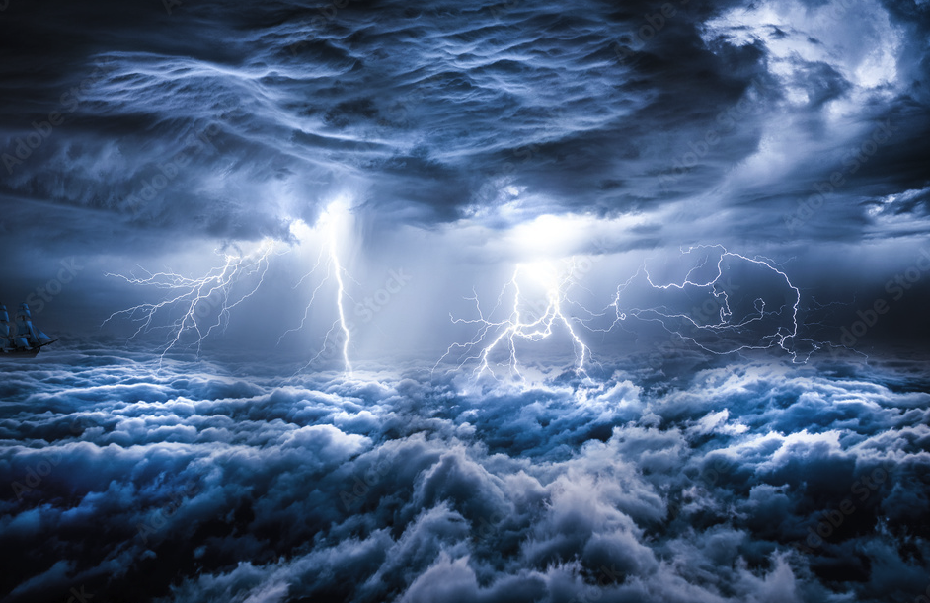
So closes Revelation chapter 12 and we immediately see before us a black and stormy sea in chapter 13 which is also found in Daniel chapter 7 (The sea is the gentile nations in turmoil and anguish.)

Slide 8
Daniel 7:1 and following: “In the first year of Belshazzar king of Babylon Daniel saw a dream...Daniel said, “I was looking in my vision by night, and behold the four winds of heaven were stirring up the great sea.”

Slide 9
“And four great beasts were coming up from the sea,...The first was like a lion and had the wings of an eagle [a griffon], ...And behold another beast, a second one, resembling a bear...and they said to it ‘Arise, devour much meat.’
After this I kept looking, and behold another one, like a leopard, which had on its back four wings of a bird...After this I kept looking in the night visions, and behold a fourth beast, dreadful and terrifying and extremely strong; and it had large iron teeth. It devoured and crushed, and trampled down the remainder with its feet; and it was different from all the beasts that were before it, and it had ten horns. (horns are indicative of powers such as nations)
While I was contemplating the horns, behold another horn , a little one, came out of them, and three of the first horns were pulled out by the roots...and behold this horn possessed eyes like the eyes of a man, and a mouth uttering great boasts...” this one is called the little horn, man of sin, the beast or the antichrist.

Slide 10
vs. 11 and following “Then I kept looking because of the sound of the boastful words which the horn was speaking; ...until the beast was slain, and its body was destroyed and given to the burning fire.
As for the rest of the beasts their dominion was taken away,...
I kept looking in the night visions, One like a Son of Man was coming, And He came up to the Ancient of Days And was presented before Him, and to Him was given dominion...His dominion is an everlasting dominion.
As for me, Daniel my spirit was distressed within me, and the visions in my mind kept alarming me.”

Slide 11
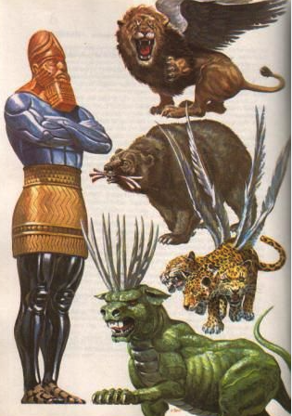
The vision Daniel saw was God’s perspective of the Great Statue vision of Daniel 2
Babylon – Head of Gold
Medio Persia - Chest of Silver
Greece – Belly of Bronze
Rome - Legs of Iron

Slide 12
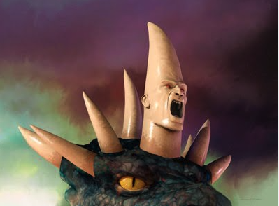
Antichrist ...the little boastful horn has many names. Man of Sin, the Beast, etc. But he apparently comes to power in the midst of a 10 nation confederation and must conquer 3 of them to gain the ascendency.
Read Daniel 7:24-28

Slide 13
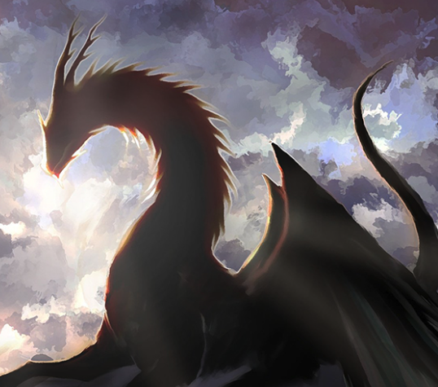
And he [the dragon-Satan] stood on the sand of the seashore.
Rev. 13:1

Slide 14
The beasts are obviously related to those Daniel saw and pertain to the end of days.

Slide 15
And the beast which I [John] saw was like a leopard, and his feet were like those of a bear, and his mouth was like the mouth of a lion. And the dragon gave him his power and his throne and great authority.
“And I saw one of his heads as if it had been slain, and his fatal wound was healed. And the whole earth was amazed and followed after the beast.” Rev. 13:3

Slide 16
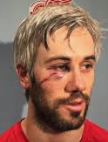
Jesus is the Good Shepherd Who lays down His life for the sheep...but according to Zechariah there will come a Worthless Shepherd. Zechariah 11:15-17 who will be severely wounded in the eye and arm.
In Rev. 13 this “worthless shepherd” emulating the Son of God by staging some sort of a resurrection. He will behave like a lamb, but will be a wolf in sheep’s clothing. Revelation 13:3

Slide 17
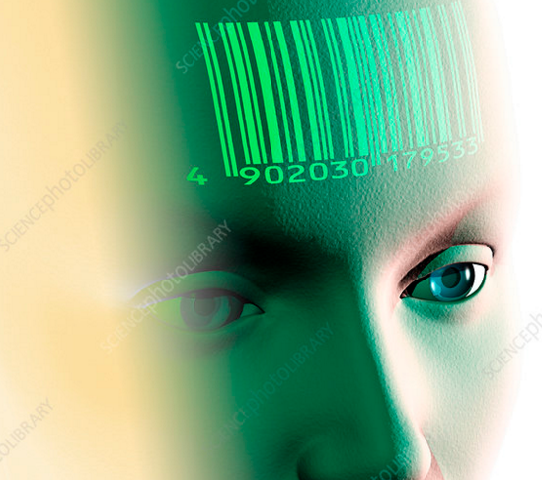
And he causes all, the small and the great, and the rich and the poor, and the free men and the slaves, to be given a mark on their right hand, or on their forehead,
“
6
Notes:
Key: The marked man now adds words at the click.

Slide 18
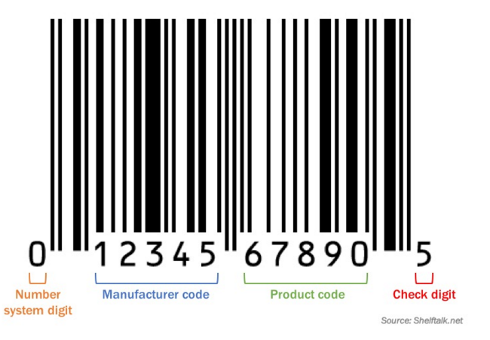
The UPC Product Codes all have had the 666 ` embedded in them for years.
“
Note that the lines above 6 are the same diameter as those above bars on the un-numbered center and ends.
Notes:
Key: a blue box appears…when clicked the UPC will appear and the automated pictures will follow.

Slide 19
“
6
6
6
The 666 is already hidden in every UPC bar code on every product sold in the USA.
Notes:
Key: The UPC remains and will automate to form the 666.

Slide 20
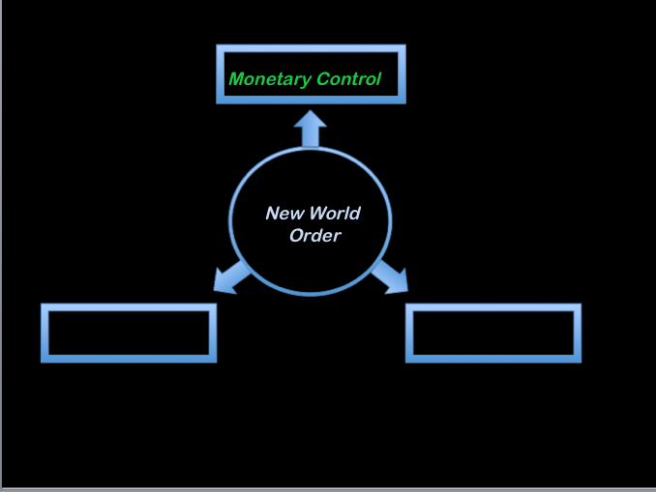
“
One world religion
Political Control
Notes:
Key….the monetary arm of the NWO

Slide 21
“I have come in My Father’s name, and you do not receive Me. “If another should come in his own name, you will receive Him. “
Jesus written down by John 5:43
“
Notes:
Key….the monetary arm of the NWO

