Slide 1
Project Overview
CO Detector

Slide 2
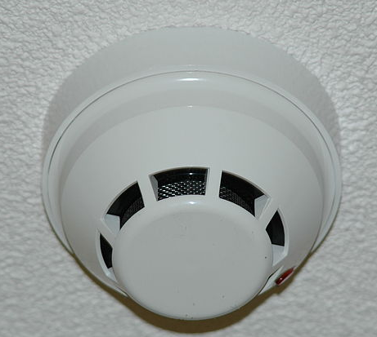
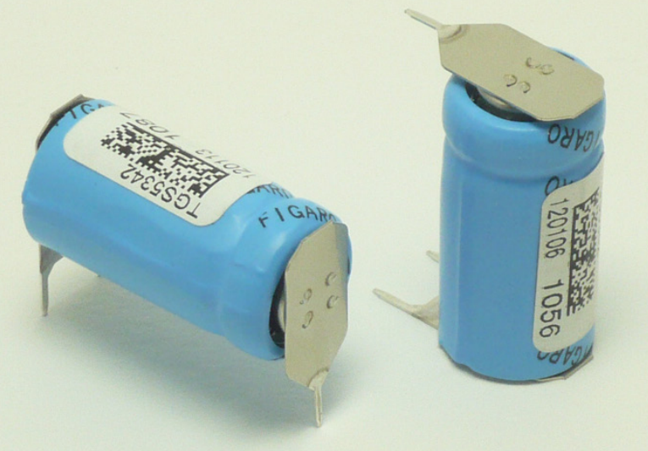
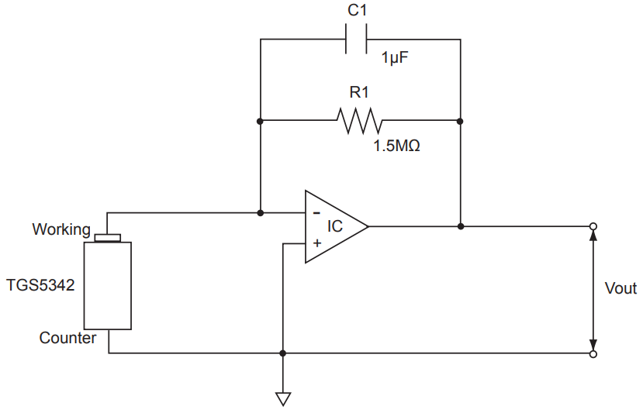




Project Overview
TGS5342 Carbon Monoxide Sensor
Carbon Monoxide Detector (Marine)
Reference Circuit
Safety Certifications

Slide 3
System Diagram

Slide 4
System Diagram
Generic Data Acquisition System
Sensor
Analog
Signal
Processing
ADC
Digital
Signal
Processing
Data
Storage
Logic
Comms /
Network
Interface
Human
Interface
(HMI)

Slide 5
System Diagram
CO Detector Black Box
Alarm Horn
Greatest of:
15dB above average
5dB above maximum
75dB
(NFPA 72)
Air Intake
30-69 ppm: 30 day alarm
70-149 ppm: 1-4 hour alarm
150-399 ppm: 10-50 min alarm
400+ ppm: < 4 min alarm
(UL)
LED
Status & operation
confirmation
Button
Silence & test

Slide 6
System Diagram
CO Detector System Diagram
Power
(Battery)
Microcontroller
CO
Sensor
Analog
Signal
Processing
ADC
Digital
Signal
Processing
Data
Storage
Logic
Serial
(RS-485)
Button
LED
Alarm
Horn

Slide 7
Analog Signal Processing

Slide 8
Analog Signal Processing
CO Sensor Circuit
R
+
-
Sensor Equivalent Circuit
Simple Single-Ended Op-Amp Circuit

Slide 9
Analog Signal Processing
Negative Feedback
Feedback
Network
-
+
Amplification
Input
Signal
Σ
Output
Signal

Slide 10
Analog Signal Processing
Negative Feedback
Feedback
Network
-
+
Amplification
Input
Signal
Σ
Output
Signal

Slide 11
Analog Signal Processing
Negative Feedback
Feedback
Network
-
+
Amplification
Input
Signal
Σ
Output
Signal

Slide 12
Analog Signal Processing
Negative Feedback
R_{f}
Σ
=
Input
Signal
R_{in}
-
Output
Signal
+

Slide 13
Analog Signal Processing
Negative Feedback
R_{f}
Σ
=
Input
Signal
R_{in}
-
Output
Signal
+

Slide 14
Analog Signal Processing
Negative Feedback
R_{f}
Σ
=
Input
Signal
R_{in}
-
Output
Signal
+

Slide 15
Analog Signal Processing
Signal Path Implementation
+
-
CO
Sensor
-
ADC
100k
+
-
+
Sensor Circuit
Instrumentation Amplifier
Anti-aliasing Filter
Cypress PSoC1

Slide 16
Analog Signal Processing
Signal Path Implementation Improvements
+
-
?
CO
Sensor
-
ADC
+
?
-
+
VREF
AGND
Sensor Circuit
Guard Traces
Bias Current Path
AGND
Instrumentation Amplifier
Anti-aliasing Filter
Corrected Values
MCU

Slide 17
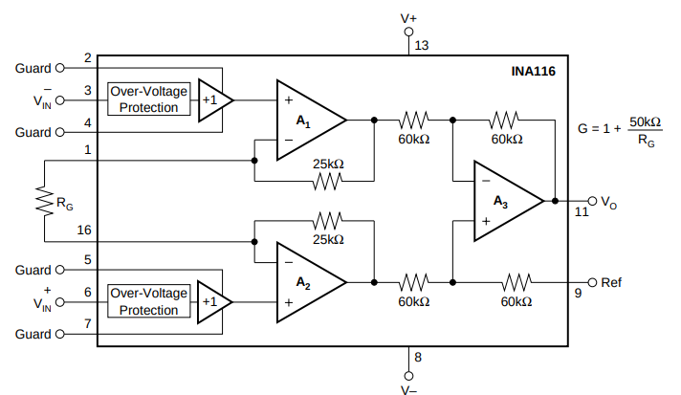
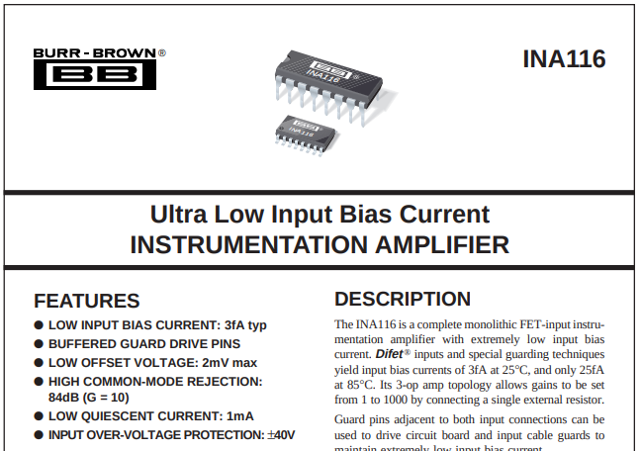
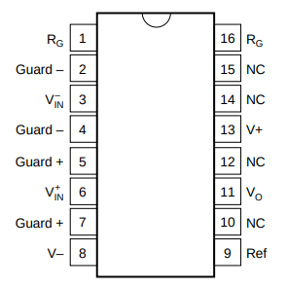
Analog Signal Processing
Signal Path Implementation Improvements
Guarded Traces
Example In-Amp with Guarded Inputs
Image: https://www.ti.com/lit/ds/sbos034/sbos034.pdf?ts=1588264952402

Slide 18
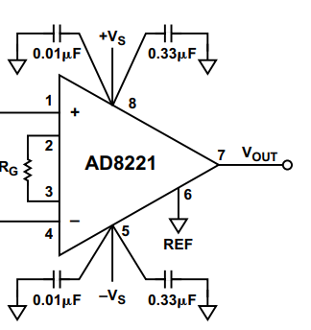
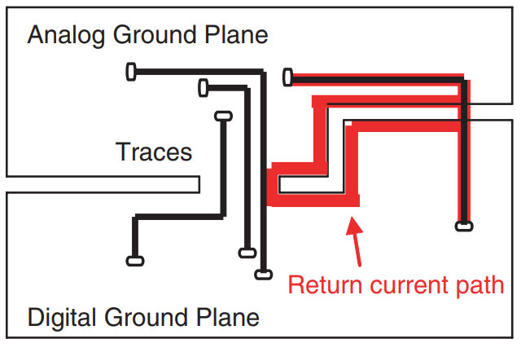
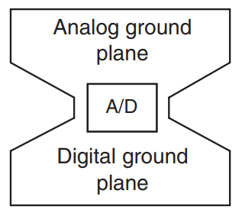
Analog Signal Processing
Signal Path Implementation Improvements
Analog Ground Plane
Image: https://www.teledyne-e2v.com/content/uploads/2014/09/Board-Layout.pdf
Image: https://www.analog.com/media/en/training-seminars/design-handbooks/designers-guide-instrument-amps-chI.pdf
Decoupling Caps with Complimentary Frequency Response
Isolation of Analog and Digital Ground Return Current

Slide 19
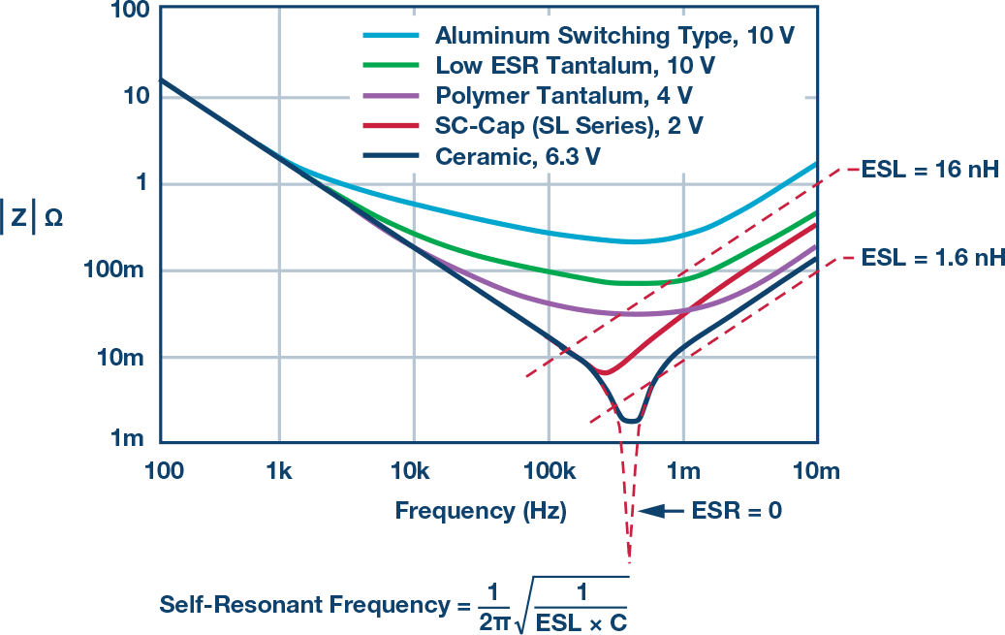
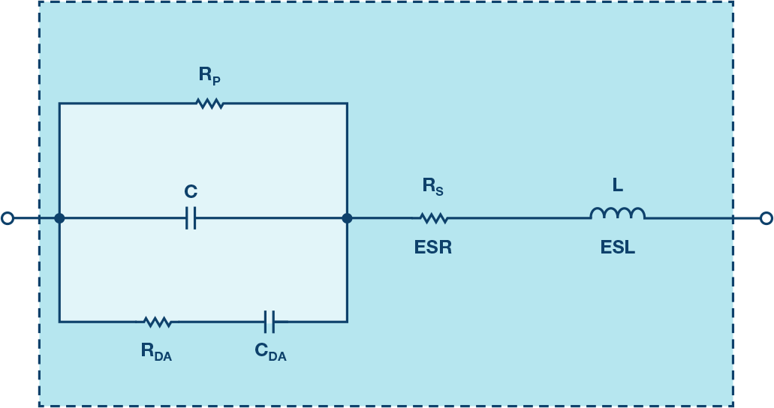
Analog Signal Processing
Non-Ideal Capacitors
Images: https://www.analog.com/en/analog-dialogue/studentzone/studentzone-may-2017.html
Capacitor Frequency Response
Actual Capacitor Equivalent Circuit

Slide 20
Analog Signal Processing
Signal Path Implementation Improvements
Self Test

Slide 21
ADC

Slide 22
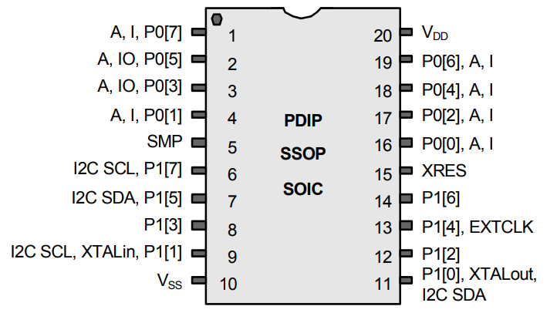
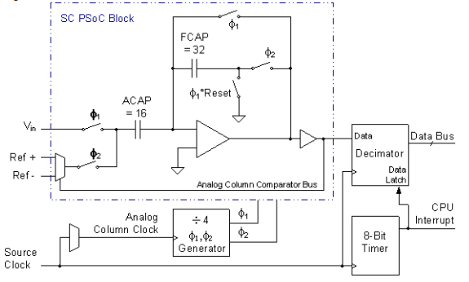
ADC
Physical Restrictions
Cypress PSoC1 CY8C24223A
DELSIG8 8-Bit Delta Sigma ADC
6mA
Current [A]
25uA
Time [s]
MCU Active vs. Sleep Periods

Slide 23
ADC
Physical Restriction: Power
Restriction | Value | Units
Energy capacity of two AA batteries | 7.8 | Wh
Energy capacity of two AA batteries (90% efficiency) | 7.0 | Wh
Current capacity at 3.3V | 2.1 | Ah
MCU current draw while active | 6.0 | mA
MCU current draw while in sleep | 25 | uA
Minimum interval between battery replacements | 1 | year
Max seconds with MCU active | 1.15E+06 | sec
Min seconds with MCU in sleep | 30.39E+06 | sec
Ratio of active to sleep | 36 | %
6mA
Current [A]
25uA
Time [s]
MCU Active vs. Sleep Periods

Slide 24
ADC
Physical Restriction: Time
Restriction | Value | Units
Minimum ADC sample conversion time | 31.25 | us
Minimum MCU wake + sample time (estimated) | 100 | us
Sleep time (from ratio) | 2.74 | ms
Minimum sample interval time (100us + 2.74ms) | 2.75 | ms
Maximum sample rate | 352 | Hz
6mA
Current [A]
25uA
Time [s]
MCU Active vs. Sleep Periods

Slide 25
ADC
Sampling Rate & Nyquist-Shannon Theorem

Slide 26
ADC
Oversampling & Aliased Frequencies
Entire signal band and background noise
Amplitude
Signal band of Interest
frequency

Slide 27
ADC
Oversampling & Aliased Frequencies
Entire signal band and background noise
Amplitude
Signal band of Interest
frequency
Aliased frequencies

Slide 28
ADC
Oversampling & Aliased Frequencies
Low-pass filtering
Amplitude
Signal band of Interest
frequency

Slide 29
ADC
Oversampling & Aliased Frequencies
Low-pass filtering
Amplitude
Signal band of interest
frequency
Aliased frequencies

Slide 30
ADC
Oversampling & Aliased Frequencies
Low-pass filtering
Amplitude
Signal band of interest
frequency
Aliased frequencies

Slide 31
ADC
Physical Restriction: Resolution
Restriction | Value | Units
ADC bit resolution | 8 | bit
Percent size of least significant bit (1 / 2^8) | 0.39 | %
Attenuation at least significant bit | -48 | dB
6mA
Current [A]
25uA
Time [s]
MCU Active vs. Sleep Periods

Slide 32
ADC
Designing a 1-Pole Anti-Aliasing Filter
2M
100uF
Vin
Vout

