Slide 1
CONVOLUTIONAL NEURAL NETWORKS: image information extraction
Grzegorz Kakareko
October 17, 2019

Slide 2
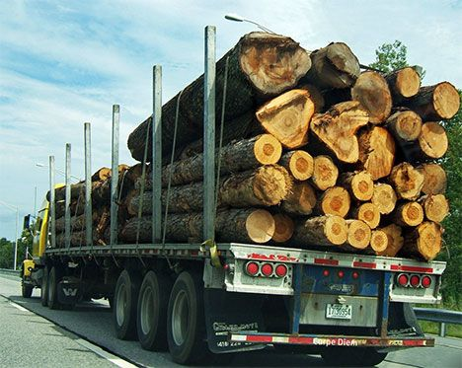
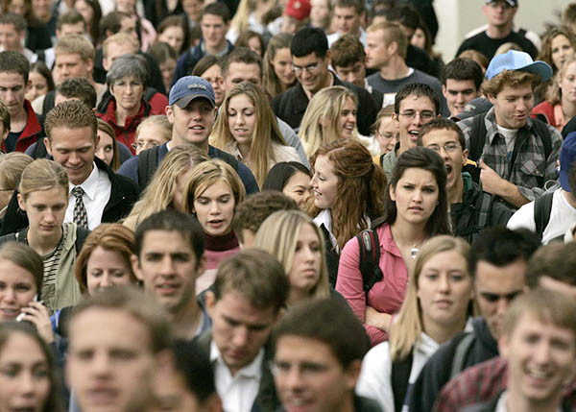
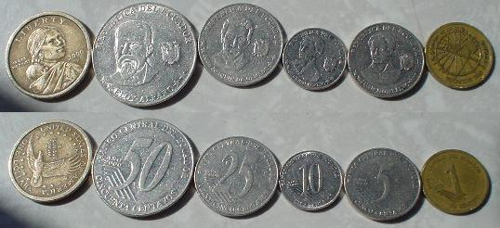
problem to solve
How many trees ?
How many people are on the picture ?
How much money is on the picture ?

Slide 3
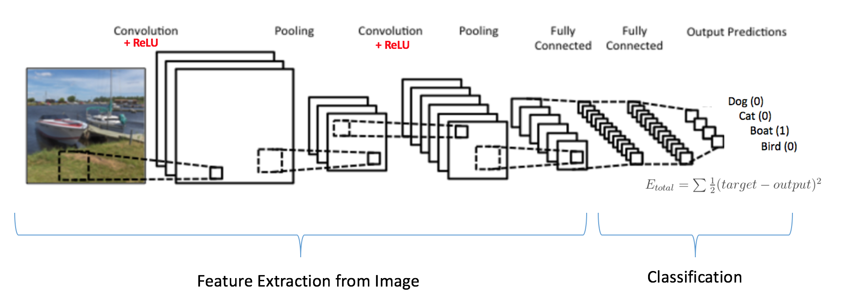
convolutional neural network
A convolutional neural network consists of an input and an output layer, as well as multiple hidden layers. The hidden layers of a CNN typically consist of a series of convolutional layers that convolve with a multiplication or other dot product. The activation function is commonly a RELU layer,
Around 2012 CNNs enjoyed a huge surge in popularity (which continues today) after a CNN called AlexNet achieved state-of-the-art performance labeling pictures in the ImageNet challenge. Alex Krizhevsky

Slide 4
Data set
The dataset was composed of three-channel images (rgb) with the 76x76 pixels resolution with 1:1000 scale
10,000 trees images and 30,000 non-tree images in the Leon County

Slide 5
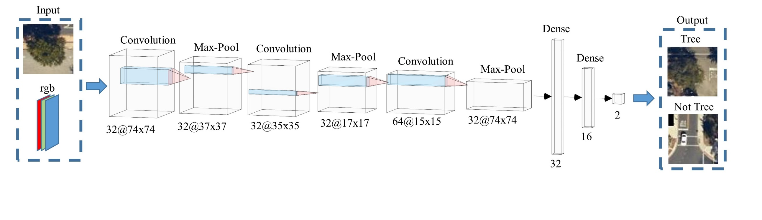
The architecture of CNN-I: tree recognition
The first network CNN-I was trained to recognize the existence of the tree from the satellite images.
The network was trained on GPU on 100 epochs, with the batch size equal to 128. As an activation function a rectified linear (ReLu)
98.5% accuracy

Slide 6
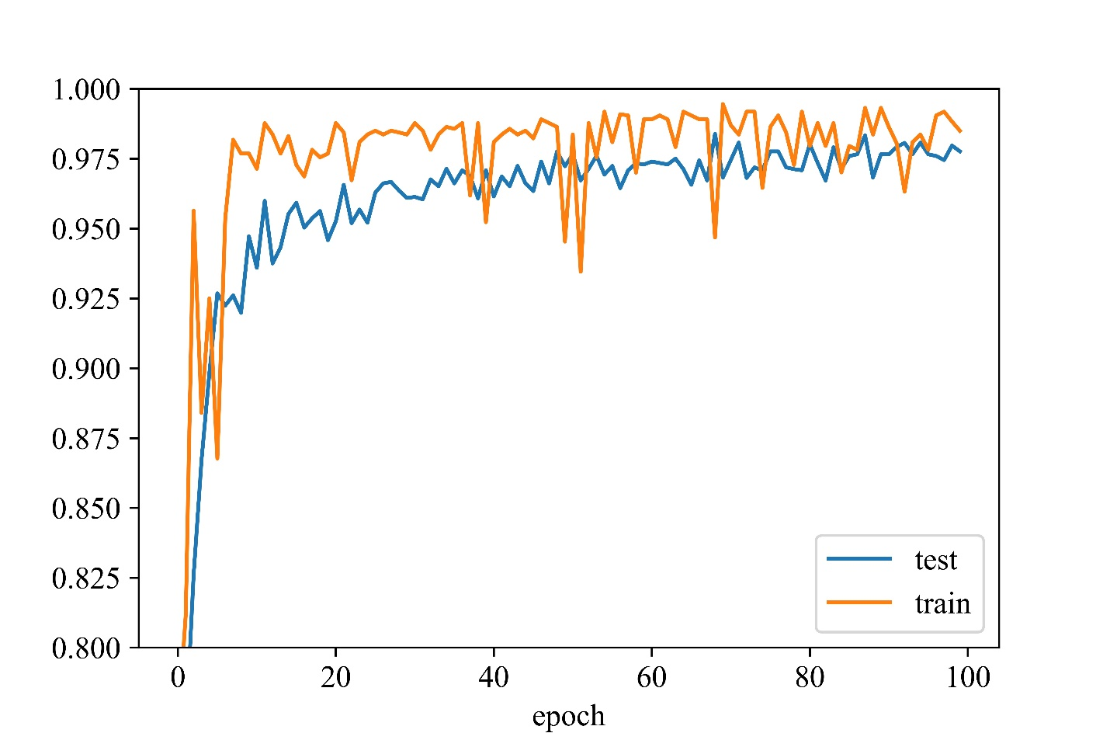
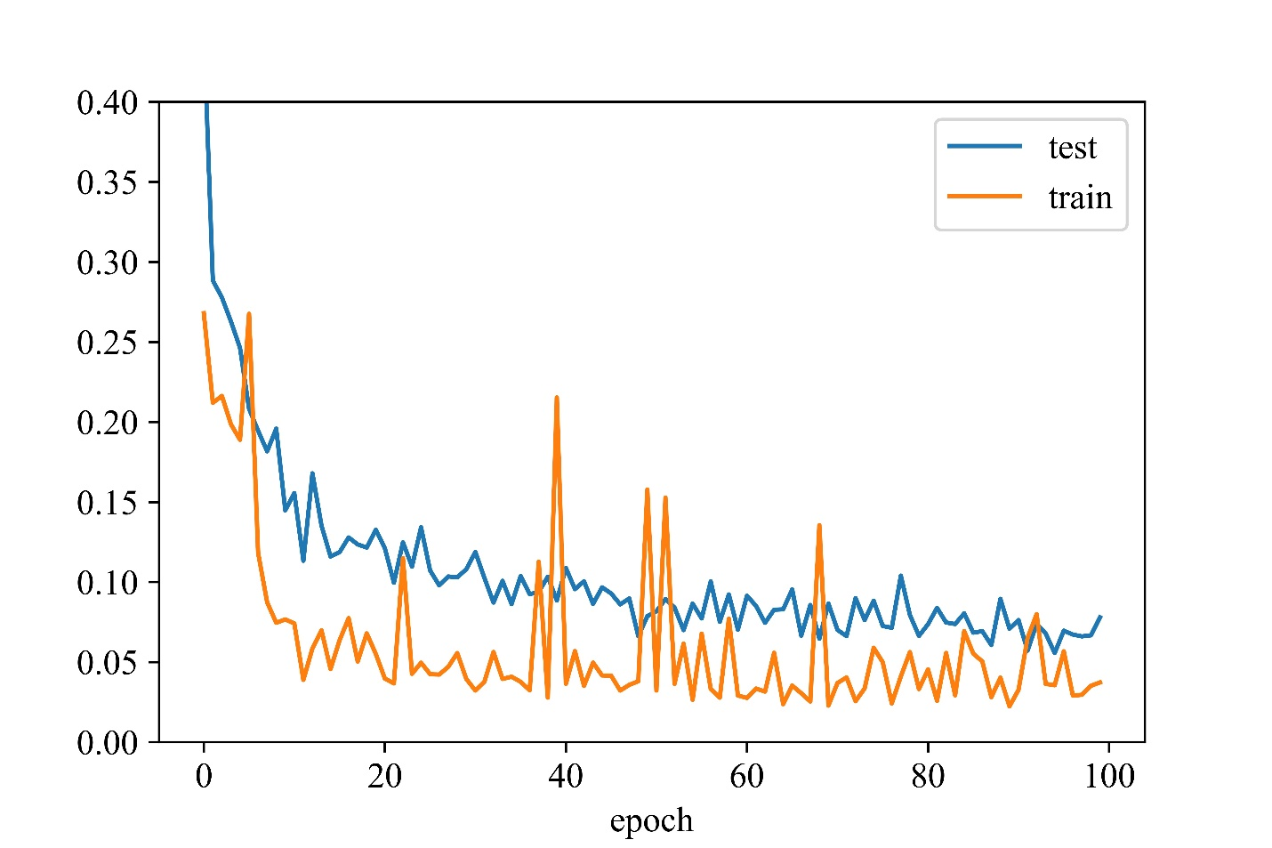
Accuracy
Loss -Cross-entropy

Slide 7
Window looping through satelite image
What’s the problem ?
The same tree recognized multiple times

Slide 8
Clustering
k-means
Number of Clusters need to be provided
Mean-Shift
Object is moved to the densest area (no cluster number needed)
Cluster analysis or clustering is the task of grouping a set of objects in such a way that objects in the same group (called a cluster) are more similar (in some sense) to each other than to those in other groups (clusters)

Slide 9
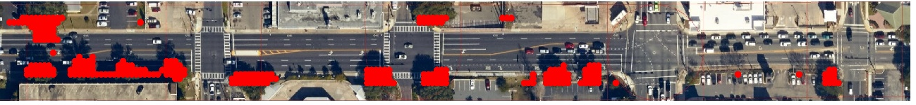
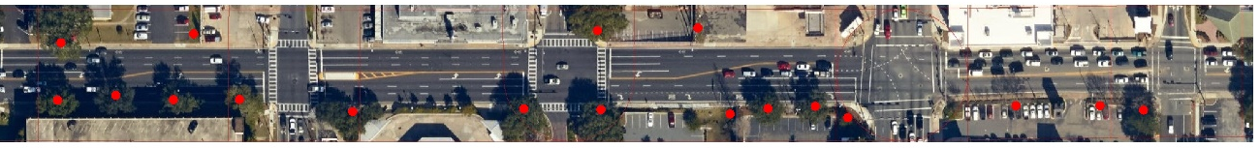
CNN recognition
After clustering

Slide 10


Tree crown estimation
The Adaptive Gaussian Thresholding (AGT) was used to calculate the area of the crown from the image and then estimate the diameter.

Slide 11
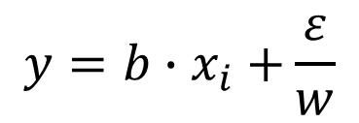
Tree diameter and height estimation PITA
Aproximate the tree parameters
$$y=b{∙x}_{i}+\frac{ε}{w}$$

Slide 12
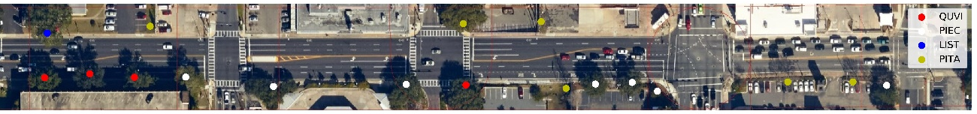
Recognize tree species

Slide 13

Possible exercses
Easy
Harder
Change the bandwidth in Mean-Shift clustering
Design the function that will be able to count the number of circles on the following picture:
Try different Clustering techniques

Slide 14
Summary
CNN was trained with 98.5% accuracy
CNN was later used to extract the essential information from the satellite image by using the Mean-Shift clustering
The discussed techniques can be applied to many problems to extract the essential information

Slide 15
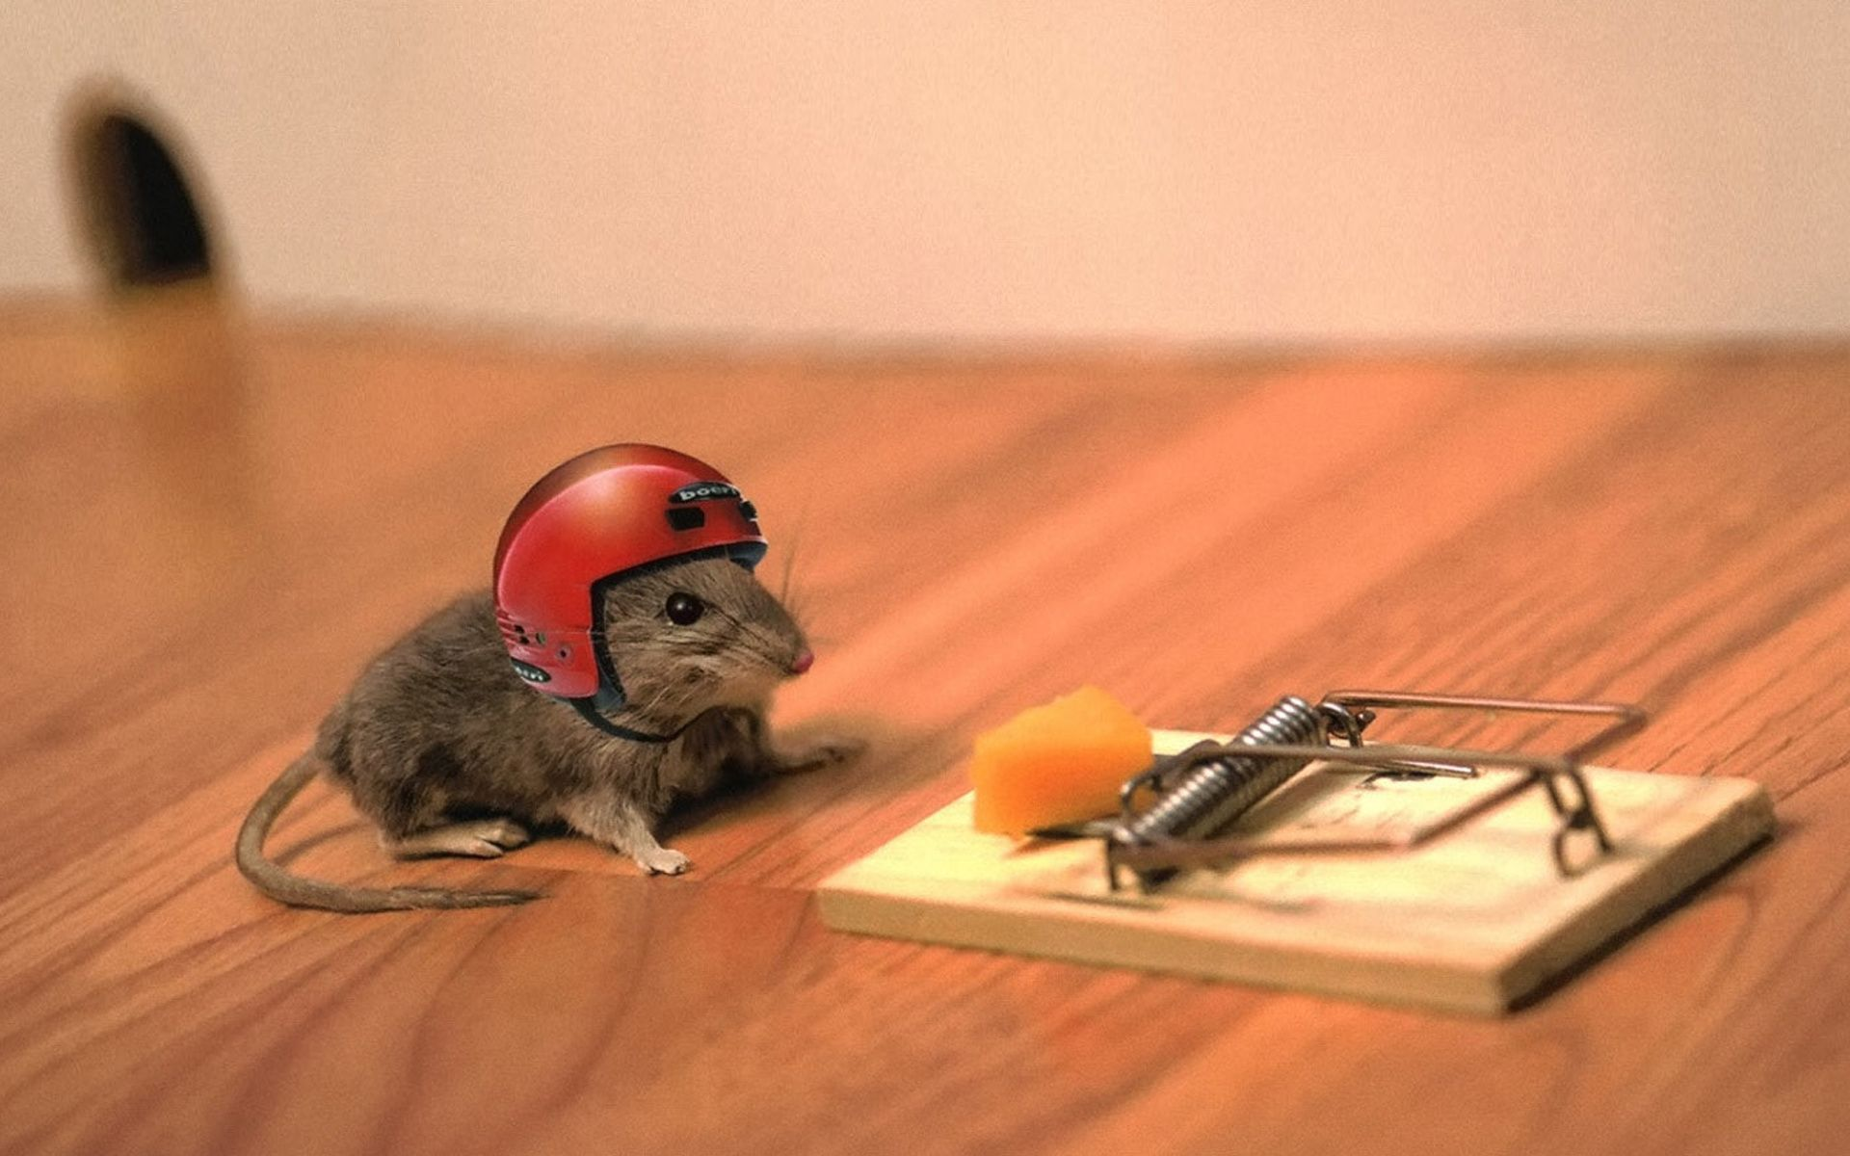
minimize the risk
Questions ?

Slide 16
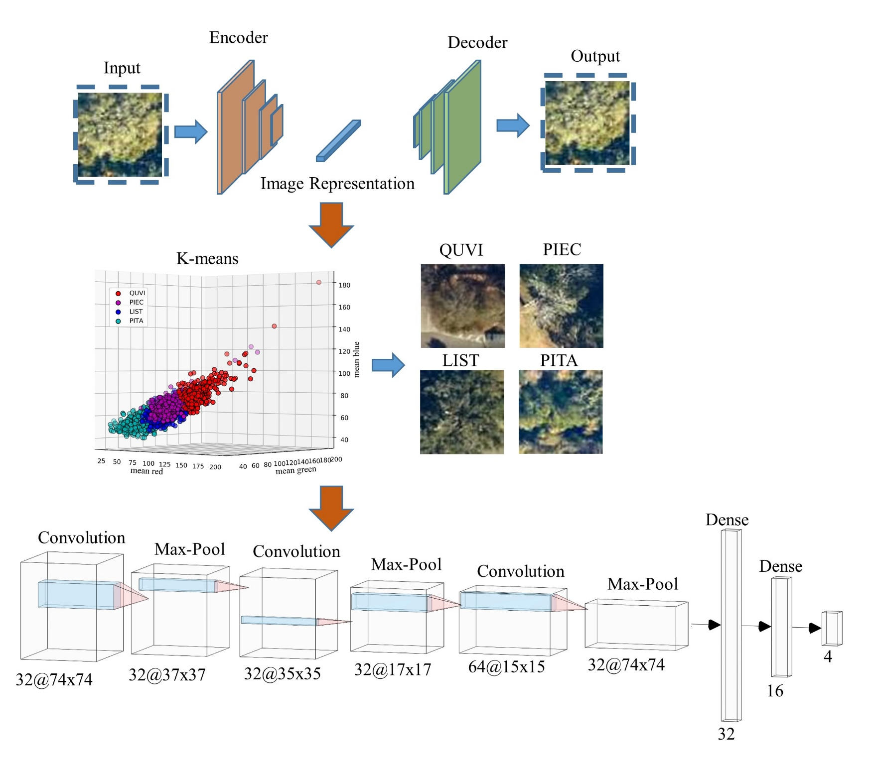
Network II: tree species recognition
Unsupervised learning feed as an input to Network II
The network was trained on GPU on 50 epochs, with the batch size equal to 128. As an activation function a rectified linear (ReLu)
live oak QUVI;
sweetgum LIST;
shortleaf pine PIEC;
lobby pine PITA.
91.5% accuracy

