Slide 1
NightLux - React + GraphQL
By Georgi Kiryakov

Slide 2
Why?

Slide 3
Solution

Slide 4
Comete
Find open services in the late hours of the night using mobile friendly web app
Use your current location
Minimalistic and easy to use UI

Slide 5
Demo

Slide 6


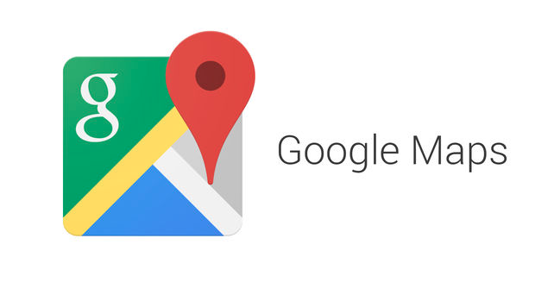



Technologies

Slide 7
Code review

Slide 8
The end.

