Slide 1
Почему у Грузии не получилось быстрого экономического роста
Юрий Полозов
Москва
19 мая 2012

Slide 2
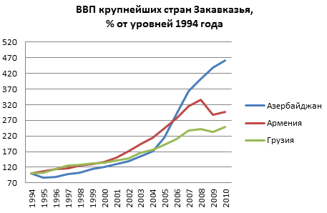

Slide 3
«Да, у Грузии есть проблемы»
Проблемы, влияющие на рост, динамику
Свойственные либертарианским рецептам
Свойственные данному правительству
Внешние
Фоновые проблемы
Notes:
The success of certain countries in their acquisition of high income levels has been sought in the expansive literature on growth economics. Classical models saw growth as a function of the resources a country was endowed with (land, labour and capital) combined with the efficiency of their use.
This model has expanded to cover geographic models (e.g. distance from Berlin, percentage of navigable rivers, access to harbours), trade models (openness to trade), and institutional models covering the quality of the socio-economic framework (political institutions, corruption, economic freedom).
All of them attempt to explain growth, which is seen as the only way to escape from poverty (as opposed to redistributive policies).

Slide 4
1. Мало либертарианства
Notes:
The success of certain countries in their acquisition of high income levels has been sought in the expansive literature on growth economics. Classical models saw growth as a function of the resources a country was endowed with (land, labour and capital) combined with the efficiency of their use.
This model has expanded to cover geographic models (e.g. distance from Berlin, percentage of navigable rivers, access to harbours), trade models (openness to trade), and institutional models covering the quality of the socio-economic framework (political institutions, corruption, economic freedom).
All of them attempt to explain growth, which is seen as the only way to escape from poverty (as opposed to redistributive policies).

Slide 5
1. Мало либертарианства
1а. Рост размера государства, доли государственных расходов.
– ухудшение данного показателя в индексе экономической свободы Heritage с 2006 года
– рост до 38,5% (Heritage 2012)
Notes:
The success of certain countries in their acquisition of high income levels has been sought in the expansive literature on growth economics. Classical models saw growth as a function of the resources a country was endowed with (land, labour and capital) combined with the efficiency of their use.
This model has expanded to cover geographic models (e.g. distance from Berlin, percentage of navigable rivers, access to harbours), trade models (openness to trade), and institutional models covering the quality of the socio-economic framework (political institutions, corruption, economic freedom).
All of them attempt to explain growth, which is seen as the only way to escape from poverty (as opposed to redistributive policies).

Slide 6
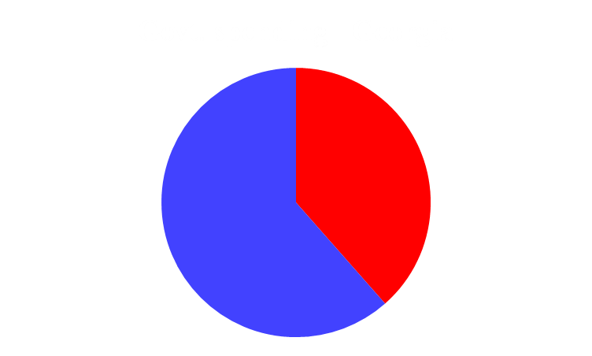
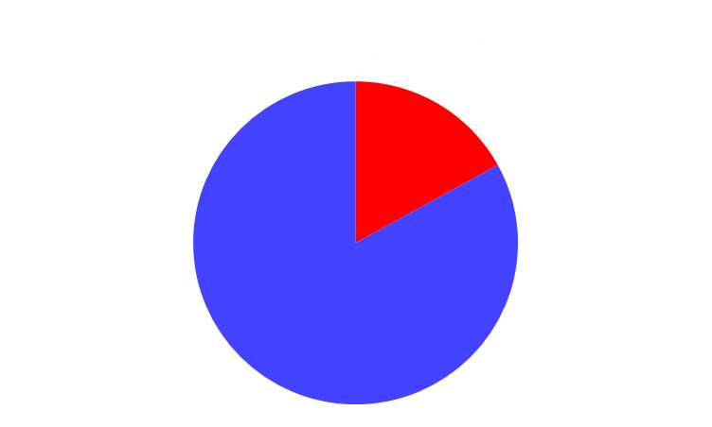
1. Мало либертарианства
1а. Рост размера государства до 38,5%
Notes:
The success of certain countries in their acquisition of high income levels has been sought in the expansive literature on growth economics. Classical models saw growth as a function of the resources a country was endowed with (land, labour and capital) combined with the efficiency of their use.
This model has expanded to cover geographic models (e.g. distance from Berlin, percentage of navigable rivers, access to harbours), trade models (openness to trade), and institutional models covering the quality of the socio-economic framework (political institutions, corruption, economic freedom).
All of them attempt to explain growth, which is seen as the only way to escape from poverty (as opposed to redistributive policies).

Slide 7
1. Мало либертарианства
1б. Рост социальной поддержки. Примеры – рост пенсий и соцобеспечения, бесплатные удобрения, бесплатные ноутбуки
Notes:
The success of certain countries in their acquisition of high income levels has been sought in the expansive literature on growth economics. Classical models saw growth as a function of the resources a country was endowed with (land, labour and capital) combined with the efficiency of their use.
This model has expanded to cover geographic models (e.g. distance from Berlin, percentage of navigable rivers, access to harbours), trade models (openness to trade), and institutional models covering the quality of the socio-economic framework (political institutions, corruption, economic freedom).
All of them attempt to explain growth, which is seen as the only way to escape from poverty (as opposed to redistributive policies).

Slide 8
1. Мало либертарианства
1в. Усиление пропаганды государства как эффективного собственника. Слепота к ошибкам государственных бюрократов.
Notes:
The success of certain countries in their acquisition of high income levels has been sought in the expansive literature on growth economics. Classical models saw growth as a function of the resources a country was endowed with (land, labour and capital) combined with the efficiency of their use.
This model has expanded to cover geographic models (e.g. distance from Berlin, percentage of navigable rivers, access to harbours), trade models (openness to trade), and institutional models covering the quality of the socio-economic framework (political institutions, corruption, economic freedom).
All of them attempt to explain growth, which is seen as the only way to escape from poverty (as opposed to redistributive policies).

Slide 9
1. Мало либертарианства
1г. Большое влияние сфер, слабо затронутых либерализацией
Сельское хозяйство
Суды
Рост денежной массы
Notes:
The success of certain countries in their acquisition of high income levels has been sought in the expansive literature on growth economics. Classical models saw growth as a function of the resources a country was endowed with (land, labour and capital) combined with the efficiency of their use.
This model has expanded to cover geographic models (e.g. distance from Berlin, percentage of navigable rivers, access to harbours), trade models (openness to trade), and institutional models covering the quality of the socio-economic framework (political institutions, corruption, economic freedom).
All of them attempt to explain growth, which is seen as the only way to escape from poverty (as opposed to redistributive policies).

Slide 10
2. На крючке у мировой бюрократии
Notes:
The success of certain countries in their acquisition of high income levels has been sought in the expansive literature on growth economics. Classical models saw growth as a function of the resources a country was endowed with (land, labour and capital) combined with the efficiency of their use.
This model has expanded to cover geographic models (e.g. distance from Berlin, percentage of navigable rivers, access to harbours), trade models (openness to trade), and institutional models covering the quality of the socio-economic framework (political institutions, corruption, economic freedom).
All of them attempt to explain growth, which is seen as the only way to escape from poverty (as opposed to redistributive policies).

Slide 11
2. На крючке у мировой бюрократии
2а. Гранты
* Гия Джандиери
Notes:
The success of certain countries in their acquisition of high income levels has been sought in the expansive literature on growth economics. Classical models saw growth as a function of the resources a country was endowed with (land, labour and capital) combined with the efficiency of their use.
This model has expanded to cover geographic models (e.g. distance from Berlin, percentage of navigable rivers, access to harbours), trade models (openness to trade), and institutional models covering the quality of the socio-economic framework (political institutions, corruption, economic freedom).
All of them attempt to explain growth, which is seen as the only way to escape from poverty (as opposed to redistributive policies).

Slide 12
2. На крючке у мировой бюрократии
2б. Стремление в ЕС
Notes:
The success of certain countries in their acquisition of high income levels has been sought in the expansive literature on growth economics. Classical models saw growth as a function of the resources a country was endowed with (land, labour and capital) combined with the efficiency of their use.
This model has expanded to cover geographic models (e.g. distance from Berlin, percentage of navigable rivers, access to harbours), trade models (openness to trade), and institutional models covering the quality of the socio-economic framework (political institutions, corruption, economic freedom).
All of them attempt to explain growth, which is seen as the only way to escape from poverty (as opposed to redistributive policies).

Slide 13
2. На крючке у мировой бюрократии
- трудовое законодательство,
- интеллектуальная собственность,
- антитраст.
Notes:
The success of certain countries in their acquisition of high income levels has been sought in the expansive literature on growth economics. Classical models saw growth as a function of the resources a country was endowed with (land, labour and capital) combined with the efficiency of their use.
This model has expanded to cover geographic models (e.g. distance from Berlin, percentage of navigable rivers, access to harbours), trade models (openness to trade), and institutional models covering the quality of the socio-economic framework (political institutions, corruption, economic freedom).
All of them attempt to explain growth, which is seen as the only way to escape from poverty (as opposed to redistributive policies).

Slide 14
3. Внешнее влияние?
Notes:
The success of certain countries in their acquisition of high income levels has been sought in the expansive literature on growth economics. Classical models saw growth as a function of the resources a country was endowed with (land, labour and capital) combined with the efficiency of their use.
This model has expanded to cover geographic models (e.g. distance from Berlin, percentage of navigable rivers, access to harbours), trade models (openness to trade), and institutional models covering the quality of the socio-economic framework (political institutions, corruption, economic freedom).
All of them attempt to explain growth, which is seen as the only way to escape from poverty (as opposed to redistributive policies).

Slide 15
3. Внешнее влияние?
3а. Военная угроза бизнесу
Notes:
The success of certain countries in their acquisition of high income levels has been sought in the expansive literature on growth economics. Classical models saw growth as a function of the resources a country was endowed with (land, labour and capital) combined with the efficiency of their use.
This model has expanded to cover geographic models (e.g. distance from Berlin, percentage of navigable rivers, access to harbours), trade models (openness to trade), and institutional models covering the quality of the socio-economic framework (political institutions, corruption, economic freedom).
All of them attempt to explain growth, which is seen as the only way to escape from poverty (as opposed to redistributive policies).

Slide 16
3. Внешнее влияние?
3б. Всемирный экономический кризис
Notes:
The success of certain countries in their acquisition of high income levels has been sought in the expansive literature on growth economics. Classical models saw growth as a function of the resources a country was endowed with (land, labour and capital) combined with the efficiency of their use.
This model has expanded to cover geographic models (e.g. distance from Berlin, percentage of navigable rivers, access to harbours), trade models (openness to trade), and institutional models covering the quality of the socio-economic framework (political institutions, corruption, economic freedom).
All of them attempt to explain growth, which is seen as the only way to escape from poverty (as opposed to redistributive policies).

Slide 17
4. Фоновые факторы
Notes:
The success of certain countries in their acquisition of high income levels has been sought in the expansive literature on growth economics. Classical models saw growth as a function of the resources a country was endowed with (land, labour and capital) combined with the efficiency of their use.
This model has expanded to cover geographic models (e.g. distance from Berlin, percentage of navigable rivers, access to harbours), trade models (openness to trade), and institutional models covering the quality of the socio-economic framework (political institutions, corruption, economic freedom).
All of them attempt to explain growth, which is seen as the only way to escape from poverty (as opposed to redistributive policies).

Slide 18
(4.) Фоновые факторы
(4а) Неразвитая бизнес-культура
Православие
Национальные особенности, отъезд евреев, армян
Notes:
The success of certain countries in their acquisition of high income levels has been sought in the expansive literature on growth economics. Classical models saw growth as a function of the resources a country was endowed with (land, labour and capital) combined with the efficiency of their use.
This model has expanded to cover geographic models (e.g. distance from Berlin, percentage of navigable rivers, access to harbours), trade models (openness to trade), and institutional models covering the quality of the socio-economic framework (political institutions, corruption, economic freedom).
All of them attempt to explain growth, which is seen as the only way to escape from poverty (as opposed to redistributive policies).

Slide 19
(4.) Фоновые факторы
(4б) Отсутствие крупных нефтяных месторождений и т.п.
Notes:
The success of certain countries in their acquisition of high income levels has been sought in the expansive literature on growth economics. Classical models saw growth as a function of the resources a country was endowed with (land, labour and capital) combined with the efficiency of their use.
This model has expanded to cover geographic models (e.g. distance from Berlin, percentage of navigable rivers, access to harbours), trade models (openness to trade), and institutional models covering the quality of the socio-economic framework (political institutions, corruption, economic freedom).
All of them attempt to explain growth, which is seen as the only way to escape from poverty (as opposed to redistributive policies).

Slide 20
Почему у Грузии не получилось быстрого экономического роста?
Большая роль государства в экономике и половинчатость либертарианских реформ, причем, многие реформы так и не начаты, а в некоторых сферах заметен откат.
Эти проблемы имеют как внутренние, так и внешние корни.
Notes:
The success of certain countries in their acquisition of high income levels has been sought in the expansive literature on growth economics. Classical models saw growth as a function of the resources a country was endowed with (land, labour and capital) combined with the efficiency of their use.
This model has expanded to cover geographic models (e.g. distance from Berlin, percentage of navigable rivers, access to harbours), trade models (openness to trade), and institutional models covering the quality of the socio-economic framework (political institutions, corruption, economic freedom).
All of them attempt to explain growth, which is seen as the only way to escape from poverty (as opposed to redistributive policies).

Slide 21
Полозов Юрий Сергеевич,
вице-председатель
Либертарианской партии России
Libertarian-Party.ru
YPolozov.livejournal.com
www.facebook.com/ypolozov
ypolozov@libertarian-party.ru

