Slide 1

Tutorial 4
Computer Engineering Department
Faculty of Engineering
Cairo University
Image Processing & Computer Vision - CMP(N)446
Morphology

Slide 2
Quiz Time

Slide 3
Sheet Time

Slide 4
Lab 4
Morphology

Slide 5
Required
You are required to implement/consume functions that apply the following morphological operations to images:
Erosion/Dilation
Opening/Closing
Skeletonization
Thinning

Slide 6



Part 1: Erosion Dilation
Purpose: Removes islands and small objects so that only substantive objects remain.
Purpose: Makes objects more visible and fills in small holes in objects

Slide 7



Part 2: Opening Closing
Purpose: Removes internal noise in an image while safeguarding certain foreground region according to the structuring element
Purpose: Enlarges the boundaries of foreground (bright) regions while preserving background regions

Slide 8

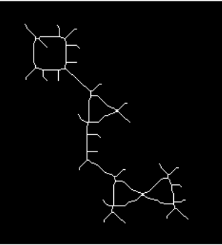
Part 3: Skeletonization
Purpose: Reduces foreground regions in a binary image to a skeletal remnant that largely preserves the extent and connectivity of the original region while throwing away most of the original foreground pixels.

Slide 9
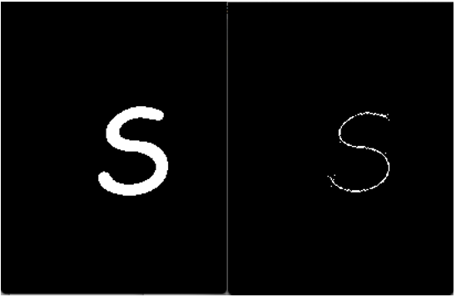
Part 4: Thinning
Purpose: Usually used to post-process the output of edge detectors by reducing all lines to single pixel thickness. Unlike Skeletonization, thinning doesn’t retain the size of the input objects (end points usually don’t extend to edges).

