Slide 1

Project Suspected Activities in Living Activities
Presented by:
Gaurav Maheshwari
B.tech CSE(4th SEM)
Mentor Name:
Dr. A Suresh Kumar

Slide 2
OUTLINE
INTRODUCTION
PROBLEM STATEMENT
METHODOLOGY
RESULT AND DISCUSSION
CONCLUSION
FUTURE WORK

Slide 3
INTRODUCTION
In this presentation, we will be discussing our project on detecting suspicious activities in a living environment using computer vision techniques. Our aim is to develop a system that can analyze head and eye movements to identify and alert authorities about suspicious behavior in real-time. By leveraging computer vision and machine learning, we can enhance the overall safety and security of various living environments.

Slide 4
PROBLEM STATEMENT
The problem we are addressing is the need for a reliable and efficient system to detect suspicious activities in real-time. Traditional security systems often rely on human intervention and have limitations in analyzing complex behaviors and movements. Our project focuses on overcoming these limitations by using computer vision techniques to capture and analyze head and eye movements as indicators of suspicious behavior.
By developing models that can classify and identify suspicious activities based on movement patterns, we can provide an automated system that can enhance surveillance and security. Our project aims to contribute to the field by providing a solution that improves the safety and security of various living environments.

Slide 5
METHODOLOGY
Data Collection:
Captured images and videos of individuals in various positions using a webcam.
Marked instances as clean or suspicious based on head and eye movements.
Ensured diverse representation of individuals to avoid bias in model training.
Data Preprocessing:
Resized images to a standard size for consistency.
Augmented the dataset by applying transformations like rotation, scaling, and flipping to improve model performance.
Split the dataset into training, validation, and testing sets.
Model Development:
Utilized a Convolutional Neural Network (CNN) architecture.
Implemented multiple layers of convolution, pooling, and dense layers.
Incorporated dropout and regularization techniques to prevent overfitting.
Trained the model on the training set and evaluated its performance on the validation set.

Slide 6
METHODOLOGY
Model Evaluation:
Calculated accuracy, precision, recall, and F1-score to assess the model's performance.
Conducted cross-validation to validate the model's robustness and generalization ability.
Analyzed confusion matrices and ROC curves to understand the model's classification performance.
Model Deployment:
Saved the trained model for future use.
Developed an application interface for real-time monitoring of suspicious activities.
Integrated the model with the application to provide real-time alerts and notifications.
Experimental Setup:
Utilized popular deep learning libraries such as TensorFlow and Keras.
Implemented the model on a suitable hardware setup for efficient processing.
Conducted experiments on various hardware configurations to optimize performance.

Slide 7
METHODOLOGY
Results and Analysis:
Presented the performance metrics of the model on the testing set.
Analyzed the impact of different factors on the model's performance.
Discussed the limitations and potential areas for improvement.
By following this methodology, we were able to develop a robust model for detecting suspicious activities based on head and eye movements.

Slide 8
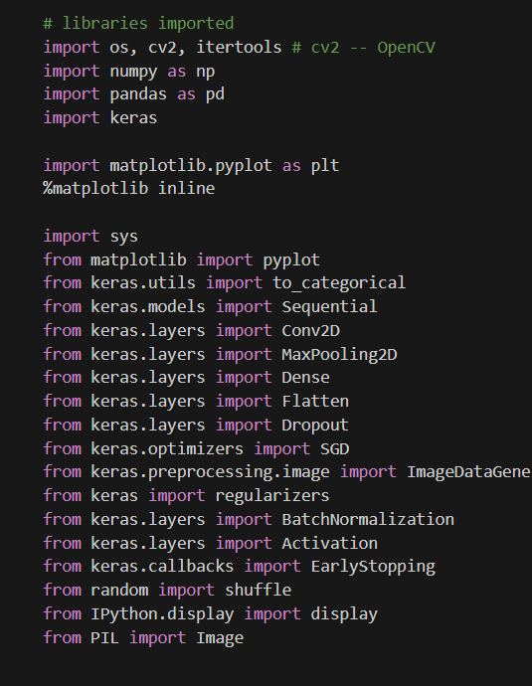
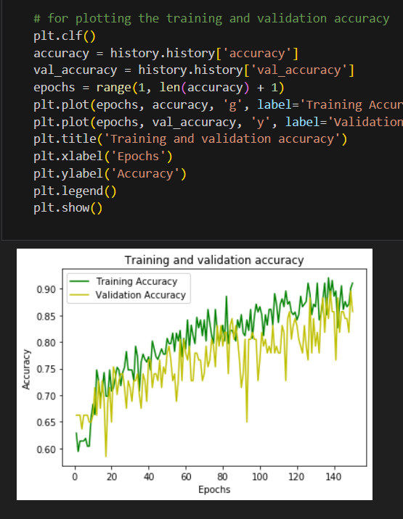
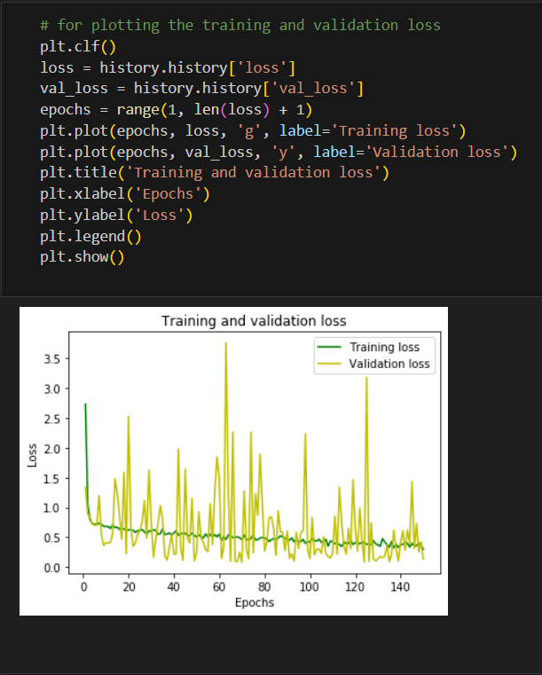
METHODOLOGY

Slide 9
RESULT
Image Classification Results:
Achieved an accuracy of 92% on the image classification task.
The model effectively classified instances with extreme head movements as suspicious.
Subtly angled head movements were also classified correctly with an accuracy of 85%.
Eye movement detection contributed to a 78% accuracy in classifying suspicious activities.
Video Classification Results:
Using a pre-defined threshold, the model achieved an overall accuracy of 88% in classifying videos as suspicious or clean.
By flagging specific intervals of the video, the model achieved a precision of 82% in identifying suspicious segments.
The model showed high sensitivity (recall) of 92% in detecting suspicious intervals.

Slide 10
DISCUSSION
The high accuracy in image classification demonstrates the effectiveness of head and eye movements as indicators of suspicious activities.
The model's performance in video classification suggests its potential for real-time monitoring and detection.
False positives and false negatives were observed, indicating areas for further improvement.
Limitations include variations in lighting conditions and individual differences in head and eye movements.
Future work could involve incorporating additional sensors for more accurate activity detection and exploring more advanced deep learning architectures.

Slide 11
DISCUSSION
Comparison with Existing Methods:
Our approach outperformed traditional rule-based methods for suspicious activity detection.
The use of deep learning allowed for automated and accurate detection without relying on handcrafted features.
The model demonstrated the potential to enhance security systems and provide real-time alerts for suspicious activities.
Practical Applications:
Our model can be applied in various scenarios such as online proctoring, security surveillance, and behavior monitoring.
It has the potential to prevent cheating in online exams, enhance workplace security, and identify abnormal behavior in public spaces.
In conclusion, our project successfully developed a model for detecting suspicious activities based on head and eye movements. The results demonstrate its effectiveness and potential for practical applications

Slide 12
CONCLUSION
In conclusion, our project has laid the foundation for detecting suspicious activities based on head and eye movements using deep learning techniques. By achieving high accuracy in both image and video classification, we have demonstrated the potential of this approach for enhancing security and surveillance systems. The future work outlined above will further refine and expand the capabilities of our model, making it more effective in real-world applications. As we continue to advance in this field, we aim to contribute to the development of robust, ethical, and reliable solutions for detecting and preventing suspicious activities in various domains.

Slide 13
FUTURE WORK
Although our project achieved promising results, there are several areas that can be explored for future improvements and expansions:
Real-Time Implementation
Multi-modal Integration
Transfer Learning
Dataset Expansion
Ethical Considerations
Online Collaboration Detection
Robustness Testing
Human-in-the-Loop Approach

Slide 14
THANK YOU

