Slide 1
Canadian Charity Twitter Analysis
An analysis of tweets related three International Development charities
William Greg Matthews
wmatthews@ryerson.ca
500867762

Slide 2
Context & Problem Statement
Since the recession of 2008, Canadian charities have seen a steady decline in donations
New generations display distinctly different charitable giving habits as compared previous generations
Canadian Charities must engage with new generations …in meaningful ways …through social media …to build Trust

Slide 3
Primary Research Questions
Topic identification:
What are the most common topics in twitter posts associated with World Vision Canada (WVC) and how do they compare to other charities?
Sentiment Analysis:
What is the sentiment of twitter posts associated with WVC, and how do they compare to other charities?

Slide 4
Dataset
-Compassion Canada (CC) -Plan Canada (PC) -World Vision Canada (WV)
10,099 tweets spanning 2-year time-period: 2016-11-01 to 2018-10-31

Slide 5
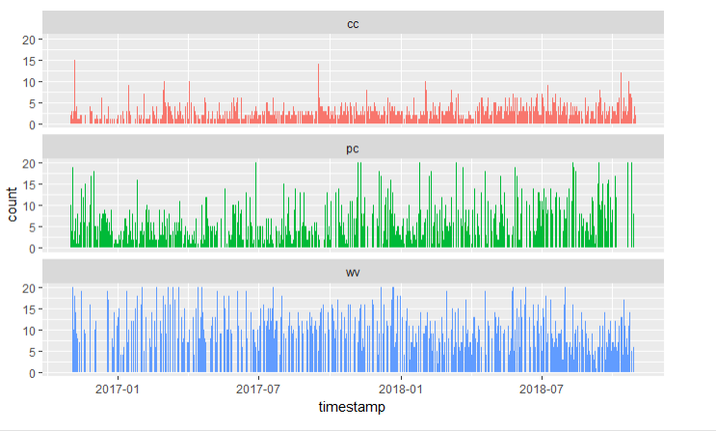
Number of Tweets Over Time

Slide 6
Frequent & Unique Words / N-grams

Slide 7
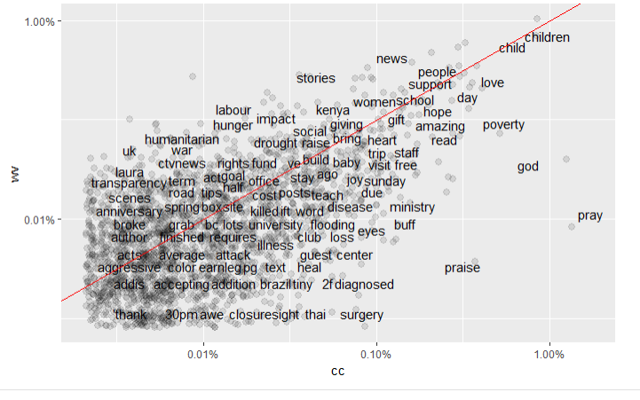
World Vision vs. Compassion - words

Slide 8
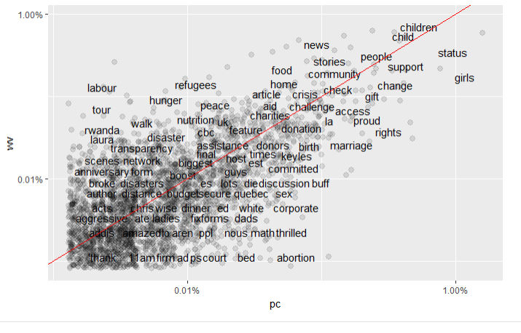
World Vision vs. Plan - words

Slide 9
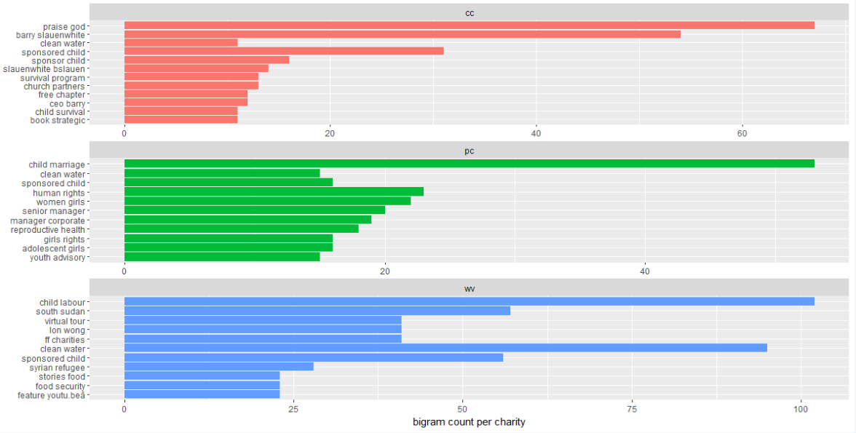
Bi-grams

Slide 10
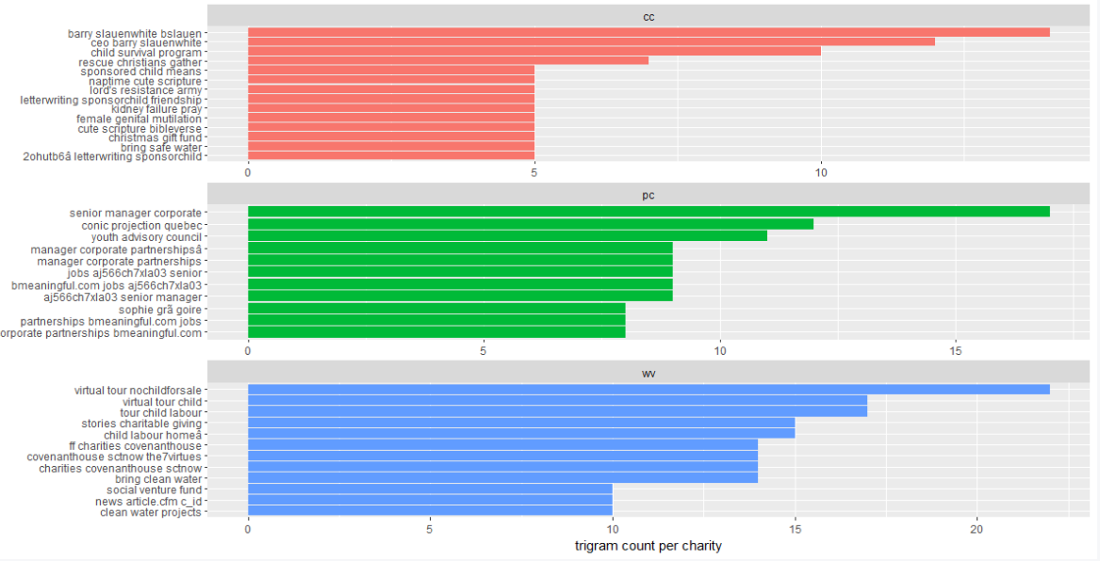
Tri-grams

Slide 11
Sentiment Analysis

Slide 12
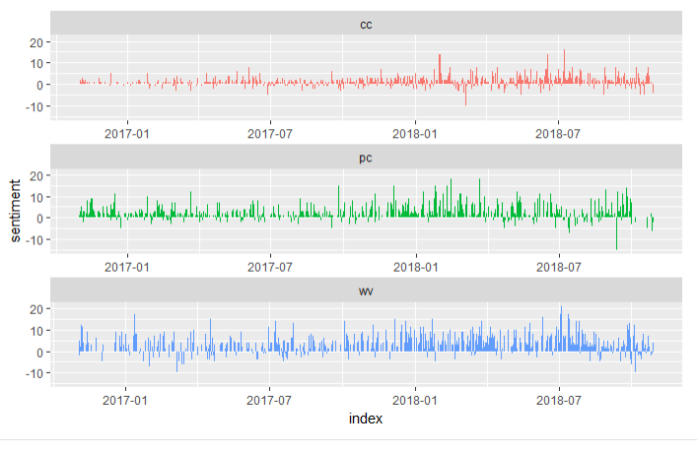
Positive/Negative Tweets Over Time

Slide 13
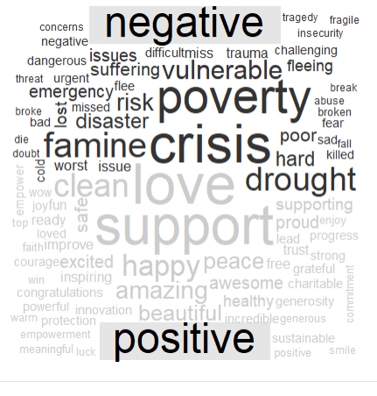
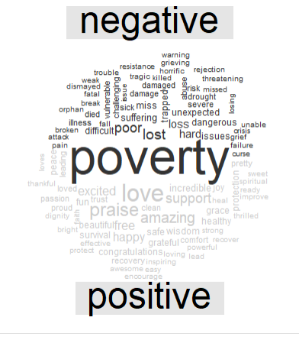
World Vision Canada | Compassion Canada

Slide 14
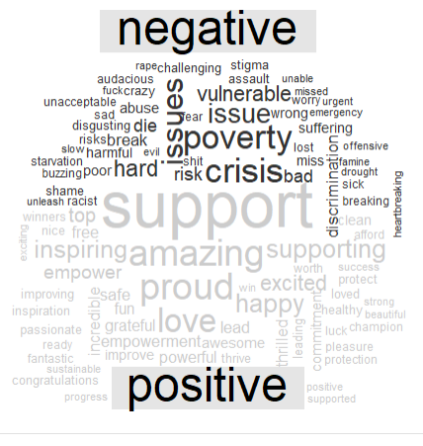
World Vision Canada | Plan Canada

Slide 15
Context: Negative Tweets
Compassion Canada
“A horrific attack by fire: one year later https://www.compassion.ca/blog/a-horrific-attack-by-fire-one-year-later/Â â€¦ via @CompassionCA”
Plan Canada
“I swear charities are accelerating this Age of Disillusionment same way the Daily Show degraded political discourse into playground bullying.”
World Vision Canada
“Violence affects more than 1.7 billion children every year...The good news is that there's growing evidence of the most effective solutions to end violence against children & mounting public pressure that it will no longer be tolerated”

Slide 16
Context: Positive Tweets
Compassion Canada
“Amazing. Amazing. What a generous, passionate, driven church. So grateful. (@CompassionCA) https://twitter.com/ssundby/status/871570849509261312Â â€¦”
Plan Canada
“Pretty amazing to have been part of helping to shape this G7 focus on girls education in my role as @PlanCanada CEO. Even more thrilled to see our PM @JustinTrudeau creating global momentum to make this historic commitment a reality.”
World Vision Canada
“Visit @worldvisioncan to see how they're making a difference in this world and what you can do to help \n#nonprofit #givingtuesday #hungerfreepic.twitter.com/M3My4i5FlA”

Slide 17
Engagement Analysis

Slide 18
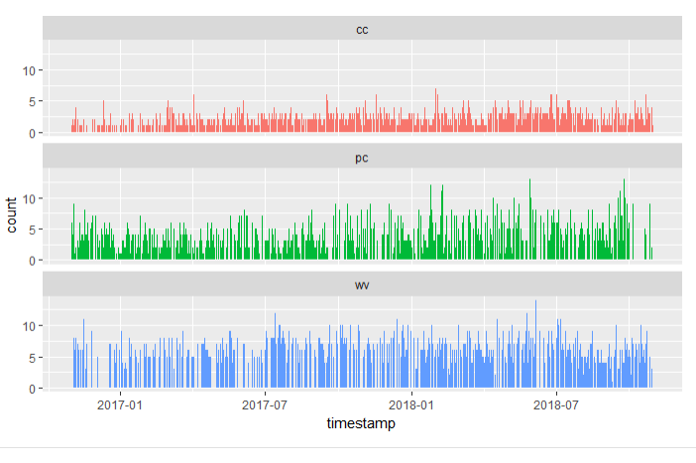
Frequency of Likes Over Time

Slide 19
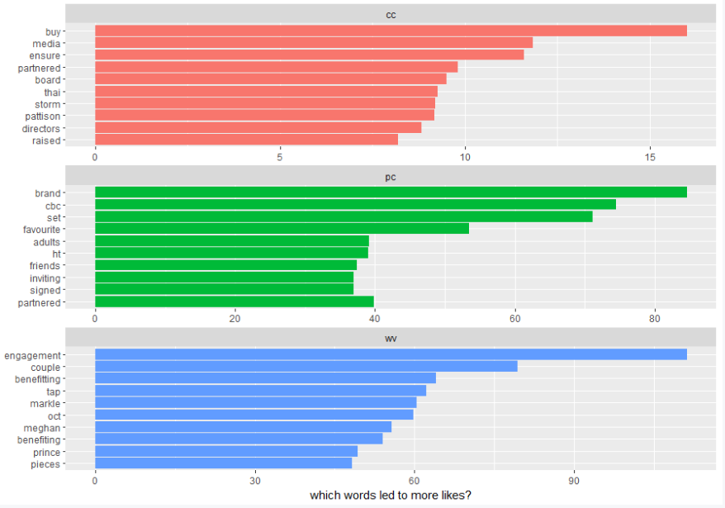
Highest Average Likes

Slide 20
Context: Most-Liked Tweets
“Such neat innovations in refrigeration and sanitation #socent #socinnhttps://www.theguardian.com/global-development/2016/oct/24/a-water-chilled-coolbox-gets-vaccines-on-tap-to-the-worlds-poorest-grand-challenges-conference-London”
“Tonight on a brand new Mercer Report â€“ always my favourite show of the year. We profile & salute the winners of this yearâ€™s Spread the Net Student Challenge. The feel good episode of the decade! 8:00 (8:30 NL) on CBC. Set your PVR Retweet & tell two friends. #PlanCanada”
“Heartfelt congratulations to Meghan Markle, our ambassador for the past 2 years, on her engagement to Prince Harry. We're grateful for her support of the worldâ€™s most vulnerable children. We wish the couple every happiness together.”

Slide 21
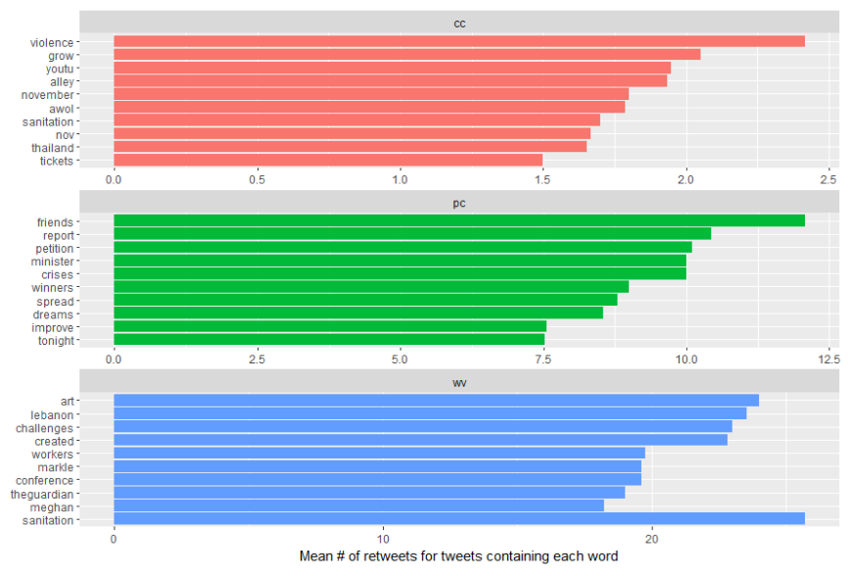
Highest Average Retweets

Slide 22
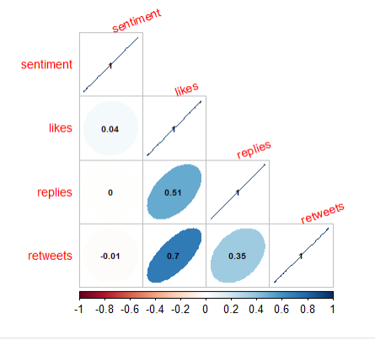
Engagement Correlation

Slide 23
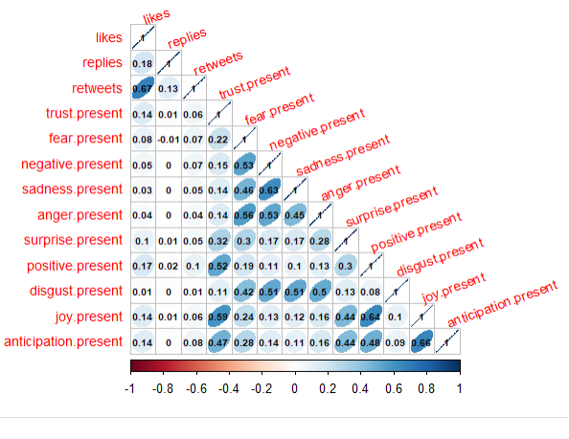
Sentiment Correlation

Slide 24
Conclusion

Slide 25
Topics and words more similar than not, but still a unique ‘brand’
Compassion Canada: -Overtly religious language to engage its primarily Christian donor base -Least active, least engagement -Twitter platform as a medium for organizational news
Plan Canada: -‘On-brand’: associated with advocating for the rights of girls, and reproductive health -Twitter platform to inform, engage, and also to post about job openings -Association with celebrities led to higher engagement
World Vision Canada -Emphasis on children, but also refugees and ‘fragile-context’ countries -High-level of activity & association with celebrities led to highest level of engagement
Sentiment of tweets didn’t have a strong correlation with engagement metrics
Suggests that the subject of tweets and the person they are associated with is more likely to drive engagement than sentiment alone

Slide 26
Recommended Next-Steps

Slide 27
Expand scope to include other Canadian International Development charities (ex. MetoWe; Food for the Hungry; Save the Children)
Conduct case studies on charities who are most innovative in engaging young audiences on social media, and most successful in converting engagement to donations (ex. Charity:Water; Doctors without Borders (MSF); Toronto Sick Kids Hospital (“Sick Kids VS” campaign)
Use different techniques to derive new insights: predictive models, deep learning
Incorporate more data: -location of posts (geographic differences) -other social media data (from Facebook, Snapchat, etc.) -digital and campaign engagement -financial data

Slide 28
Thank You!
Questions?
William Greg Matthews
wmatthews@ryerson.ca
500867762

