Slide 1
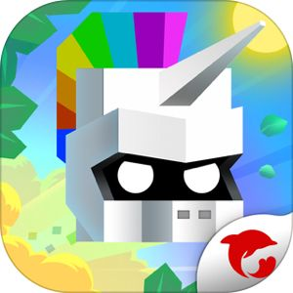


The Will Hero
SHASHANK SHEKHAR SINGH(2020119)
VASU KHANNA (2020483)

Slide 2
DESIGN
All the orcs islands chests etc present in the game are fixed using an array list of hardcoded coordinates.
The character earns 5 points with each forward movement.
The character can revive if it has earned 500 coins at the time of being killed.
The character earns 500 coins after opening a coin chest.
The character equips either of the two weapons(sword or axe) after opening a weapon chest.
The weapon upgrades(damage increases) when a weapon is collected twice.
TNT is added in the game which kills the character if explodes near it.

Slide 3
IMPLEMENTATION
The character jumps and the scene moves with the use of TRANSLATE TRANSITION
Collision is detected with the help of animation timer
The saving and loading process is done by implementing the serialisable interface
The weapons are used to defeat the orcs using the rotate transition

Slide 4
CONTRIBUTION
DEADLINES | Shashank | Vasu
1st deadline | UML class + Use case | UML class + Use case
2nd deadline | Animations+ combining Main menu with the animations of characters | Main menu+User name page +Exit feature
3rd deadline | Adding animations, adding weapons, saving reloading ,bonus etc | Placing objects, making array lists, classes, creating orcs,chests, islands, bonus etc

Slide 5
BONUS
We have included a bonus feature by adding a portal in the game, when our character arrives at the portal the character is teleported to the forward direction and lands safely on an island.

Slide 6
THANK YOU

