Slide 1

Cloudathon

Slide 2
Team 12 – Code-Breaker
Team Members:
Rahul Gujarathi
Surya
Sekhar
Chaitanya

Slide 3
Centralised Dashboard for Customer Investment Health

Slide 4
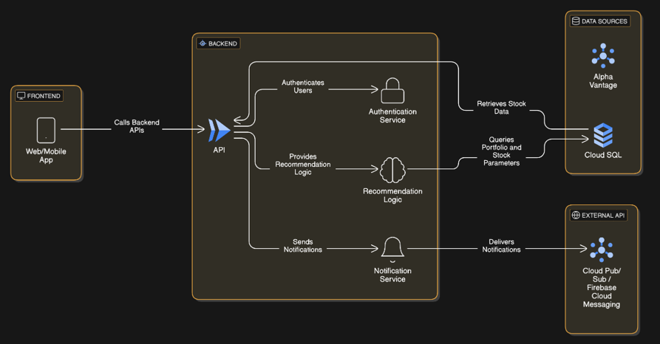
Architecture

Slide 5
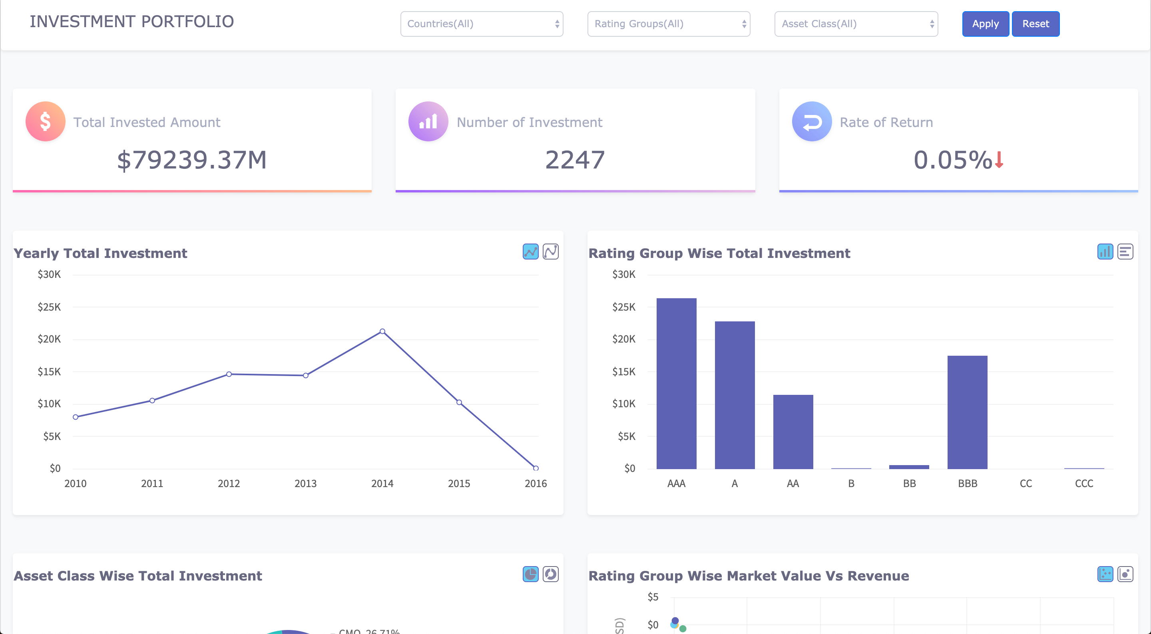
Dashboard

Slide 6
Features
Stock Recommendation System
User Authentication & Security
Real-time Stock Data Retrieval
Notification System
Scalable Backend API
The system provides stock recommendations to users based on their portfolio and Stock market data
Secure user authentication via an Authentication Service
Stores and queries stock-related data using Cloud SQL
Uses Cloud Pub/Sub or Firebase Cloud Messaging for delivering notifications
Provides endpoints for authentication, recommendations, and notifications

Slide 7


