Slide 1




Training on Arduino

Slide 2
Voltage, Current, Resistance, and Ohm's Law
Voltage is an electromotive force or potential difference expressed in volts.
Current is a flow of electrical charge carriers, usually electrons or electron deficient.
Resistance is a material’s tendency to resist the flow of charge (current).
Ohm's Law: V=IR

Slide 3
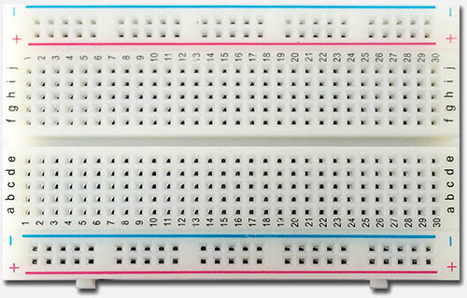
Breadboard
Solder-less Breadboard.
Building prototypes of a circuit.
Resistance is a material’s tendency to resist the flow of charge (current).
The breadboard consists of a matrix of holes in which rows or columns of them are interconnected.

Slide 4
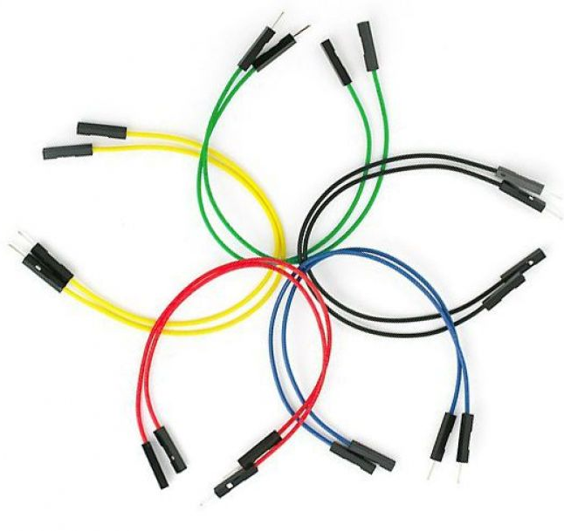
Jumper Wires
Jumper wires are used for making connections between items on your breadboard and your Arduino’s header pins. Use them to wire up all your circuits!
Many types of Jumper wires

Slide 5
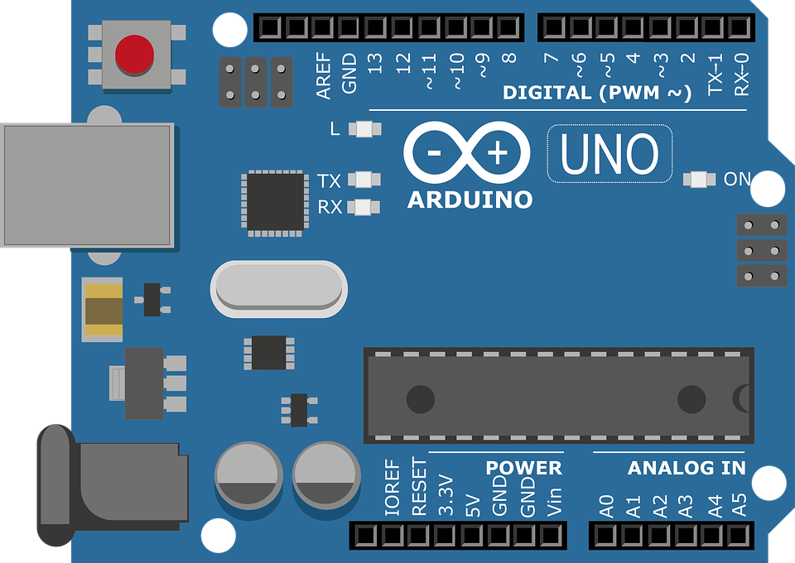
Arduino
Arduino is a microcontroller on a circuit board which makes it easy to receive inputs and drive outputs.
A microcontroller is a integrated computer on a chip.

Slide 6
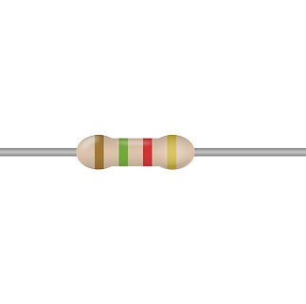

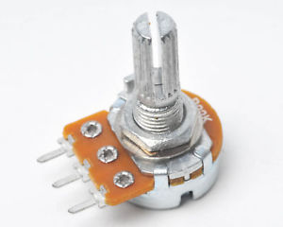
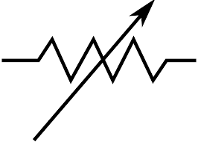
Resistor
Resistor is a two terminal passive electrical device that acts to reduce current through itself. In electronic circuits resistors are most common component.
A variable resistor is a resistor of which the electric resistance value can be adjusted.

Slide 7
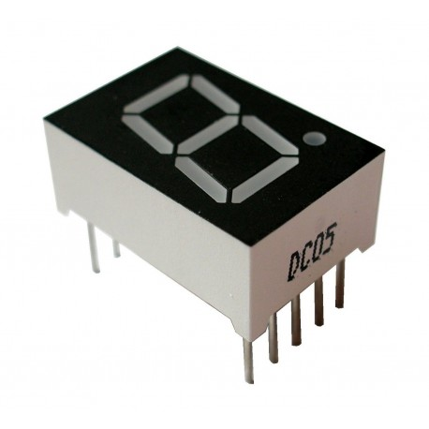
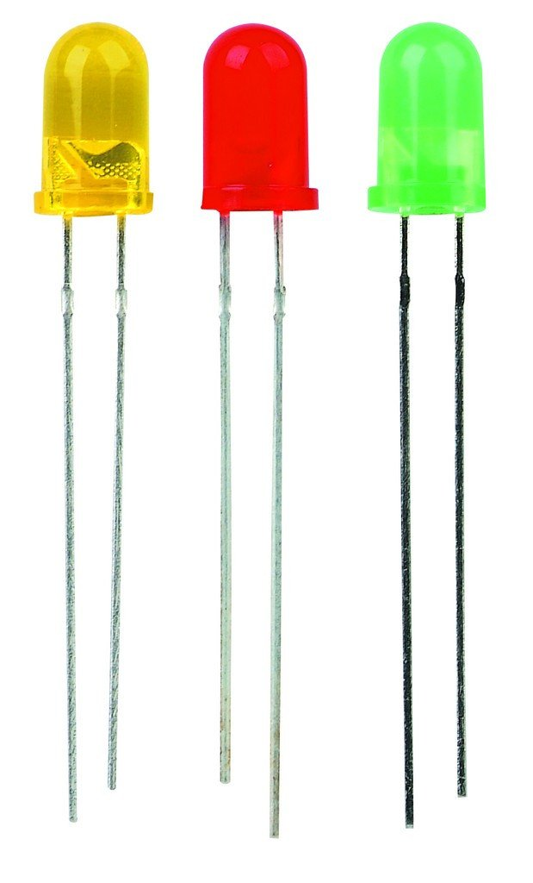
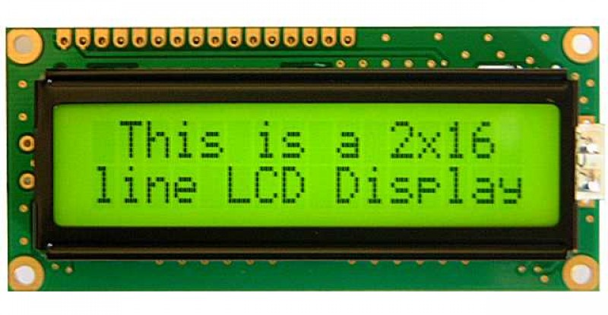
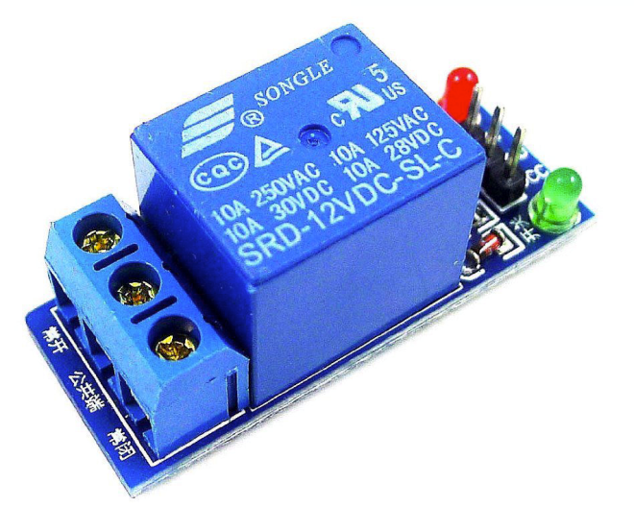
Output Device
LEDs are available in a variety of sizes and shapes including the 3mm LED.
The 7-segment display, also written as consists of seven LEDs arranged in a rectangular fashion as shown.
A 16x2 LCD means it can display 16 characters per line and there are 2 such lines.
A relay is an electromagnetic switch.

Slide 8
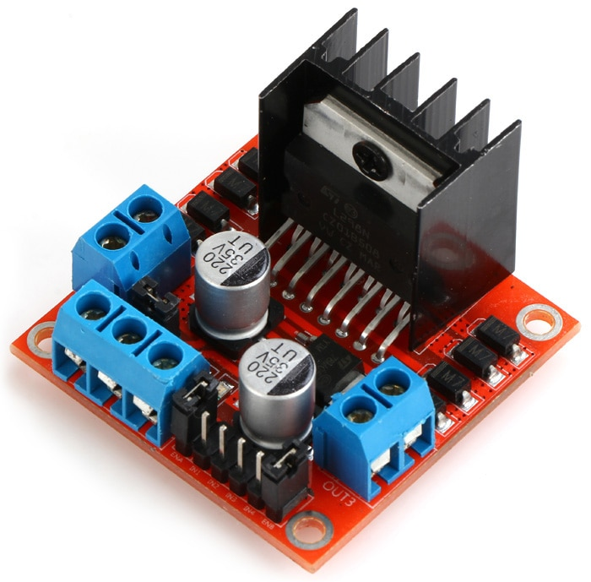
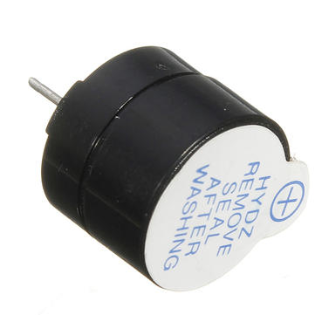
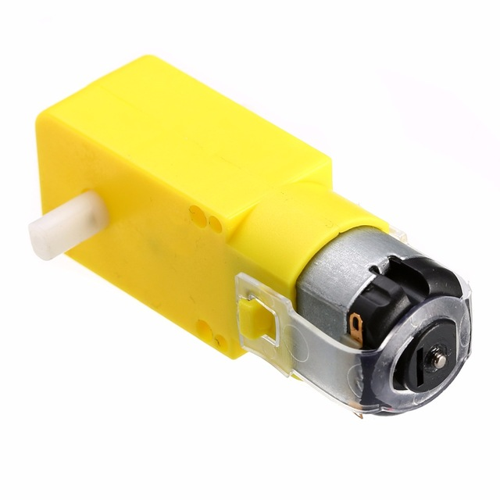
Output Device
The L298N is a dual H-Bridge motor driver which allows speed and direction control of two DC motors at the same time.
6v DC plastic gear motor.
This active buzzer can be used to generate tones and sounds from a 5V signal.

Slide 9
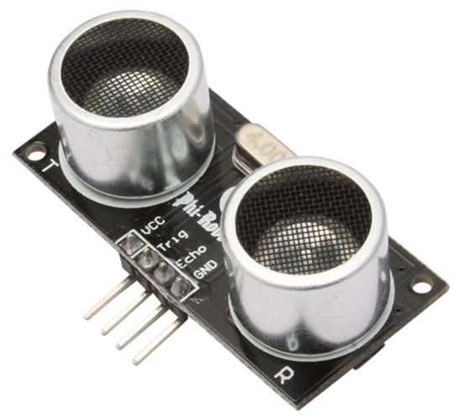
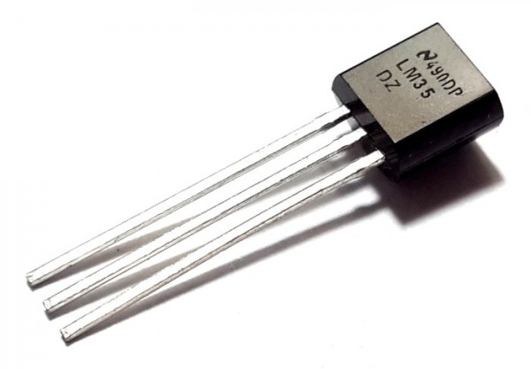
Input Device
The LM35 device has an advantage over linear temperature sensors calibrated in Kelvin.
HC-SR04 ultrasonic ranging sensor. This sensor provides 2cm to 400cm of non-contact measurement functionality.
A 16x2 LCD means it can display 16 characters per line and there are 2 such lines.
A relay is an electromagnetic switch.

Slide 10
THANK YOU
www.g-robotics.cc
www.fb.com/GRoboticsLTD

