Slide 1
CSE 402 · NUMERICAL ANALYSIS, SIMULATION & MODELING
Numerical Analysis of the SIR Epidemic Model
S
→
I
→
R
Solver Accuracy, Parameter Recovery, and Robustness to Noise
Section [Section] · Group [Group Number] · Final Project Defense
[Member Name]
[Member Name]
[Member Name]
[Member Name]
[Member Name]
ID [Student ID]
ID [Student ID]
ID [Student ID]
ID [Student ID]
ID [Student ID]
Supervised by [Supervisor Name]
Notes:
Introduce the team, section/group, and supervisor. One sentence on the topic before moving to the hook.

Slide 2
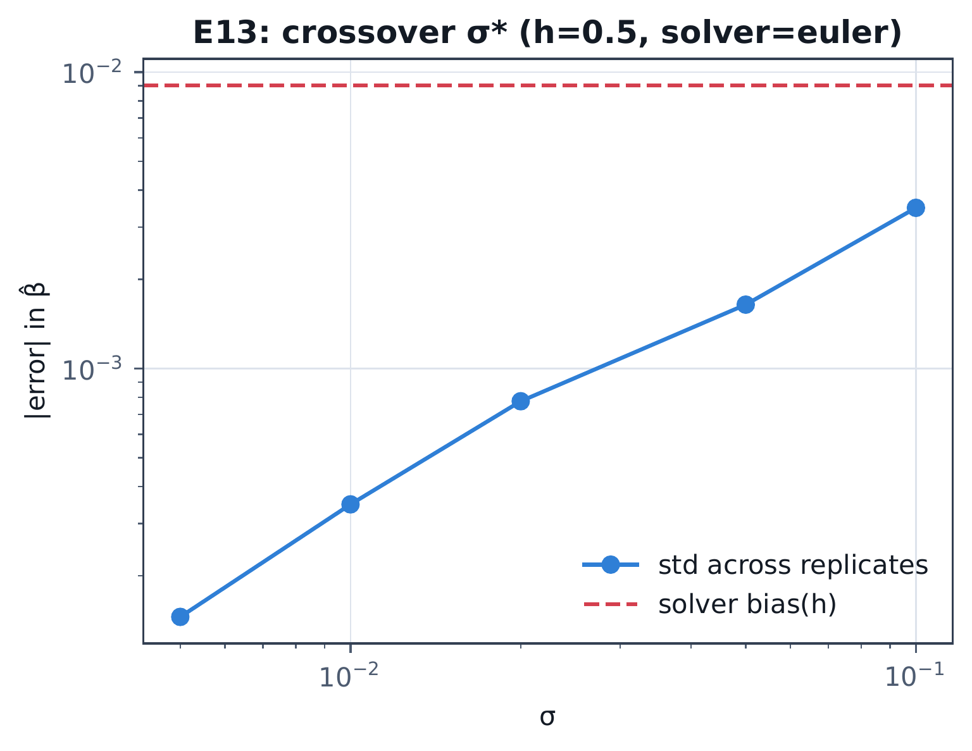
THE BIG QUESTION
Does your choice of solver actually matter?
We fit the SIR epidemic model using six solvers we wrote ourselves — from plain Forward Euler to adaptive Runge–Kutta — then asked when the solver you pick changes the answer.
Below σ*, solver choice is the main source of error.
Above σ*, noise drowns it out — any solver will do.
measured σ* ≈ 0.058
reference case: h = 0.1
Where the two lines cross is σ* — below it, solver bias (dashed) beats noise; above it, noise (solid) wins.
Notes:
This is the headline finding. State it once in plain language, then point at the crossover point on the chart. If time allows, this is a good place to switch to a live run instead of the static chart.

Slide 3
WHERE WE STARTED
The base paper treats the solver as a black box
P
Capaldi et al. (2012)
?
The gap
Fit the SIR model to outbreak data.
Measured how confident we can be in the recovered β and γ.
Showed accuracy drops as you sample less often.
They never ask which ODE solver produced those numbers, or how big a step size — the solver is just “whatever gets us the curve.”
Our twist: we make the solver itself the experiment.
Notes:
Name the base paper once. State the one-sentence gap. This slide is a setup for the method slide, keep it brief.

Slide 4
HOW WE DID IT
One pipeline, six solvers, one exact reference
SIR model
→
6 solvers, hand-written
→
Fit β, γ
→
Score against truth
the 3 equations below
Euler to adaptive RK45
least squares
an exact, solver-free reference
The reference solution comes from an exact algebraic reduction of these equations — no numerical solver involved — so every accuracy claim is checked against the truth, not a finer guess.
dS/dt = −βSI/N
dI/dt = βSI/N − γI
dR/dt = γI
root finding
LU & QR
power method
least squares
quadrature
Monte Carlo & MCMC
Notes:
Walk the pipeline left to right, then point at the equations. Mention the course methods list only if asked, don't read it aloud slide-by-slide.

Slide 5
UNDER THE HOOD
How one config file becomes a live result
configs/*.yaml
one config per experiment — quick & full profiles
↓
experiment runner
experiments/registry.py routes E01 – E14
↓
core/sirlab — hand-written, no SciPy
models
solvers
estimate
uq
↓
results/*.json
content-hash cached · seeded · git-SHA tagged
report figures
web dashboard
scripts/make_figures.py → the LaTeX report
live, interactive — deployed for this defense
Notes:
This is the software architecture, not the numerical method — configs drive the runner, the runner calls the hand-written core library, results are cached JSON, and the same JSON feeds both the report figures and the live dashboard. Mention the deployed link here if doing a live demo.

Slide 6
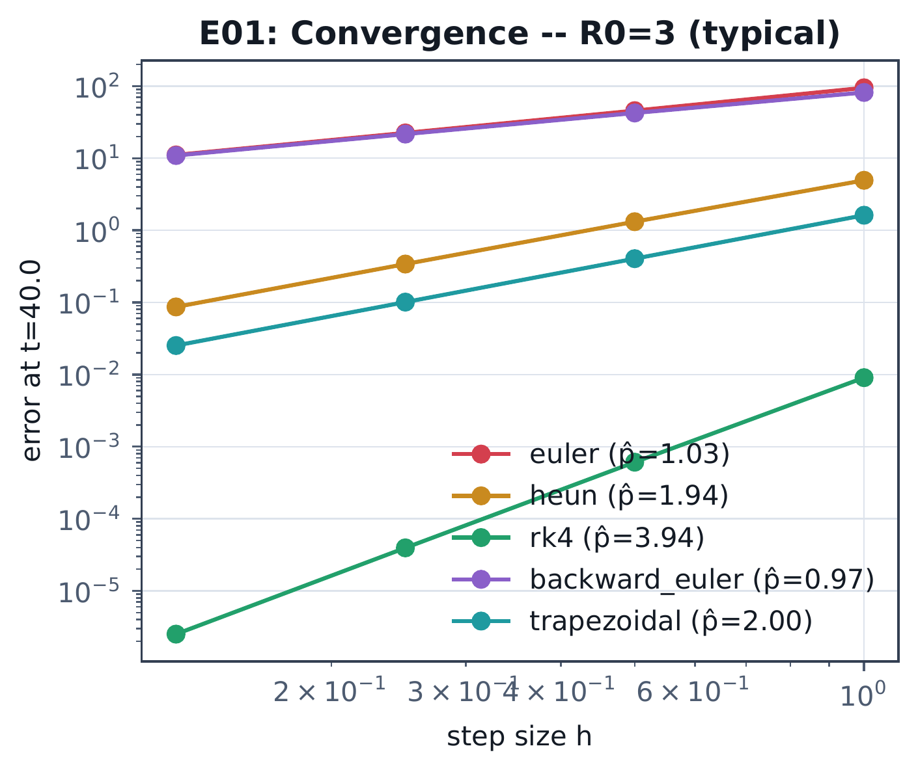
WHAT WE FOUND
Solver error behaves exactly like the textbook says
1.03
1.94
3.94
Euler, order 1
Heun, order 2
RK4, order 4
Measured order matches the predicted order almost exactly — the same error then carries straight through into the fitted β.
A trap we almost fell for: checking S+I+R = N looks perfect even when the solve is completely wrong. It's not a real accuracy check — we needed the exact reference instead.
Halve the step size — each solver's error shrinks at exactly its own theoretical rate.
Notes:
Point at the three orders matching theory. The trap callout is a good spot for a question - invite it if the room is quiet.

Slide 7
WRAPPING UP
Below σ*, the numerical method is the answer
Below the crossover noise level, the solver and step size you choose decide whether your epidemic estimate is trustworthy. Above it, more data matters more than a fancier solver.
S
→
I
→
R
Next: run the full-scale experiment grid, verify the 1666 Eyam outbreak data against the original source, and test whether the crossover still holds for stiffer, higher-dimensional models.
Thank you
[Name] — numerics core: the model, six solvers, exact reference solution
Questions welcome.
[Name] — eigenvalues, testing, and this report
Code:
github.com/g-schatten/CSE402-Project
[Name] — fitting and uncertainty quantification
[Name] — interactive web dashboard
[Name] — experiment pipeline, model variants, real data
Notes:
Restate the one-line conclusion without reading it verbatim. Every member should be ready to speak to their own row when asked individually.

