Slide 1

AUTOMATED PARKING SYSTEM
CREATIVE AND INNOVATIVE PROJECT (IT7611)
BATCH NUMBER : 03
SUBMITTED BY:
SHRIRAM G
(2018506116)
Divya Darshini K (2018506029)
Easwar Raja S (2018506030)
MADRAS INSTITUTE OF TECHNOLOGY CAMPUS , ANNA UNIVERSITY

Slide 2
OUTLINE
Problem Statement
Tech Stack
Introduction To Domain
Literature Survey
Similar Apps
Proposed and Drawbacks
Our Proposals
Architecture
Screenshots
Conclusion and Future

Slide 3
PROBLEM STATEMENT
With increase in population, number of vehicle increases and due to unmanaged parking it lead to many problems.
In metropolitan cities with huge population faces difficulties as number of vehicles creates congestion, wastage of space, wastage of time, traffic problems, car napping, car vandalism and many other.

Slide 4
Tech Stack
JAVA, XML and Python ( Front end)
Python (Back end)
Flask (Web server)
Firebase (Database)

Slide 5
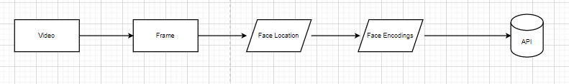
INTRODUCTION TO DOMAIN
Facial recognition system :
A facial recognition system is a technology capable of matching a human face from a digital image or a video frame against a database of faces, typically employed to authenticate users through ID verification services, works by pinpointing and measuring facial features from a given image.
Here the user is allowed to register his face and on parking site his face will be validated against the registered face encodings.

Slide 6
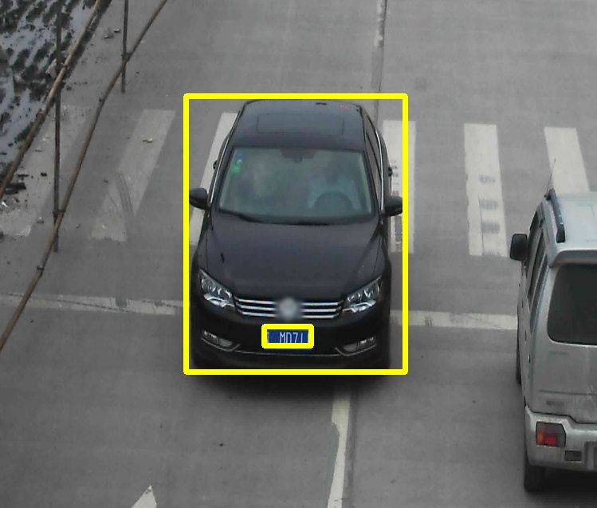
Object Detection
This is the part where we first identify the presence of the vehicle.
The surveillance Camera captures the footage of the vehicle entering the zone.
We use CascadeClassifier() to identify and detect vehicles

Slide 7
Classification of the Vehicle
Here we use a deep learning model using CNN to classify if the detected vehicle is a 2 wheeler, 4-wheeler or Large.
First we send a frame from the surveillance camera into the model
CNN Model returns if its a 2 wheeler, 4-wheeler or Large.
This vehicle information will be stored in the backend along with other details like Face Image and Number plate.

Slide 8
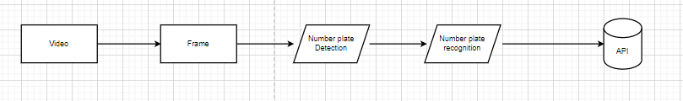
Number Plate Recognition
A conventional ANPR model consists of 4 stages: Vehicle image capture, Number plate detection, Character segmentation and Character recognition.
This is where the license plate number is detected and recognised.
In the database backend, it will be linked with the other obtained informations: driver/owner of the vehicle and the type of vehicle.

Slide 9
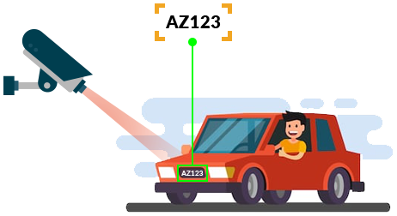
Here we will use super-vision algorithm to improve the low resolution of the image in preprocessing.
Pre-processing-->iterative bilateral filter and adaptive histogram equalization.
Here character recognition will be done using OCR in Tesseract

Slide 10
Literature Review
Xiujie Qu∗, Tianbo Wei, Cheng Peng, Peng Du represents [1] A Fast Face Recognition System Based On Deep Learning
Schalk Wilhelm Pienaar, Reza Malekian [2] proposes Human activity recognition using visual object detection.
Priyanka Prabhakar, Anupama P, Resmi S R - 2014 [3] describes Automatic Vehicle Number Plate Detection And Recognition
Omar Abdul Rhman Salim, Rashidah Funke Olanrewaju, Wasiu Adebayo Balogun [4] represents Class Attendance Management System Using Face Recognition

Slide 11
Cont..
The accurate results are obtained when tested on high costing hardware's only.
Face detection process and must be supported by adding an accelerator device.
The deep cascaded networks-based face detection algorithms still do not have the training strategy of shared convolution.
Reducing computation overhead further as introducing parallelism into the design makes it longer economical and time efficient. Further work in this direction is very much necessary to include all the possible complex cases and also consider minor rotation and skew.
Training when done using SSD Inception and RCNN provide more accurate results, but too process-intensive for running on CPU, especially with live video feed

Slide 12





SIMILAR APPS
Parker | ParkWhiz | SpotHero
Parkopedia | Honk | BestParking

Slide 13
PROPOSAL AND DRAWBACKS
Find a spot through the app, choose the amount of time you would like to stay there/reserve the place for (whether an hour or a month), and pay on the app.
you enter your destination into the app, you can see nearby spots—and comparison shop.
You can also search for your current location and see nearby availability, hours and pricing.
Is not completely automatic
Integration is tedious

Slide 14
OUR PROPOSAL
Image processing based real time vehicle theft detection and prevention systems can provide an ultimate solution for this problem.
License plate recognition (LPR) plays a significant role throughout this busy world, owing to the rise in vehicles day by day.
Face Recognition techniques and Object Detection can contribute in linking the driver/owner of the vehicle with its the model of the vehicle, aiding in the creation of this system.
By reservation system we can avoid congession to maximum extend
Automatic parking system will also reduce processing time

Slide 15
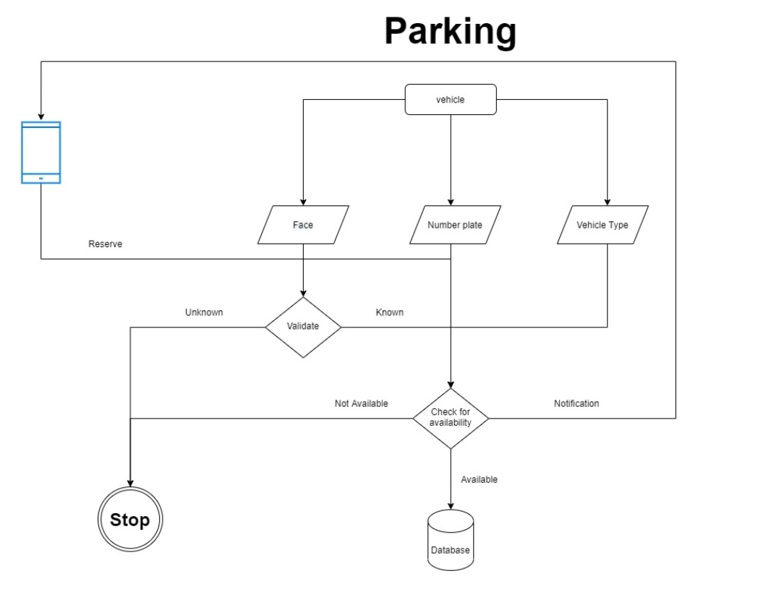
ARCHITECTURE :

Slide 16
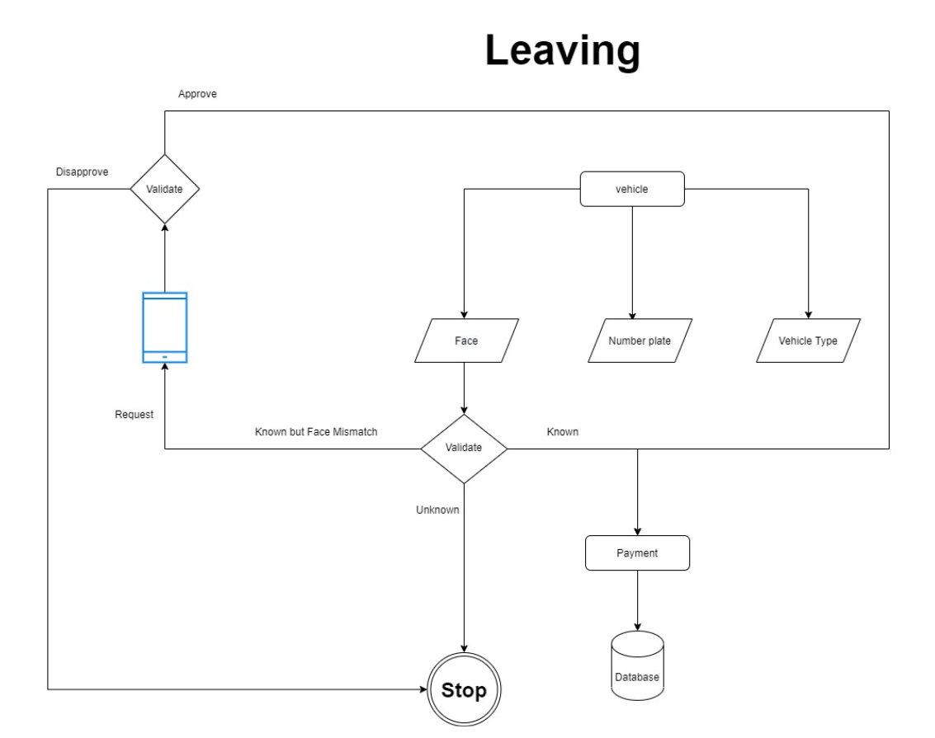

Slide 17
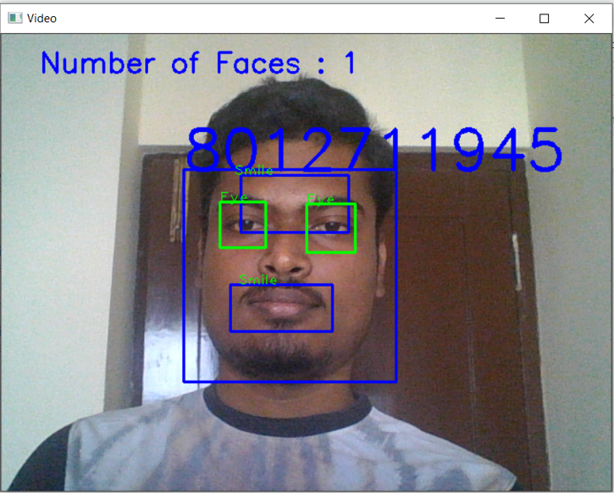
SCREENSHOTS

Slide 18
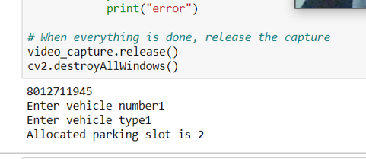

Slide 19
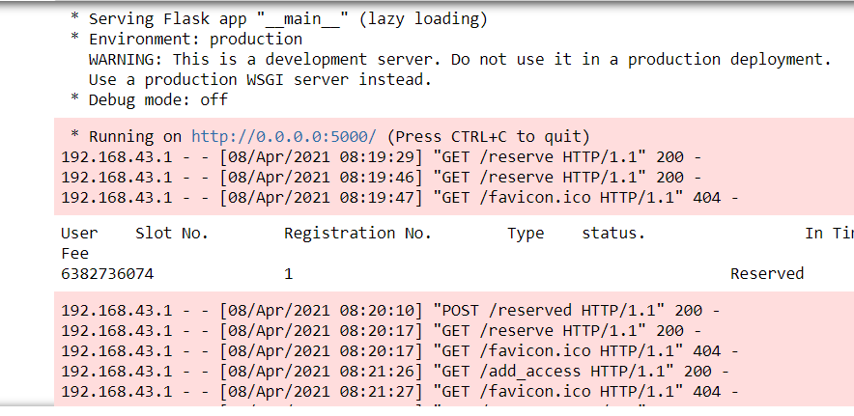

Slide 20
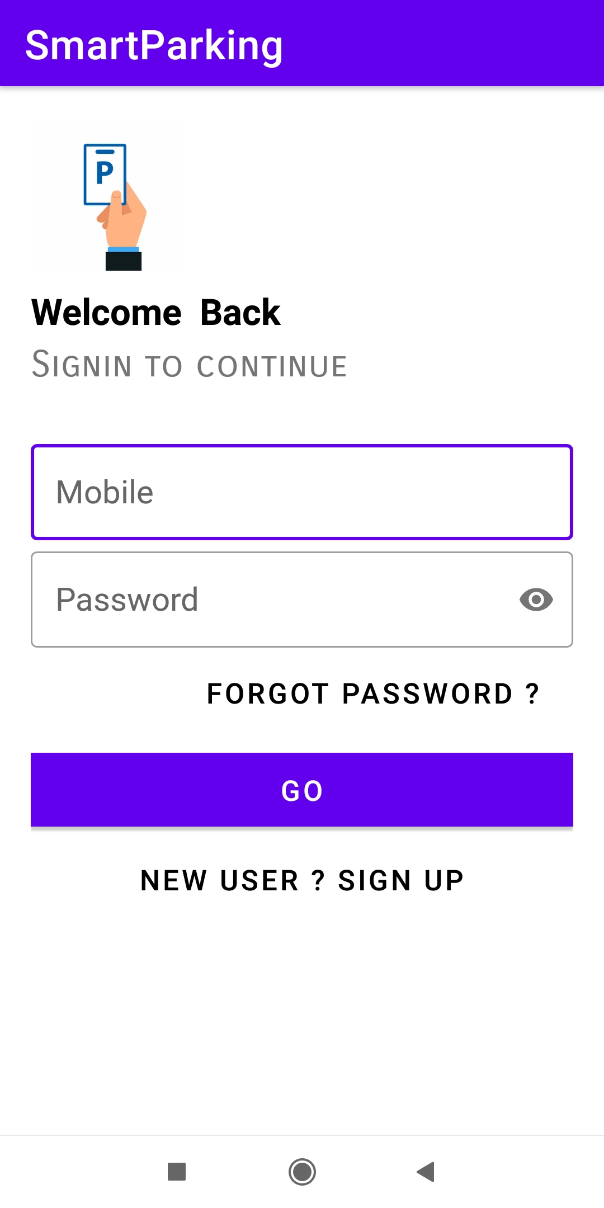
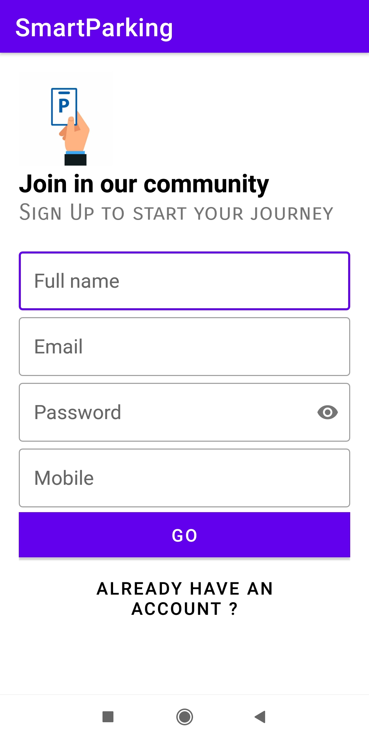
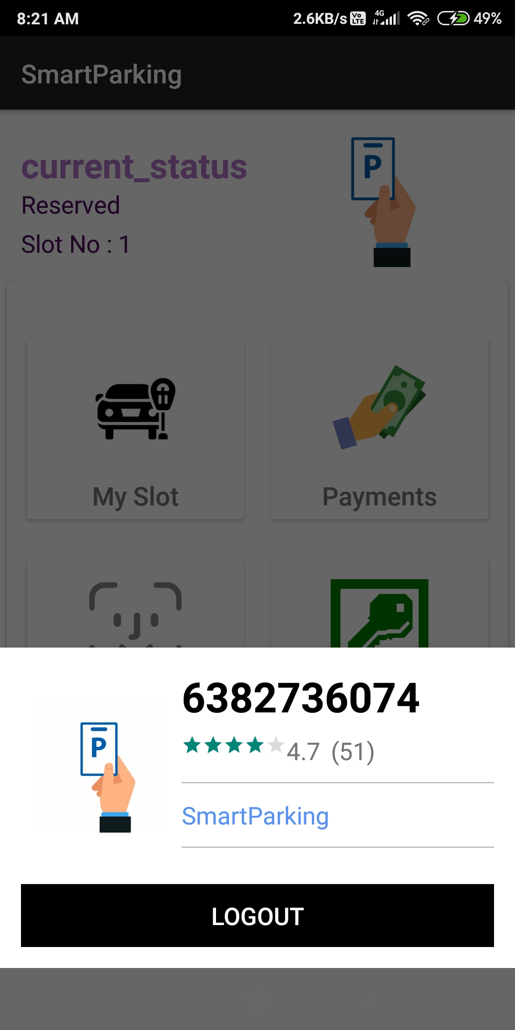

Slide 21
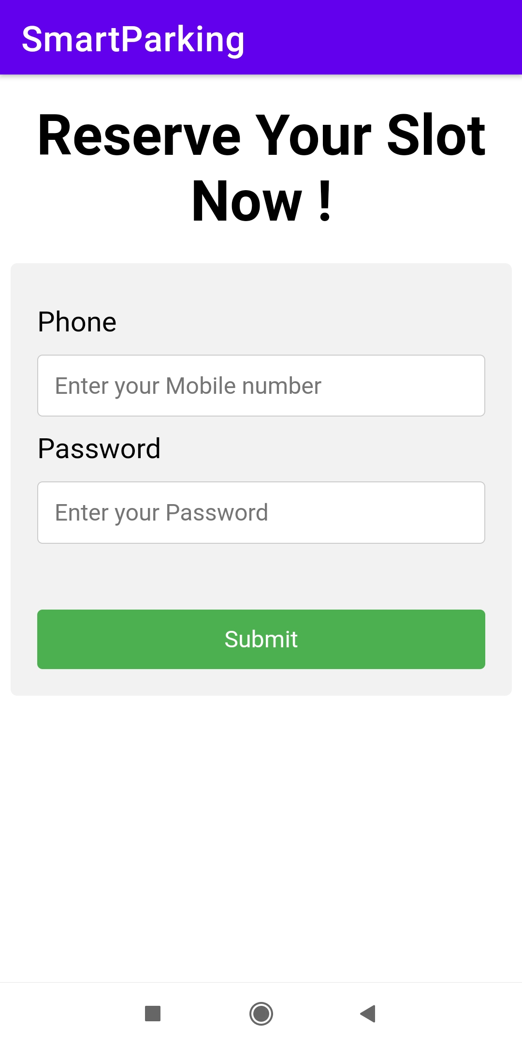

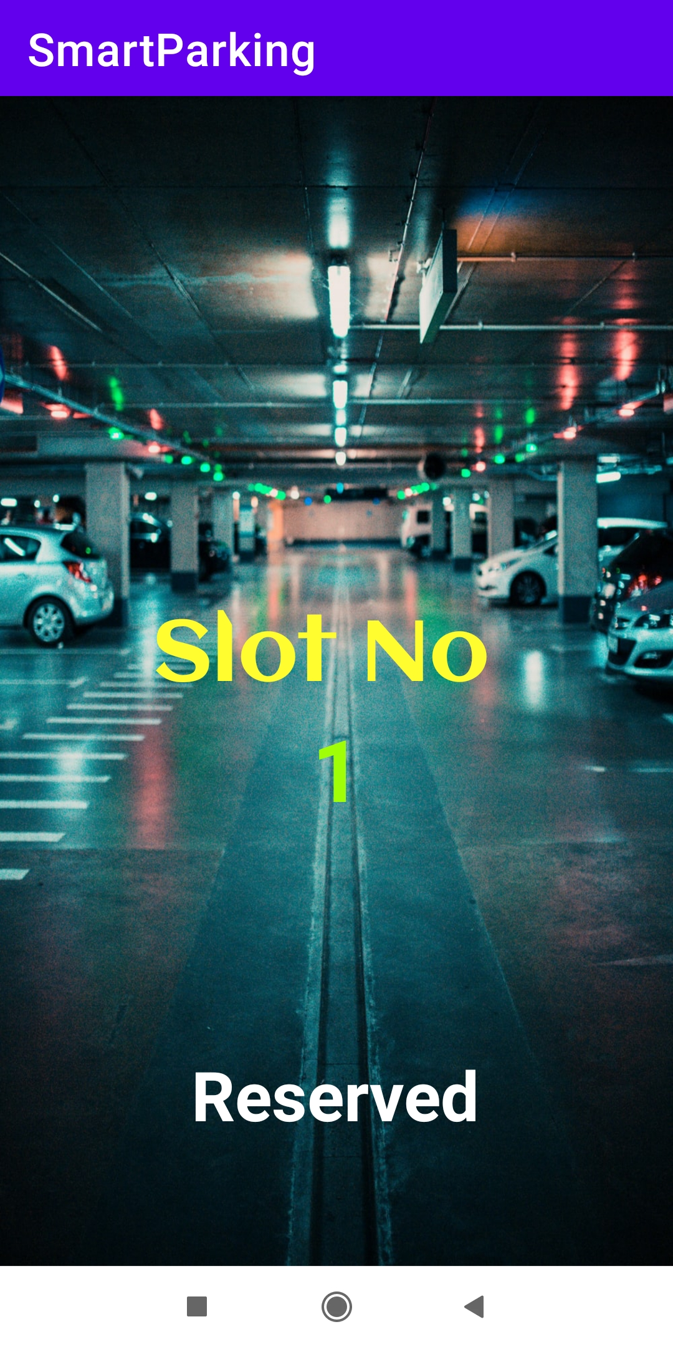
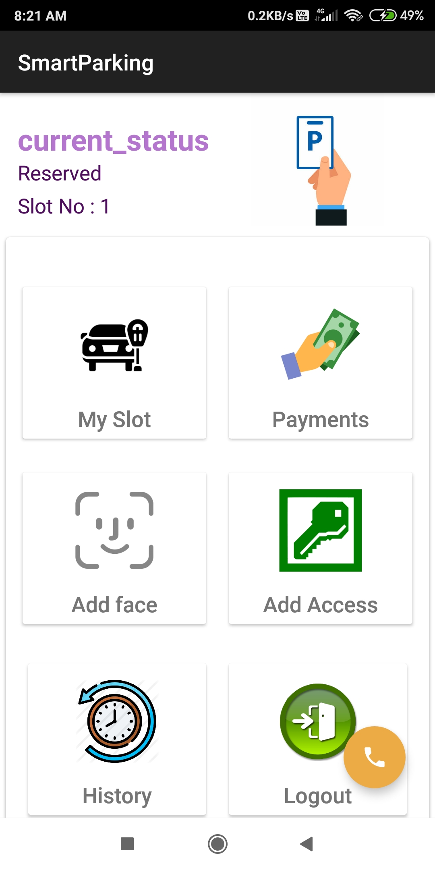

Slide 22
CONCLUSION AND FUTURE
We have to include feature to show nearby parking sites.
Feature to integrate parking site
Payment feature
To improve accuracy of models used.
To improve security on backend by introducing cryptography

