Slide 1
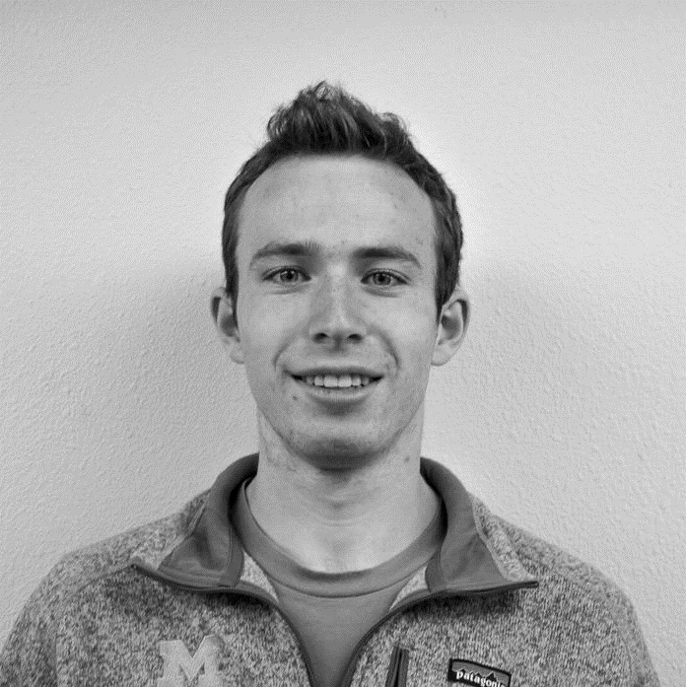














Brad Michaels
18–27-year-old
USA
PERSONAL
INFO
ABOUT ME
EDUCATION
Spends most of his free time on the phone
Became interested in politics after most recent election
Spends a lot of time on social media. He likes to connect with his family online
High school diploma
BIRTH DATE
1993-present
NATIONALITY
U.S. Citizen
Applications
Challenges
Facebook
Twitter
Coming across potential articles that are fake
Might spread fake news to other people if he trusts a source that is not legitimate.
Can potentially be motivated to vote for another candidate based on wrong information
Frequently gets into arguments online over information that he/she seen on their timeline
2010
2011
2012
2013
2014
2015
2016
2017
2018
2019
EMAIL
LANGUAGES
Needs and Wants
English
Needs an application that is quick and easy to use
Needs to be up to date with the news
HOBBIES

Slide 2
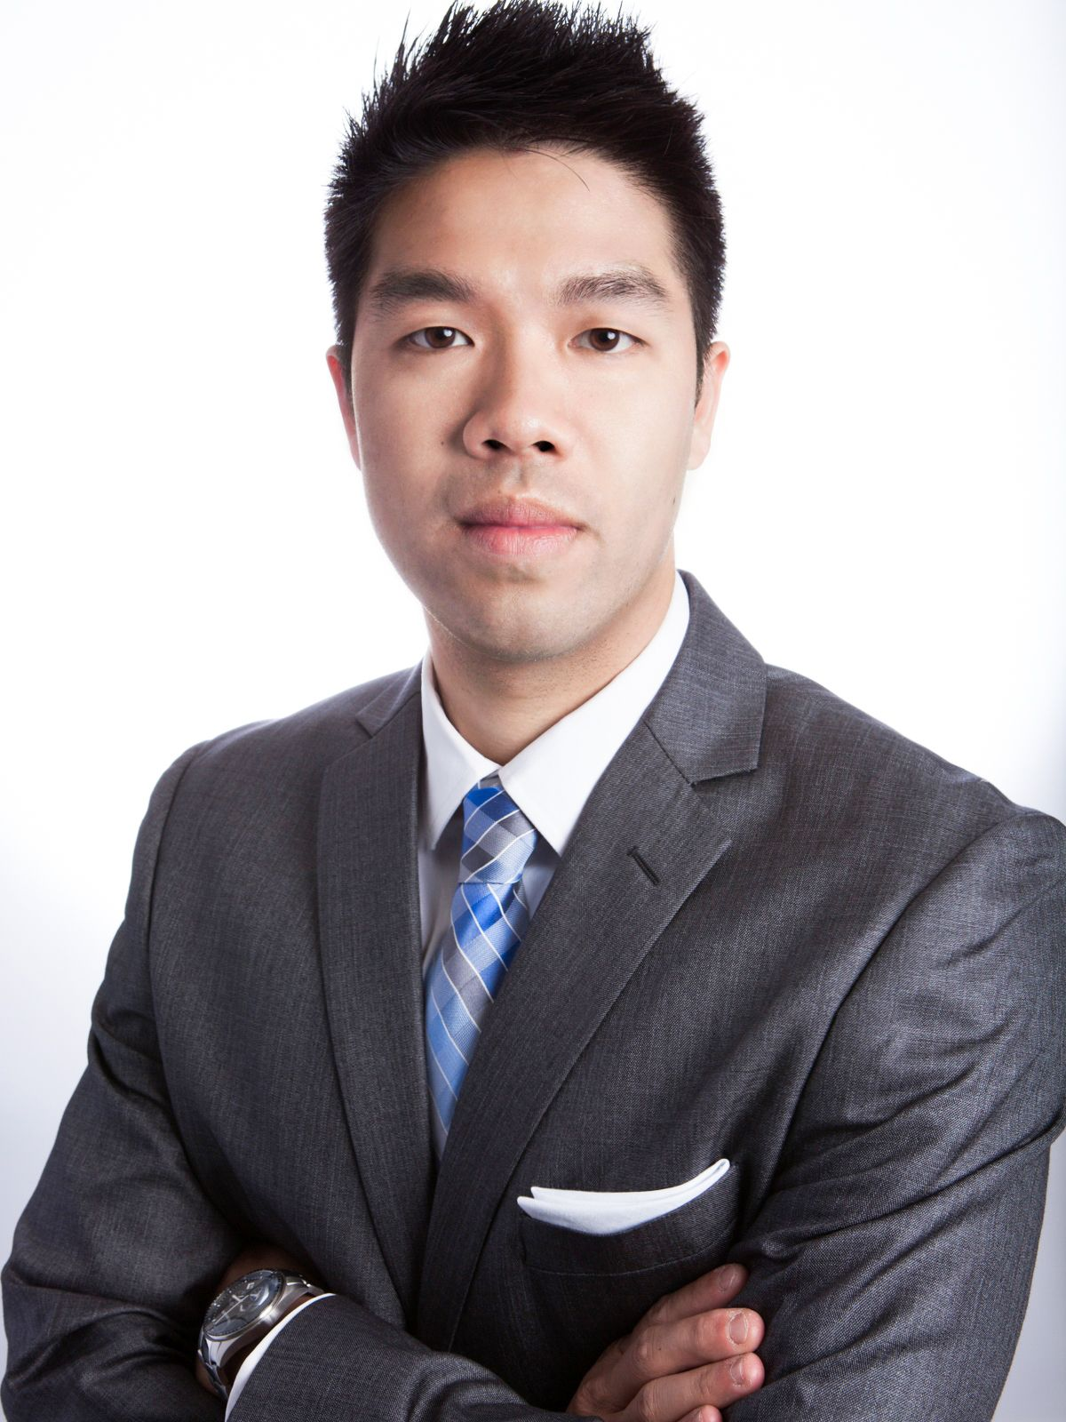
Josh Doritos
Chief Executive Officer
PERSONAL
INFO
ABOUT ME
EDUCATION
Spends most of his free time making sure the day-to-day operations of his company are running smoothly.
Looks for ways to improve the efficiency of his web/mobile application.
Area of expertise is on Technology
College graduate
BIRTH DATE
2002-present
NATIONALITY
Undetermined
Applications
Challenges
Facebook
Twitter
Users are experiencing trust issues towards the content that they are seeing on the app. In turn, this can cause the users to look for another more reliable app to use.
App users having an unpleasant experience.
Spreading misinformation throughout the app.
2010
2011
2012
2013
2014
2015
2016
2017
2018
2019
EMAIL
LANGUAGES
Needs and Wants
English
Needs an alternative solution to help tackle fake news throughout the app.
Wants users to be able to have more trust towards the content that is being streamed throughout the application.
Wants to stop the spread of misinformation on his app.
Wants increase user retention
HOBBIES

