Slide 1
Generative Adversarial Networks (GANs)

Slide 2
Analogy
Generative: team of counterfeiters, trying to fool police with counterfeit money
Discriminative: police trying to detect the counterfeit money
Competition drives to improve both, until counterfeits are virtually indistinguishable from genuine currency.
Now counterfeiters have, as a side effect, learned something about real currency.

Slide 3
Big Idea
Train a generative model G(z) to generate data with random noise, z, as input
Adversary is discriminator D(x) which is trained to distinguish synthetic and true data
Represent G(z) & D(z) as multilayer perceptrons for differentiability
Notes:
Firstly, let's gain an intuitive understanding of GANs and understand exactly how these deep learning algorithms work.
The generator and discriminator in a GAN compete against each other (hence the term "adversarial"). The generator whose aim is to replicate and produce realistic data to trick the discriminator; the generator wants to bypass the numerous checks it will perform. On the other hand, the role of the discriminator is to catch the artificially generated data as sold by the generator. The discriminator tries to catch the abnormalities and detect the false images made by the generator.
In other words, the generator takes in a noisy input and tries to produce realistic images from it. Even though it fails terribly at first, it slowly learns how to make more convincing counterfeits. The discriminator block then tries to determine which images are real and which ones are fake. So, these models compete against each other until a point of "perfection" is reached.
The point of perfection is said to be reached when the generator starts to generate multiple high-quality, realistic images and bypasses the testing phase of the discriminator. Once the images are successfully realistic, the discriminator cannot distinguish between the actual and fake images. After a certain point, the accuracy of the discriminator becomes 50%, basically a coin flip. Have to prevent overtraining beyond the convergence point, to prevent the discriminator from picking up minor discrepancies in the data, and learning noise. After this point, you can use the generator on its own, and you don’t require a discriminator anymore. When you use a generator to synthesise new pieces of data, it’s effectively learning a transformation from a distribution of noise to a target data distribution
Since we have already established that GANs consist mainly of these two building blocks, namely the generator and the discriminator, let us now look at them in further detail in the upcoming sections. In summary, these two blocks are separate neural networks:
"Generators" are neural networks that learn to generate fake images (or data points) that look realistic, and can pass as real when fed to a discriminator network.
"Discriminators" are neural networks that distinguish between real and fake images (or whatever type of data). The discriminator performs an essential role in the learning process of the generator.

Slide 4
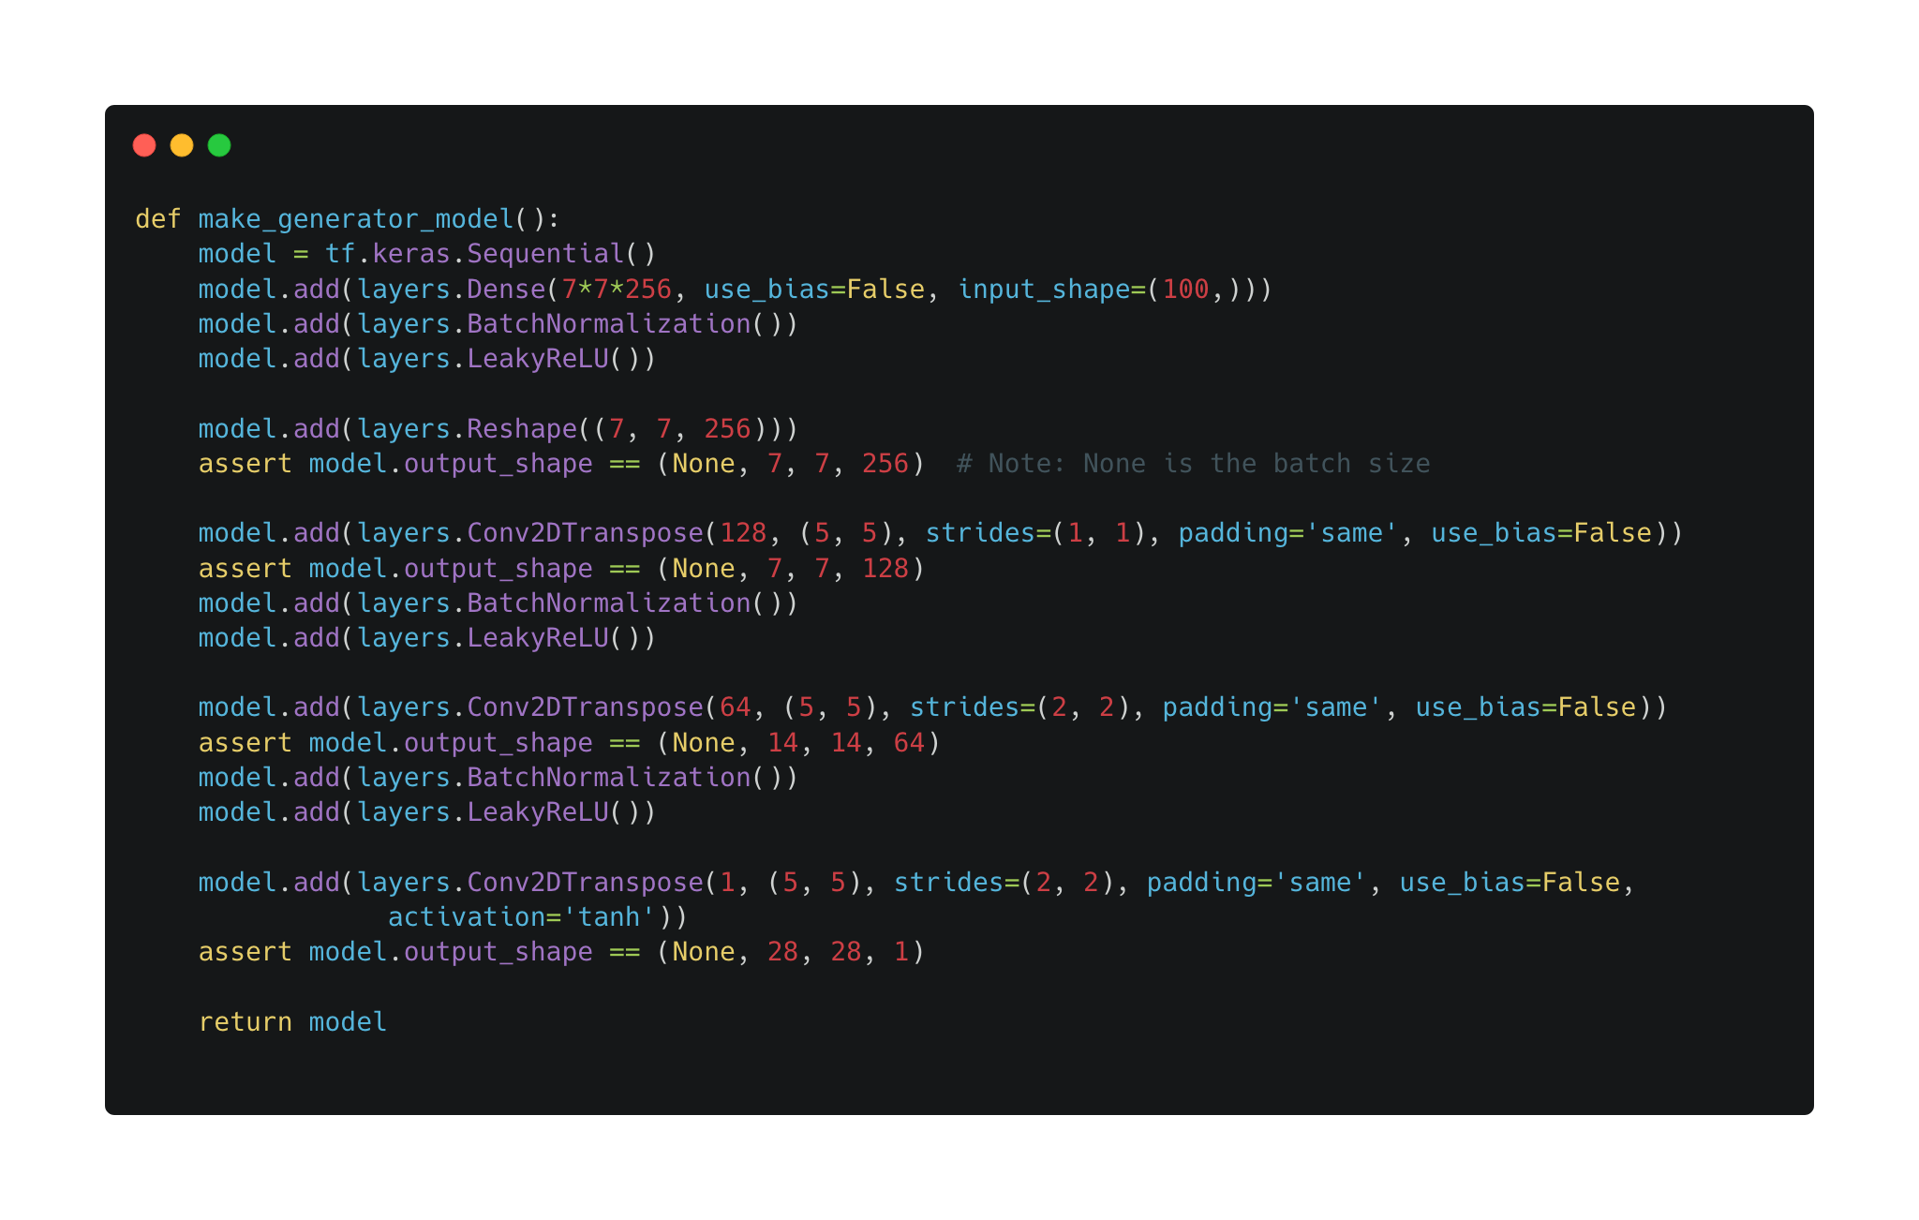
Notes:
Tensorflow implementation of a GAN.
The generator uses upsampling layers to produce an image from a seed (random noise). Start with a Dense layer that takes this seed as input, then upsample several times until you reach the desired image size of 28x28x1

Slide 5
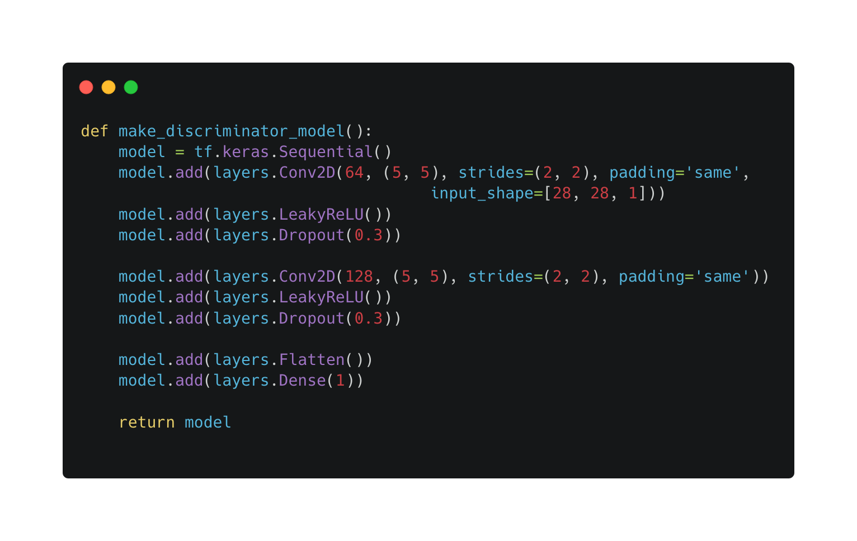
Notes:
The discriminator is a CNN-based image classifier.

Slide 6
Global Optimum: A global minimum of this minimax function
Probability that discriminator identifies real data as real
$$minmaxE_{z,x}[logD(G(z))+log(1-D(x))]$$
G
D
Probability that discriminator identifies generated image as fake
Notes:
●How much should we train G before going back to D? If we train too much we won’t converge (overfitting)
●Trick about changing the objective from min log(1-D(G(z))) to max log(D(G(z))) to avoid saturating gradients early on when G is terrible
Loss function looks similar to cross entropy loss
D(x) is the probability that a real image is identified as fake, so 1 - D(x) is the probability that a real image is classified as real
G is trying to minimise this loss function, D is trying to maximise it. From the perspective of the generator, it cannot affect the D() as its solely based on the discriminator

Slide 7
Training GANs
Notes:
Can utilise the power of back propagation
Able to generate entirely new pieces of data (e.g text, speech, images, music)

Slide 8
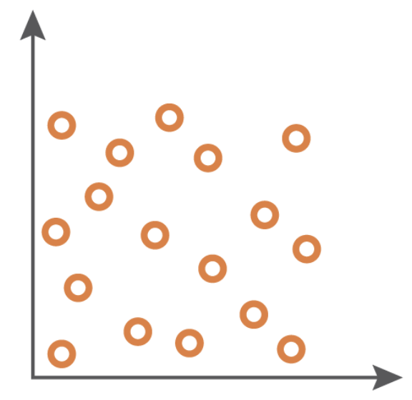
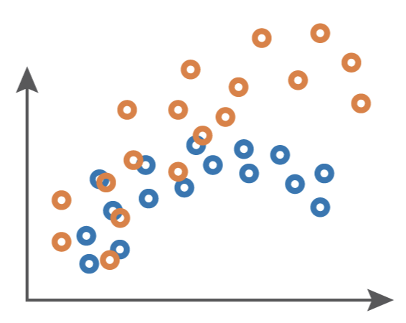
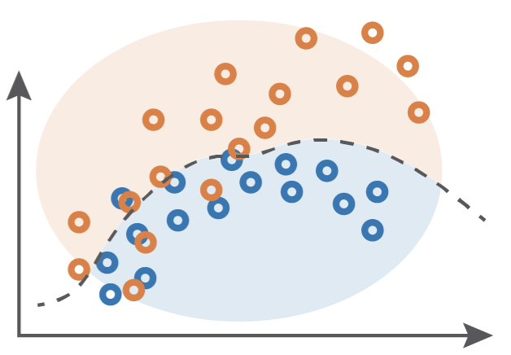
Forward propagation (generation & classification)
Backward propagation (adversarial training)
Fake Data
Real Data
Use generator to create fake data from random input
Use discriminator to separate true data from real data
Gaussian Noise
Generative Network
Discriminative Network
Update the generator’s weights to increase classification error
Update the discriminator’s weights to decrease classification error
Input random variable
(Drawn from a simple distribution, e.g gaussian noise)
The generative network is trained to maximise the final classification error
The generated distribution and true distribution are not compared directly
The discriminative network is trained to minimise the final classification error
The classification error is the reference metric for the training of both networks
Notes:
The second key point is the notion of adversarial training that defines how the generator learns
the function that transforms a simple distribution into the correct target distribution.
When training the generative network, the target and the generated distributions are not directly
compared. Instead, a discriminative network is trained to take true data and generated data
and to classify them.
During training, the two networks (generator and discriminator) have opposing goals. The
discriminator always wants to classify the data as accurately as it can. The generator always tries to
produce fake data that looks like the true data to fool the discriminator.
After every iteration of training, the orange points(fake) move closer to the blue points(real) which means that the generator is generating more realistic images that fool the discriminator.

Slide 9
Drawbacks of using GANs
Notes:
Gans are difficult to work with for a bunch of reasons. Here are some of them.

Slide 10
Mode Collapse
Natural data distributions are highly complex and multimodal.
During mode collapse, the generator produces samples that belong to a limited set of modes. The generator believes that it can fool the discriminator by locking on to a single mode, so it produces only samples from this exclusive mode.
The discriminator eventually figures this out. Generator just locks on to another mode.
Cycle repeats
Without mode collapse
With mode collapse
Notes:
That is, the data distribution has a lot of “peaks” or “modes”. Each mode represents a concentration of similar data samples, but are distinct from other modes.
The discriminator eventually figures out that samples from this mode are fake. As a result, the generator simply locks on to another mode. This cycle repeats indefinitely, and this essentially limits the diversity of the generated samples.

Slide 11
Convergence
When do we stop training?
Since the generator loss improves when the discriminator loss degrades (and vice-versa), we cannot judge convergence based on the value of the loss function.
Typical plot of a GAN loss function. Note how convergence cannot be interpreted from this plot
Notes:
A common question in GAN training is “when do we stop training them?
Unclear stopping criteria
Need to manually babysit during training
Easy to get trapped in local optima that memorise training data

Slide 12
Quality
It is difficult to quantitatively tell when the generator is producing high quality samples.
Additional perceptual regularisation added to the loss function can help mitigate the situation to some extent.

Slide 13
Metrics
The GAN objective function explains how well the Generator or the Discriminator is performing with respect to its adversary.
It does not represent the quality or diversity of its output.
Hence we need distinct metrics that can measure these.

Slide 14
Techniques for improving Performance
Alternative loss functions: Replace Jensen Shannon divergence of conventional GANs with Wasserstein Loss
Two Timescale Update Rule (TTUR): Use a different learning rate for D and G
Gradient penalty: greatly enhances stability and reduces mode collapse
Stacking GANs: Use multiple GANs to solve an easier version of the problem
Notes:
Wasserstain - improves the stability when training the model and provides a loss function that correlates with the quality of generated images.
Stacking: A single GAN may not be powerful enough to handle a task effectively. We could instead use multiple GANs placed consecutively, where each GAN solves an easier version of the problem. For instance, FashionGAN used two GANs to perform localized image translation. Taking this concept to the extreme, we can gradually increase the difficulty of the problem presented to our GANs. For instance, Progressive GANs (ProGANs) can generate high quality images of excellent resolution.

Slide 15
Recent advances in GANs

Slide 16
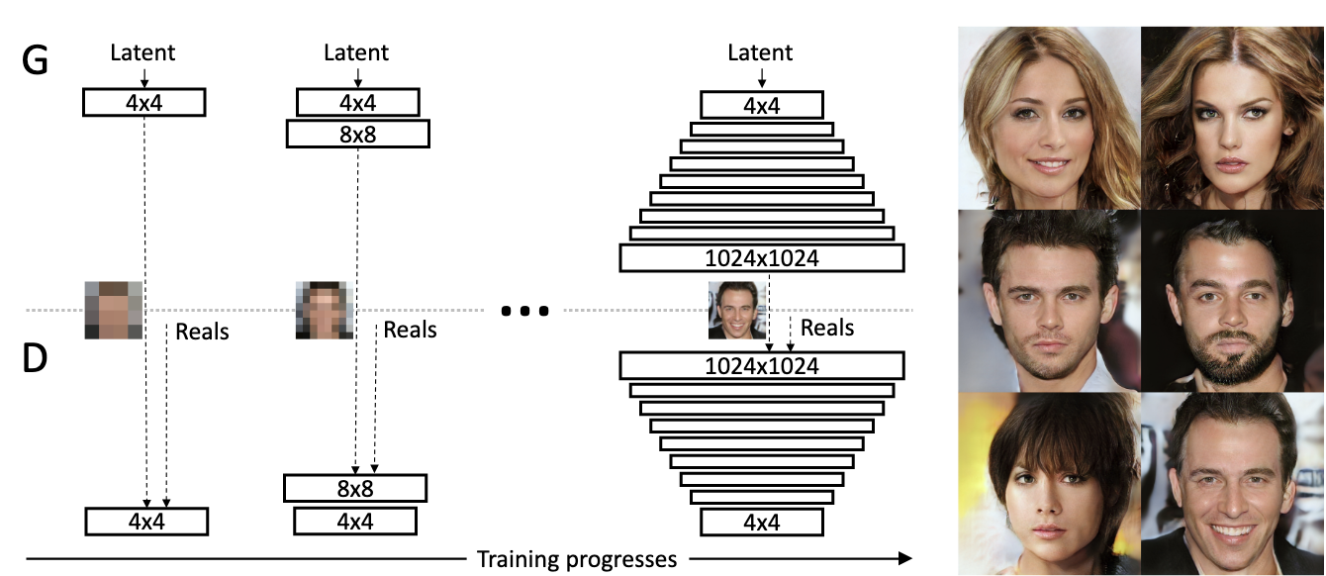
Progressive growing of GANs
A type of GAN that involves the conditional generation of images by a generator model
Advantages:
Produce images of unprecedented quality
Speeds up training, and also stabilises it.
Notes:
We describe a new training methodology for generative adversarial networks. Thekey idea is to grow both the generator and discriminator progressively: starting from a low resolution, we add new layers that model increasingly fine details astraining progresses. This both speeds the training up and greatly stabilizes it, al-lowing us to produce images of unprecedented quality

Slide 17
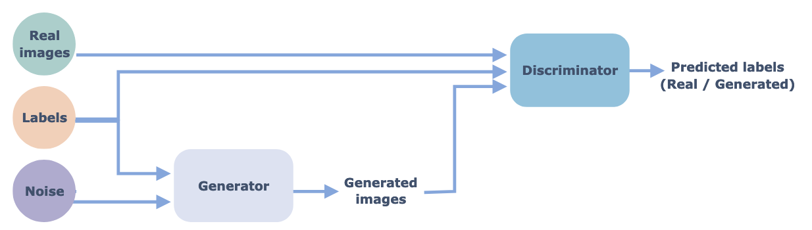
Conditional GANs
A type of GAN that involves the conditional generation of images by a generator model
Advantages:
Convergence will be faster. Even the random distribution that the fake images will follow will have some pattern
You can control the output of the generator at test time, by giving the label for the image you wan’t to generate.
Notes:
In cGANs, a conditional setting is applied, meaning that both the generator and discriminator are conditioned on some sort of auxiliary information (such as class labels or data) from other modalities. As a result, the ideal model can learn multi-modal mapping from inputs to outputs by being fed with different contextual information.
If that was confusing, consider this example:
Suppose you train a GAN on hand-written digits (MNIST images). You normally cannot control what specific images the generator will produce. In other words, there is no way you can request a particular digit image from the generator.
This is where the cGANs come in as we can add an additional input layer of one-hot-encoded image labels. This additional layer guides the generator in terms of which image to produce.

Slide 18
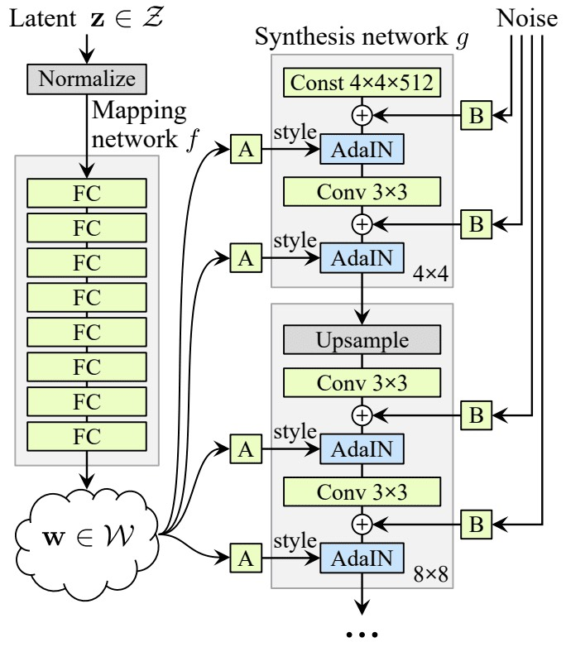
StyleGAN
Progressive growing + Style transfer
Notes:
Style transfer: trying to compose an image in the style of another image
In summary, you discovered the Style Generative Adversarial Network that gives control over the style of generated synthetic images
The lack of control over the style of synthetic images generated by traditional GAN models, the StyleGAN makes up for.
The architecture of StyleGAN model GAN model that introduces control over the style of generated images at different levels of detail
Impressive results achieved with the StyleGAN architecture when used to generate synthetic human faces, as shown here.

Slide 19
CycleGAN
For image-to-image translation without paired examples
Image-to-image translation often involves the controlled modification of an image and requires large datasets of paired images.
CycleGAN is a technique for training unsupervised image translation models via GAN architecture using unpaired collections of images from different domains
Can be used for season translation, object transfiguration, style transfer, photograph enhancement.
Object transfiguration
Season transfer
Notes:
Image-to-Image translation involves the controlled modification of an image and requires large datasets of paired images that are complex to prepare or sometimes don’t exist.
CycleGAN is a technique for training unsupervised image translation models via the GAN architecture using unpaired collections of images from two different domains.
CycleGAN has been demonstrated on a range of applications including season translation, object transfiguration, style transfer, and generating photos from paintings.

Slide 20
References
[ARTICLE]: Understanding Generative Adversarial Networks
[SLIDES]: Foundations of GANs
[ARTICLE]: Advances in GANs
[ARTICLE]: Introduction to StyleGANs
[PAPER]: Progressive growing of GANs

