Slide 1







Capstone Project Findings Report
Garvish Patel
4/15/24

Slide 2



OUTLINE
Executive Summary
Introduction
Methodology
Results
Visualization – Charts
Dashboard
Discussion
Findings & Implications
Conclusion
Appendix

Slide 3

EXECUTIVE SUMMARY
Visualization of common tools used for SD
Finding trends in Dataset for;
Current Technology Usage,
Future Technology Usage, and
Demographics
Current most used Languages, Databases, Platforms, and Web Frames
Predicted desired Languages, Databases, Platforms and Web Frames
Regions in the world that study is based on by Gender

Slide 4

INTRODUCTION
Dashboard analyzing current trends for software development
Dashboard predicting desired trends for software development
Identifies possible required skills and area of use
Responsive real-time comparisons
Based on Gender
Based on Region

Slide 5

METHODOLOGY
Data Source
m5_survey_data_technologies_normalised.csv
m5_survey_data_demographics.csv
Data Cleaning
Removal of blank values
Data Exploration
Data Visualization
Dashboards
Charts

Slide 6
RESULTS
PROGRAMMING LANGUAGE TRENDS
Graphs
Findings and Implications
DATABASE TRENDS
Graphs
Findings and Implications

Slide 7
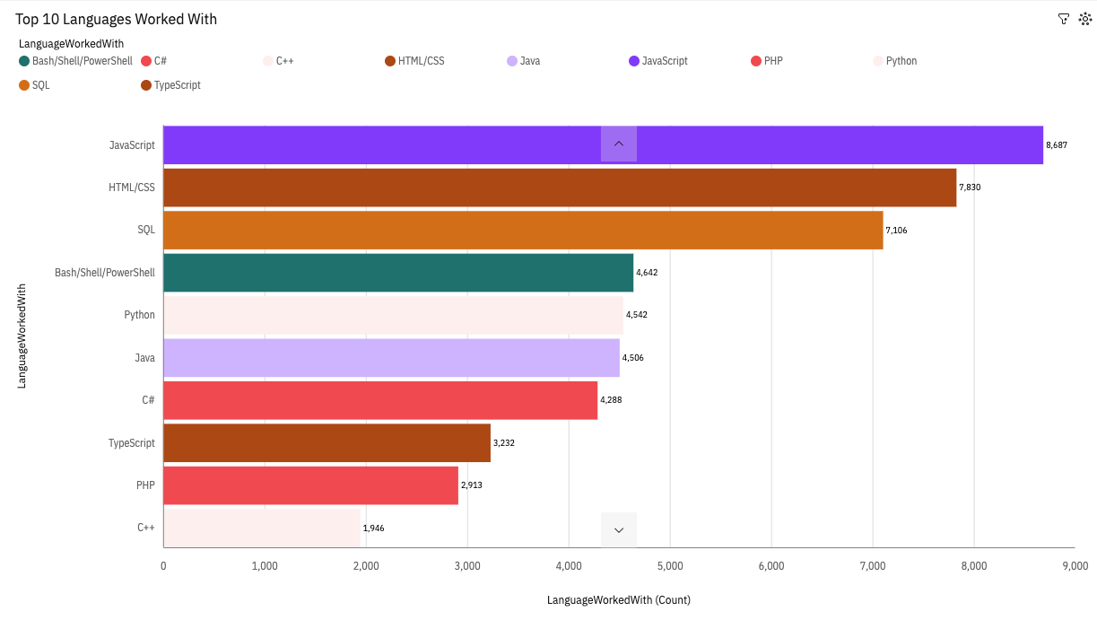
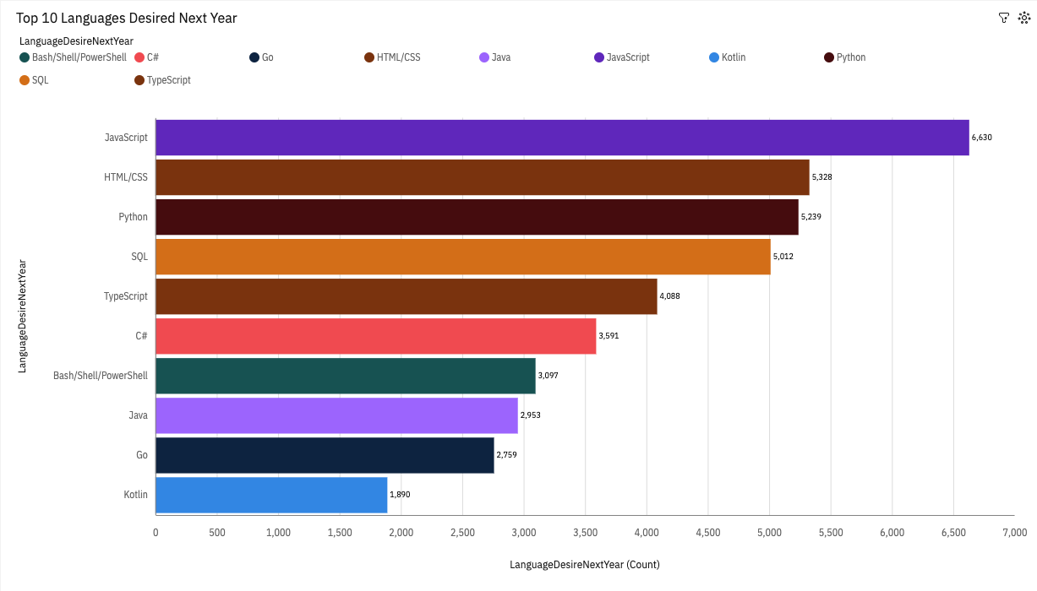
PROGRAMMING LANGUAGE TRENDS
Current Year
Next Year
<Bar chart of top 10 programming languages for the current year goes here.>
< Bar chart of top 10 programming languages for the next year goes here.>

Slide 8
PROGRAMMING LANGUAGE TRENDS - FINDINGS & IMPLICATIONS
Findings
Python is predicted to be more of use compared to its current popularity
JavaScript and HTML/CSS prove to be relevant in the coming year
C++ and PHP are predicted not to be in the top 10 next year
Bash/Shell/Powershell has lost relevance
Implications
SQL is still an essential requirement for in-demand languages
Web Development seems to be a strong requirement
New stronger, better, faster, easier languages will be required to know for new programmers
Newer, better tools introduced eliminates use for unpopular ones

Slide 9
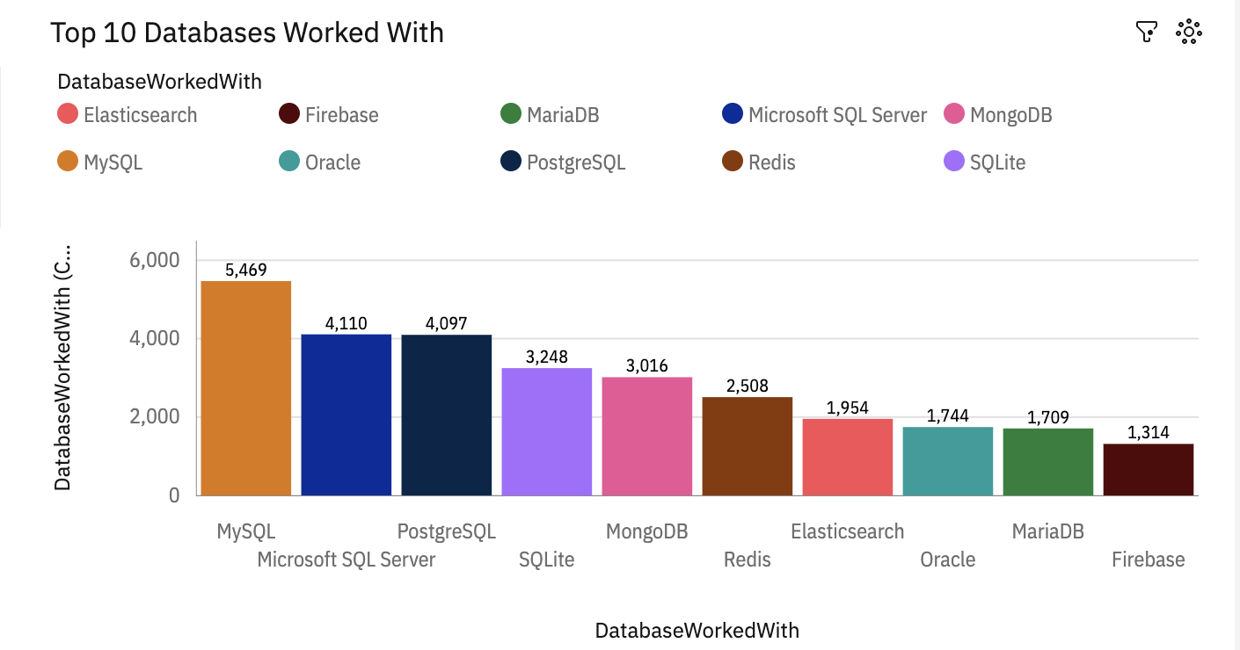
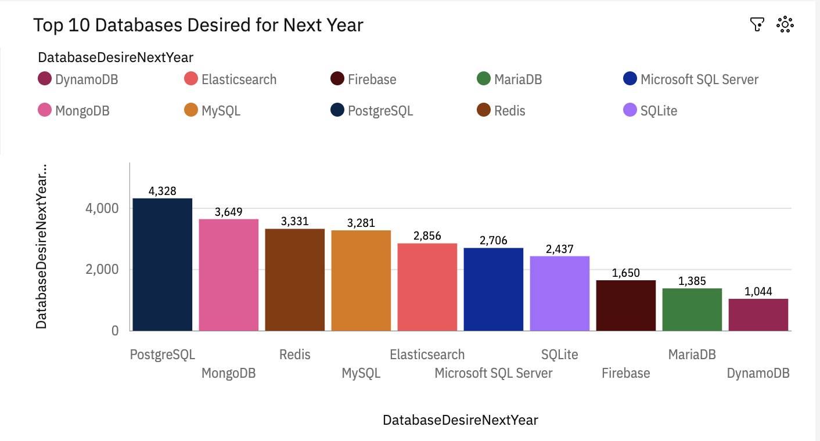
DATABASE TRENDS
Current Year
Next Year
< Bar chart of top 10 databases for the current year goes here >
< Bar chart of top 10 databases for the next year goes here.>

Slide 10
DATABASE TRENDS - FINDINGS & IMPLICATIONS
Findings
PostgreSQL seems to be of most relevance remaining in top 3
MySQL and MS SQL server predicted to be of less use in the coming year
DynamoDB has booted out Oracle for 10th place
MySQL still remains in the top 5, could become a prominent tool again in the near future
Implications
MySQL had a bigger difference with MS SQL Server compared to PostgreSQL with MongoDB
May be difficult to transition from current commonly used databases
Not suitable for multi-item or cross tables transactions
Tools that satisfy the basic requirements of data analysis will remain useful for practical teaching

Slide 11

DASHBOARD
https://github.com/g-v1sh/JDA_Activities/blob/main/Building%20a%20dashboard%20with%20IBM%20Cognos%20Analytics.pdf

Slide 12
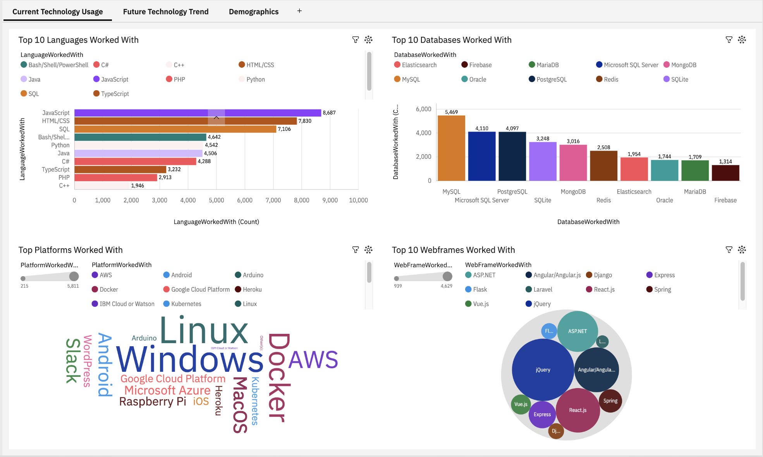
DASHBOARD TAB 1
Screenshot of dashboard tab 1 goes here

Slide 13
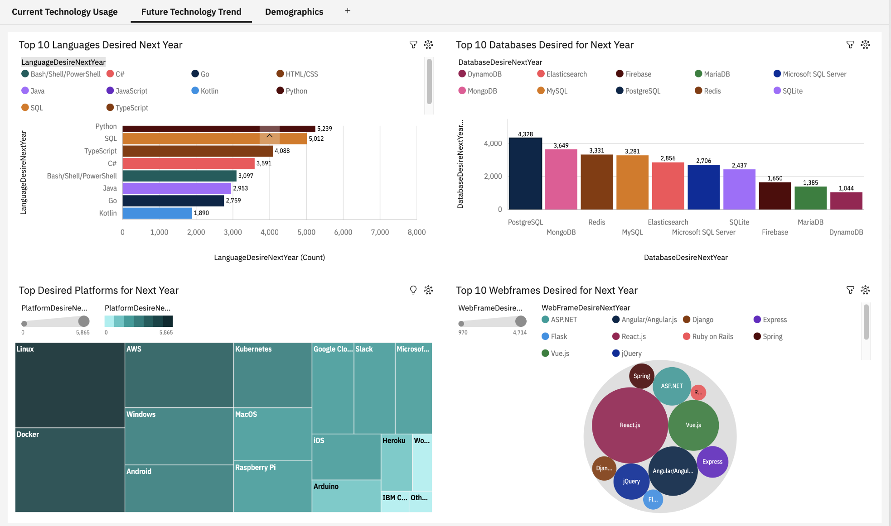
DASHBOARD TAB 2
Screenshot of dashboard tab 2 goes here

Slide 14
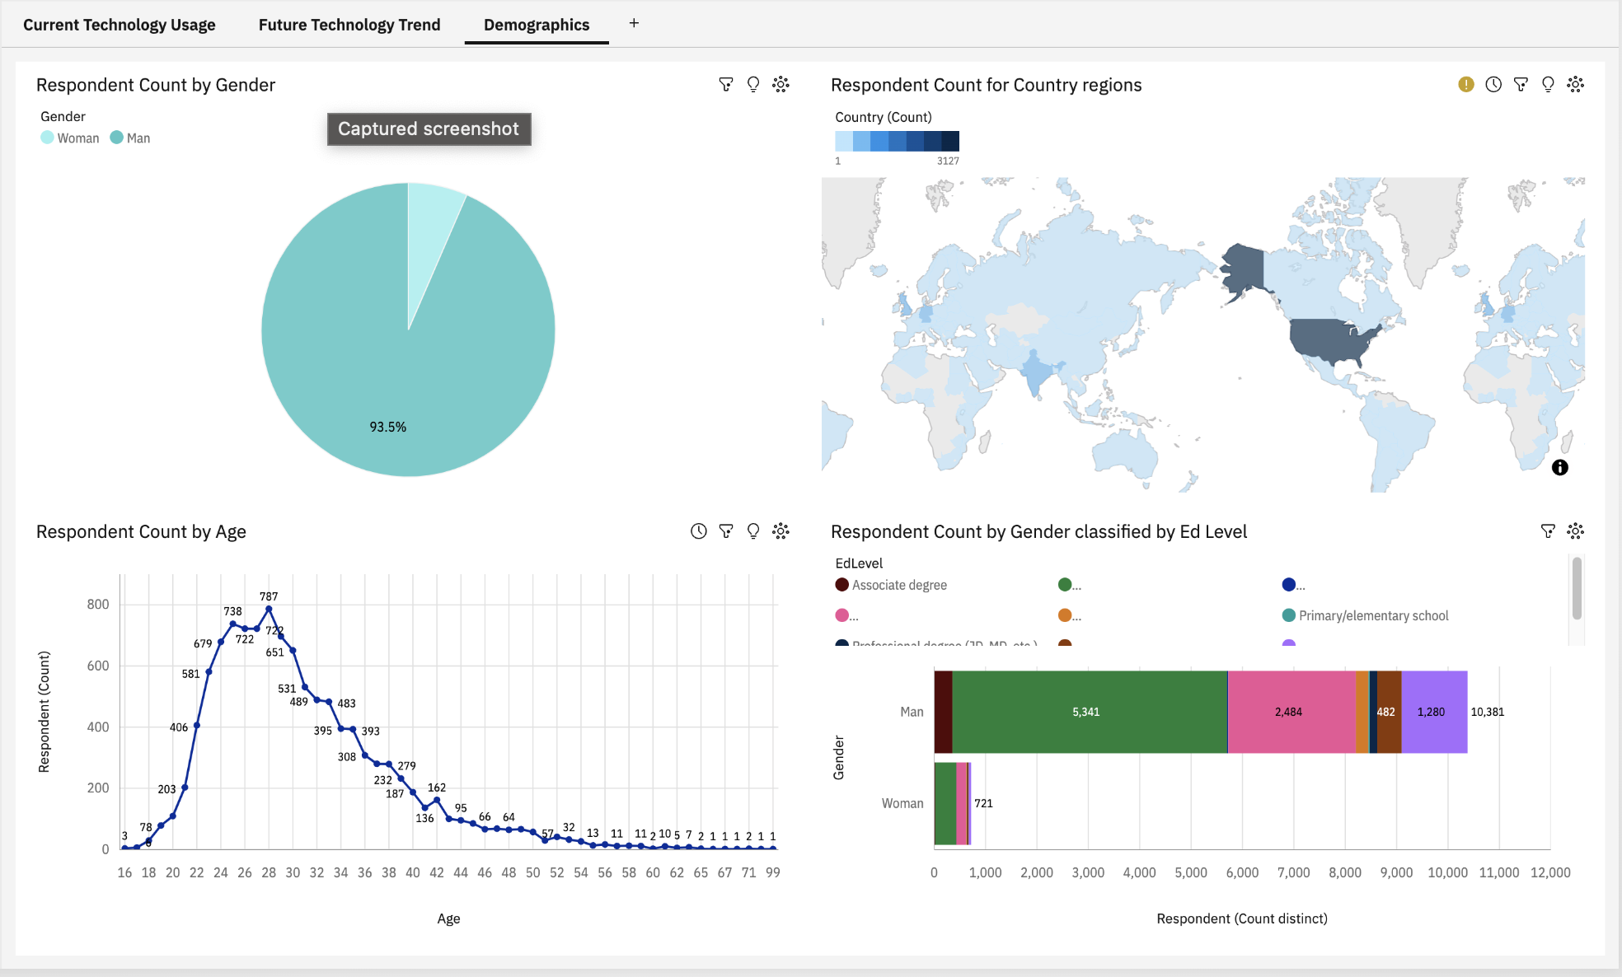
DASHBOARD TAB 3
Screenshot of dashboard tab 3 goes here

Slide 15
DISCUSSION
Impact of changes of commonly used languages/databases/platforms/web frames
How long will the predicted tools remain relevant

Slide 16
OVERALL FINDINGS & IMPLICATIONS
Findings
No guarantee of tools prominently being in use
Huge prominence of usage in region such as India and America
Men are still prominently more knowledgeable in this field
Smaller/newer skills/tools are becoming more popular and in use
Implications
Companies need to focus on the ability of understanding core concepts rather than memorizing syntax
Open more job opportunities in regions of lesser tech use
Woman may not feel comfortable in such environments
Hire based on adaptability instead of length of experience

Slide 17

CONCLUSION
Technologies will always be on-going and requiring users to be up-to-date
Spreading knowledge and skills through-out regions can help grow communities
Focus on the concepts of data analysis and popularity of tools secondary
Predictions and Estimations help provide an idea but results are not guaranteed

Slide 18

APPENDIX
Include any relevant additional charts, or tables that you may have created during the analysis phase.

Slide 19
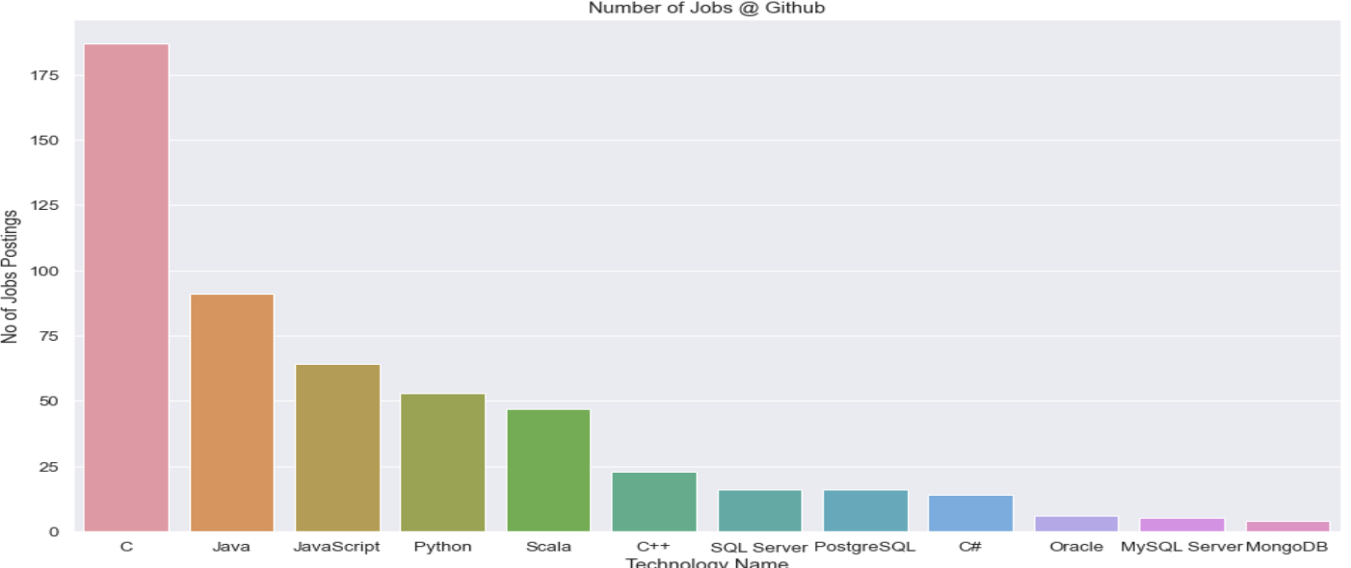
JOB POSTINGS
In Module 1 you have collected the job posting data using Job API in a file named “job-postings.xlsx”. Present that data using a bar chart here. Order the bar chart in the descending order of the number of job postings.

Slide 20
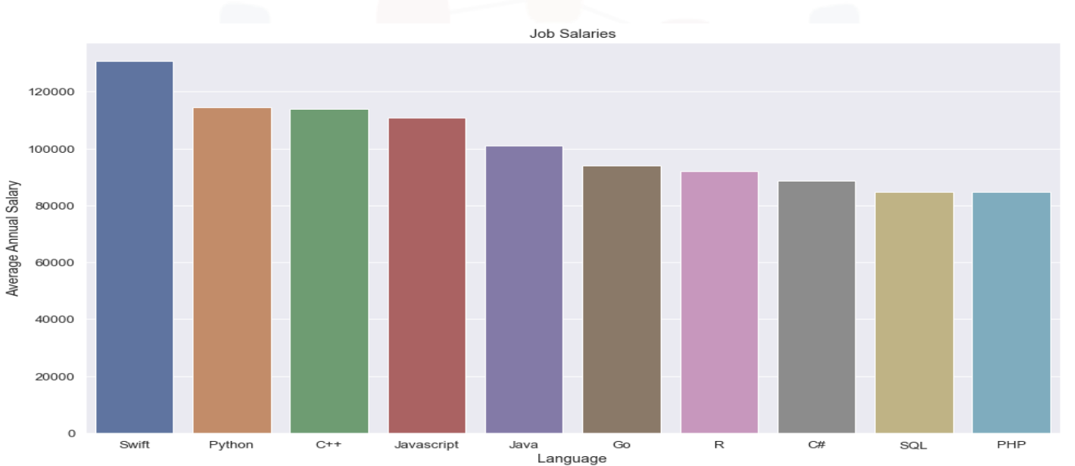
POPULAR LANGUAGES
In Module 1 you have collected the job postings data using web scraping in a file named “popular-languages.csv”. Present that data using a bar chart here. Order the bar chart in the descending order of salary.

