Slide 1

Secure IoT Intrusion Detection System
Privacy-Preserving Federated Learning for IoT (FedPrIDS)
Major Project Review - 1
Batch ID: AIML-A4
Project Guide
Project Batch Members
Mr./Mrs./Dr. Gayatri
Professor, Dept. of AIML, VVIT
Guddanti Vijaya Lakshmi – 23BQ1A6140.
Geeta Malika Maddela – 23BQ1A6139.
Bitra Sai Hema Latha – 23BQ1A6112.
Gajula Sasi Naag – 24BQ5A6124.

Slide 2
Secure IoT Intrusion Detection System
Privacy-Preserving Federated Learning for IoT (FedPrIDS)
Guide: Dr. Gayatri
Batch ID: AIML-A4
Regd No: 23BQ1A6140 (TL), 23BQ1A6139,
23BQ1A6112, 24BQ5A6124
Problem statement
To develop an enhanced privacy-preserving Federated Learning based IoT Intrusion Detection System that not only detects malicious network traffic but also identifies the specific attack class and provides a simple explanation of the detected attack, while keeping organizations’ raw IoT data.
Multi-Class Attack Prediction: Instead of giving only “Benign” or “Malicious,” the proposed model will predict the specific attack category supported by the selected dataset.Attack Explanation: After predicting an attack, the system will provide a simple explanation describing what that predicted attack category represents and why it is a security concern. The exact attack classes should be chosen from the labels available in the dataset used for your implementation; your current PPT does not list those individual classes.
Privacy-Preserving Detection: Organizations will continue to train locally using Federated Learning, so sensitive raw network traffic does not need to be centrally shared.

Slide 3
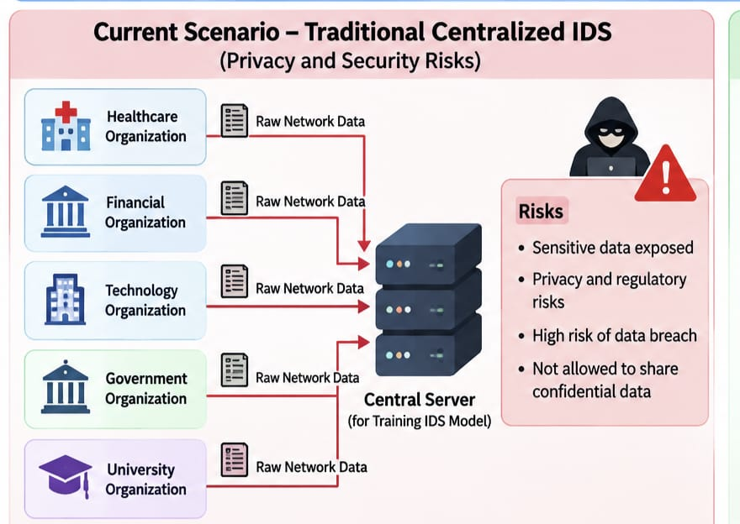
Secure IoT Intrusion Detection System
Privacy-Preserving Federated Learning for IoT (FedPrIDS)
Guide: Dr. Gayatri
Batch ID: AIML-A4
Regd No: 23BQ1A6140 (TL), 23BQ1A6139,
23BQ1A6112, 24BQ5A6124
Literature Review
Ref 01 – FedPrIDS: Privacy-Preserving Federated Learning for Collaborative NIDS in IoT
Mankotia, Conte de Leon & Rimal, 2026 | Journal of Cybersecurity and Privacy (Base Paper)
| Proposed Method | Data & Setup | key Results | Strengths & Limitations | Relevance to my research |
“The main problem is that IoT networks face different types of cyberattacks, and organizations need to improve intrusion detection by learning from each other. But directly sharing network traffic data between organizations creates privacy and security concerns. Centralized learning also requires collecting data at one place. Therefore, this project uses Federated Learning, where organizations train the intrusion detection model locally and share only model updates instead of raw data.”

Slide 4
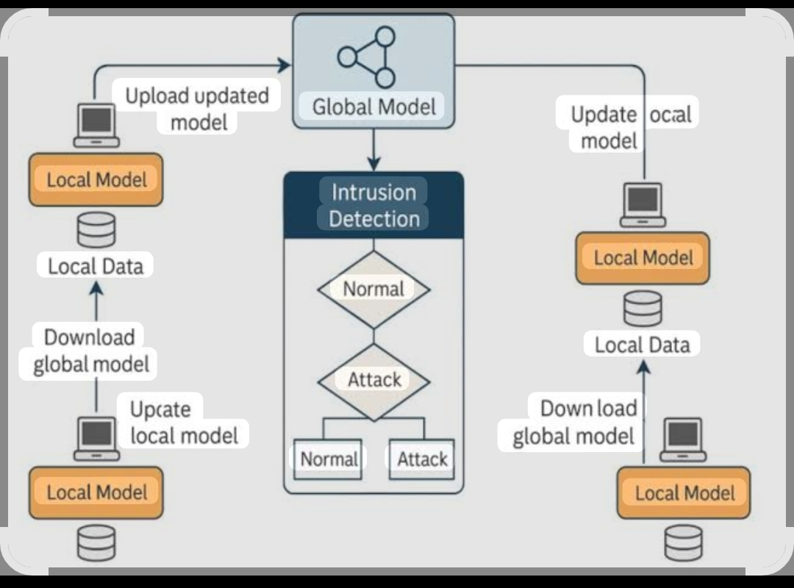
Secure IoT Intrusion Detection System
Privacy-Preserving Federated Learning for IoT (FedPrIDS)
Guide: Dr. Gayatri
Batch ID: AIML-A4
Regd No: 23BQ1A6140 (TL), 23BQ1A6139,
23BQ1A6112, 24BQ5A6124
Literature Review
Ref 01 – FedPrIDS: Privacy-Preserving Federated Learning for Collaborative NIDS in IoT
Mankotia, Conte de Leon & Rimal, 2026 | Journal of Cybersecurity and Privacy (Base Paper)
| Proposed Method | Data & Setup | key Results | Strengths & Limitations | Relevance to my research |
Datasets Used: CIC-IDS-2017, UNSW-NB15, and Bot-IoT.
Organizations: Data is distributed among 5 simulated organizations – Financial, Technology, Healthcare, Government, and University.
Data Split: 80% for training and 20% for testing.
Feature Selection: Unnecessary features are removed to reduce processing time.
Model Training: Uses PyTorch, Adam optimizer, batch size 128, and 20 federated rounds.
Privacy: Differential Privacy is applied so organizations can train without sharing their raw network data.

Slide 5
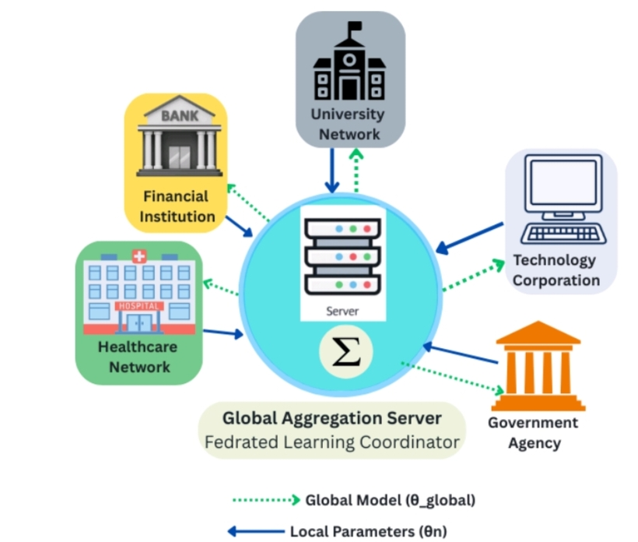
Secure IoT Intrusion Detection System
Privacy-Preserving Federated Learning for IoT (FedPrIDS)
Guide: Dr. Gayatri
Batch ID: AIML-A4
Regd No: 23BQ1A6140 (TL), 23BQ1A6139,
23BQ1A6112, 24BQ5A6124
Literature Review
Ref 01 – FedPrIDS: Privacy-Preserving Federated Learning for Collaborative NIDS in IoT
Mankotia, Conte de Leon & Rimal, 2026 | Journal of Cybersecurity and Privacy (Base Paper)
| Proposed Method | Data & Setup | key Results | Strengths & Limitations | Relevance to my research |
Federated detection accuracy: 90.3% on CIC-IDS-2017, 89.7% on UNSW-NB15, 92.1% on Bot-IoT.
Collaboration gain over isolated (non-federated) training: +8.5% to +14.4% (average +11.3%).
Hybrid feature selection cut preprocessing time by 37–43% with only 0.12–0.15% accuracy loss.
Even at the strictest privacy setting (ε = 0.5), accuracy dropped by less than 2.5% — privacy cost stayed low.
Federated training converged within 20 rounds and cut inter-organizational communication overhead by ~50%.

Slide 6
Secure IoT Intrusion Detection System
Privacy-Preserving Federated Learning for IoT (FedPrIDS)
Guide: Dr. Gayatri
Batch ID: AIML-A4
Regd No: 23BQ1A6140 (TL), 23BQ1A6139,
23BQ1A6112, 24BQ5A6124
Literature Review
Ref 01 – FedPrIDS: Privacy-Preserving Federated Learning for Collaborative NIDS in IoT
Mankotia, Conte de Leon & Rimal, 2026 | Journal of Cybersecurity and Privacy (Base Paper)
| Proposed Method | Data & Setup | key Results | Strengths & Limitations | Relevance to my research |
Strengths
Limitations
1. Strong Data Privacy: Uses Differential Privacy (DP) to protect sensitive network information while organizations collaboratively train the model.
2. Efficient Feature Selection: Uses variance filtering, correlation analysis, and mutual-information ranking to remove unnecessary features, reducing preprocessing time.
3. Multiple Dataset Validation: Tested on CIC-IDS-2017, UNSW-NB15, and Bot-IoT, which helps evaluate the approach across different intrusion datasets.
4. Organization-Specific Privacy: Different organizations can have different privacy budgets and data quality, making the federated setup more flexible.
5. Safer Aggregation: Uses MAD-based outlier detection and rollback safeguards to identify abnormal model updates during aggregation.
1. Requires Labeled Data: The model depends on correctly labeled benign and malicious traffic for supervised training.
2. Trusted Central Server: It relies on a trusted central aggregator to combine model updates. If the central server cannot be trusted, this becomes a limitation
.3. Simulated Organizations: Experiments use fictitious/simulated organizations, rather than a real multi-organization deployment.
4. No Real-Time Testing: The system was not evaluated for real-time or production-scale deployment.
5. Lower Recall: Although overall accuracy is high, the PPT reports relatively low recall of around 57–62%, meaning some actual attacks may not be detected.

Slide 7
Secure IoT Intrusion Detection System
Privacy-Preserving Federated Learning for IoT (FedPrIDS)
Guide: Dr. Gayatri
Batch ID: AIML-A4
Regd No: 23BQ1A6140 (TL), 23BQ1A6139,
23BQ1A6112, 24BQ5A6124
Literature Review
Ref 01 – FedPrIDS: Privacy-Preserving Federated Learning for Collaborative NIDS in IoT
Mankotia, Conte de Leon & Rimal, 2026 | Journal of Cybersecurity and Privacy (Base Paper)
| Proposed Method | Data & Setup | key Results | Strengths & Limitations | Relevance to my research |
Base Paper: FedPrIDS is the base/reference paper for our Secure IoT Intrusion Detection System.
Federated Learning: We use its idea of training across multiple organizations without sharing raw network
data.Privacy Protection: Its Differential Privacy approach provides the basis for protecting sensitive IoT/network information.
Feature Selection: Its hybrid feature-selection technique helps select important network features and reduce processing time.
Secure Aggregation: Its federated aggregation approach provides a foundation for combining local model updates.Extension Opportunity: Our research can build on the paper by addressing limitations such as dependence on labeled data and a trusted central aggregator.

Slide 8
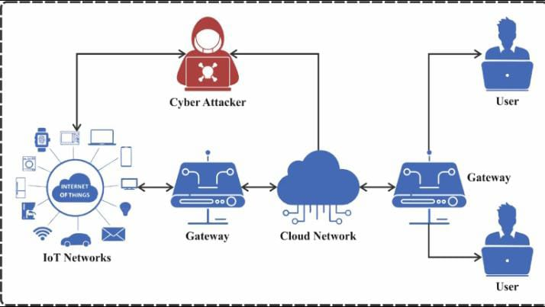
Secure IoT Intrusion Detection System
Privacy-Preserving Federated Learning for IoT (FedPrIDS)
Guide: Dr. Gayatri
Batch ID: AIML-A4
Regd No: 23BQ1A6140 (TL), 23BQ1A6139,
23BQ1A6112, 24BQ5A6124
Literature Review
Ref 02 – Fed-ANIDS: Federated Learning for Anomaly-Based NIDS
Janati Idrissi et al., 2023 | Expert Systems with Applications
| Proposed Method | Data & Setup | key Results | Strengths & Limitations | Relevance to my research |
1. Problem Statement
Nowadays, many computers and devices are connected through networks. Because of this, cyber attacks and network intrusions are increasing.
Traditional Intrusion Detection Systems (IDS) have some problems:
They mainly depend on previously known attack patterns.
They may fail to detect new or unknown attacks.
Organizations usually have network data at different locations.
Sharing this private network data with a central server can create privacy and security problems.
Anomaly-based IDS can detect new attacks, but they can also produce false alarms.

Slide 9
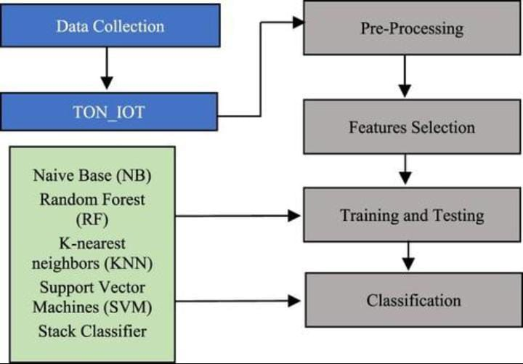
Secure IoT Intrusion Detection System
Privacy-Preserving Federated Learning for IoT (FedPrIDS)
Guide: Dr. Gayatri
Batch ID: AIML-A4
Regd No: 23BQ1A6140 (TL), 23BQ1A6139,
23BQ1A6112, 24BQ5A6124
Literature Review
Ref 02 – Fed-ANIDS: Federated Learning for Anomaly-Based NIDS
Janati Idrissi et al., 2023 | Expert Systems with Applications
| Proposed Method | Data & Setup | key Results | Strengths & Limitations | Relevance to my research |
Evaluated on USTC and CIC-IDS-2017/2018 network traffic datasets across distributed simulated clients.
Related evaluation on NSL-KDD reported a detection rate of 84.86% with a 4.86% false-alarm rate.
Each client trains its autoencoder locally; only model parameters are exchanged with the aggregator.
The methodology has 5 main steps:
Data Collection: Network traffic data is collected from different clients using datasets such as USTC-TFC2016, CIC-IDS2017, and CSE-CIC-IDS2018.
Data Preprocessing: The data is cleaned, useful features are selected, and the features are converted and normalized for model training.
Local Autoencoder Training: Each client trains an Autoencoder on its own network data to learn normal traffic patterns. High reconstruction error indicates possible attack traffic.
Federated Learning: Clients do not share their original data. They train locally and send only model updates to the central server, which creates a global model.
FedAvg/FedProx: The study compares FedAvg and FedProx for combining client updates. FedProx performs better than FedAvg in the reported experiments.

Slide 10
Secure IoT Intrusion Detection System
Privacy-Preserving Federated Learning for IoT (FedPrIDS)
Guide: Dr. Gayatri
Batch ID: AIML-A4
Regd No: 23BQ1A6140 (TL), 23BQ1A6139,
23BQ1A6112, 24BQ5A6124
Literature Review
Ref 02 – Fed-ANIDS: Federated Learning for Anomaly-Based NIDS
Janati Idrissi et al., 2023 | Expert Systems with Applications
| Proposed Method | Data & Setup | key Results | Strengths & Limitations | Relevance to my research |
The proposed Secure IoT Intrusion Detection System detects malicious network traffic, classifies traffic as Normal or Attack, supports early threat detection, protects data privacy through Federated Learning, provides real-time security alerts, and uses XAI to explain the reasons behind model predictions. The system can also visualize attack patterns and evaluate performance using standard metrics such as Accuracy, Precision, Recall, and F1-score.

Slide 11
Secure IoT Intrusion Detection System
Privacy-Preserving Federated Learning for IoT (FedPrIDS)
Guide: Dr. Gayatri
Batch ID: AIML-A4
Regd No: 23BQ1A6140 (TL), 23BQ1A6139,
23BQ1A6112, 24BQ5A6124
Literature Review
Ref 02 – Fed-ANIDS: Federated Learning for Anomaly-Based NIDS
Janati Idrissi et al., 2023 | Expert Systems with Applications
| Proposed Method | Data & Setup | key Results | Strengths & Limitations | Relevance to my research |
Strengths
Limitations
Provides accurate detection of malicious IoT traffic.
Protects sensitive data using Federated Learning.
Detects unusual and potentially unknown attacks.
Supports real-time monitoring and security alerts.
XAI explains why the system predicted an attack.
Can support multiple IoT devices and clients.
Reduces the need to share raw network data.
Requires sufficient computational resources for model training.
Federated Learning creates communication overhead.
Different client data can affect model performance.
The system may generate false positives.
Some advanced attacks may remain undetected.
Performance depends on the quality of the dataset.
IoT devices may have limited processing and memory resources.
XAI explanations may not always be completely accurate or comprehensive.

Slide 12
Secure IoT Intrusion Detection System
Privacy-Preserving Federated Learning for IoT (FedPrIDS)
Guide: Dr. Gayatri
Batch ID: AIML-A4
Regd No: 23BQ1A6140 (TL), 23BQ1A6139,
23BQ1A6112, 24BQ5A6124
Literature Review
Ref 02 – Fed-ANIDS: Federated Learning for Anomaly-Based NIDS
Janati Idrissi et al., 2023 | Expert Systems with Applications
| Proposed Method | Data & Setup | key Results | Strengths & Limitations | Relevance to my research |
Nowadays, many computers and devices are connected through networks. Because of this, cyber attacks and network intrusions are increasing.
Traditional Intrusion Detection Systems (IDS) have some problems:
They mainly depend on previously known attack patterns.
They may fail to detect new or unknown attacks.
Organizations usually have network data at different locations.
Sharing this private network data with a central server can create privacy and security problems.
Anomaly-based IDS can detect new attacks, but they can also produce false alarms.

Slide 13
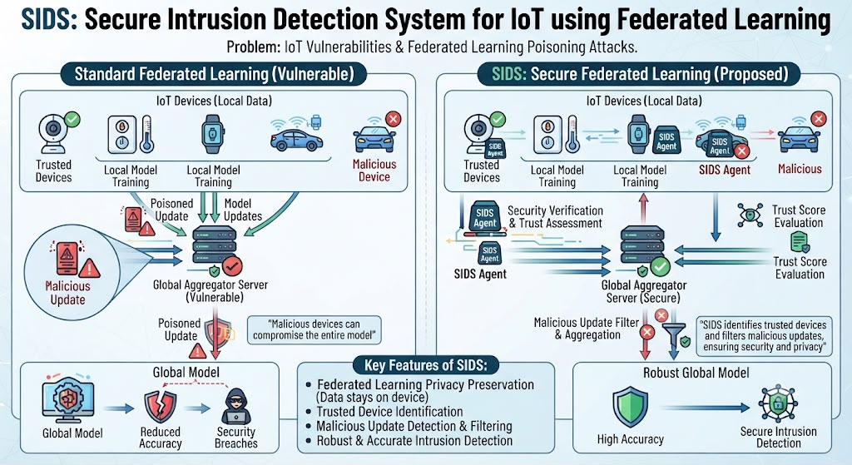
Secure IoT Intrusion Detection System
Privacy-Preserving Federated Learning for IoT (FedPrIDS)
Guide: Dr. Gayatri
Batch ID: AIML-A4
Regd No: 23BQ1A6140 (TL), 23BQ1A6139,
23BQ1A6112, 24BQ5A6124
Literature Review
Ref 03 – SIDS: Federated Learning for Intrusion Detection in IoT using Social IoT
Amiri-Zarandi, Dara & Lin, 2023 | Computer Networks
| Proposed Method | Data & Setup | key Results | Strengths & Limitations | Relevance to my research |
Problem Statement – SIDS
IoT devices are vulnerable to cyberattacks, so an Intrusion Detection System (IDS) is needed. Federated Learning protects data privacy by keeping data on local devices, but malicious devices can send false or poisoned updates and reduce the model’s accuracy. Therefore, SIDS aims to identify trusted and untrusted IoT devices and provide secure, privacy-preserving intrusion detection.

Slide 14
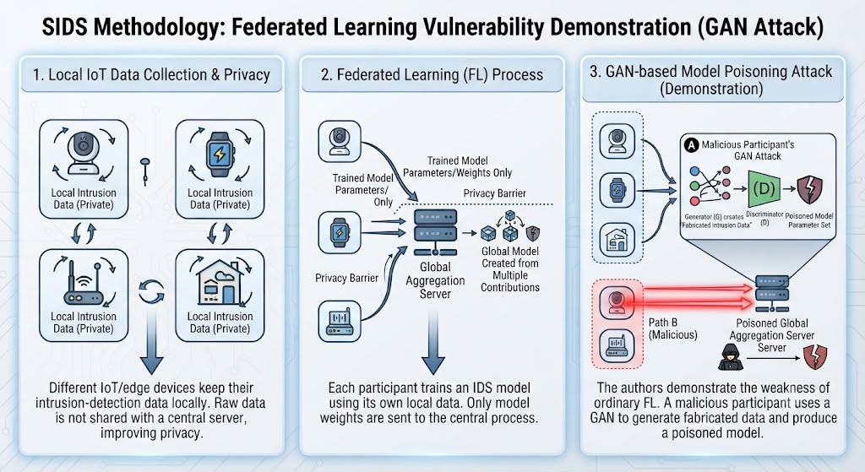
Secure IoT Intrusion Detection System
Privacy-Preserving Federated Learning for IoT (FedPrIDS)
Guide: Dr. Gayatri
Batch ID: AIML-A4
Regd No: 23BQ1A6140 (TL), 23BQ1A6139,
23BQ1A6112, 24BQ5A6124
Literature Review
Ref 03 – SIDS: Federated Learning for Intrusion Detection in IoT using Social IoT
Amiri-Zarandi, Dara & Lin, 2023 | Computer Networks
| Proposed Method | Data & Setup | key Results | Strengths & Limitations | Relevance to my research |
Simulated SIoT federated-learning setting with multiple client nodes, some deliberately acting as malicious / dishonest participants.
Compared trust-weighted (Social Tie) aggregation against standard federated averaging under attack conditions.
Methodology
The paper proposes SIDS (Social Intrusion Detection System), which combines Federated Learning (FL), Social Internet of Things (SIoT), trust management, GAN-based attack analysis, and collaborative feature selection.
Main steps:
1. Local IoT data collection
* Different IoT/edge devices keep their intrusion-detection data locally.
* Raw data is not shared with a central server, improving privacy.
2. Federated Learning
* Each participant trains an IDS model using its own local data.
* Only the trained model parameters/weights are sent to the central aggregation process.
* The global model is created from the contributions of multiple participants.
3. GAN-based model poisoning attack
* The authors first demonstrate the weakness of ordinary federated learning.
* A malicious participant uses a Generative Adversarial Network (GAN) to generate fabricated data and produce a poisoned model.

Slide 15
Secure IoT Intrusion Detection System
Privacy-Preserving Federated Learning for IoT (FedPrIDS)
Guide: Dr. Gayatri
Batch ID: AIML-A4
Regd No: 23BQ1A6140 (TL), 23BQ1A6139,
23BQ1A6112, 24BQ5A6124
Literature Review
Ref 03 – SIDS: Federated Learning for Intrusion Detection in IoT using Social IoT
Amiri-Zarandi, Dara & Lin, 2023 | Computer Networks
| Proposed Method | Data & Setup | key Results | Strengths & Limitations | Relevance to my research |
SIDS maintains higher detection accuracy than regular FL approaches when the system is under attack from malicious participants.
The Social Tie measurement successfully filters out untrustworthy model updates before aggregation, improving robustness.
SIDS performed better than normal Federated Learning when malicious devices were present. The trust mechanism helped reduce the effect of false model updates. It also maintained data privacy because the original data stayed with the local devices. Feature selection helped make the training process faster.
SIDS achieved better detection accuracy under attacks because it could identify and reduce the effect of dishonest devices.

Slide 16
Secure IoT Intrusion Detection System
Privacy-Preserving Federated Learning for IoT (FedPrIDS)
Guide: Dr. Gayatri
Batch ID: AIML-A4
Regd No: 23BQ1A6140 (TL), 23BQ1A6139,
23BQ1A6112, 24BQ5A6124
Literature Review
Ref 03 – SIDS: Federated Learning for Intrusion Detection in IoT using Social IoT
Amiri-Zarandi, Dara & Lin, 2023 | Computer Networks
| Proposed Method | Data & Setup | key Results | Strengths & Limitations | Relevance to my research |
Strengths
Limitations
Directly targets poisoning / malicious-participant robustness
Trust-based weighting is lightweight and IoT-appropriate
Assumes a social/trust graph exists between IoT nodes
No explicit differential-privacy mechanism
Single-dataset, simulated evaluation only

Slide 17
Secure IoT Intrusion Detection System
Privacy-Preserving Federated Learning for IoT (FedPrIDS)
Guide: Dr. Gayatri
Batch ID: AIML-A4
Regd No: 23BQ1A6140 (TL), 23BQ1A6139,
23BQ1A6112, 24BQ5A6124
Literature Review
Ref 03 – SIDS: Federated Learning for Intrusion Detection in IoT using Social IoT
Amiri-Zarandi, Dara & Lin, 2023 | Computer Networks
| Proposed Method | Data & Setup | key Results | Strengths & Limitations | Relevance to my research |
SIDS highlights a security gap that FedPrIDS does not directly address: robustness to malicious / poisoning participants.
Its trust-weighted aggregation idea could complement FedPrIDS’s MAD-based outlier detection in our project.
Reinforces the need for participant-trust or robustness checks alongside differential privacy in our own design.

Slide 18
Secure IoT Intrusion Detection System
Privacy-Preserving Federated Learning for IoT (FedPrIDS)
Guide: Dr. Gayatri
Batch ID: AIML-A4
Regd No: 23BQ1A6140 (TL), 23BQ1A6139,
23BQ1A6112, 24BQ5A6124
Literature Review - Summary
Reference | Year | Main Idea | Strengths | Limitations
Mankotia et al. (FedPrIDS – base paper) | 2026 | FL + differential privacy + hybrid feature selection for multi-org IoT NIDS | Formal DP guarantees; 8–15% accuracy gain; faster preprocessing | Needs labeled data; trusted aggregator; simulated orgs
Janati Idrissi et al. (Fed-ANIDS) | 2023 | FL + autoencoder-based anomaly detection with FedProx aggregation | No labels needed; validated on multiple datasets | No formal privacy guarantees; higher false positives
Amiri-Zarandi et al. (SIDS) | 2023 | Social-trust-weighted FL for intrusion detection in Social IoT | Robust to malicious / dishonest participants | Needs a social trust graph; no DP; single dataset
Liu et al. (VFL Survey) | 2024 | Survey of Vertical Federated Learning concepts, advances & challenges | Comprehensive taxonomy of VFL techniques | Conceptual survey; no new experimental system

Slide 19
Secure IoT Intrusion Detection System
Privacy-Preserving Federated Learning for IoT (FedPrIDS)
Guide: Dr. Gayatri
Batch ID: AIML-A4
Regd No: 23BQ1A6140 (TL), 23BQ1A6139,
23BQ1A6112, 24BQ5A6124
Review – 1
Questions?

