Slide 1
Implementation of Semi-Autonomous and Fully-Autonomous Parking Features for the DE2Bot
Yotam Ghebre
Kevin Hilinski
Sebastian Jara Garay
Brian Mull
Joey Sterling
ECE 2031 Digital Design Laboratory L01
Georgia Institute of Technology
April 18, 2017
Notes:
Introductions

Slide 2
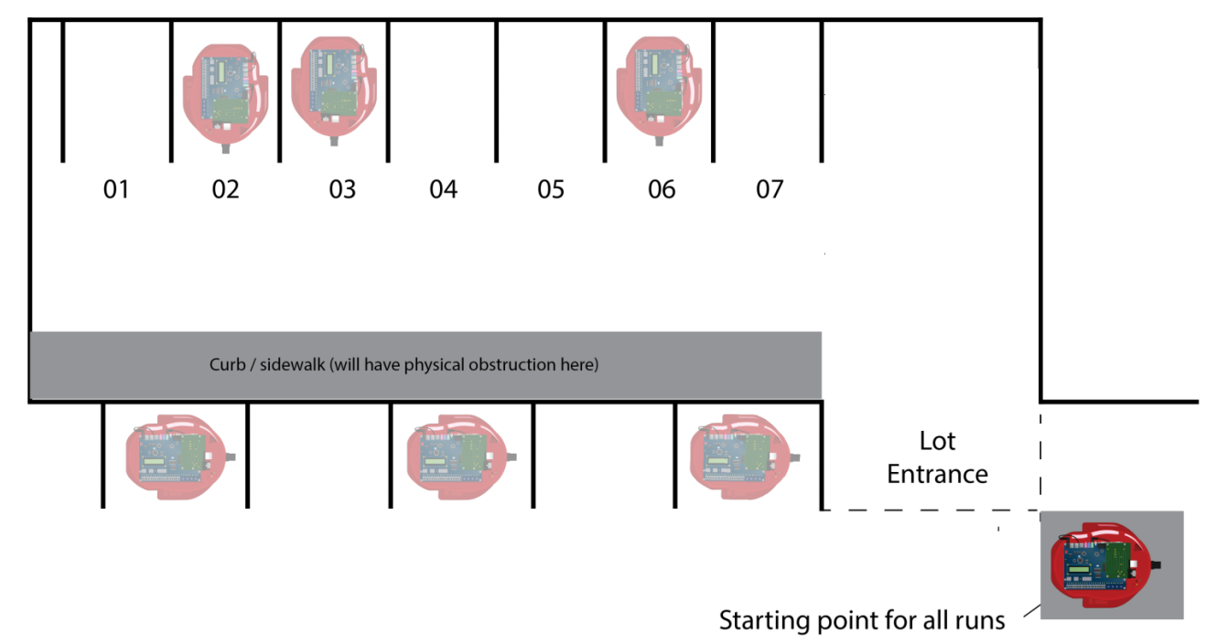
Project Objectives
Implement a semi-autonomous perpendicular parking function in the DE2Bot
Implement a semi-autonomous parallel parking function in the DE2Bot
Implement a fully-autonomous perpendicular parking function in the DE2Bot
Parking lot image source: Assignment Sheet: Design Proposal
Notes:
Yotam

Slide 3
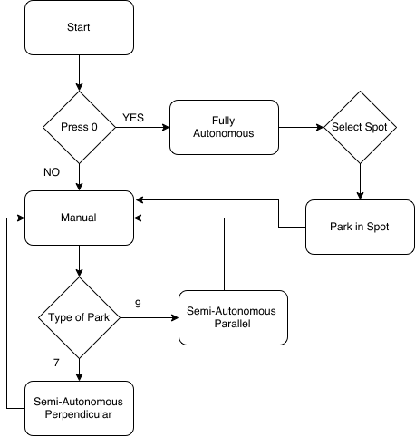
Design Solution
Robot is in manual mode unless “0” is pressed
Robot returns to manual mode once autonomous parking is completed
All autonomous operations are composed up of 4 basic movements
Notes:
Yotam

Slide 4
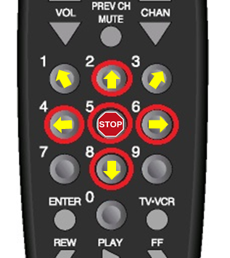
Manual Driving Operation
Remote image source: Infrared TV Remote Manual
Notes:
Kevin

Slide 5
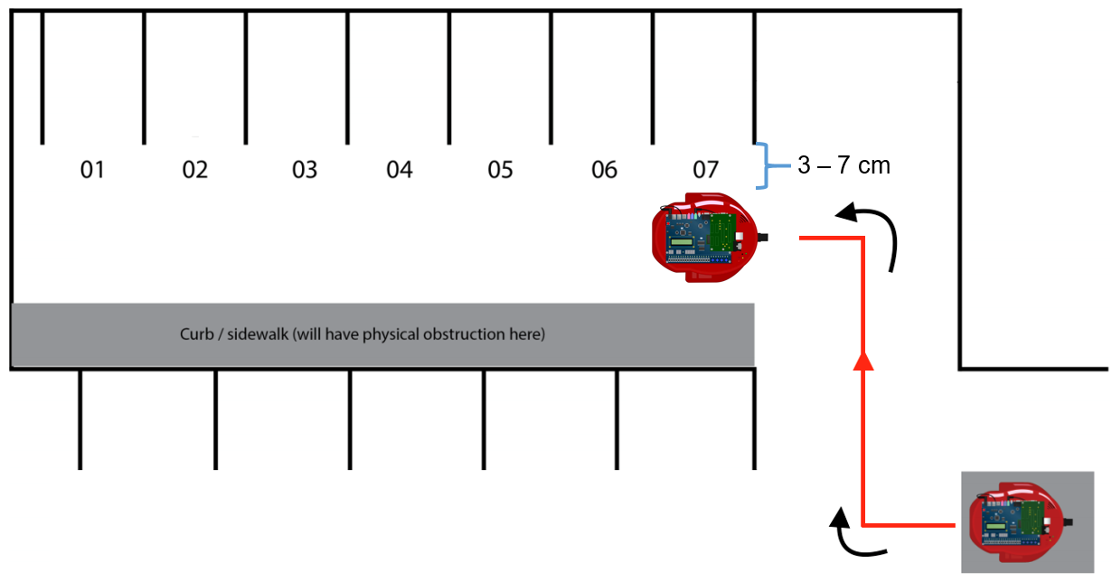
Semi-Autonomous Perpendicular Parking Operation
Manually drive to desired position
Press “7” to execute automatic-parking maneuver
Parking lot image source: Assignment Sheet: Design Proposal
Notes:
Kevin

Slide 6
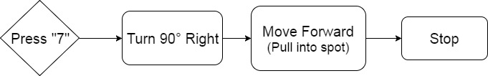
Semi-Autonomous Perpendicular Parking Execution
Reset position for greater accuracy
Check for vacancy of the spot
Use sonar for detection
Drive 47.4 cm into parking spot

Slide 7
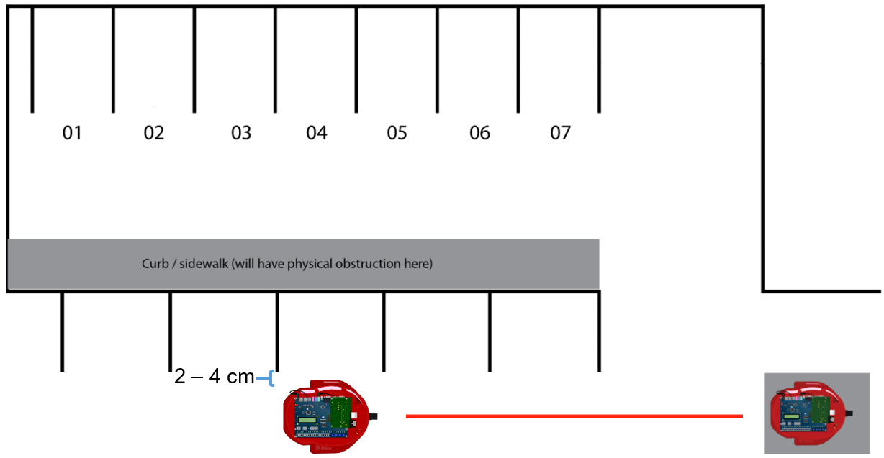
Semi-Autonomous Parallel Parking Operation
Manually drive to desired position
Press “9” to execute automatic-parking maneuver
Parking lot image source: Assignment Sheet: Design Proposal
Notes:
Kevin

Slide 8
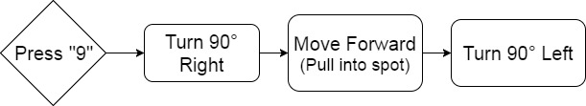
Semi-Autonomous Parallel Parking Execution
Reset position for greater accuracy
Check for vacancy of the spot
Use sonar for detection
Drive 32.9 cm into parking spot

Slide 9
Fully-Autonomous Perpendicular Parking Initiation
From the starting space outside of the parking lot, “0” is pressed on the remote to enter fully-autonomous mode
To select a destination parking spot, button “1” through “7” will be pressed corresponding to the parking spot number
Notes:
Joey

Slide 10
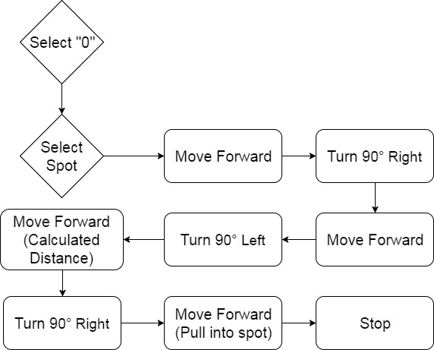
Fully-Autonomous Perpendicular Parking Maneuver
Once a spot is selected, the following sequence of movement instructions will follow:
Notes:
Joey

Slide 11
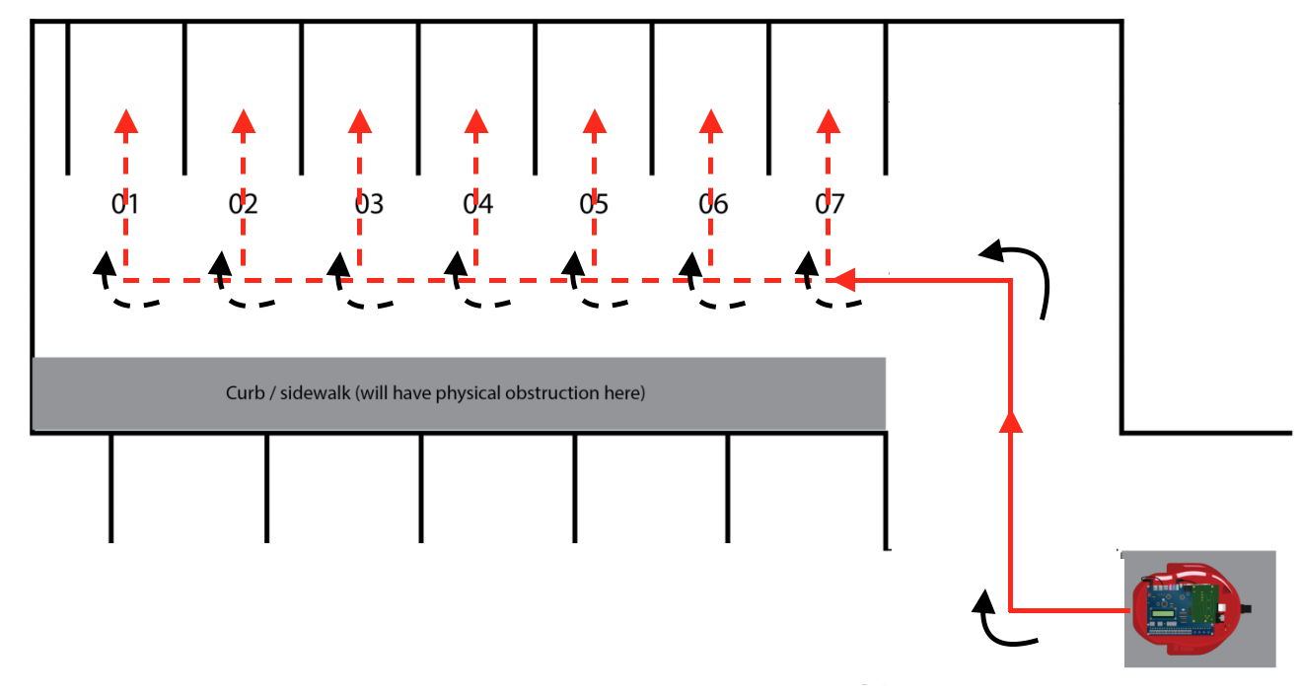

Fully-Autonomous Maneuver Diagram
(51.2 cm, -97.5 cm)
+x
+y
(0,0)
(51.2 cm,0)
Parking lot image source: Assignment Sheet: Design Proposal
Notes:
Joey

Slide 12
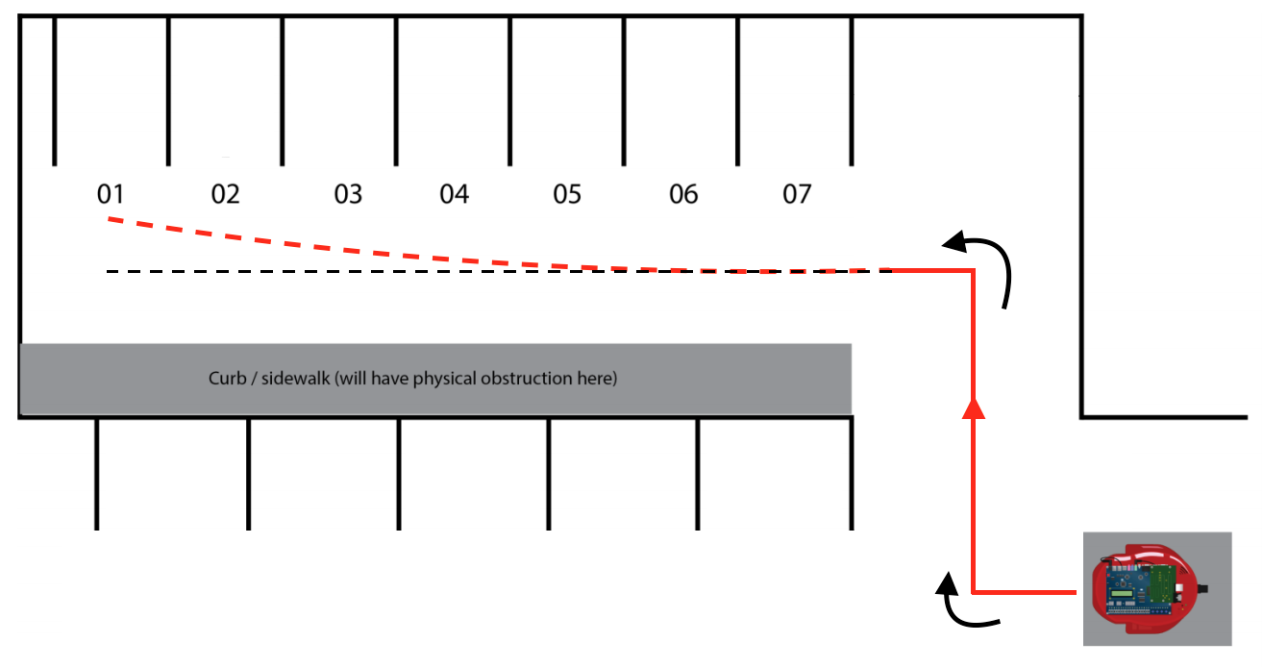
Problems Encountered
Drifting caused by using DVel to control wheel speed
Increased speed reduced stopping accuracy
Slack in wheels was causing error in odometer readings
Parking lot image source: Assignment Sheet: Design Proposal

Slide 13
Improving Drift
Calling the provided control movement function in an endless loop results in more accurate robot movement
As opposed to an external interrupt updating the speed of the robot every 0.1 seconds
Decreased speed (slow speed) in order to reduce overall drift
Notes:
sebastian

Slide 14
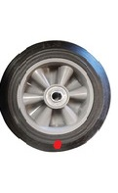
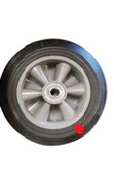
Improving Parking Execution
Created special autonomous parking distances
Spot 5,6,7 = 50.96cm
Spot 1 = 44.30cm
Readjust wheel slack by rolling bot into starting block
Left Wheel
Right Wheel
Wheel image source: www.openclipart.org
Notes:
motors engage at different times

Slide 15
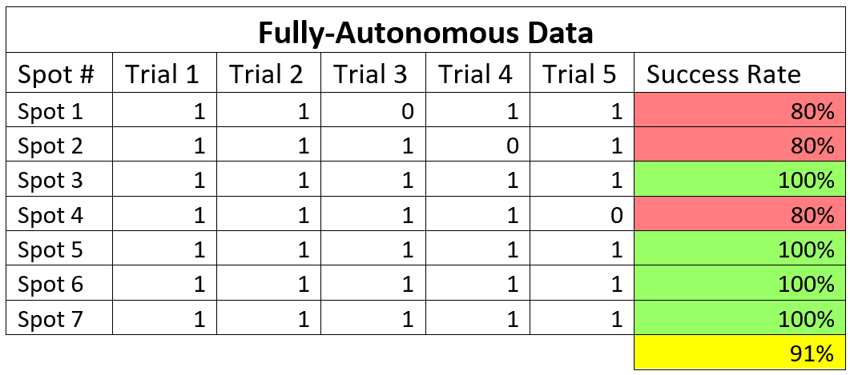
Results of Pre-Demo Fully-Autonomous Trials

Slide 16
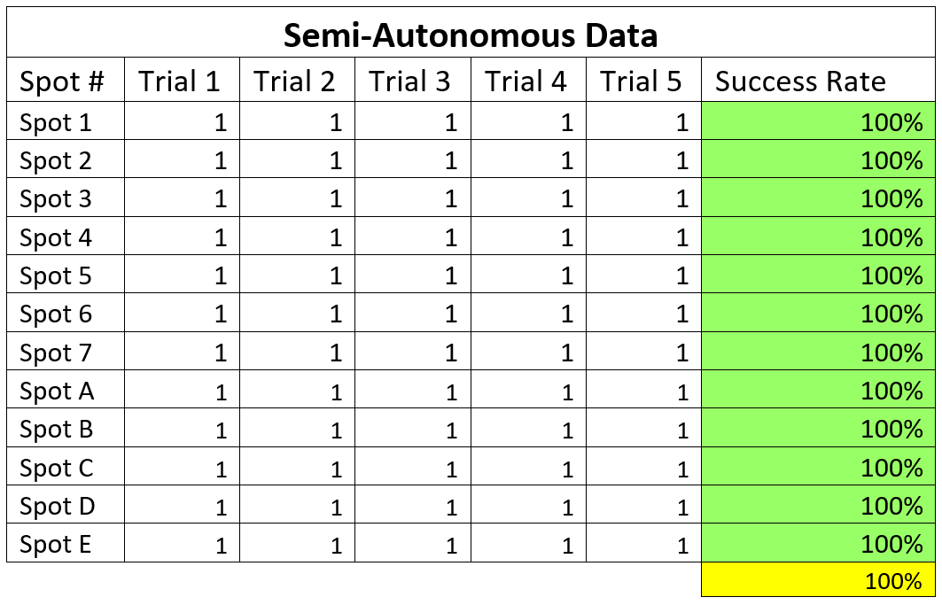
Results of Pre-Demo Semi-Autonomous Trials

Slide 17
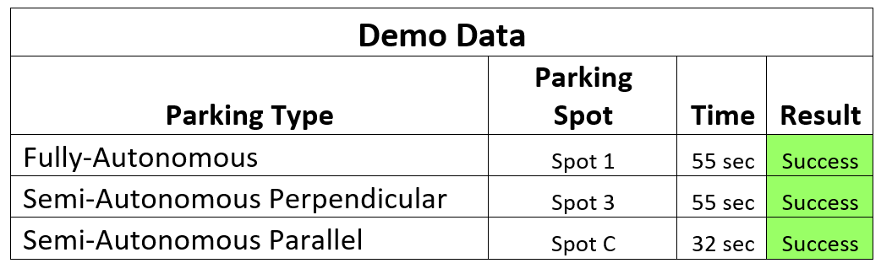
Demo Results

Slide 18
Special Features
Autonomous Pause and Abort
“5” pauses
“5” again aborts autonomous and resumes manual control
“0” resumes autonomous parking
5° adjustment
for semi-autonomous parking
“1” shifts left
“3” shifts right
Notes:
Kevin

Slide 19

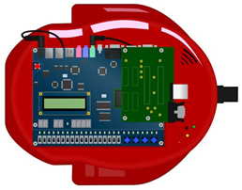
Future Work
Sonar
safety stop in semi-autonomous parking
drift correction in autonomous parking
start correction
Speed
Accommodating to allow for faster parking
DE2Bot image source: DE2Bot User’s Manual
Notes:
Brian

Slide 20
Conclusions
Strengths
Intuitive and user friendly control layout
High Accuracy
Parking pause and abort
Simple control instructions for future implementations
Notes:
Brianz

Slide 21
Questions?

