Slide 1
C# basic
Presented by:
Jidesh Govinda Baidya
Developer

Slide 2
introduction
C# is a simple, modern, general-purpose, object-oriented programming language developed by Microsoft
.NET is its most popular framework
C# programming is very much based on C and C++ programming languages, so if you have a basic understanding of C or C++ programming, then it will be fun to learn C#
C# is designed for Common Language Infrastructure (CLI), which consists of the executable code and runtime environment that allows use of various high-level languages on different computer platforms and architectures

Slide 3
reasons make C# a widely used professional language
It is a modern, general-purpose programming language
It is object oriented.
It is component oriented.
It is easy to learn.
It is a structured language.
It produces efficient programs.
It can be compiled on a variety of computer platforms.
It is a part of .Net Framework.

Slide 4
Important features of C#
Boolean Conditions
Automatic Garbage Collection
Standard Library
Assembly Versioning
Properties and Events
Delegates and Events Management
Easy-to-use Generics
Indexers
Conditional Compilation
Simple Multithreading
LINQ and Lambda Expressions
Integration with Windows

Slide 5
.NET Framework
Following application can be made using .NET Frame work
Windows applications
Web applications
Web services

Slide 6
Components of .NET Framework
Common Language Runtime (CLR)
The .Net Framework Class Library
Common Language Specification
Common Type System
Metadata and Assemblies
Windows Forms
ASP.Net and ASP.Net AJAX
ADO.Net
Windows Workflow Foundation (WF)
Windows Presentation Foundation
Windows Communication Foundation (WCF)
LINQ

Slide 7
IDE for C#
Visual Studio 2010 (VS)
Visual C# 2010 Express (VCE)
Visual Web Developer

Slide 8
Let us look at a simple code that prints the words "Hello World" −
class HelloWorld { static void Main(string[] args) { /* my first program in C# */ Console.WriteLine("Hello World"); Console.ReadKey(); }
Using System;
Namespace HelloWorldApplication{
class HelloWorld{
static void Main(string[] args) {
console.WriteLine(“hello world”);
console.Readkey();
}
}
}

Slide 9
C# program consists of following parts
Namespace declaration
A class
Class methods
Class attributes
A Main method
Statements and Expressions
Comments

Slide 10
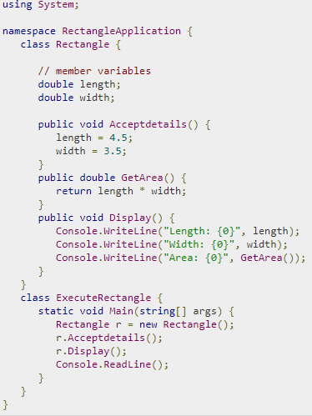

Slide 11
The using Keyword
The first statement in any C# program
The using keyword is used for including the namespaces in the program.
A program can include multiple using statements.
The class Keyword
The class keyword is used for declaring a class.

Slide 12

comment
Comments are used for explaining code. Compilers ignore the comment entries. The multiline comments in C# programs start with /* and terminates with the characters */ as shown below −
Single-line comments are indicated by the '//' symbol. For example,

Slide 13
Member Variables
Variables are attributes or data members of a class, used for storing data. In the preceding program, the Rectangle class has two member variables named length and width.
Member Functions
Functions are set of statements that perform a specific task. The member functions of a class are declared within the class. Our sample class Rectangle contains three member functions: AcceptDetails, GetArea and Display.
Instantiating a Class
In the preceding program, the class ExecuteRectangle contains the Main()method and instantiates the Rectangle class.

Slide 14
Identifier
An identifier is a name used to identify a class, variable, function, or any other user-defined item. The basic rules for naming classes in C# are as follows −
A name must begin with a letter that could be followed by a sequence of letters, digits (0 - 9) or underscore. The first character in an identifier cannot be a digit.
It must not contain any embedded space or symbol such as? - + ! @ # % ^ & * ( ) [ ] { } . ; : " ' / and \. However, an underscore ( _ ) can be used.
It should not be a C# keyword.

Slide 15
C# Keywords
Keywords are reserved words predefined to the C# compiler.
These keywords cannot be used as identifiers.
In C#, some identifiers have special meaning in context of code, such as get and set are called contextual keywords.

Slide 16
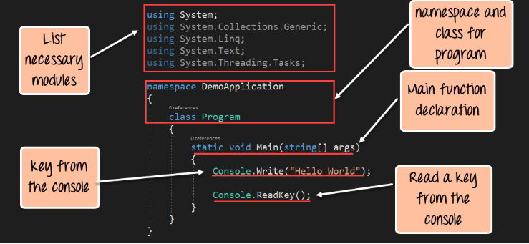

Slide 17
Points to be noted
C# is case sensitive.
All statements and expression must end with a semicolon (;).
The program execution starts at the Main method.
Unlike Java, program file name could be different from the class name.

Slide 18
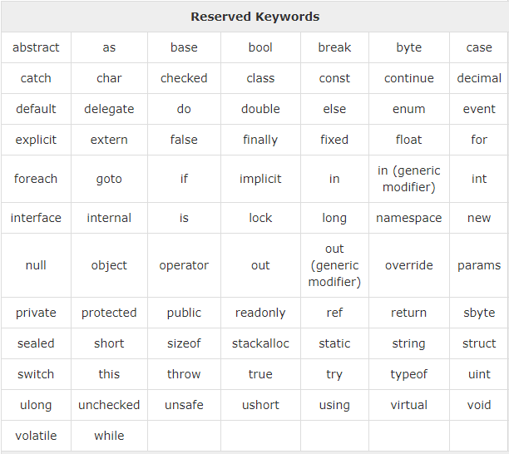

Slide 19
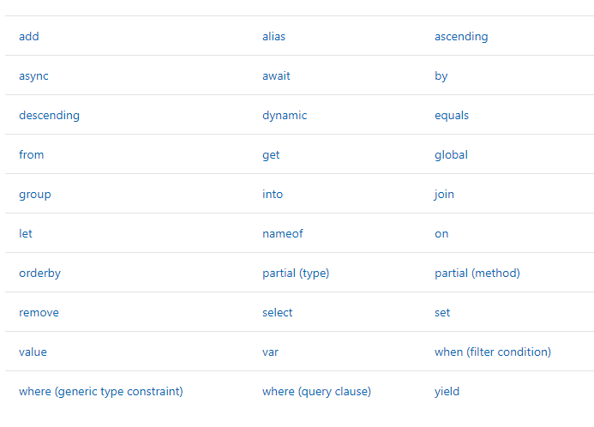
other keyword

Slide 20
The End

