Slide 1
C# IF, Switch, For, While Loop Statements
Jidesh Govinda Baidya
Developer

Slide 2
Flow Control and conditional statements
Flow control and conditional statements are available in any programming language to alter the flow of a program.
For example, if someone wants to execute only a particular set of statements based on some certain logic, then Flow control, and conditional statements will be useful.
You will get a better understanding as we go through the various statements which are available in C#.

Slide 3
We will learn about the following
If Statement
Switch Statement
While loop
For loop

Slide 4
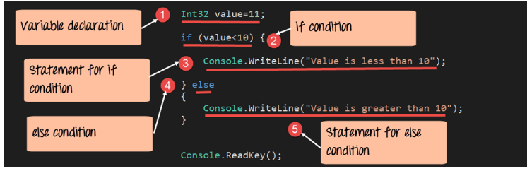
If statement

Slide 5
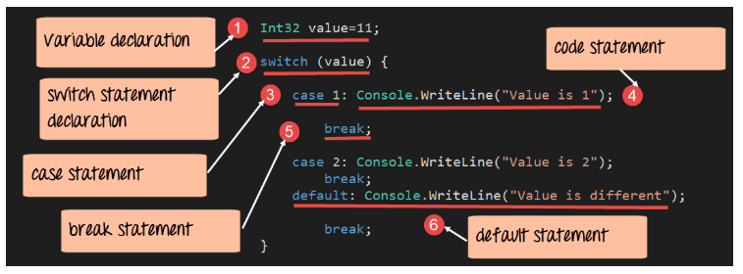
Switch statement

Slide 6
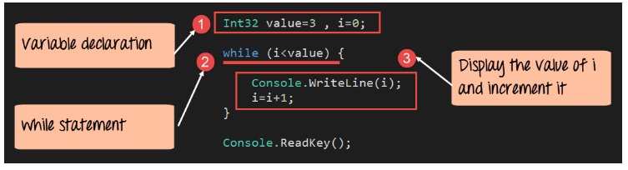
While loop

Slide 7
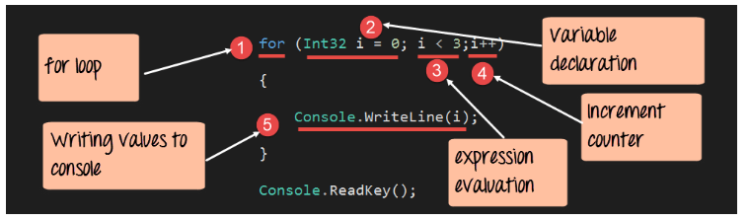
For loop

