Slide 1
Danger to success
Presented by:
Binod nagorkoti
Jidesh goivnda baidya

Slide 2
Primary objective
To make game using JavaScript and learn JavaScript
secondary objective
To take the blue block(player) from red to green
To alert game over if the player block goes beyond play area i.e beyond canvas area
To alert you win if player is able to touch the green block

Slide 3
limitation
Only 1 level
If obstacle is in height < 10 and if player touch that obstacle than it will alert you win even without touching green block
No score and point system
Not so addictive

Slide 4
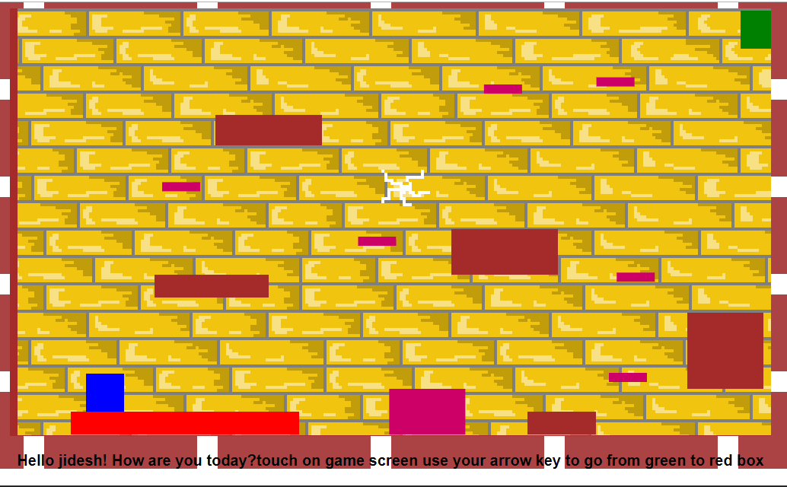

Slide 5
introduction
Fully JS class based game
class Vehicle { constructor(make, model, color) { this.make = make; this.model = model; this.color = color; } getName() {return this.make + " " + this.model; } }
To create new instance of class vechile
let car = new Vehicle("Toyota", "Corolla", "Black");

Slide 6
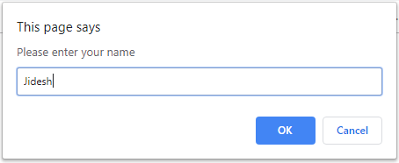
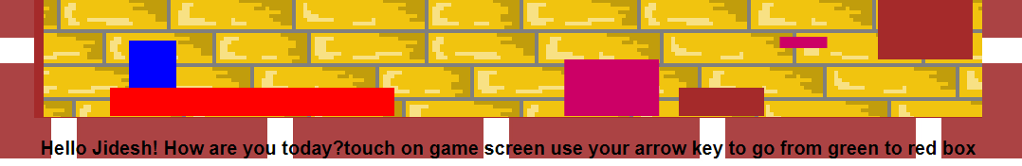
Game Size : 1.1MB
Consists of 4 files i.e 1 html, 1 js and 2 image file
Image is used for the html background and canvas background

Slide 7
Consists of 7 classes
Rect, Rec,Gameobject,Gameobject2,player(child of gameObject2), MovingPlate(child of gameObject)
Some build in function like constructor(),toString(),alert(),super() etc
12 user define function are used collidewith(),move(),fall(),jump(),plateMove() etc

Slide 8
class gameObject {
constructor(game, rect, color="green", gravity=false) { this.rect = new Rec(rect[0], rect[1], rect[2], rect[3])
}
To create the new instance of class gameObject
new gameObject(this, [80, 530, 300, 30], "red", false)

Slide 9
class GameObject2 {
constructor(game, rect, color="green", gravity=false) {
if (!(rect instanceof Rec)) {
this.rect = new Rec(rect[0], rect[1], rect[2], rect[3])
}
To create new instance of GameObject2
new GameObject2(this, [960, 3, 50, 50], "green", false)

Slide 10
class Player extends GameObject2 {
constructor(game, rect) {
super(game, rect, "blue", true)
}

Slide 11
class MovingPlat extends GameObject {
constructor(game, rect, xdir, ydir, distance, speed) {
super(game, rect, "#cc0066", false)
this.xdir = xdir
this.ydir = ydir
this.distance = distance
this.speed = speed
this.active = true
this.moved = 0
}
To create the new instance of class MovingPlate
new MovingPlat(this, [750, 70, 50, 12], 1, 1, 150, 2)

Slide 12
for (let i = 0; i < this.col.length; i++) {
if (this.rect.collidesWith(this.col[i].rect) && this != this.col[i]) {
if (nx > 0) {
this.rect.x = this.col[i].rect.x-this.rect.w
if(this.rect.x>999 || this.rect.x<5){
alert("game over");
}
if(this.rect.y<10){
alert("Congrach you win");
}
}

Slide 13
Game Controller
this.canvas.addEventListener("keydown", (e) => {this.keyState[e.code] = true})
this.canvas.addEventListener("keyup", (e) => {this.keyState[e.code] = false})
if (this.keyState["ArrowUp"] === true && !this.player.falling) {
this.player.jump()
}
if (this.keyState["ArrowLeft"] === true) {
this.player.move(4, -1, 0)
}
if (this.keyState["ArrowRight"]) {
this.player.move(4, 1, 0)
}

Slide 14
Future enhancement
More level
Point and score system
Sound
Better UI/UX
Decrease limitation

Slide 15
Thank you for listening
You all are welcomed to the further extension of this game if you are interested

