Slide 1
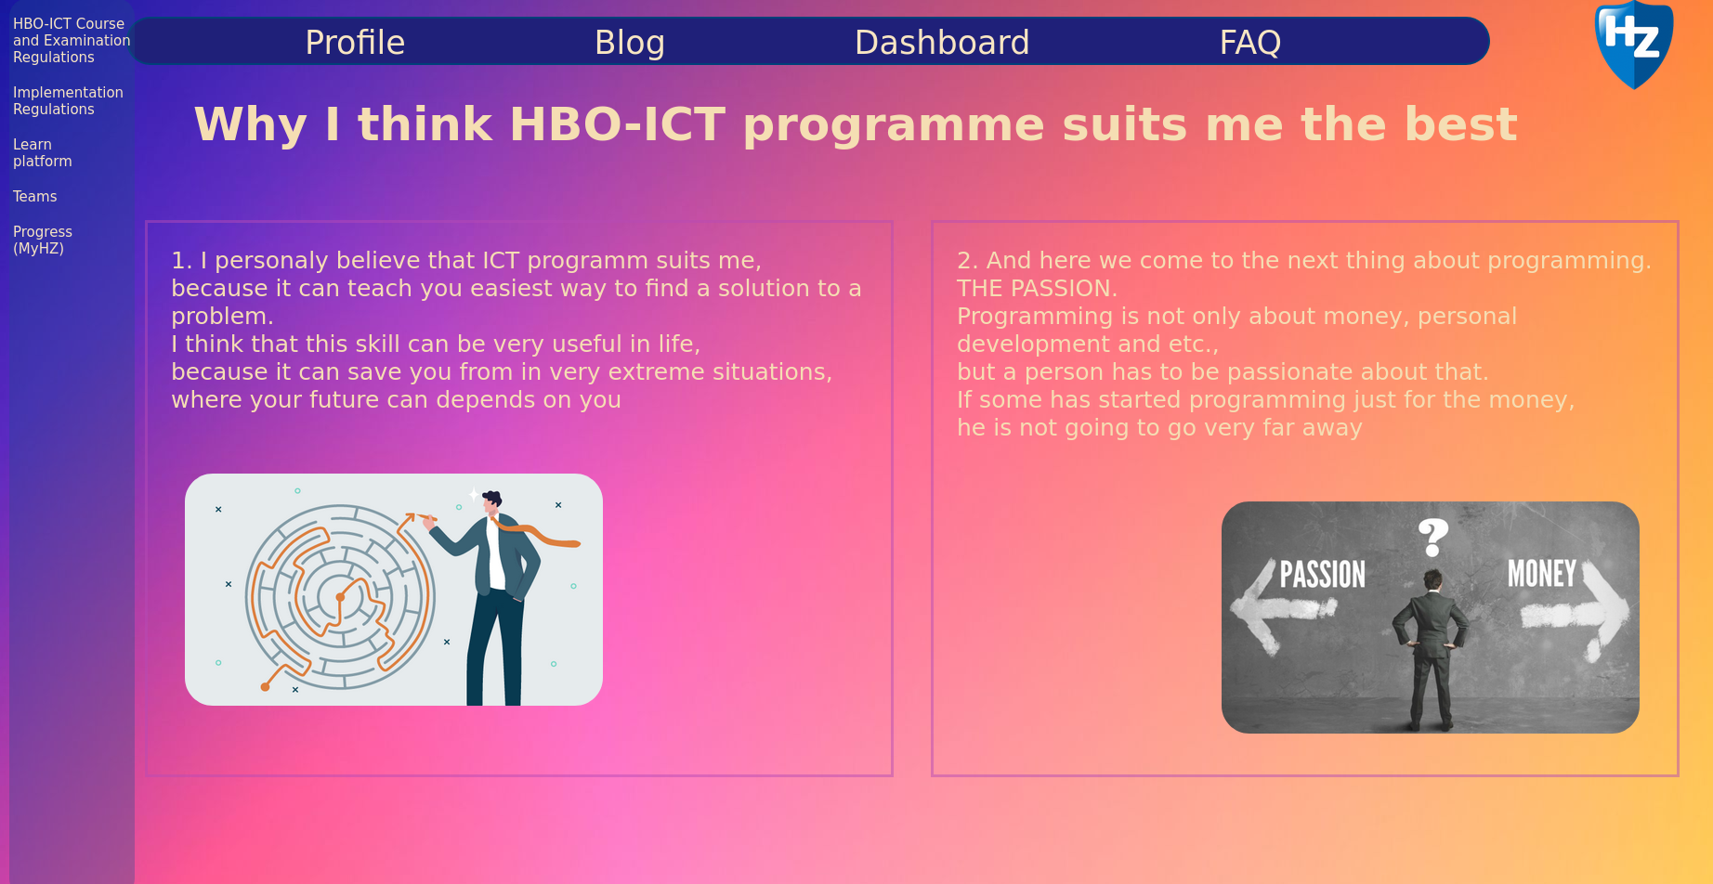
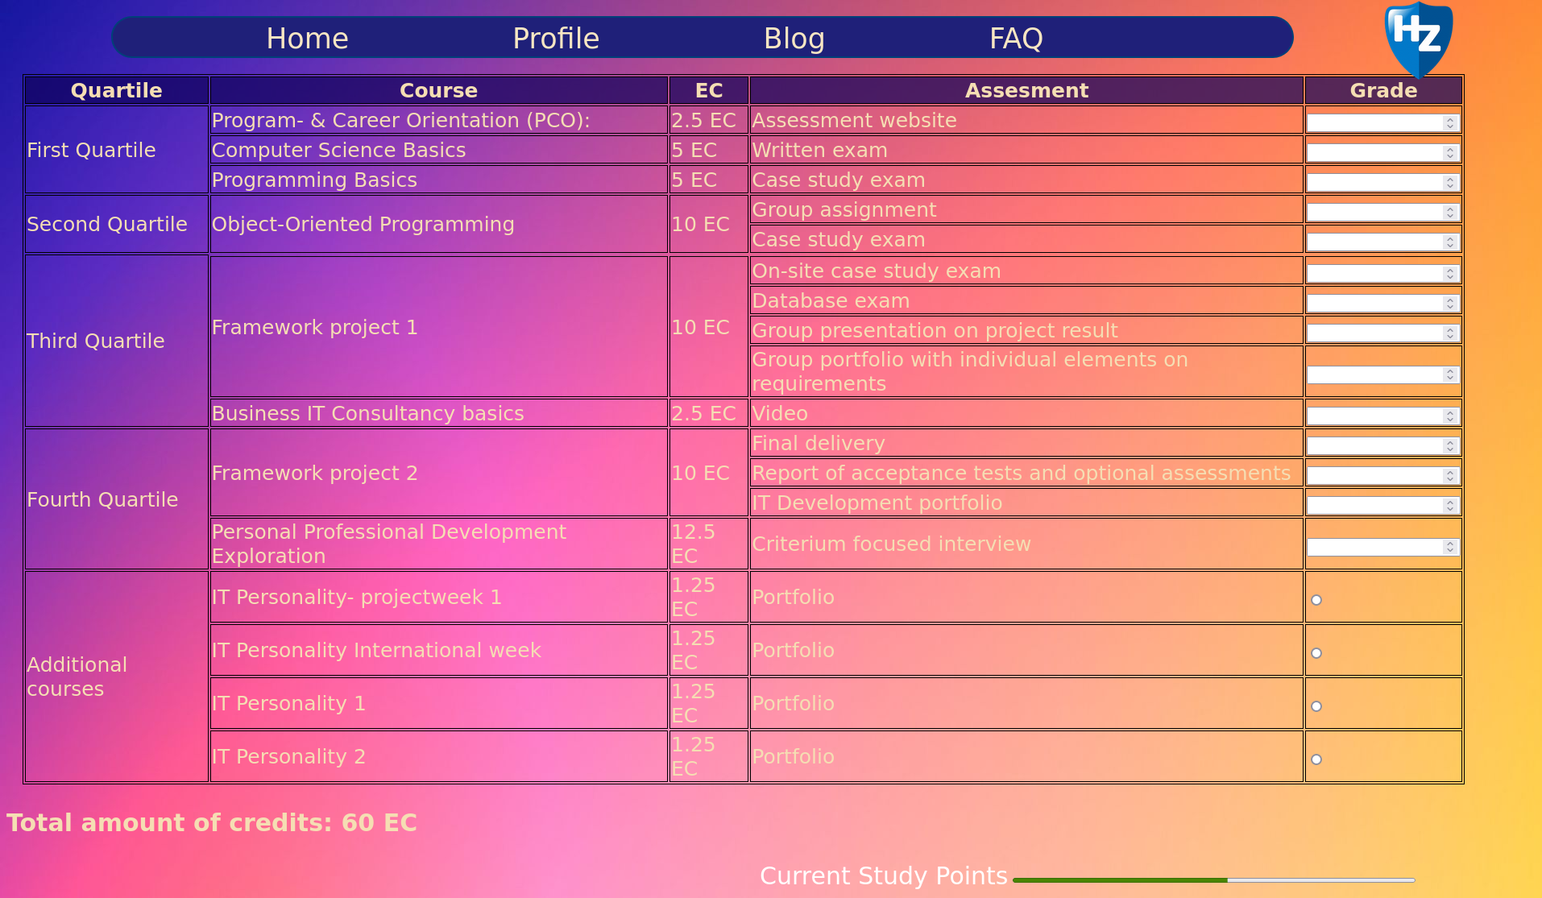
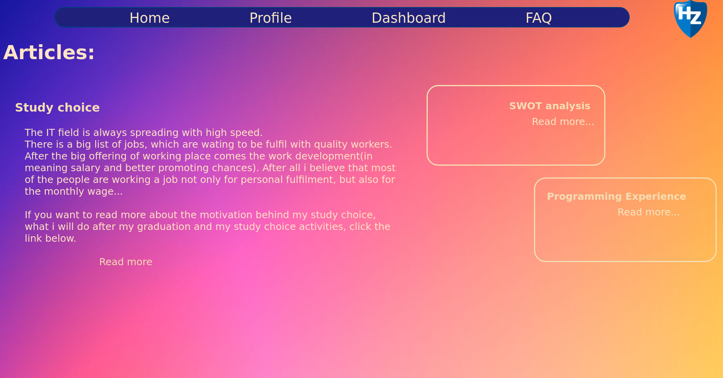
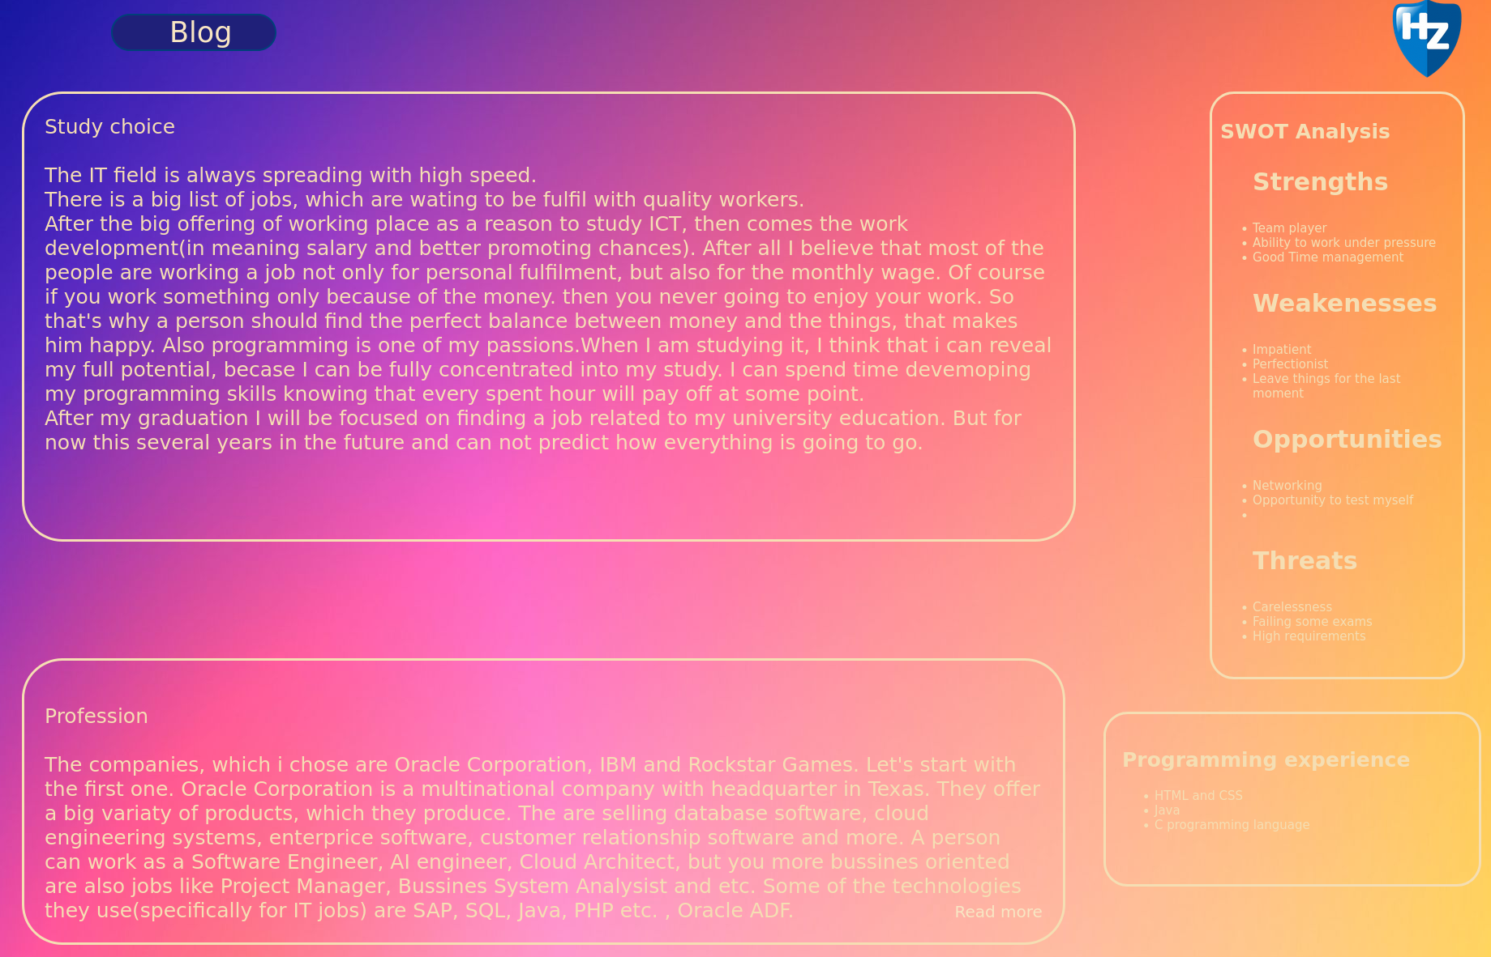
Poster
Home Page
Dashboard Page
Blog Page
Post Page
Font style, color and background color used in my project:
- font-family: 'Gill Sans', 'Gill Sans MT', Calibri, 'Trebuchet MS', sans-serif;
- font-color: wheat;
- background-color: gradient(fading from blue through light pink to yellow);

