Slide 1
MAISON LUMEN GROUP · LUMEN CONSOL (ORACLE FCCS)
The half-year close
in 10 steps
End-user training for entity controllers · training data set: H1 2026 close
Training pack v1.0 · Prepared by Gaurav Sharma, EPM consultant · Fictional group and data
Notes:
Welcome. This session prepares entity controllers for the half-year close in Lumen Consol. We will walk through the ten steps of the close, then practise on the training data set (H1 2026).

Slide 2
WELCOME
What you will be able to do
1
Prepare and check your entity's package
Local data in your currency, intercompany detail, balance checks.
Agenda · 2 hours
09:30
The close process
20 min
2
Resolve intercompany differences
Read the matching report and correct with a journal, not by editing data.
09:50
Hands-on in Lumen Consol
60 min
10:50
Two exercises
30 min
3
Follow the journal workflow
Prepare, scan, submit, get approval, post.
11:20
Questions and support
10 min
4
Read the consolidated results
Bring: your entity's H1 package and the list of your intercompany partners.
Worksheet, statements and the four close checks.
Lumen Consol · The half-year close in 10 steps
2
Notes:
Four outcomes for the session. The agenda alternates short explanations with hands-on work in the application.

Slide 3
THE PROCESS
The close at a glance: 10 steps, 8 working days
1
D+1
2
D+2
3
D+2
4
D+3
5
D+3
Log in, check your point of view
Review your local package
Complete the intercompany detail
Check exchange rates
Match intercompany
Entity controller
Entity controller
Entity controller
Group consolidation
Group consolidation
6
D+4
7
D+4
8
D+5
9
D+6
10
D+8
Correct with a journal
Approve and post journals
Run the consolidation
Review statements and checks
Sign off the close
Entity controller
CFO, then preparer
Group consolidation
Group consolidation
CFO
Your steps as entity controller
Lumen Consol · The half-year close in 10 steps
3
Notes:
The whole close on one page. D+n means working days after the period end. The target is a close at day 8, four days earlier than last year. Steps 1 to 3 and 6 are yours; the group team drives the others.

Slide 4
ROLES
Who does what
EC
Entity controller (you)
GC
Group consolidation team
Submits the local package in local currency
Details every intercompany balance by partner
Prepares correcting journals
Loads the exchange rates
Runs intercompany matching and the consolidation
Reviews results and the close checks
CFO
Approver (CFO)
AU
Statutory auditors
Approves or rejects journals, with a reason
Signs off the consolidated figures
Never posts a journal they approved
Consulted on consolidation rules
Review journals and checks at the half-year review
Lumen Consol · The half-year close in 10 steps
4
Notes:
Who does what during the close. The key control is segregation of duties: the person who approves a journal cannot post it.

Slide 5
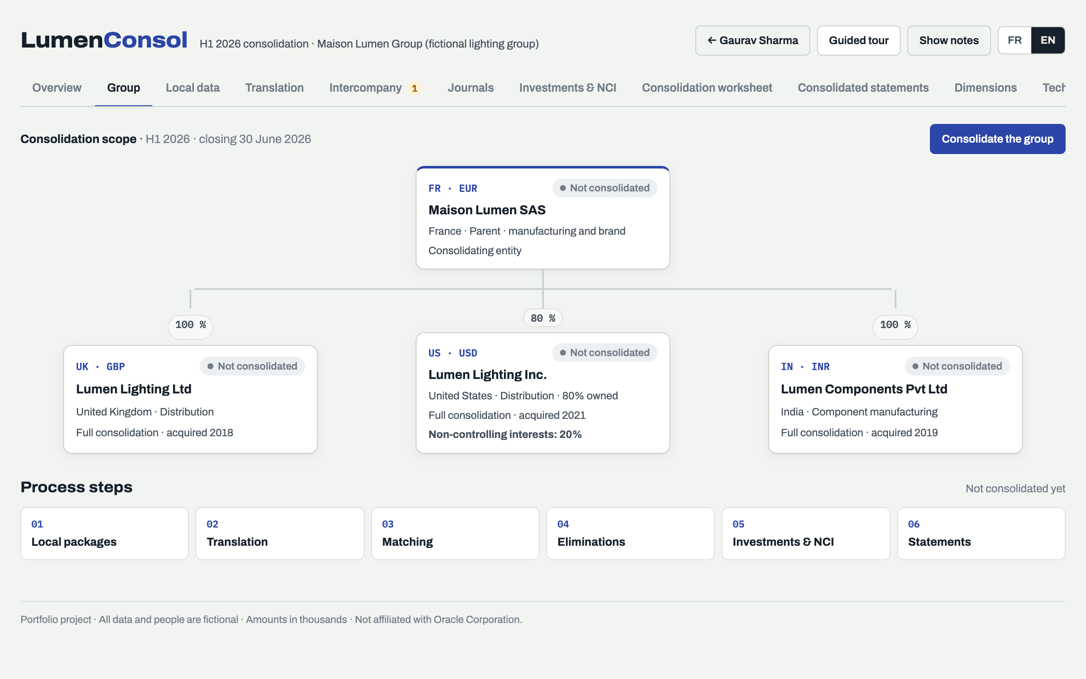
STEP 1 · D+1
Find your way around
4
1
Tabs follow the close: local data, translation, intercompany, journals, results.
1
3
2
Scope: the four companies, the share held and the status (Not consolidated, OK, Impacted).
2
3
Consolidate the group: group team only.
4
Guided tour and notes explain every screen.
Lumen Consol · The half-year close in 10 steps
5
Notes:
Step 1. Tabs follow the order of the close. The scope shows each company, the share held and its status. Only the group team runs the consolidation.

Slide 6
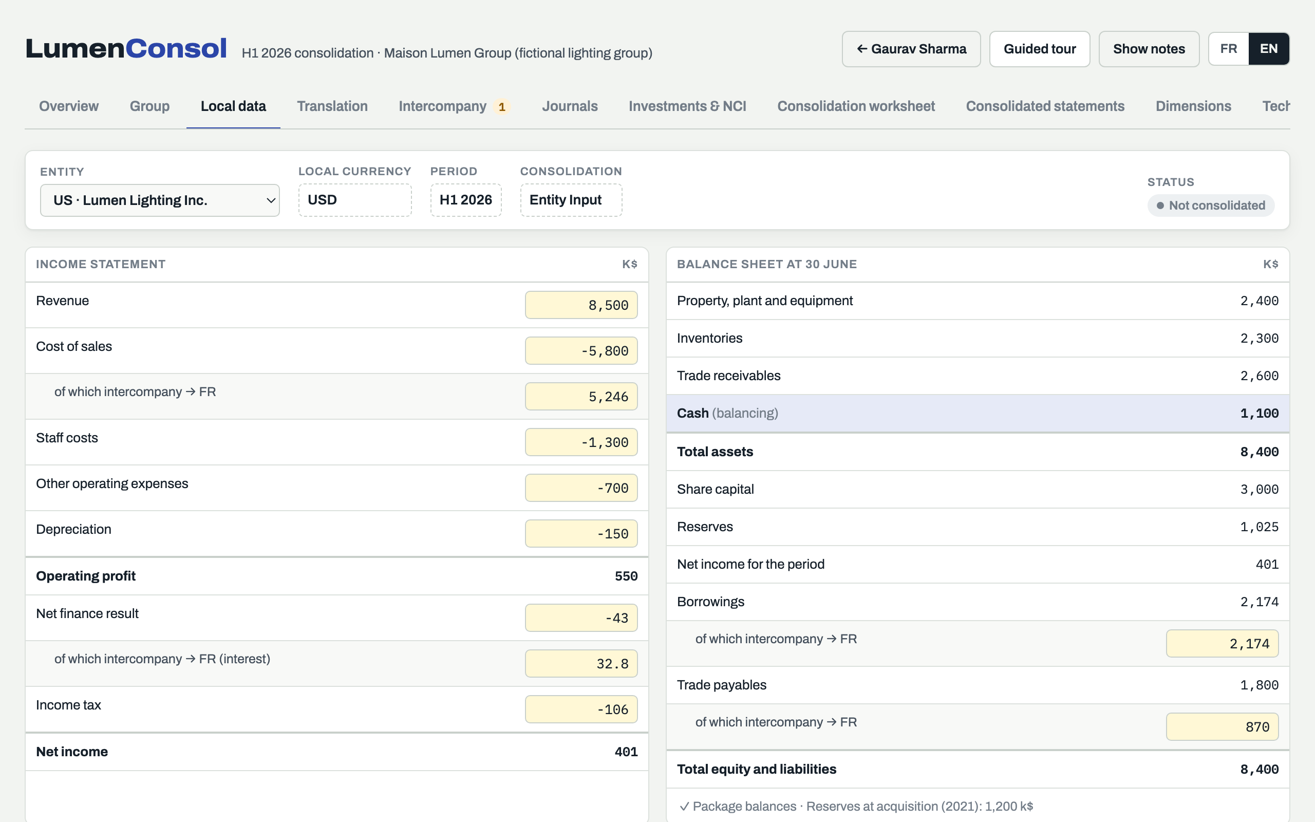
STEPS 2 AND 3 · D+2
Review your local package
1
Your entity: amounts in its own currency (here USD).
1
2
Yellow cells are editable; totals are calculated.
2
3
Of which intercompany: the partner of every internal flow. Matching relies on it.
3
4
4
Cash balances the package: if it looks wrong, another line is wrong.
Lumen Consol · The half-year close in 10 steps
6
Notes:
Steps 2 and 3. The package is in the entity's own currency. The intercompany lines are the most important data in the package: without the partner, the flow cannot be eliminated.

Slide 7
STEP 4 · D+3
Exchange rates: which rate for which line
Closing rate
Average rate
Historical rates
1.1700
1.1650
1.2000
EUR for 1 GBP
EUR for 1 GBP
EUR for 1 GBP
Balance sheet
Income statement
Equity
Assets and liabilities at 30 June
Revenue, costs and net income for H1
Capital and reserves at their original rates; dividends at the payment date
The difference is the translation reserve (IAS 21). It is not a gain or a loss: it sits in equity, and its movement for the half-year is reported in other comprehensive income.
Check on the Translation tab that your entity's figures in euros look right, then tell the group team.
Lumen Consol · The half-year close in 10 steps
7
Notes:
Step 4. The group team loads the rates; you check your translated figures. The translation reserve is not a gain or a loss: it goes to other comprehensive income.

Slide 8
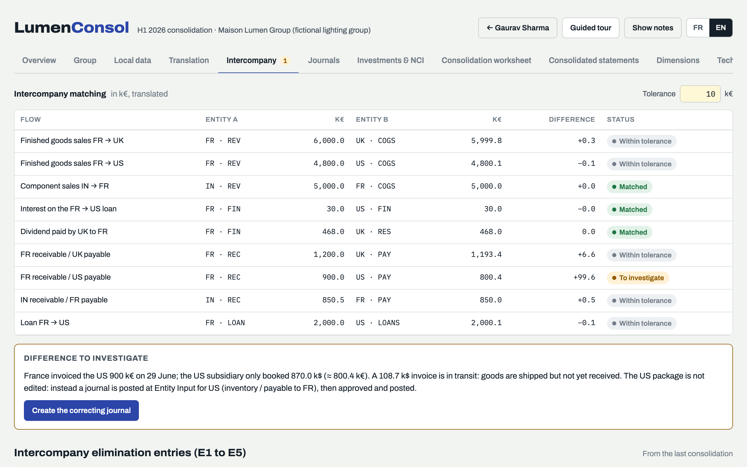
STEP 5 · D+3
Match intercompany
1
One line per pair: seller and buyer, both in euros.
2
1
2
Tolerance: up to 10 k€ is accepted (FX, rounding).
3
To investigate: FR invoiced 900 k€; the US booked about 800 k€.
4
Create the correcting journal from here.
3
Matched
Within tolerance
4
FX difference
To investigate
Lumen Consol · The half-year close in 10 steps
8
Notes:
Step 5. Each intercompany flow is shown once, with both sides converted to euros. The only difference above tolerance is the invoice in transit between France and the US.

Slide 9
STEP 6 · D+4
Correct with a journal, never by editing the package
Why a journal?
The package stays as submitted: journals are stored separately (Data Source: Journal Input).
Every correction has an author, a date and a reason for the auditors.
Someone other than the preparer approves it.
Entity Input: in the entity's currency, translated with its package.
US_IC_INTRANSIT_0629 · Entity Input · USD
FR invoice of 29 June in transit: goods shipped, not yet received
Entity | Account | ICP | Debit | Credit
US | Inventories | — | 108.7
US | Trade payables | ICP_FR |  | 108.7
Total |  |  | 108.7 | 108.7
108.7 k$ = 100 k€ at the closing rate of 0.92. The partner ICP_FR lets matching pair the payable with France's receivable.
Label rules: no spaces or special characters, unique. Balance: each entity balances in its own currency. Partner: never the entity itself.
Lumen Consol · The half-year close in 10 steps
9
Notes:
Step 6. We never edit the submitted package. A journal at Entity Input, in the entity's currency, adds the missing invoice and keeps a trace of who changed what and why.

Slide 10
STEP 7 · D+4
Approve and post: the journal workflow
Working
Submit
Submitted
Approve
Approved
Post
Posted
Preparer · Léa Moreau
Waiting for approval
Approver · Marc Dubois (CFO)
Posted by the preparer
Reject: back to Working, reason required
Whoever approves does not post
The CFO approves; the preparer posts. The auditors check this rule on every journal.
Scan before you submit
Label format and uniqueness
Balance by entity, in its currency
No negative amounts, no debit and credit on one line
Valid intercompany partners
Lumen Consol · The half-year close in 10 steps
10
Notes:
Step 7. The workflow has four states. The approver can reject with a reason. Posting is done by a different person from the approver: this is the segregation of duties the auditors test.

Slide 11
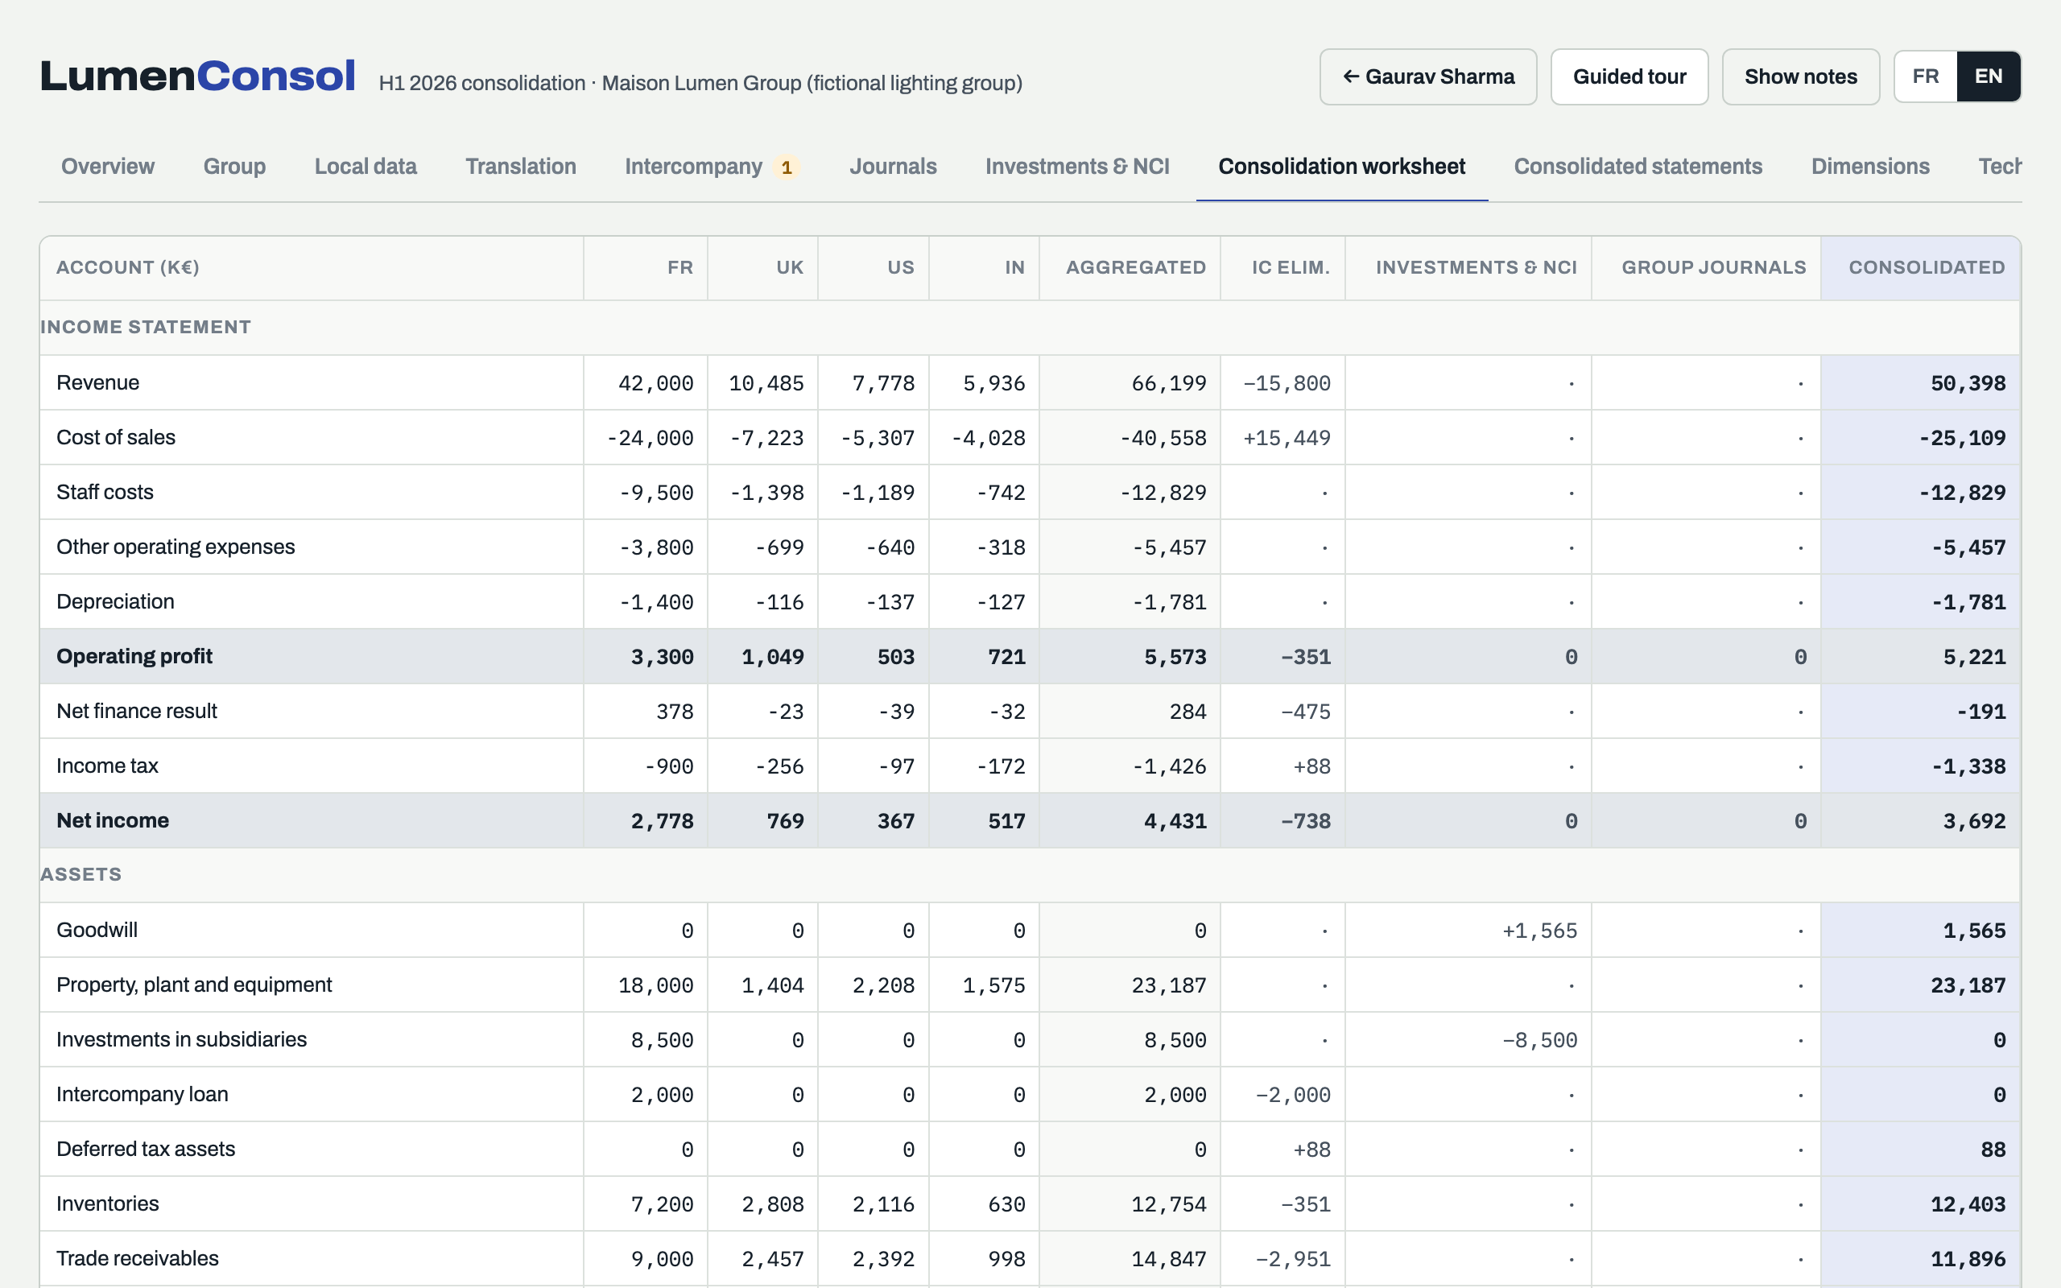
STEP 8 · D+5
Run the consolidation and follow the calculation
1
Aggregated: the four companies translated into euros, added up.
1
2
3
2
Eliminations: intercompany (E1 to E5) and investments with NCI (E6).
3
Consolidated = aggregated + eliminations + group journals.
Status after the run
Every entity shows OK. Any later change turns it to Impacted: consolidate again before reading the figures.
Lumen Consol · The half-year close in 10 steps
11
Notes:
Step 8. The group team runs the consolidation. Everything is recalculated in one pass. If anything changes afterwards, the entity turns to Impacted and the consolidation must run again.

Slide 12
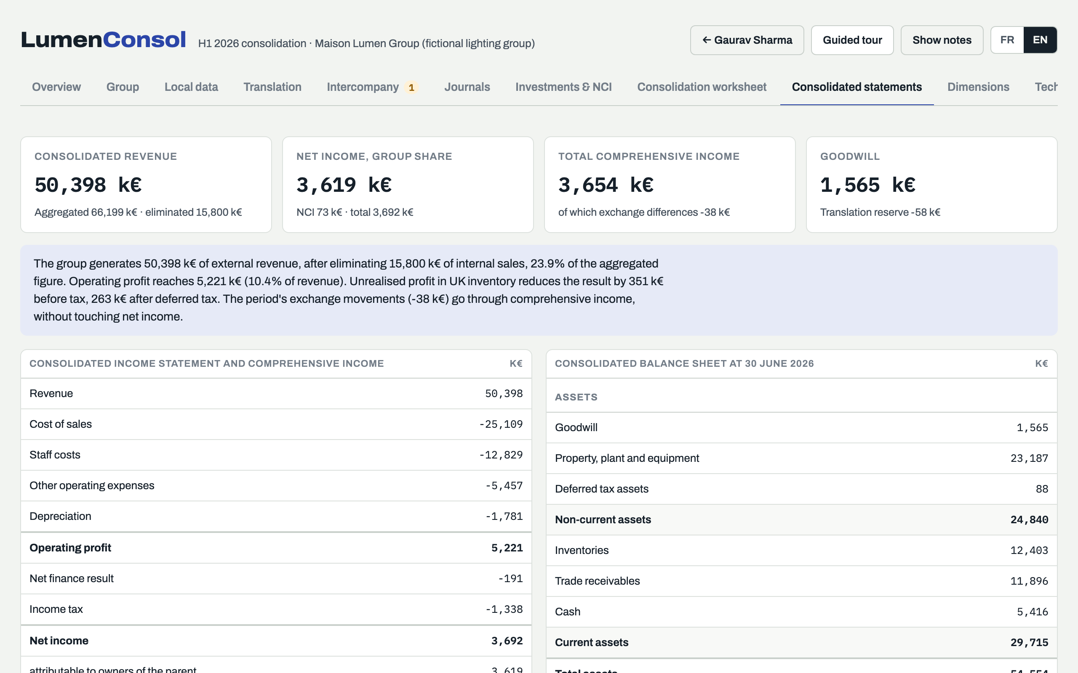
STEP 9 · D+6
Review the statements and the four checks
1
Key figures: revenue, net income (group share and NCI), comprehensive income, goodwill.
1
2
Summary in plain words of what the consolidation did.
2
The four close checks
✓
Balance sheet balances
✓
No intercompany difference in suspense
✓
Investments and loan fully eliminated
✓
All entities consolidated with the latest data
Lumen Consol · The half-year close in 10 steps
12
Notes:
Step 9. Read the key figures first, then the four checks. On the training data, the in-transit invoice leaves one check open until the journal is posted and the group is consolidated again.

Slide 13
STEP 10 · D+8
Sign off the close
✓
Every entity shows OK: no entity Impacted
TARGET
Day 8
✓
The four close checks are green
✓
No journal left Submitted or Approved without being posted
Last year: day 12
✓
Auto-reversing journals scheduled for July
Four days gained by matching intercompany early and correcting with approved journals.
✓
Commentary ready: revenue, net income, translation reserve
✓
CFO sign-off recorded; period locked
Lumen Consol · The half-year close in 10 steps
13
Notes:
Step 10. The group team completes the checklist; the CFO signs off. After sign-off, any change needs a formal reopening request.

Slide 14
HANDS-ON · 30 MIN
Exercises
Exercise 1 · Clear the invoice in transit
Exercise 2 · Test a currency move
1
On Intercompany, find the line To investigate
1
On Translation, click Pound sterling −5 %
2
Create the correcting journal, scan and submit it
2
Note that UK turns Impacted
3
Switch to Approver and approve; switch back and post
3
Consolidate again
4
On Group, consolidate again
4
Compare the translation reserve and net income
Expected result
No line To investigate · suspense at 0 · balance sheet at 54,654 k€ · all four checks OK
Expected result
The translation reserve and comprehensive income fall; net income moves only through the average rate; the balance sheet still balances
Lumen Consol · The half-year close in 10 steps
14
Notes:
Two exercises on the training data set, fifteen minutes each. The expected results let everyone check their work.

Slide 15
TIPS
Common mistakes and how to avoid them
!
Editing the package to fix a difference
!
Forgetting the partner on an intercompany line
!
Investigating tiny FX differences
Post a journal: the package stays as submitted.
Every internal balance needs its partner, or matching cannot pair it.
Up to 10 k€ they are accepted and go to finance result automatically.
!
Reading figures from an old run
!
Approving and posting the same journal
!
Raising a difference at D+4
If an entity shows Impacted, consolidate again first.
Approver and poster must be two different people.
Call your counterpart as soon as matching shows the gap.
Lumen Consol · The half-year close in 10 steps
15
Notes:
The six mistakes we see most often in the first closes, and the habit that avoids each one.

Slide 16
SUPPORT AND NEXT STEPS
Questions and support
During the close
Application issues
Next steps
Group consolidation team: first contact for any question
User guide and this deck on the finance intranet
IT support logs the incident
Oracle support request (SR) raised by IT when needed
Parallel run on the November close (1 to 14 December 2026)
Go-live on the year-end close (8 January 2027)
Maison Lumen and all data in this deck are fictional · Portfolio sample by Gaurav Sharma
Notes:
Where to get help, and what comes next: the November parallel run, then the year-end close in FCCS.

