Slide 1
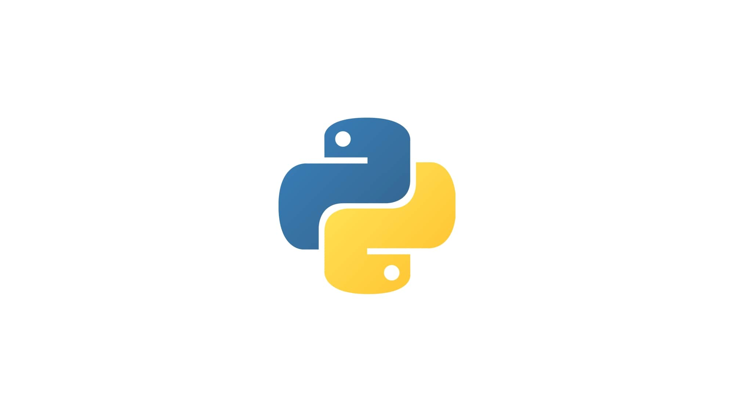

Testing and Implementation
of
Sound Event Localization and Detection of Overlapping Sources Using Convolutional Recurrent Neural Networks
By Giuliano Martinelli 1915652
And Nicolò Palmiero 1918734
Using Google Colab

Slide 2
Introduction
In this project we replicated the experiments of the paper.
We replicated a model that was capable of:
Sound Event Classification
Sound Direction of Arrival Localization

Slide 3
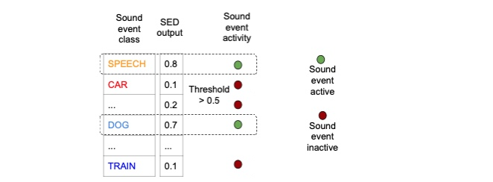
Sound Event Detection
Sound Event Dectection (SED) is the task that aims at detecting temporally the onsets and offsets of sound events and further associating textual labels to the detected events. In this implementation we approach this task with a multi-class classification method.

Slide 4
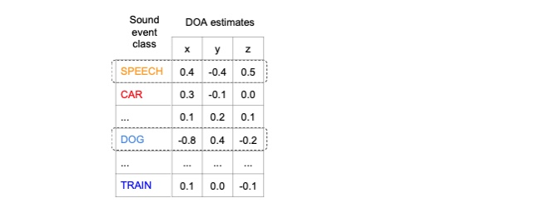
Sound Direction of Arrival Localization
Sound direction of arrival (DOA) localization is the estimation of the sound event direction. We deal with this using a multi-class regression approach
Coordinates of a unitary vector indicating the direction of arrival of detected sounds

Slide 5
But let’s take a step back and talk about …
Datasets
We used two Datasets :
ANSIM
Contains registrations made in an-echoic room of 11
different sound classes
RESIM
More similar to reality since contains same recordings as ANSIM but carried out in real-world ambients (echoich)
Each dataset is composed by three sets defined the number of overlaps
and each overlap has 3 splits that can be used to perform crossvalidation

Slide 6
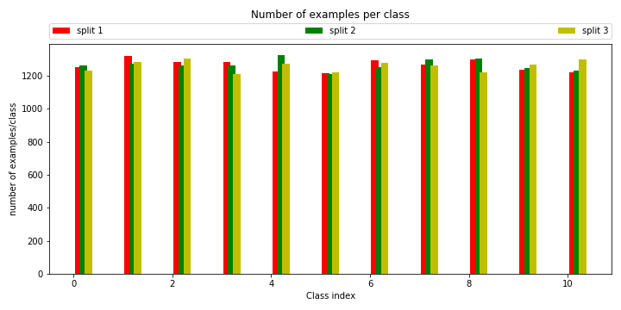
Datasets Distribution
This graph shows how the different splits are distributed
We can assume that they are well balanced

Slide 7
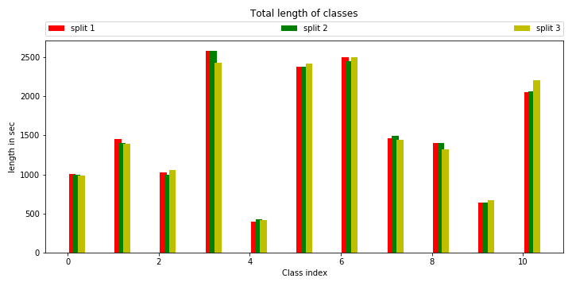
Datasets Distribution
This graph shows the length of the samples in the different splits
Those are balanced in the different splits

Slide 8
Now let’s focus on the...
Model Architecture
The paper proposed a very interesting Architecture
It is hybrid and uses two kind of neural network types
In order to learn relevant inter-channel features required for localization, and to learn time and frequency features suitable for both SED and DOA
In order to to learn the temporal context information from the CNN output activations
Convolutional
Recurrent

Slide 9
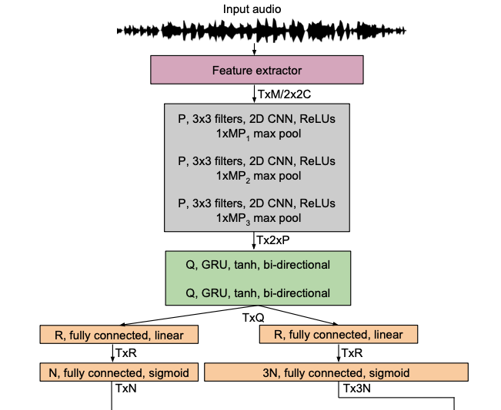
Model Architecture
SED Classification
Doa Regression

Slide 10
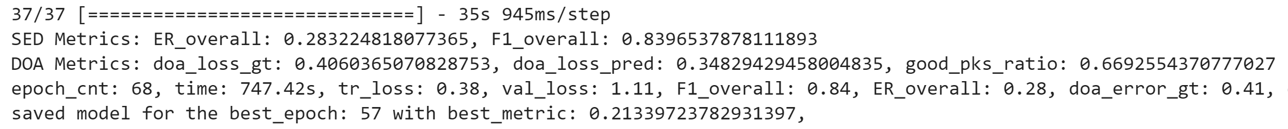
Training
We trained a consistent number of models, since we needed
one for each overlap of each dataset.
Each one was trained for an average time of 12 h
Every training had a mean of 50 epochs
Used early stopping based on the average performances of DOA and SED measured by custom metrics

Slide 11
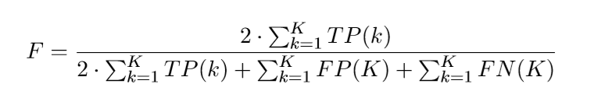
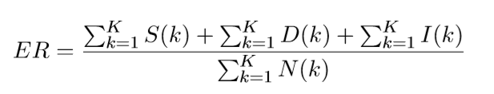
Evaluation Metrics: SED
The paper used two main metrics for Sound Classification:
F-Score is a measure of the framewise SED performances and is defined as:
Another metric, that quantifies SED classification error, is SED Error and is defined as:
Where S(k), D(k), I(k) are the number of substitutions, deletions, insertions in a given frame k.

Slide 12

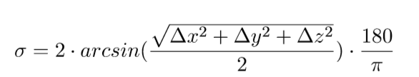
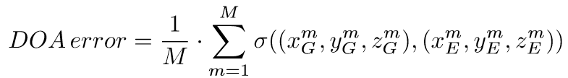
Evaluation Metrics: DOA
Direction of arrival has two main measures:
Frame recall is our performance measure of a DOA prediction
and is simply defined as:
DOA Error instead calculates the difference between the predicted DOA angle and the ground truth’s one and is defined as:

Slide 13


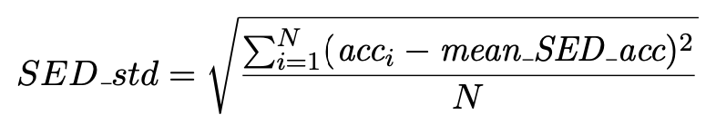
Training Metrics and Statistics
We further implemented other metrics and statistics to better know the performances of our model
SED error ± 95% confidence intervals, that represent an interval in which the error could be with a 95% probability:
SED accuracy, calculated
as:
SED crossvalidation standard deviation is the standard deviation of mean accuracy between the different splits

Slide 14
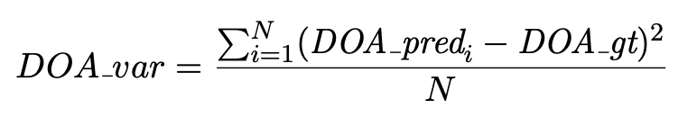
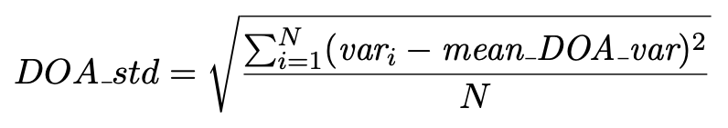
And further on...
For DOA we implemented two other metrics:
DOA mean variance: It represents how much every DOA prediction differs from its corresponding ground truth value
DOA crossvalidation standard deviation: it indicates the standard deviation of the variation between the mean variance across every split

Slide 15
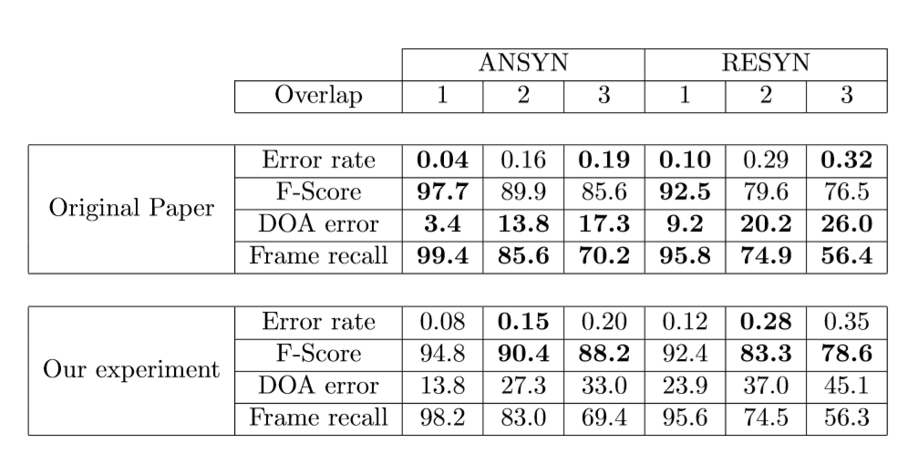
And finally, let’s check the...
Results

Slide 16
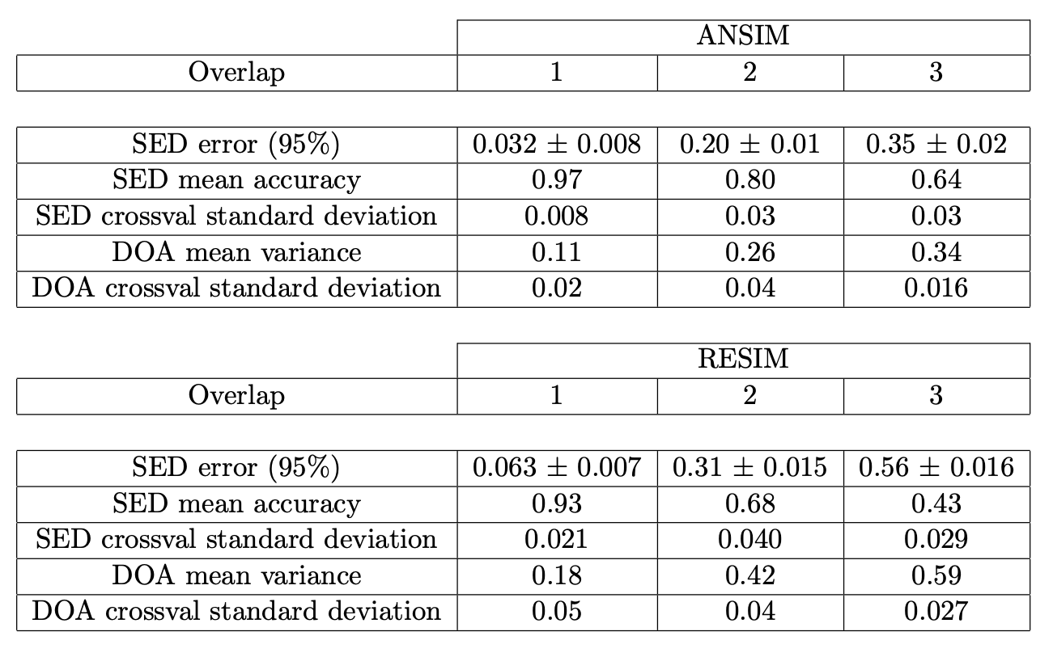
Training Metrics Evaluation

Slide 17
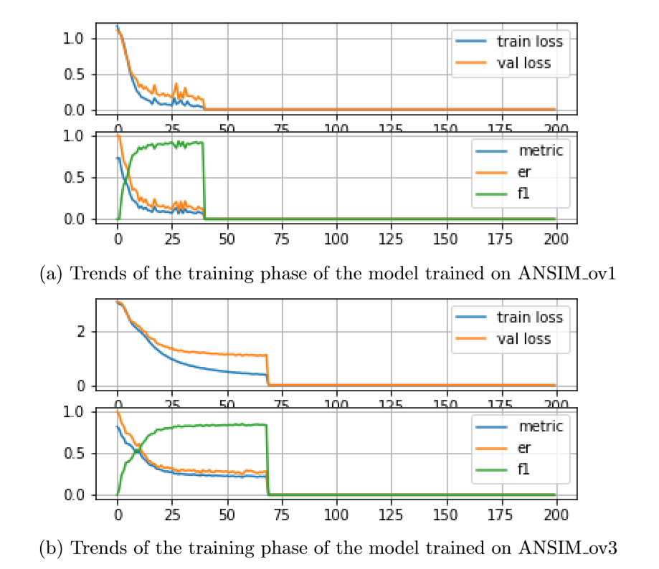
Training Plots

Slide 18
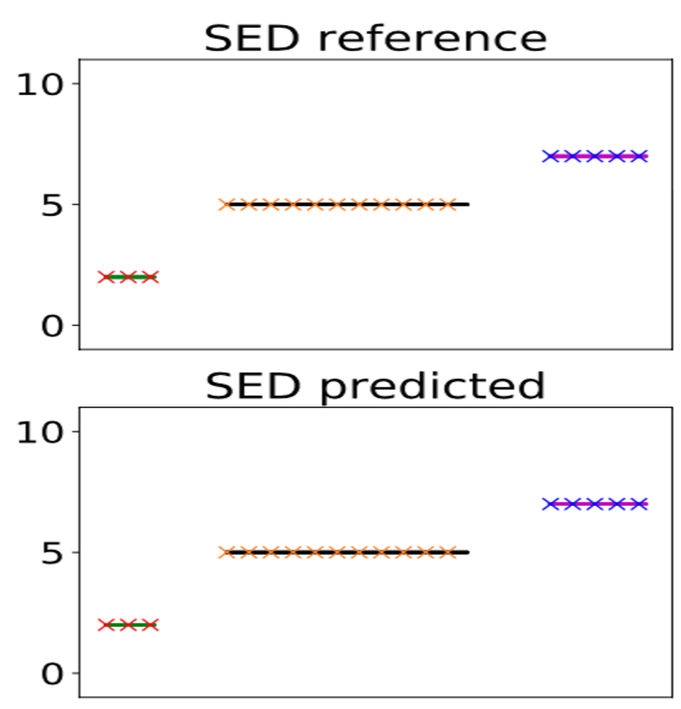
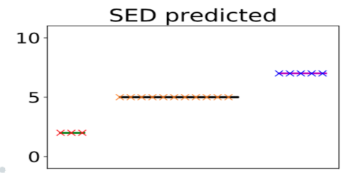
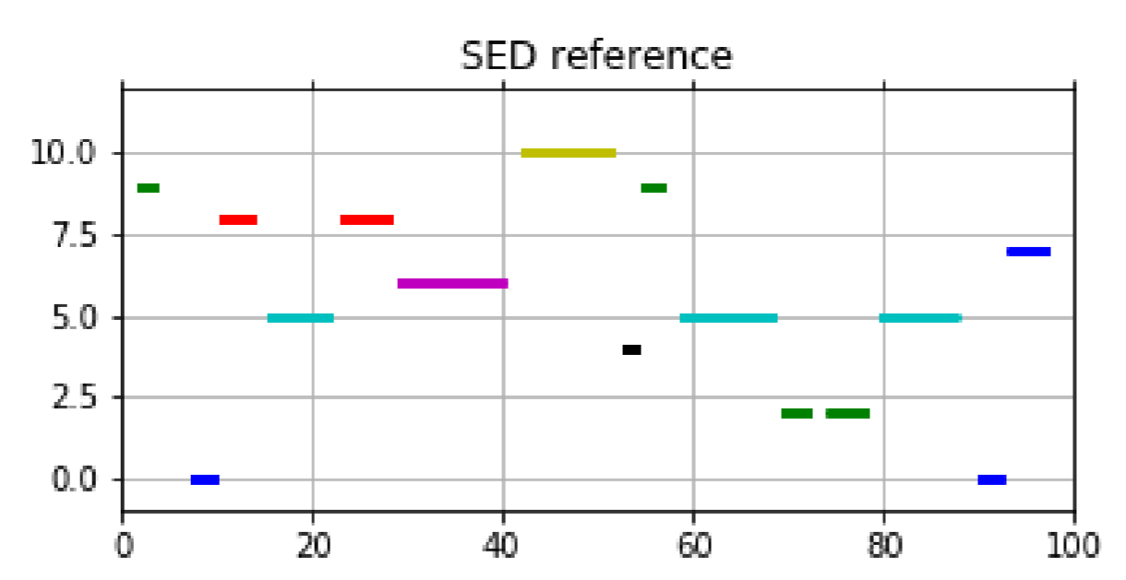
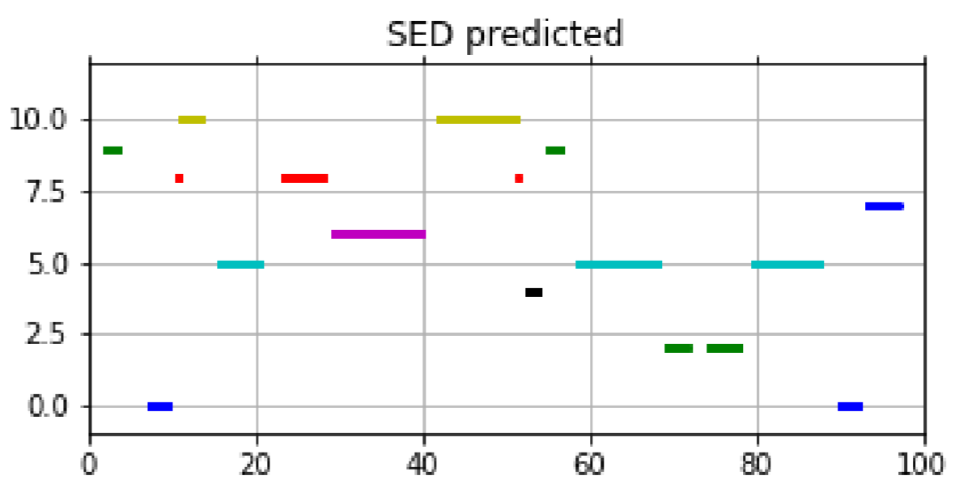
Prediction Plots

Slide 19
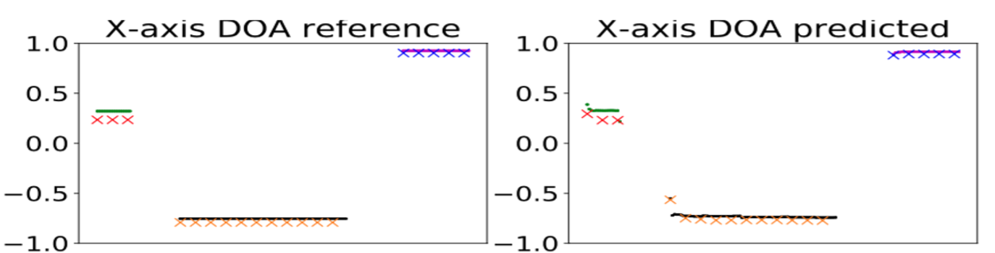
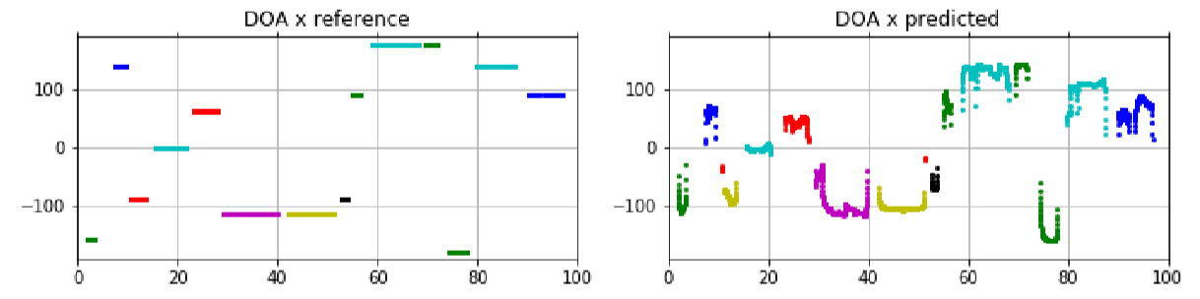
Prediction Plots

Slide 20
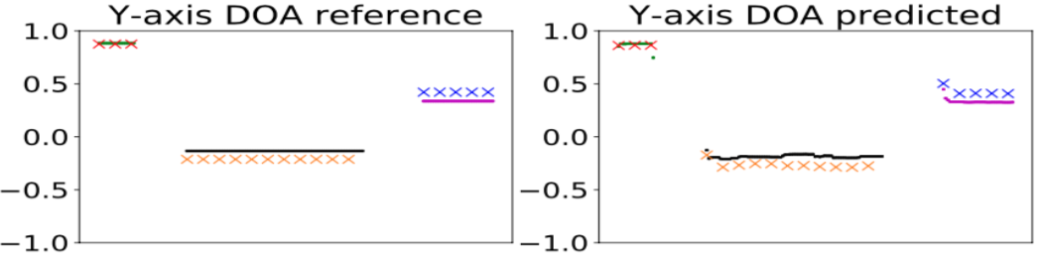
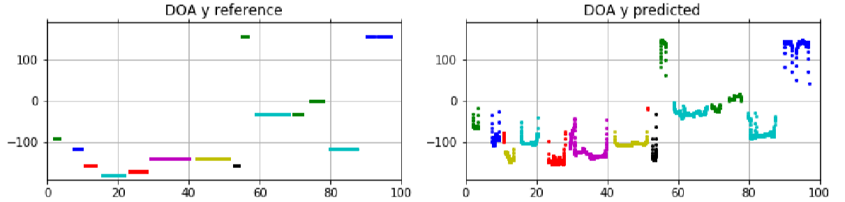
Prediction Plots

Slide 21
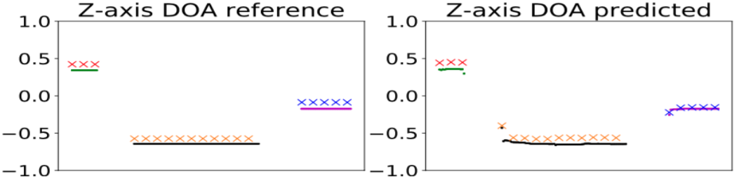
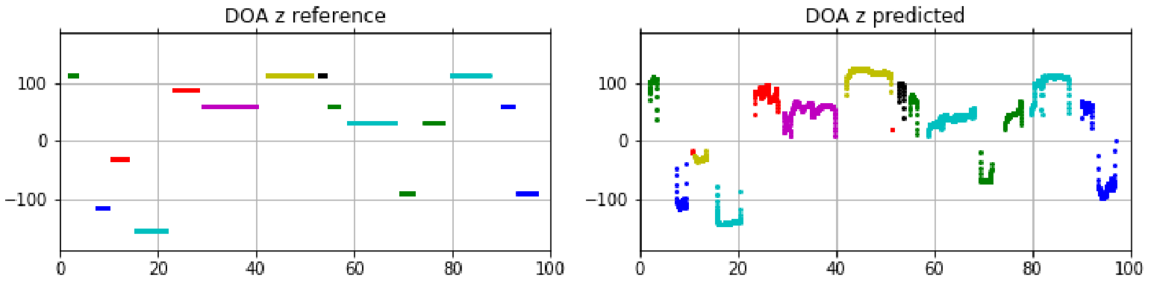
Prediction Plots

Slide 22
Thanks for listening

