Slide 1
CSL 458 PROJECT
Lost N Found Portal
- “If you don’t get lost,
There’s a chance you will never be found”
Gaurav Mittal
Rahul Mittal
Kaushal Yagnik
Deepak Chawla

Slide 2
Problem Description
Number of items being lost by people increasing day by day
Tough to reach the person who might have lost that item
Also, most of us send mail to everyone’s account regarding the lost entity:
Either to btechxx@iitrpr.ac.in which limits oneself to just the B.Tech. students
Or, to the Broadcast which takes a long time to reach the recipients.
Now, considering at least one item is lost every day, over a hundred mails reach our accounts which are of not much use and also, fill up our valuable space.

Slide 3
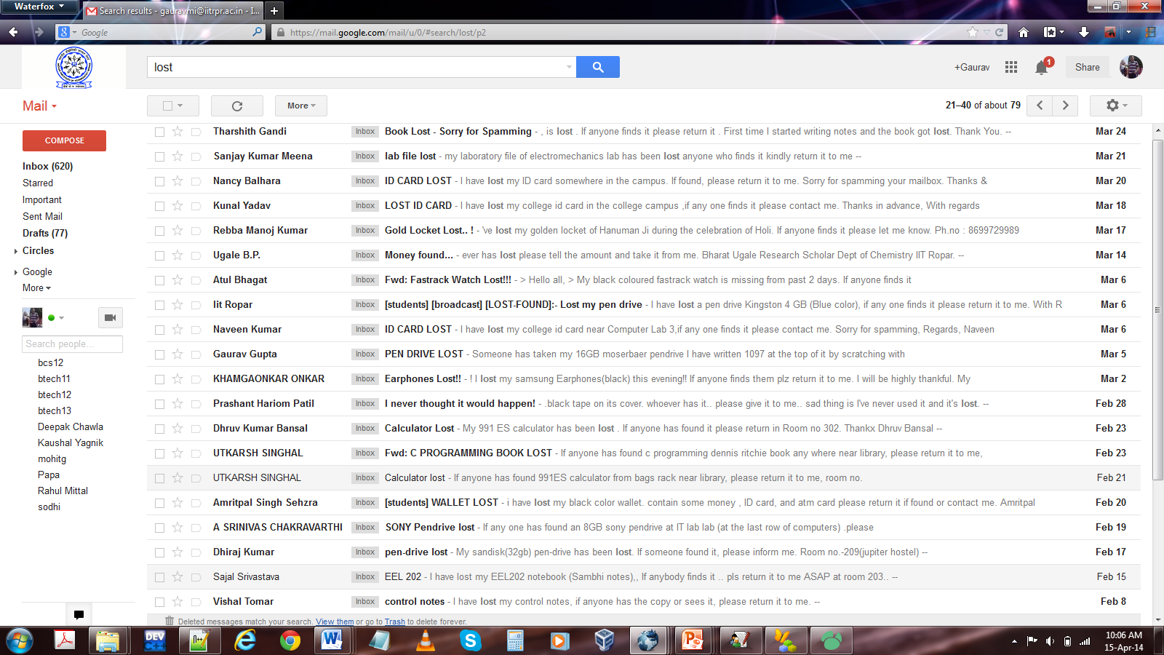

Slide 4
Objective
To develop a platform which can bring the notifications about lost and found items at one place making it convenient for the concerned person to find his/her lost item or reach the person who has lost the item found and at the same time, deal with the big issue of spamming in our campus.

Slide 5
Solution Implemented
Created an Intranet based Lost And Found portal to cater the needs of those who either lose something or find something in the campus.
Provides the facility of submitting the details regarding a lost or found item by the user in least effort possible
Item details can be viewed by other users who can then send message to the user concerned, asking about that item.

Slide 6
Design Options Considered
Framework to Use
Design should be such that it can be easily maintained, is reliable and very user friendly.
We had the following choice before us which we did not choose:
PHP for server side and a content management system like Drupal
JSP to create servlets
Drupal did not provide us the amount of abstraction like database independent models and view abstraction.
Also, we found PHP more like C.
To save us from compiling the code every time we made any modification, we chose not to use Java for implementation.

Slide 7
Option Chosen
Python based Django
Django provided us with great flexibilty in programming alongwith excellent documentation and security features.
Django is a high-level Python Web framework that encourages rapid development and clean, pragmatic design.

Slide 8
Why Django ?
There were several advantages that compelled us to use this framework:
Based on Python which allowed us to do concise and crisp coding.
The entire code is spread across just 500 lines - could have been more than 1000 lines in java and over 2000 lines in C/C++.
Can create our data models as Python classes
Django on its own create the database schema in any of the popular RDBMS.
We can even view the corresponding SQL code through Django.
Provides the feature of views to handle data flow between the server and client effectively.
Implements Model-view-controller Pattern allowing us to create reusable modules/apps.

Slide 9
Model-View-Controller Pattern
Django implements MVC pattern making the portal efficient to use and easy to maintain.
MVC pattern divides a software application into three connected parts, separating the internal representations of information from the way that information is presented to or accepted from the user.
Why use MVC ?
Helped us to organize our code well leading to a better design and increased maintainability.
Allowed us to divide our work efficiently during the development phase.

Slide 10
Design Issues
We wanted the portal to be as user-friendly as possible, that is, a user can post details regarding an item or even view details about other items in not more than 3 clicks.
Security was a huge concern in our portal. Since we are targeting the reduction of spamming through the LNF Portal, we do not want intruders to gain access of features which they are not entitled to in unauthorized way.
Since we aimed to install this service for exclusively IIT Ropar, we wanted to design such that only people from IIT Ropar can avail it. For that some kind of verification system needed to be set up in place.
The portal being an Intranet service should rely on the internet as less as possible.
The portal should provide an efficient search mechanism allowing the user to pin point the item he/she wants in no time.

Slide 11
Design Decisions
To make the portal exclusively for IIT Ropar, we verified a person's email against the list of valid emails before allowing him/her to create an account and use the facility.
In the registration form, we did not ask for a password. Instead, we send a mail to the email used for registration containing the password, in order to prevent someone from using another person's email to access the portal.
In order to save the user from the hassles of logging into the portal every time to use it, we created cookies that will remember whether the user is still logged in and will get automatically deleted when the user logs out.
We created our own registration system instead of using gmail login API, in order to avoid dependence on the internet.
When a person logs into the portal, he/she should find all the options on a single page which is a very user friendly design.

Slide 12
Design Decisions – contd.
When a user posts a found item, he may wish to remain anonymous, in case he/she does not want to be bothered by unnecessary users.
A user is able to edit his/her details which include name, address and password.
User can also edit the description of his/her items.
Cookies are used to authorize the access whenever some GET/POST request is sent to the server.
For security purposes, any submitted form is validated both on the client side and the server side.

Slide 13
Development Environment
Entirely developed in Ubuntu 13.10(Raring Ringtail) and made use of free tools and editor
Python was installed in the system, particularly Python 2.7.5
Installed Django module using pip:
pip install Django==1.6.2
(We used ver. 1.6.2 as it is the latest stable version available.)
Default SQLite database used which is included in Python.

Slide 14
Used Gobby - a free collaborative editor. It allowed multiple persons to work on the same file simultaneously.
Used Notepad++ for editing HTML5, CSS and Javascript.
Finally, documentation for the project written using Notepad++ and Microsoft Word 2010.

Slide 15
System Requirements
For the Server
Django 1.6.2 should be installed along with django-haystack, PIL and whoosh APIs.
Database set up on the server : MySQL, PostgreSQL or SQLite
Apache HTTP server with mod_wsgi
For the Client
Web browser with HTML5 support alongwith Javascript and cookies enabled.

Slide 16
How to Access
During the Development Phase
Planned
10.1.9.83:8000/lnf when the server is running
Integrate it with Sutluj - IIT Ropar's Intranet as 24/7 facility
Source code available on github: https://github.com/elitecode/LostNFound

Slide 17
IMPLEMENTATION

Slide 18
manage.py
All the Django management commands can be accessed via the terminal using manage.py.
Starting a Project
Reach the desired directory
Starting the server
Change to the project directory
Creating an app
Starting the Interactive Python Shell
Run from the terminal: django-admin startproject LostNFound_Project
Run from the terminal: python manage.py runserver
Run from the terminal: python manage.py startapp LostNFound
Run from the terminal: python manage.py shell

Slide 19
Database Design
Database can be created by specifying data models as Python classes in models.py inside app folder.
Viewing the SQL
Syncing the DB
python manage.py sql LostNFound
python manage.py syncdb
Key Elements
There exists a many to one relationship between items and user and a many to many relationship between item and its tags.
Foreign key relationship defines both one to one and many to one.

Slide 20
Client Side
Client Side Templates
All the HTML pages with related CSS and Javascript resides in the template folder inside the app folder.
The HTML pages contain python code processed by Django for context to be rendered on the web pages.
Client Side Validation
Javascript running on the client side provide necessary form validation to assist the user in filling the form correctly.

Slide 21
Views
Views are Django's way to return HttpResponse to the user after performing some operation such as processing GET/POST data.
Each view is associated with a particular web page and template.
Views can be defined in views.py inside app folder.

Slide 22
Forms
Django forms are quite useful entities (essentially Python classes) which are versatile and perform the following:
Validating the POST data
Creating a form widget for the HTML page
Generating errors when form is invalid
Forms can be created in forms.py inside the app folder and can be easily attached to the POST data for validation.

Slide 23
URL Mapping
URL path are specified using regular expressions.
URLs for the project are defined in urls.py under the project folder.
URLs for the app are defined in urls.py under the app folder.

Slide 24
Cookies
To allow the user to remain logged into the portal from his/her browser, cookies are created at the time of login.
To authorize a person's access into the system, cookies are used to verify his/her identity.
When the user logs out of the portal, the cookies get automatically deleted.

Slide 25
Search Mechanism
To allow a lost item to be matched appropriately with a found one, a fairly good search mechanism needed to be installed.
We used django-haystack along with Python based Whoosh API for search.
It creates indexes for the entire database based on the text document created using item details specified under searchindexes.py in the appfolder.
Indexes our used to match appropriate objects to the search query given.

Slide 26
Handling Images
Django has a field named ImageField - a wrapper for the Python library - PIL - Python Imaging Library.
To upload images we transferred the file data from request.FILES to the necessary ImageField, which gets stored at path defined in settings.MEDIA_ROOT.
Also, Django does not overwrite images which have to be handled manually.

Slide 27
Bugs Encountered
django-haystack creates a cache every time we call its function SearchQuerySet().
During our beta testing phase, we found this feature is causing duplicates to persist in the list which needed to be removed manually.
TEMPORARILY FIXED !

Slide 28
THANK
YOU

