Slide 1
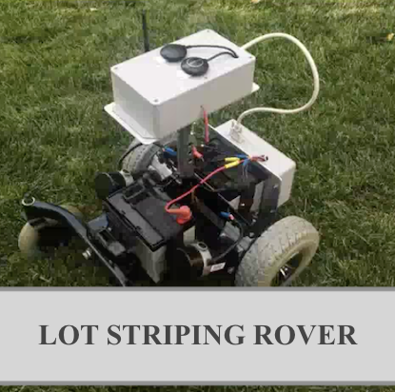
CSE 4316 -SENIOR DESIGN
Thy Tran
Gabriela Aldrete
Leutrim Dema
Duc Tien Than
Bigyan Adhikari

Slide 2


Sprint Goal
Complete the PROJECT CHATER for a Parking Lot Striping Rover.
Investigate other similar products in the market.
Research alternatives for our future product.

Slide 3
Sprint Backlog
Problem Statement
Methodology
Value Proposition
Development Milestones
Background
Related Work
System Overview
Roles and Responsibilities
Cost Proposal
Facilities & Equipment
Assumptions
Constraints
Risks
Documentation and Reporting
Major Documentation Deliverables
Recurring Sprint Items
Closeout Materials

Slide 4

Individual duties
Problem Statement - Gabriela Aldrete and Bigyan Adhikari
Methodology – Leutrim Dema and Duc Than
Value Proposition - Gabriela Aldrete and Thy Tran
Development Milestones - 4 members
Background - Thy Tran and Duc Than
Related Work -Thy Tran
System Overview -Thy Tran and Leutrim Dema
Roles and Responsibilities - 4 members
Cost Proposal – Gabriela Aldrete
Facilities & Equipment - Leutrim Dema
Assumptions - Duc Than
Constraints - Bigyan Adhikari
Risks - Duc Tran and Gabriela Aldrete
Major Documentation Deliverables - Bigyan Adhikari and Thy Tran
Recurring Sprint Items - Leutrim Dema and Duc Than
Closeout Materials – Gabriela Aldrete and Leutrim Dema

Slide 5
Team roles
SCRUM MASTER: Leutrim Dema
BUSINESS PLANNER: Gabriela Aldrete

Slide 6
Time Estimate
Problem Statement - 4hrs
Methodology - 4hrs
Value Proposition - 4hrs
Development Milestones - 6hrs
Background - 6hrs
Related Work - 6hrs
System Overview - 6hrs
Cost Proposal - 8hrs
Facilities & Equipment - 8hrs
Assumptions - 6hrs
Constraints - 7hrs
Risks - 6hrs
Major Documentation Deliverables - 4hrs
Recurring Sprint Items - 8hrs
Closeout Materials - 10hrs

Slide 7

