Slide 1
Railflow
Railway dispatch prototype
ALT University · Hackathon
Demonstration and advisory system.
Not a replacement for certified railway safety systems.
Notes:
Working full-stack prototype built on the supplied immutable railway map. All infrastructure and performance claims are scoped to the demonstration.

Slide 2
Dispatch decisions under disruption
Opposing and following services share finite track capacity.
Priority changes and incidents require a new feasible plan.
Dispatchers need to see who moves, who waits, and why.
The prototype explains each decision and records its outcome.
RAILFLOW / DEMONSTRATION
02
Notes:
Sources: project code, preserved network.json, docs/RULES.md and artifacts/*-results.json. This is not certified railway safety equipment.

Slide 3
The railway stays unchanged
49,682
841
original track edges
synthetic source ways excluded
Only existing adjacency is routable.
A visual crossing never creates a new connection.
Map geometry, labels and styles remain in the original files.
Trains, signals, occupancy and incidents are separate overlays.
RAILFLOW / DEMONSTRATION
03
Notes:
Four original assets are protected by SHA-256 regression checks. Source metadata does not contain verified switch tables, platform capacities or physical signal placements.
Sources: project code, preserved network.json, docs/RULES.md and artifacts/*-results.json. This is not certified railway safety equipment.

Slide 4
One authoritative simulation
Dashboard
REST commands
Validation
REST API
Simulation
0.2 s steps
SQLite history
Bounded
event bus
Original graph
Read-only router
Dispatch + ATO
Quality factors
Versioned SSE snapshots update the dashboard every 0.5 s
RAILFLOW / DEMONSTRATION
04
Notes:
Architecture diagram is editable. All mutation and physics run in one process. SSE sends versioned snapshots to the dashboard and map overlays.
Sources: project code, preserved network.json, docs/RULES.md and artifacts/*-results.json. This is not certified railway safety equipment.

Slide 5
A transparent dispatch preference
P = 4I + 2D + 3W − E
I = (importance − 1) / 9, input 1–10
D = min(delay / 300 s, 1)
W = eligible wait / 300 s
E = min(remaining kWh / 1000, 1)
After 300 s, feasible waiting trains enter a protected FIFO tier.
Occupancy, route compatibility and committed authority are mandatory.
RAILFLOW / DEMONSTRATION
05
Notes:
I=(importance-1)/9; D=min(predicted_positive_delay_seconds/300,1); W=eligible_wait_seconds/300, uncapped; E=min(remaining_traction_kWh/1000,1). Importance is independent of train category. FIFO tier after 300 s. Ties: departure time, then train ID.
Sources: project code, preserved network.json, docs/RULES.md and artifacts/*-results.json. This is not certified railway safety equipment.

Slide 6
Authority, occupancy and signals
Rear clearance = head − length − 25 m
Reserve an entire movement to its next stop, atomically.
Release a block only after the complete train clears it.
Keep junction locks and committed routes when importance changes.
Red holds entry. Green grants authority. Yellow governs approach.
RAILFLOW / DEMONSTRATION
06
Notes:
Sources: project code, preserved network.json, docs/RULES.md and artifacts/*-results.json. This is not certified railway safety equipment.

Slide 7
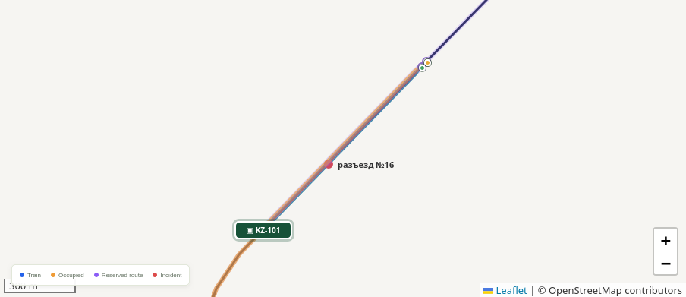
Passing on an existing loop
997.44 m
existing siding E47083
947.44 m usable after clearances
The local waits clear of both junctions.
The express uses the original bypass.
A 980 m train does not fit and is rejected.
RAILFLOW / DEMONSTRATION
07
Notes:
Siding E47083 is 997.44 m. Usable length is 947.44 m at 25 m end clearances. Approaches E47073/E47069. Bypass E47072/E47071/E47070. Demo boundary vertices V39875/V39870 are track points, not renamed stations. Image: local application browser screenshot, artifacts/map-demo.png.
Sources: project code, preserved network.json, docs/RULES.md and artifacts/*-results.json. This is not certified railway safety equipment.

Slide 8
Incidents and recovery
Create a delay, breakdown, signal failure, closure or restriction.
Identify affected trains and reconsider the plan immediately.
Compare existing detours with waiting for clearance.
Already inside? Brake and hold the occupied route until recovery.
RAILFLOW / DEMONSTRATION
08
Notes:
Incident kinds: train delay/breakdown, failed signal, track closure and temporary speed restriction. Batch validation is atomic. Unknown clearance gives unknown ETA. Late incidents require physical braking inside existing authority.
Sources: project code, preserved network.json, docs/RULES.md and artifacts/*-results.json. This is not certified railway safety equipment.

Slide 9
Driving advice and traction energy
v ≤ √(vₜ² + 2bd)
Target speed vₜ, braking b, distance d. SI units throughout.
The advice respects signals, authority and scheduled stops.
Timetable slack can reduce the recommended cruise speed.
ΔE (kWh) = [FΔx + max(0, ΔKE)] / (0.85 × 3,600,000)
Rolling coefficient 0.0015, aerodynamic coefficient 0.8
85% efficiency. No gradients or regenerative braking.
RAILFLOW / DEMONSTRATION
09
Notes:
v and target speed vₜ are m/s, braking b is m/s² and distance d is m. F = 0.0015 × mass_kg × 9.81 + 0.8 × mean_speed_mps². ΔKE = 0.5 × mass_kg × (v_new² − v_old²), in joules.
Sources: project code, preserved network.json, docs/RULES.md and artifacts/*-results.json. This is not certified railway safety equipment.

Slide 10
Movement quality, explained
Q = 30S + 20C + 20E + 20F + 10A
S Schedule: max(0, 1 − mean positive delay / 300 s)
C Capacity proxy: moving / eligible train samples
E Energy: min(1, reference / actual traction energy)
F Conflict freedom: 1 − fraction of conflict samples
A Stop position: max(0, 1 − maximum error / 5 m)
Factors range from 0 to 1 over a rolling 300 s window.
No applicable observations: neutral factor 1. No observations: no score.
RAILFLOW / DEMONSTRATION
10
Notes:
Window: 300 simulation seconds by default. Schedule averages positive ETA/actual delay across eligible services and samples. Capacity uses moving/eligible train samples. Energy compares reference/actual increments. Conflict samples include invariant violations or an unresolved wait-for cycle. Stopping uses the maximum spatial error in the window. Neutral factors with no applicable observation are disclosed. Arrival time belongs only to S.
Sources: project code, preserved network.json, docs/RULES.md and artifacts/*-results.json. This is not certified railway safety equipment.

Slide 11
Measured prototype results
Check | Observed | Target / scope
UI receipt to render, p95 | 15 ms | <500 ms
10 incidents, live SQLite | 14 ms | <5,000 ms
10 incidents, in-memory max | 0.605 ms | 20 local trials
Automated checks | 36 passed | Supplied graph
Reconnect / replay / CSV | Verified | Firefox browser
0 resource violations in 4 benchmark scenarios.
Local two-train tests. These are not production or certified safety results.
RAILFLOW / DEMONSTRATION
11
Notes:
{
"backend": {
"trials": 20,
"median": 0.574,
"p95": 0.605,
"max": 0.605
},
"browser": {
"browser": "Firefox 155.0 · WebDriver BiDi",
"viewport": "1512×1100 / mobile 390×844, DPR 1",
"reconnect_verified": true,
"replay_read_only_verified": true,
"report_download_verified": true,
"out_of_order_discarded": 7,
"received_events": 29,
"browser_errors": [],
"mobile_document_overflow": false,
"ui_receipt_to_render_ms": {
"samples": 35,
"median": 3,
"p95": 15,
"max": 396
},
"map_message_to_ack_ms": {
"samples": 28,
"median": 3,
"p95": 7,
"max": 407
},
"server_metrics": {
"replan_ms": 1.675,
"max_replan_ms": 11.599309000303037,
"replans": 2045,
"steps": 10179,
"incident_batches": 1,
"max_incident_batch_ms": 14.07638499949826,
"rejected_ingest": 0,
"last_incident_batch_ms": 14.076,
"tick_ms": 0.003,
"max_tick_ms": 33.082,
"lag_s": 0,
"connections": 3,
"subscribers": 1,
"dropped_snapshots": 0,
"history_retention_hours": 48
}
}
}
Sources: project code, preserved network.json, docs/RULES.md and artifacts/*-results.json. This is not certified railway safety equipment.

Slide 12
Demonstration and limits
Demo sequence
Current limitations
1. Load passing and start at 120×
2. Inspect siding hold and authority
3. Create and clear an incident
4. Replay and export the journal
Missing platform and switch metadata
One exclusive block per original edge
Heuristic planning, approximate ETAs
Restart does not restore live motion
Advisory simulation only.
Not a replacement for certified railway safety systems.
RAILFLOW / DEMONSTRATION
12
Notes:
Sources: project code, preserved network.json, docs/RULES.md and artifacts/*-results.json. This is not certified railway safety equipment.

