Slide 1

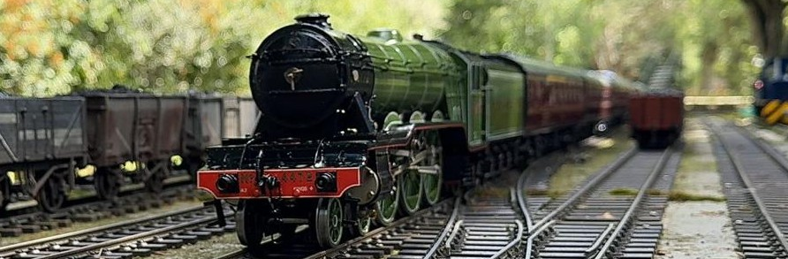
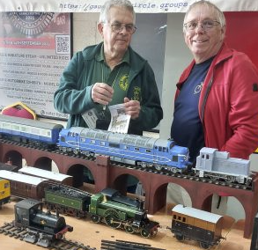
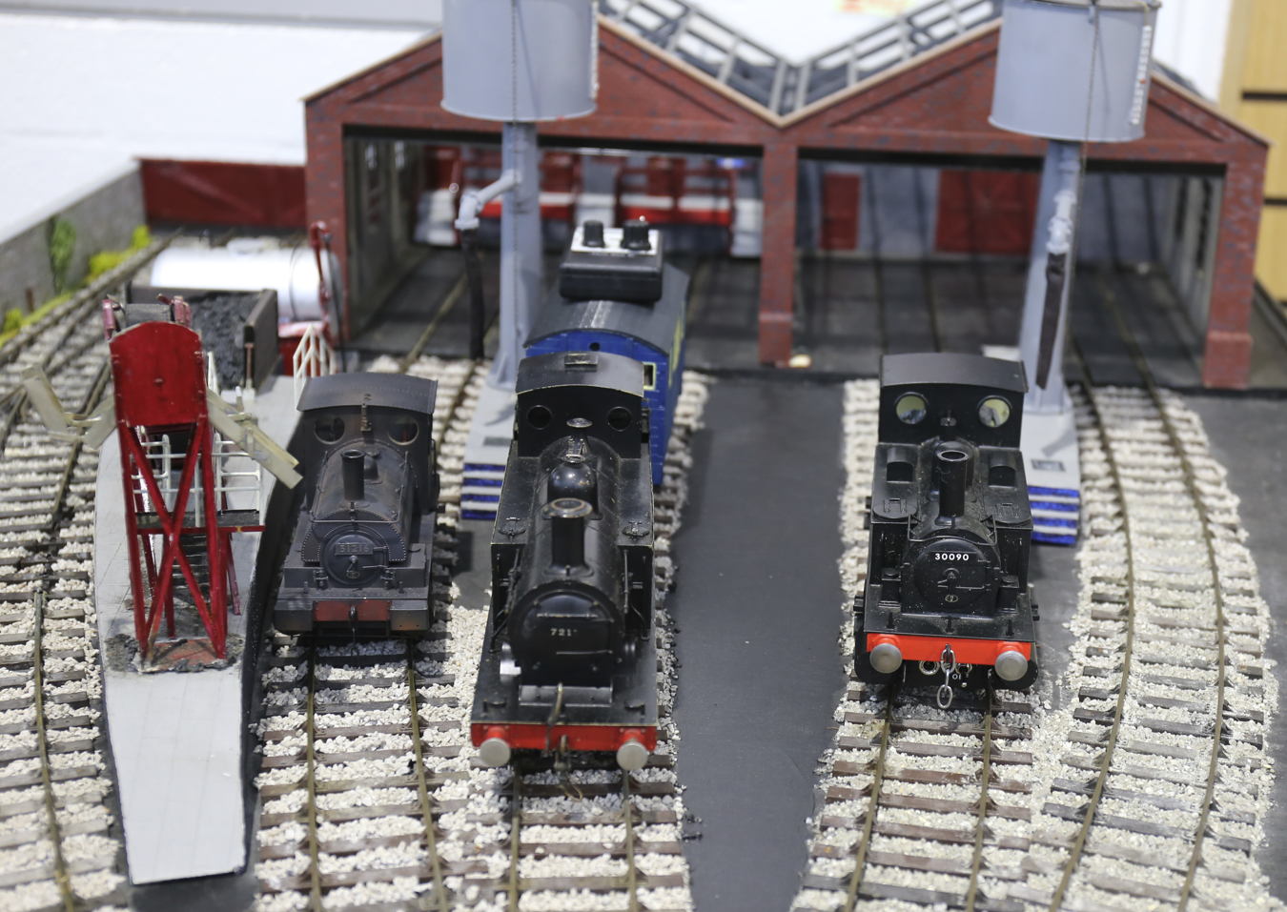
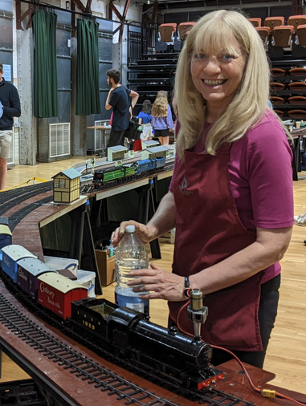
The Gauge One Model
Railway Association
The Gauge One Model
Railway Association
Gauge 1 model railways run on tracks where the rails are 45mm or 1¾ inches apart. For standard gauge, this corresponds to a scale of 1:32 or around 10mm to the foot.
Gauge 1 model railways run on tracks where the rails are 45mm or 1¾ inches apart. For standard gauge, this corresponds to a scale of 1:32 or around 10mm to the foot.
We run models powered by on-board batteries, by track-supplied current and by live steam with boilers fired by alcohol, gas or coal.
Even clockwork engines still make occasional appearances.
We run models powered by on-board batteries, by track-supplied current and by live steam with boilers fired by alcohol, gas or coal.
Even clockwork engines still make occasional appearances.
The size of Gauge 1 models allows for exquisite levels of detail in fine-scale models, and the availability of robust, simplified models also makes it an ideal scale for youngsters.
You can read about the breadth of activity within G1MRA by downloading copies of our welcome brochure and our quarterly magazine from
The size of Gauge 1 models allows for exquisite levels of detail in fine-scale models, and the availability of robust, simplified models also makes it an ideal scale for youngsters.
You can read about the breadth of activity within G1MRA by downloading copies of our welcome brochure and our quarterly magazine from
g1mra.com
g1mra.com

